Slide 1
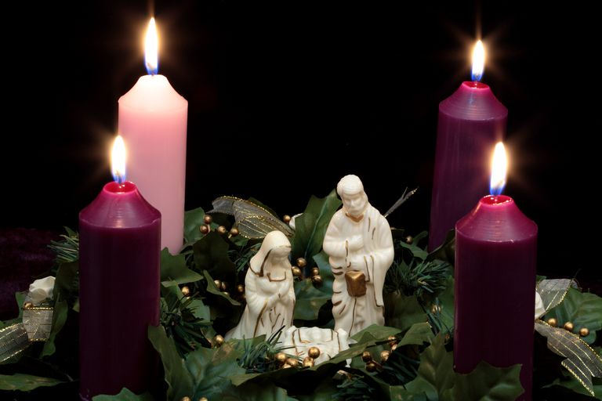

Slide 4
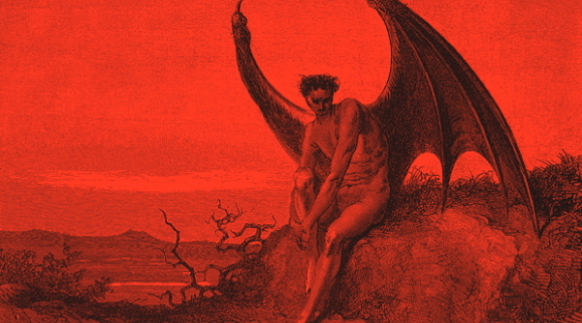
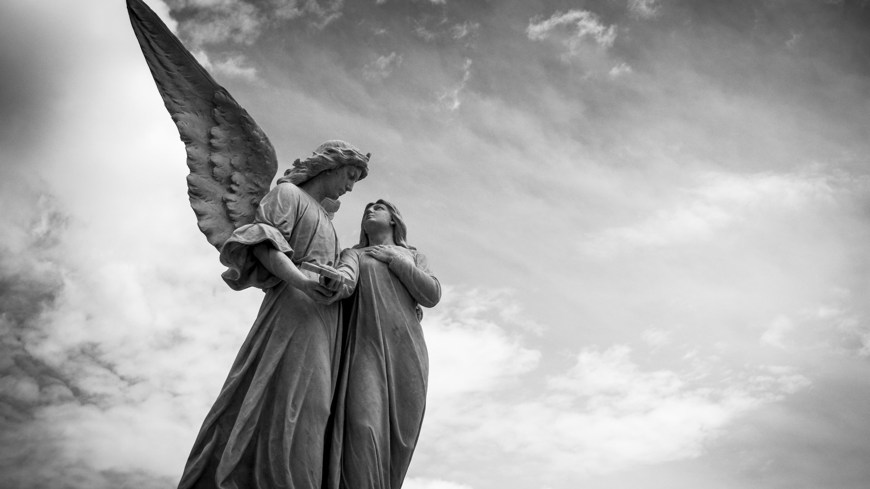
What have we come to believe or heard other people say about angels?

Slide 5
What QUESTIONS do you have about angels?

Slide 6
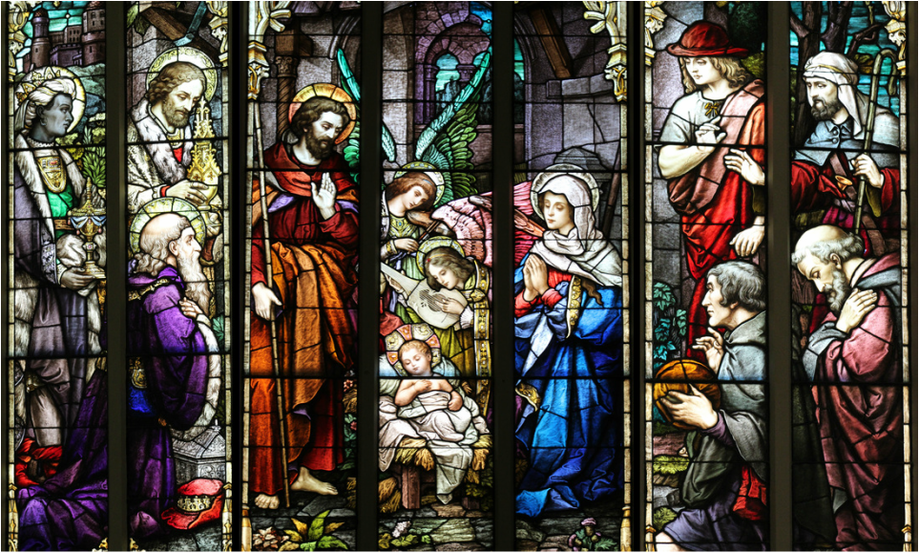

Slide 7
Matthew 1
¹⁸ This is how the birth of Jesus the Messiah came about: His mother Mary was pledged to be married to Joseph, but before they came together, she was found to be pregnant through the Holy Spirit. ¹⁹ Because Joseph her husband was faithful to the law, and yet did not want to expose her to public disgrace, he had in mind to divorce her quietly.

Slide 8
Matthew 1
²⁰ But after he had considered this, an angel of the Lord appeared to him in a dream and said, “Joseph son of David, do not be afraid to take Mary home as your wife, because what is conceived in her is from the Holy Spirit. ²¹ She will give birth to a son, and you are to give him the name Jesus, because he will save his people from their sins.”

Slide 9
Matthew 1
²² All this took place to fulfill what the Lord had said through the prophet: ²³ “The virgin will conceive and give birth to a son, and they will call him Immanuel”
(which means “God with us”). ²⁴ When Joseph woke up, he did what the angel of the Lord had commanded him and took Mary home as his wife. ²⁵ But he did not consummate their marriage until she gave birth to a son. And he gave him the name Jesus.

Slide 10
Matthew 2
¹³ When they had gone, an angel of the Lord appeared to Joseph in a dream. “Get up,” he said, “take the child and his mother and escape to Egypt. Stay there until I tell you, for Herod is going to search for the child to kill him.” ¹⁴ So he got up, took the child and his mother during the night and left for Egypt, ¹⁵ where he stayed until the death of Herod. And so was fulfilled what the Lord had said through the prophet: “Out of Egypt I called my son.”

Slide 11
Matthew 2
¹⁶ When Herod realized that he had been outwitted by the Magi, he was furious, and he gave orders to kill all the boys in Bethlehem and its vicinity who were two years old and under, in accordance with the time he had learned from the Magi.

Slide 12
Matthew 2
¹⁹ After Herod died, an angel of the Lord appeared in a dream to Joseph in Egypt ²⁰ and said, “Get up, take the child and his mother and go to the land of Israel, for those who were trying to take the child’s life are dead.”

Slide 13
Matthew 2
²¹ So he got up, took the child and his mother and went to the land of Israel. ²² But when he heard that Archelaus was reigning in Judea in place of his father Herod, he was afraid to go there. Having been warned in a dream, he withdrew to the district of Galilee, ²³ and he went and lived in a town called Nazareth. So was fulfilled what was said through the prophets, that he would be called a Nazarene.

Slide 14
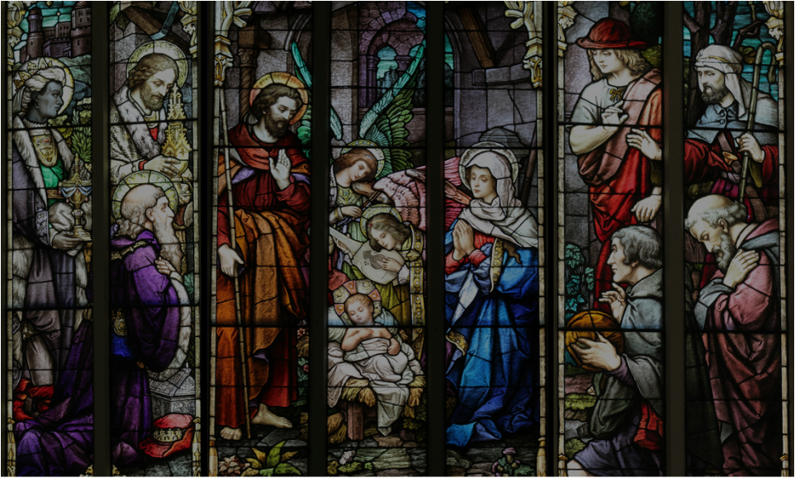
How might things have played out differently?

Slide 15
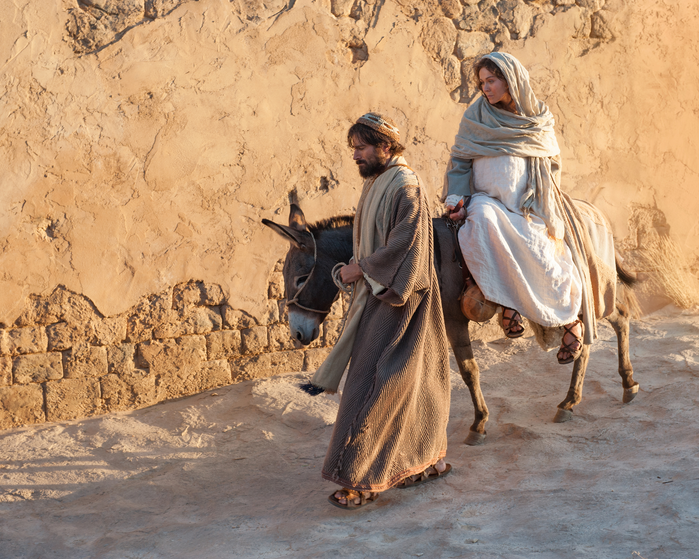

Slide 16
Micah 5:2-4
“But you, Bethlehem Ephrathah, though you are small among the clans of Judah, out of you will come for me one who will be ruler over Israel, whose origins are from of old, from ancient times.”

Slide 17
Micah 5:2-4
³ Therefore Israel will be abandoned until the time when she who is in labor bears a son, and the rest of his brothers return to join the Israelites.

Slide 18
Micah 5:2-4
⁴ He will stand and shepherd his flock in the strength of the Lord, in the majesty of the name of the Lord his God. And they will live securely, for then his greatness will reach to the ends of the earth.

Slide 19
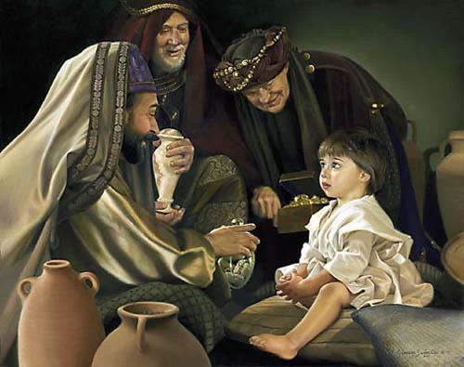

Slide 20
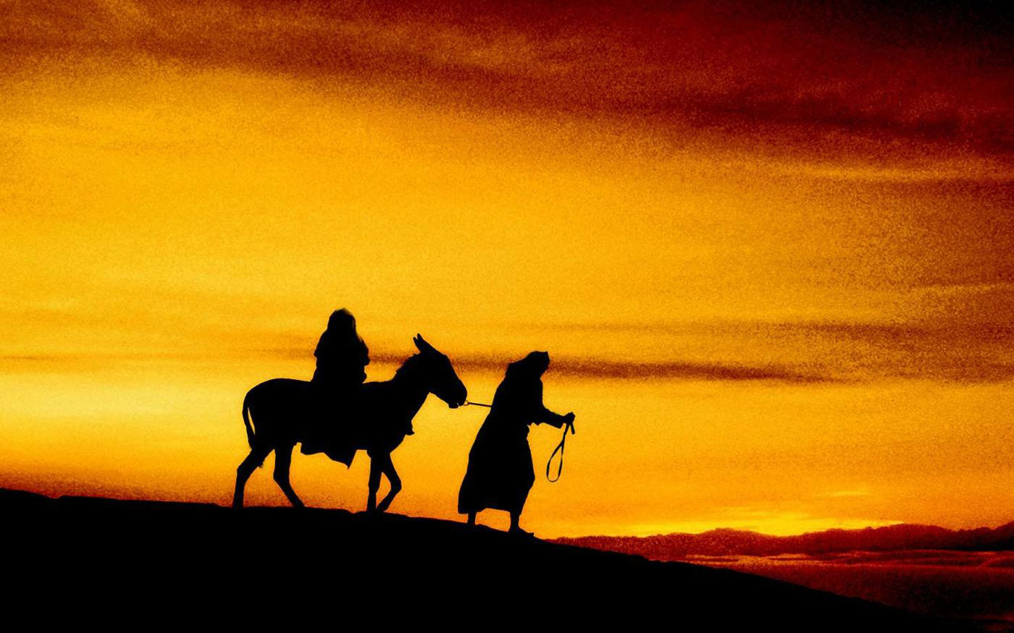
“When Israel was a child, I loved him, and out of Egypt I called my son.”
Hosea 11:1

Slide 21
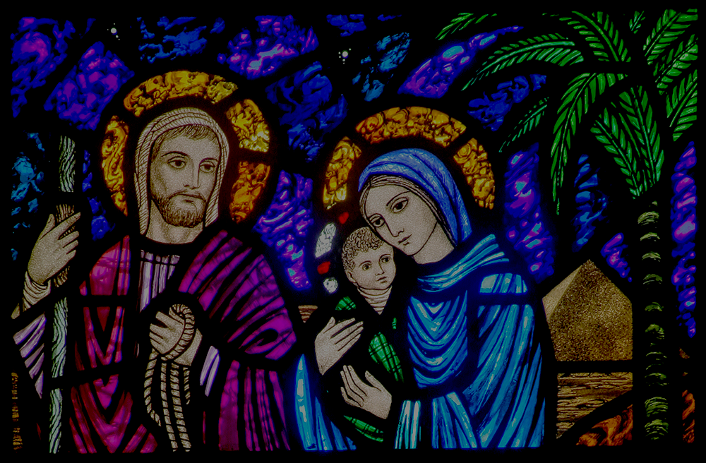
Obey immediately!
Expect difficulty.
Trust God to be speaking to your spouse
God will make a way.
Remember God’s direction in difficulty.

Slide 22
Luke 1
²⁶ In the sixth month of Elizabeth’s pregnancy, God sent the angel Gabriel to Nazareth, a town in Galilee, ²⁷ to a virgin pledged to be married to a man named Joseph, a descendant of David. The virgin’s name was Mary. ²⁸ The angel went to her and said, “Greetings, you who are highly favored! The Lord is with you.”

Slide 23
Luke 1
²⁹ Mary was greatly troubled at his words and wondered what kind of greeting this might be. ³⁰ But the angel said to her, “Do not be afraid, Mary; you have found favor with God. ³¹ You will conceive and give birth to a son, and you are to call him Jesus. ³² He will be great and will be called the Son of the Most High. The Lord God will give him the throne of his father David, ³³ and he will reign over Jacob’s descendants forever; his kingdom will never end.”

Slide 24
Mary, Luke 1
³⁴ “How will this be,” Mary asked the angel, “since I am a virgin?”
Zechariah, Luke 1:18
“How can I be sure of this? I am an old man and my wife is well along in years.”

Slide 25
Luke 1
³⁵ The angel answered, “The Holy Spirit will come on you, and the power of the Most High will overshadow you. So the holy one to be born will be called the Son of God. ³⁶ Even Elizabeth your relative is going to have a child in her old age, and she who was said to be unable to conceive is in her sixth month. ³⁷ For no word from God will ever fail.”

Slide 26
Luke 1
³⁸ “I am the Lord’s servant,” Mary answered. “May your word to me be fulfilled.” Then the angel left her.

Slide 27
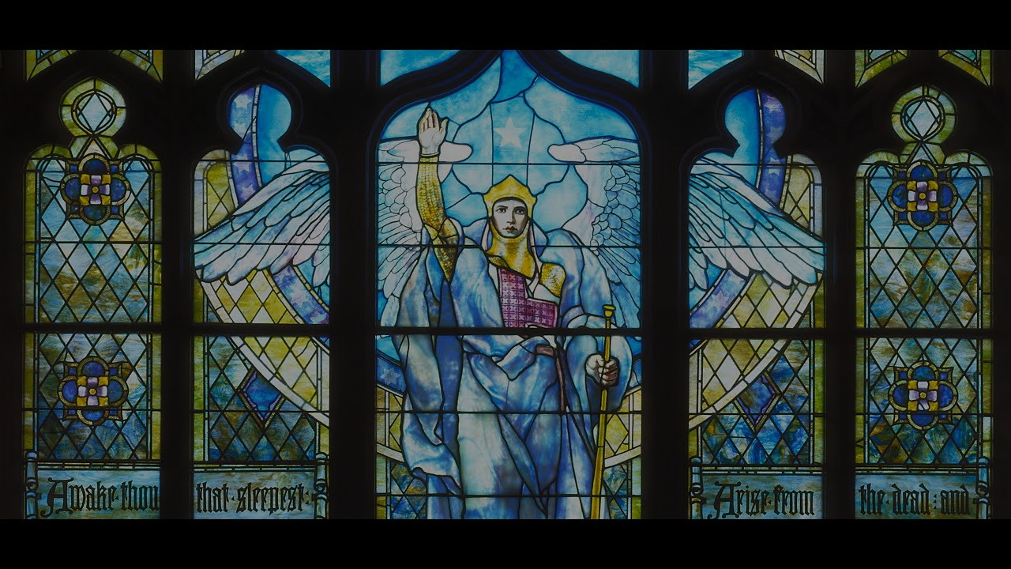
Angels reveal the will and Word of God.
Angels guide us.
Angels minister to our needs.
Angels protect us.
Angels deliver us from danger and persecution…and fight for us.
Angels strengthen and encourage us.

Slide 28
Angels help answer our prayers.
Angels minister to us in death.
Angels show us the importance of hospitality towards strangers.

Slide 29
