Slide 1
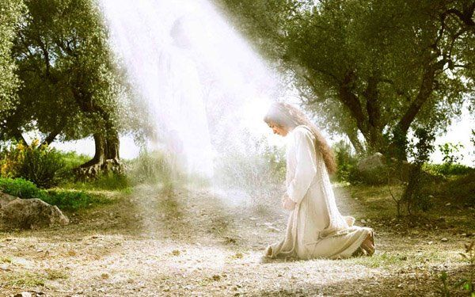
Advent Week 3—JOY—Luke 1

Slide 2
Advent Week 3—JOY—Luke 1
“My soul glorifies the Lord ⁴⁷ and my spirit rejoices in God my Savior, ⁴⁸ for he has been mindful of the humble state of his servant. From now on all generations will call me blessed, ⁴⁹ for the Mighty One has done great things for me—holy is his name.

Slide 3
Advent Week 3—JOY—Luke 1
⁵⁰ His mercy extends to those who fear him, from generation to generation. ⁵¹ He has performed mighty deeds with his arm; he has scattered those who are proud in their inmost thoughts. ⁵² He has brought down rulers from their thrones but has lifted up the humble.

Slide 4
Advent Week 3—JOY—Luke 1
⁵³ He has filled the hungry with good things but has sent the rich away empty. ⁵⁴ He has helped his servant Israel, remembering to be merciful ⁵⁵ to Abraham and his descendants forever, just as he promised our ancestors.”

Slide 6
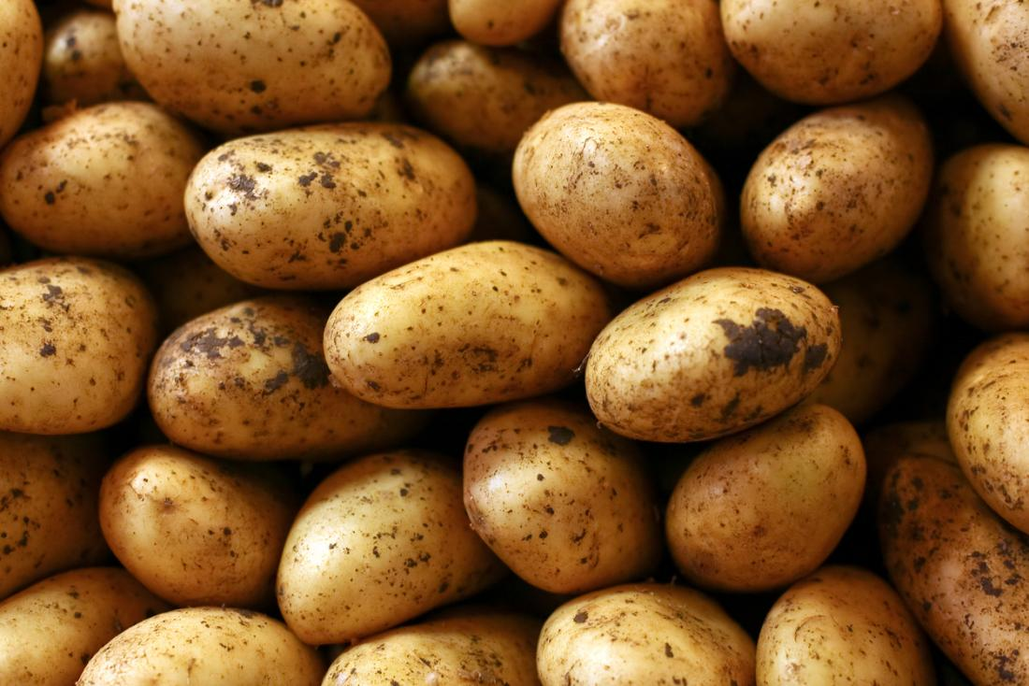
What state in the U.S. produces the most potatoes?
Which state has the most productive yield per acre of potatoes?

Slide 7
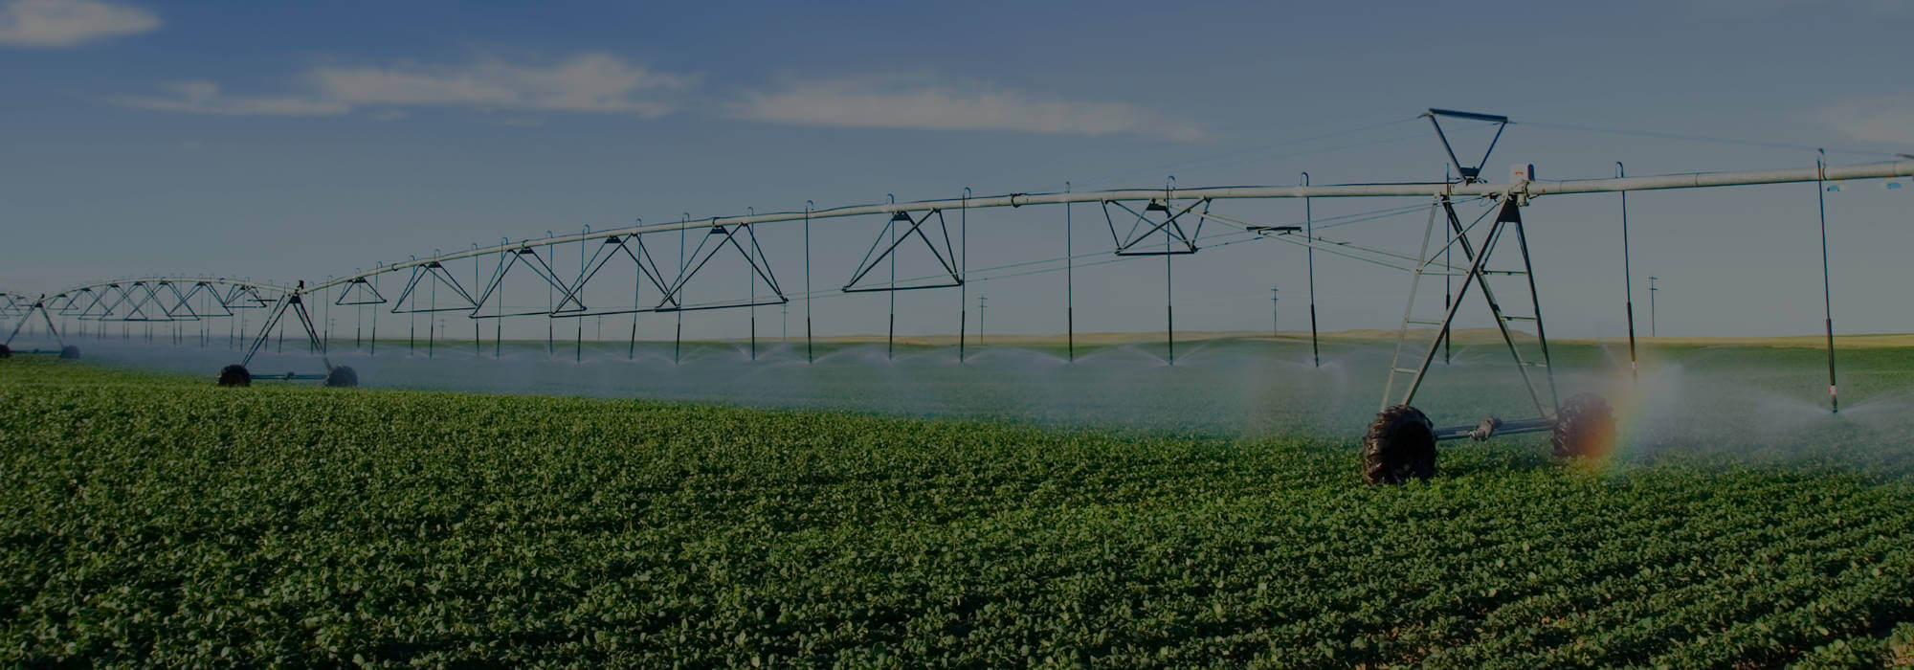

Slide 8
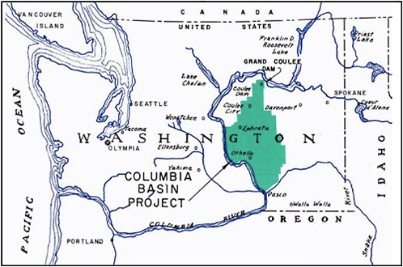
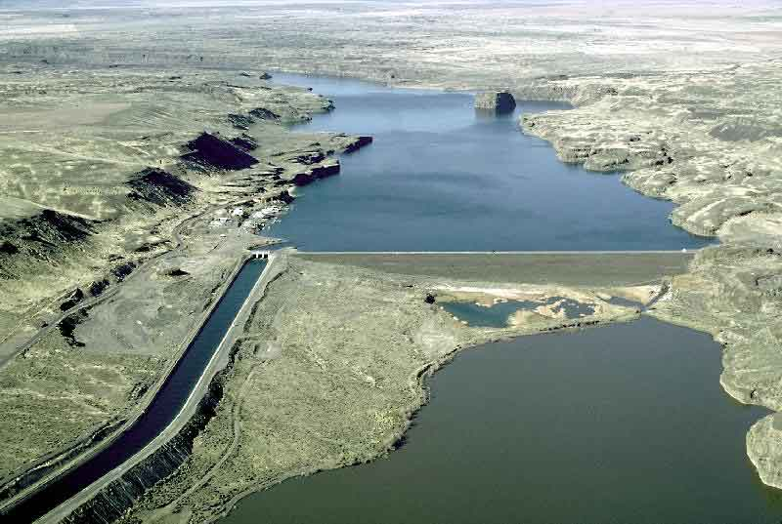

Slide 9
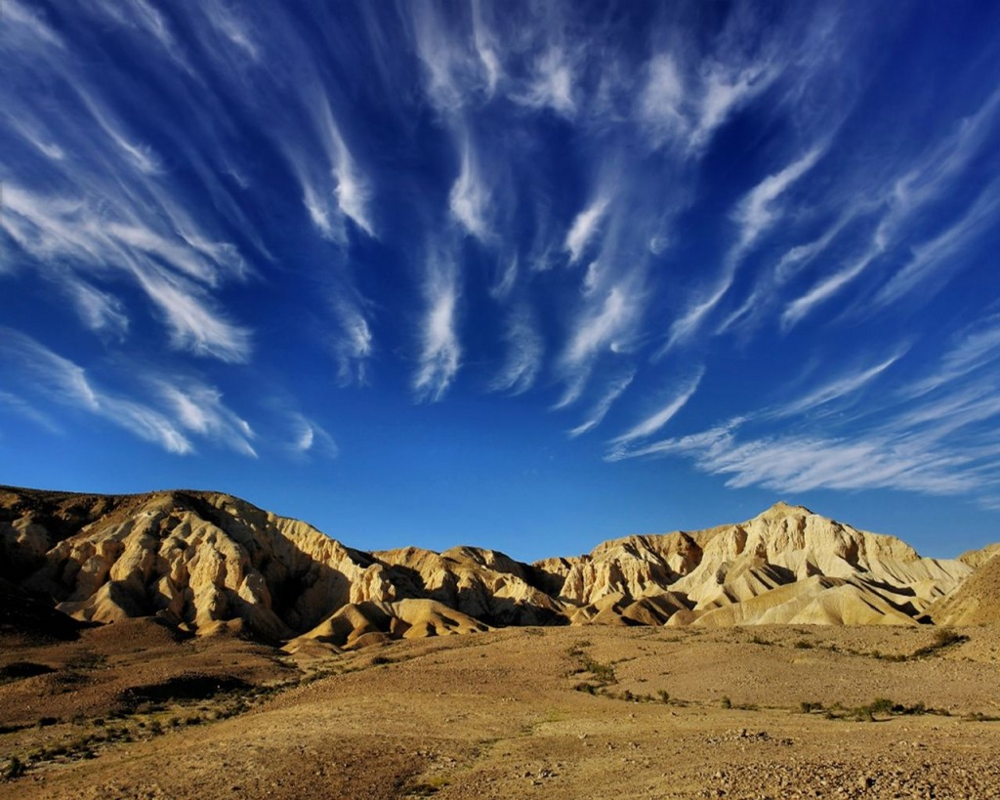
Angel in the Outback
(Part 2)
Exodus 3 & Judges 6

Slide 10
Exodus 3—Now Moses was tending the flock of Jethro his father-in-law, the priest of Midian, and he led the flock to the far side of the wilderness and came to Horeb, the mountain of God. ² There the angel of the Lord appeared to him in flames of fire from within a bush. Moses saw that though the bush was on fire it did not burn up.

Slide 11
Exodus 3
³ So Moses thought, “I will go over and see this strange sight—why the bush does not burn up.”
⁴ When the Lord saw that he had gone over to look, God called to him from within the bush, “Moses! Moses!”
And Moses said, “Here I am.”

Slide 12
Exodus 3
⁵ “Do not come any closer,” God said. “Take off your sandals, for the place where you are standing is holy ground.”
⁶ Then he said, “I am the God of your father, the God of Abraham, the God of Isaac and the God of Jacob.” At this, Moses hid his face, because he was afraid to look at God.

Slide 13
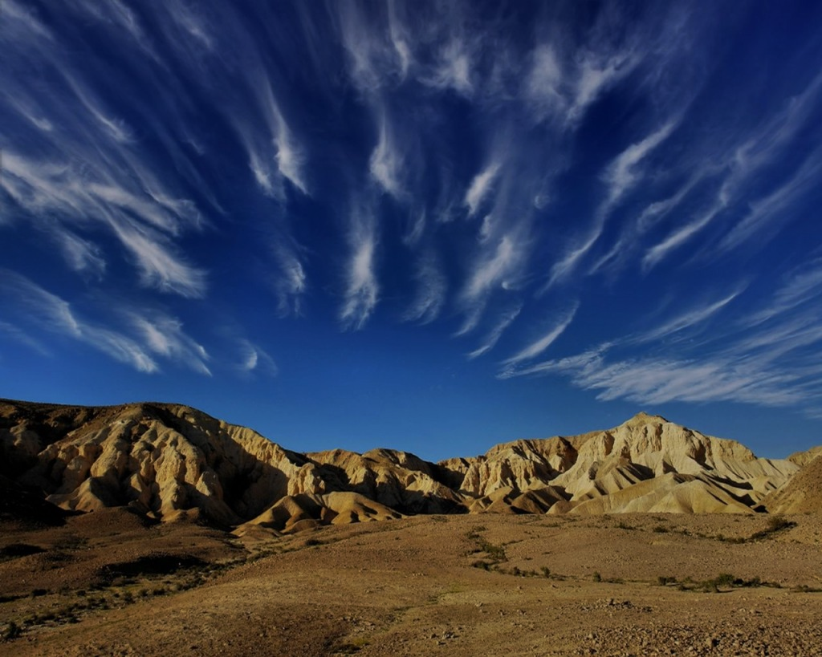
God’s calling on our lives is not based on our goodness or evil; it’s in spite of it.

Slide 14
2. When you encounter Jesus in life’s deserts, He will ask you to do things for other people that you can’t imagine possible.

Slide 15
3. God has an answer for every excuse we have.
Objection #1 (Exodus 3:11)
“But Moses said to God, “Who am I that I should go to Pharaoh and bring the Israelites out of Egypt?”

Slide 16
3. God has an answer for every excuse we have.
Objection #2 & 3
(Exodus 3:13-4:19)
What if people don’t accept me?

Slide 17
3. God has an answer for every excuse we have.
Objection #4--(Exodus 4:9-12)
Doubts about himself.
Moses said to the Lord, “Pardon your servant, Lord. I have never been eloquent, neither in the past nor since you have spoken to your servant. I am slow of speech and tongue.”

Slide 18
Judges 6
The Israelites did evil in the eyes of the Lord,
and for seven years he gave them into the hands of the Midianites. ² Because the power of Midian was so oppressive, the Israelites prepared shelters for themselves in mountain clefts, caves and strongholds. ³ Whenever the Israelites planted their crops, the Midianites, Amalekites and other eastern peoples invaded the country.

Slide 19
Judges 6
⁴ They camped on the land and ruined the crops all the way to Gaza and did not spare a living thing for Israel, neither sheep nor cattle nor donkeys. ⁵ They came up with their livestock and their tents like swarms of locusts. It was impossible to count them or their camels; they invaded the land to ravage it. ⁶ Midian so impoverished the Israelites that they cried out to the Lord for help.

Slide 20
Judges 6
⁷ When the Israelites cried out to the Lord
because of Midian, ⁸ he sent them a prophet,
who said, “This is what the Lord, the God of Israel, says: I brought you up out of Egypt, out of the land of slavery. ⁹ I rescued you from the hand of the Egyptians. And I delivered you from the hand of all your oppressors; I drove them out before you and gave you their land.

Slide 21
Judges 6
¹⁰ I said to you, ‘I am the Lord your God; do not worship the gods of the Amorites, in whose land you live.’ But you have not listened to me.”

Slide 22
Judges 6
I brought you up out of Egypt, out of the land of slavery. ⁹ I rescued you from the hand of the Egyptians. And I delivered you from the hand of all your oppressors; I drove them out before you and gave you their land. ¹⁰ I said to you, ‘I am the Lord your God; do not worship the gods of the Amorites, in whose land you live.’ But you have not listened to me.”

Slide 23
Judges 6
¹¹ The angel of the Lord came and sat down under the oak in Ophrah that belonged to Joash the Abiezrite, where his son Gideon was threshing wheat in a winepress to keep it from the Midianites. ¹² When the angel of the Lord
appeared to Gideon, he said, “The Lord is with you, mighty warrior.”

Slide 24
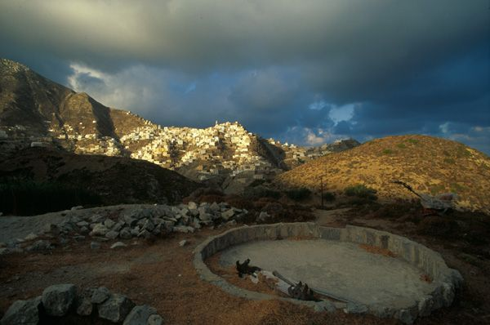
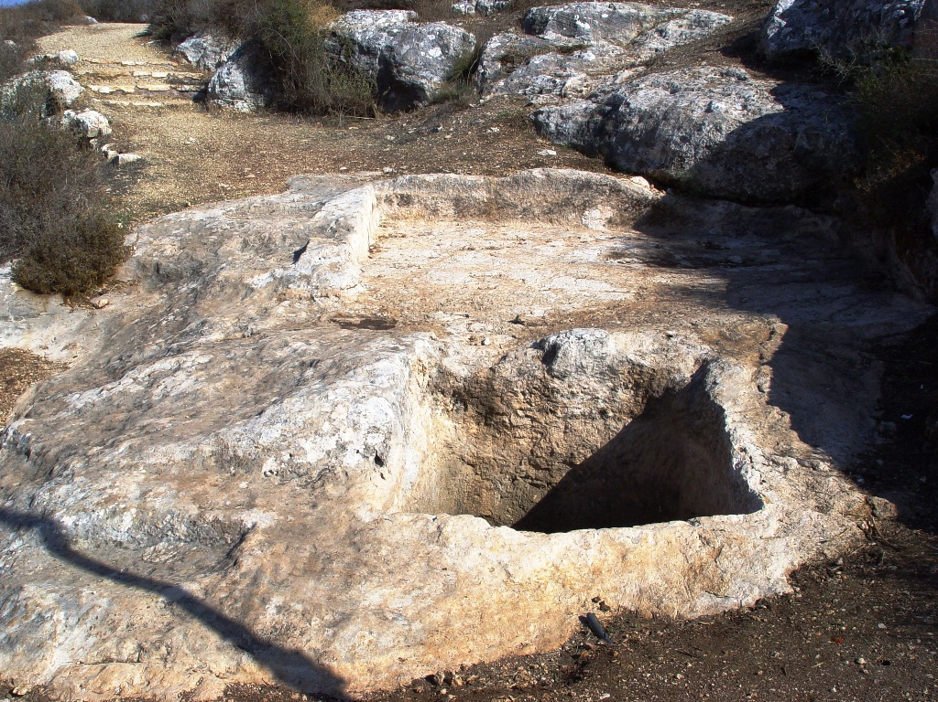

Slide 25
Judges 6
¹³ “Pardon me, my lord,” Gideon replied, “but if the Lord is with us, why has all this happened to us? Where are all his wonders that our ancestors told us about when they said, ‘Did not the Lord bring us up out of Egypt?’ But now the Lord has abandoned us and given us into the hand of Midian.”

Slide 26
Judges 6
¹⁴ The Lord turned to him and said,
“Go in the strength you have and save Israel out of Midian’s hand. Am I not sending you?”

Slide 27
Judges 6
¹⁵ “Pardon me, my lord,” Gideon replied,
“but how can I save Israel? My clan is the weakest in Manasseh, and I am the least in my family.”

Slide 28
Judges 6
¹⁵ “Pardon me, my lord,” Gideon replied,
“but how can I save Israel? My clan is the weakest in Manasseh, and I am the least in my family.”
¹⁶ The Lord answered, “I will be with you, and you will strike down all the Midianites, leaving none alive.”

Slide 29
Judges 6
¹⁷ Gideon replied, “If now I have found favor in your eyes, give me a sign that it is really you talking to me. ¹⁸ Please do not go away until I come back and bring my offering and set it before you.”
And the Lord said, “I will wait until you return.”

Slide 30
Judges 6
¹⁹ Gideon went inside, prepared a young goat, and from an ephah of flour he made bread without yeast. Putting the meat in a basket and its broth in a pot, he brought them out and offered them to him under the oak. ²⁰ The angel of God said to him, “Take the meat and the unleavened bread, place them on this rock, and pour out the broth.” And Gideon did so.

Slide 31
Judges 6
²¹ Then the angel of the Lord touched the
meat and the unleavened bread with the tip
of the staff that was in his hand. Fire flared from the rock, consuming the meat and the bread. And the angel of the Lord
disappeared. ²² When Gideon realized that it was the angel of the Lord, he exclaimed, “Alas, Sovereign Lord! I have seen the angel of the Lord face to face!”

Slide 32
Judges 6
²³ But the Lord said to him, “Peace! Do not be afraid. You are not going to die.”
²⁴ So Gideon built an altar to the Lord there and called it The Lord Is Peace. To this day it stands in Ophrah of the Abiezrites.

