Slide 1
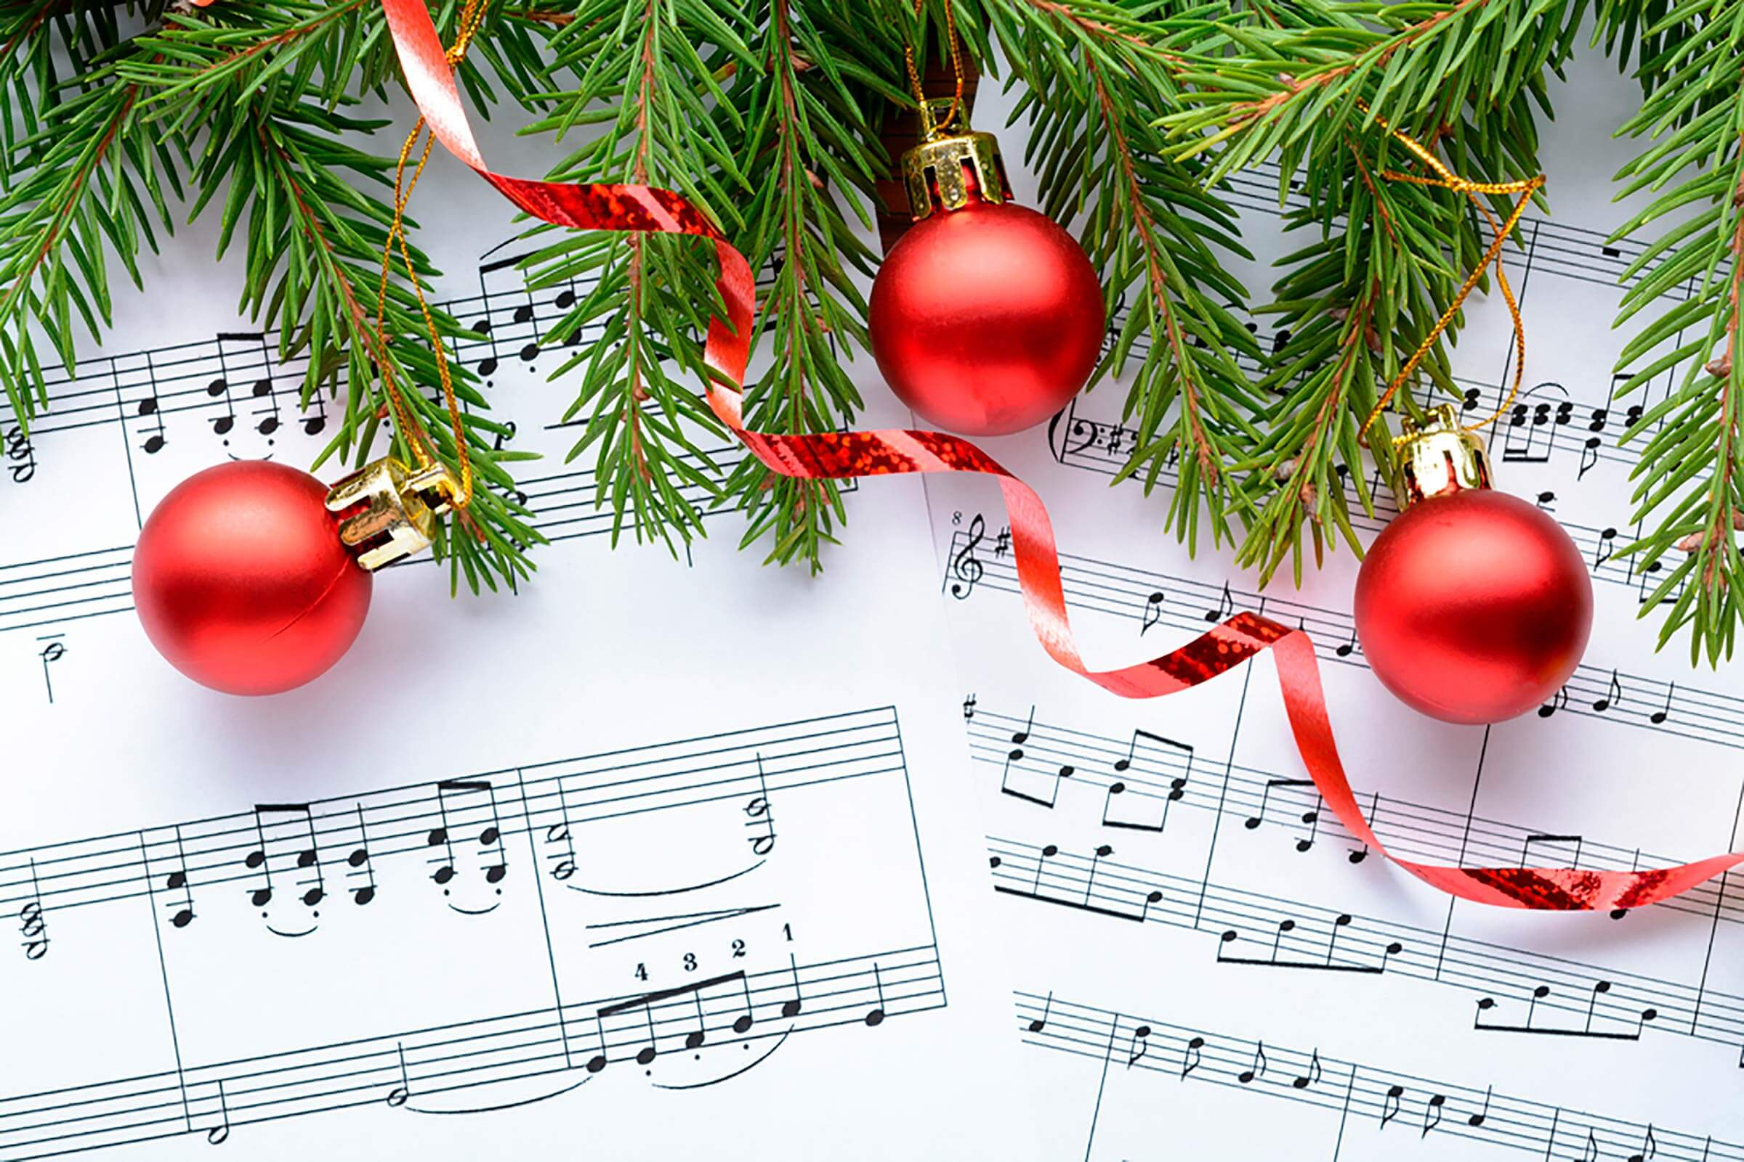
What’s your favorite Christmas carol
that speaks of angels?

Slide 3
Advent Week 2--PEACE
“You will keep him in perfect peace whose mind is focused on You because He trusts in You” (Isaiah 26:3).

Slide 4
Advent Week 2--PEACE
“Blessed are the peacemakers for they will be called the children of God” (Matthew 5:9).

Slide 5
Lord, make me an instrument of your peace. Where there is hatred, let me sow love; Where there is injury, pardon; Where there is doubt, faith; Where there is despair, hope; Where there is darkness, light; and where there is sadness, joy…

Slide 6
Divine Master; Grant that I may not so much seek to be consoled as to console; to be understood as to understand; to be loved as to love; For it is in giving that we receive; it is in pardoning that we are pardoned; and it is in dying that we are born to eternal life. Amen.

Slide 8
How many Christmas carols & songs are there about ANGELS?

Slide 9
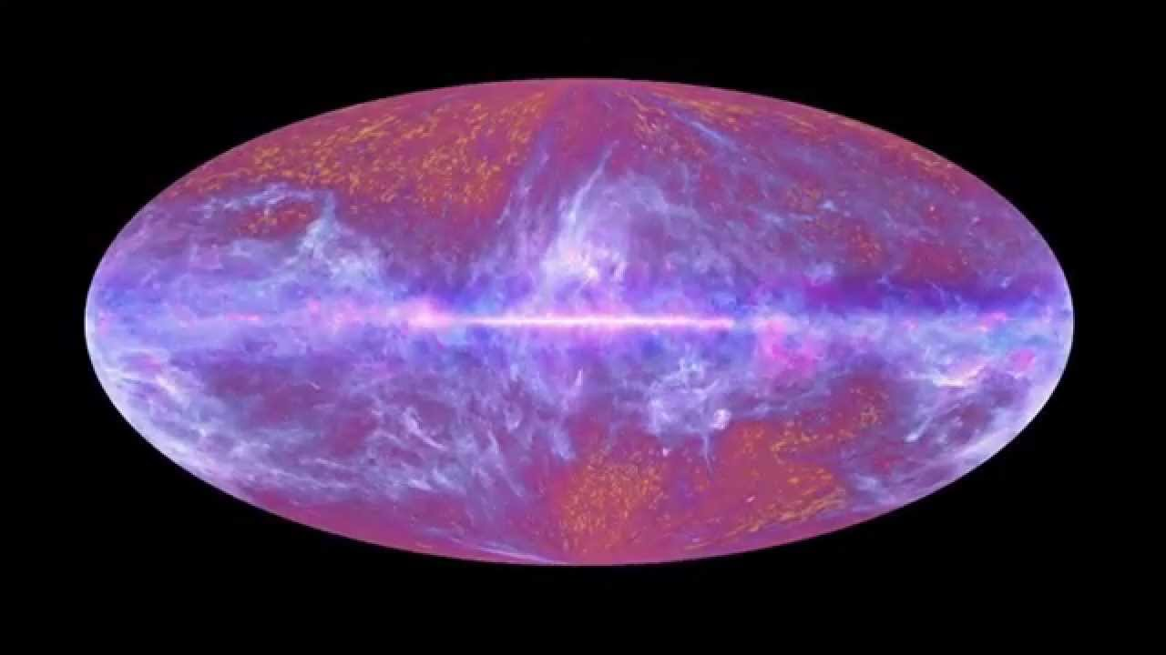
Fully God
&
Fully Man

Slide 10
Genesis 1:1
“In the beginning God created….”
John 1:3
“Through him all things were made; without him nothing was made that has been made.”

Slide 11
Colossians 1:16
“For in him all things were created: things in heaven and on earth, visible and invisible….”

Slide 12
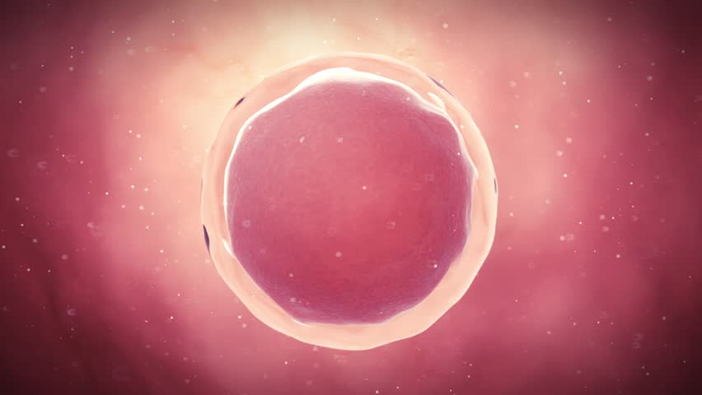

Slide 13
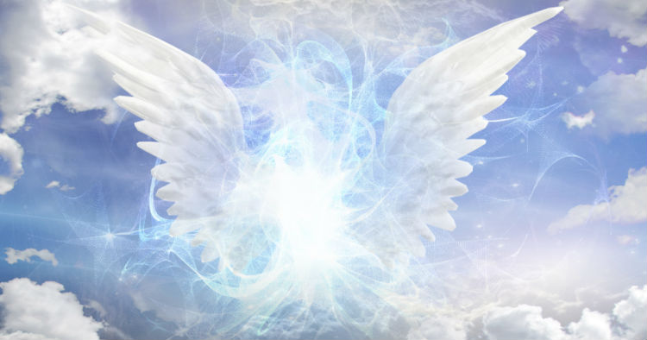
The Angel of the LORD
A Theophany

Slide 14
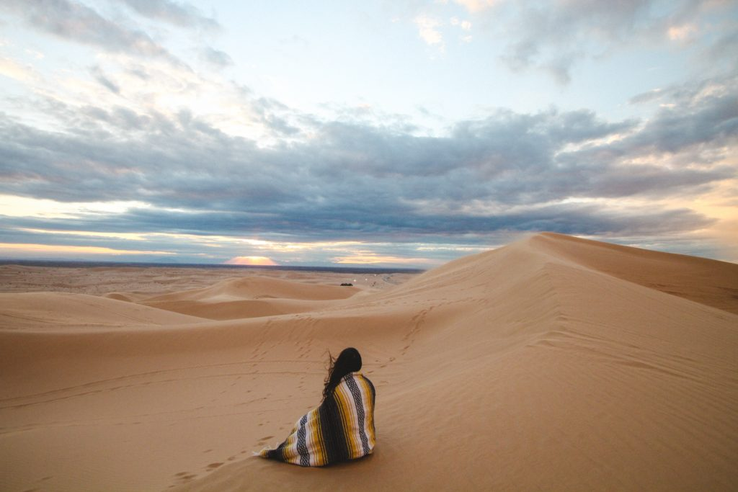
Angel in the Outback
(Genesis 16)

Slide 15
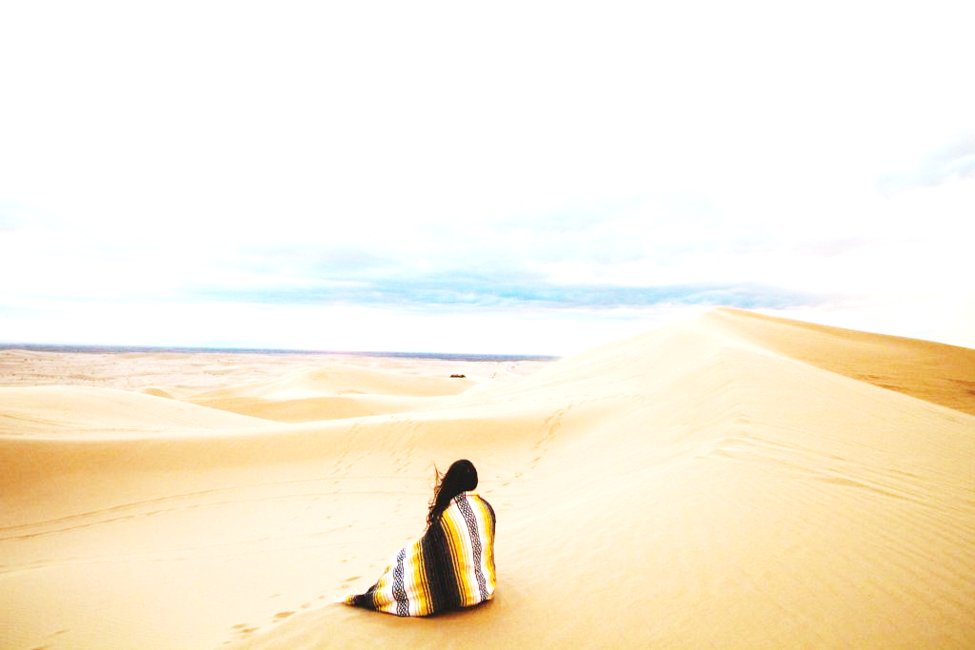
GENESIS 16--“Now Sarai, Abram’s wife, had borne him no children. But she had an Egyptian slave named Hagar; ² so she said to Abram, “The Lord has kept me from having children. Go, sleep with my slave; perhaps I can build a family through her.”
Abram agreed to what Sarai said. ³ So after Abram had been living in Canaan ten years, Sarai his wife took her Egyptian slave Hagar and gave her to her husband to be his wife. ⁴ He slept with Hagar, and she conceived.

Slide 16
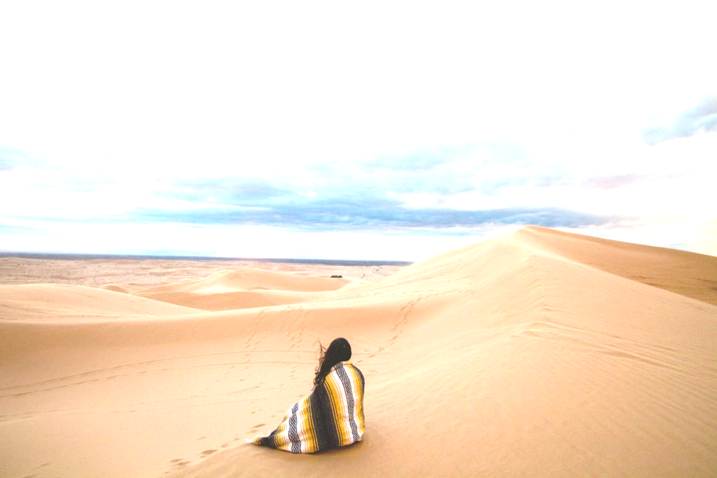
Unmet longings???

Slide 17
Right desires and dreams
allowed to grow unchecked
can lead to
wrong decisions, actions and results.

Slide 18
GENESIS 16
When she [Hagar] knew she was pregnant, she began to despise her mistress [Sarai]. ⁵ Then Sarai said to Abram, “You are responsible for the wrong I am suffering. I put my slave in your arms, and now that she knows she is pregnant, she despises me. May the Lord judge between you and me.”

Slide 19
GENESIS 16
When she [Hagar] knew she was pregnant, she began to despise her mistress [Sarai]. ⁵ Then Sarai said to Abram, “You are responsible for the wrong I am suffering. I put my slave in your arms, and now that she knows she is pregnant, she despises me. May the Lord judge between you and me.”
⁶ “Your slave is in your hands,” Abram said. “Do with her whatever you think best.” Then Sarai mistreated Hagar; so she fled from her.

Slide 20
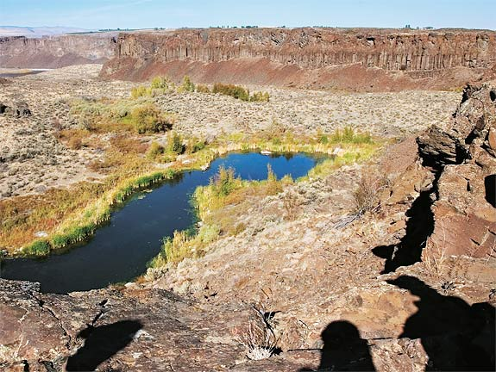
GENESIS 16
⁷ The angel of the Lord found Hagar near a spring in the desert; it was the spring that is beside the road to Shur. ⁸ And he said, “Hagar, slave of Sarai, where have you
come from, and where are
you going?”

Slide 21
GENESIS 16
⁷ The angel of the Lord found Hagar near a spring in the desert; it was the spring that is beside the road to Shur. ⁸ And he said, “Hagar, slave of Sarai, where have you
come from, and where are
you going?”

Slide 22
GENESIS 16
⁷ The angel of the Lord found Hagar near a spring in the desert; it was the spring that is beside the road to Shur. ⁸ And he said, “Hagar, slave of Sarai, where have you
come from, and where are
you going?”

Slide 23
GENESIS 16
⁷ The angel of the Lord found Hagar near a spring in the desert; it was the spring that is beside the road to Shur. ⁸ And he said, “Hagar, slave of Sarai, where have you
come from, and where are
you going?”
“I’m running away from
my mistress Sarai,”
she answered.

Slide 24
GENESIS 16
⁹ Then the angel of the Lord told her, “Go back to your mistress and submit to her.” ¹⁰ The angel added, “I will increase your descendants so much that they will be too numerous to count.”
¹¹ The angel of the Lord also said to her:
“You are now pregnant and you will give birth to a son. You shall name him Ishmael, for the Lord has heard of your misery.

Slide 26
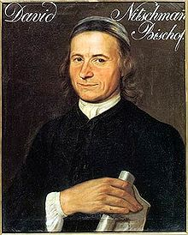
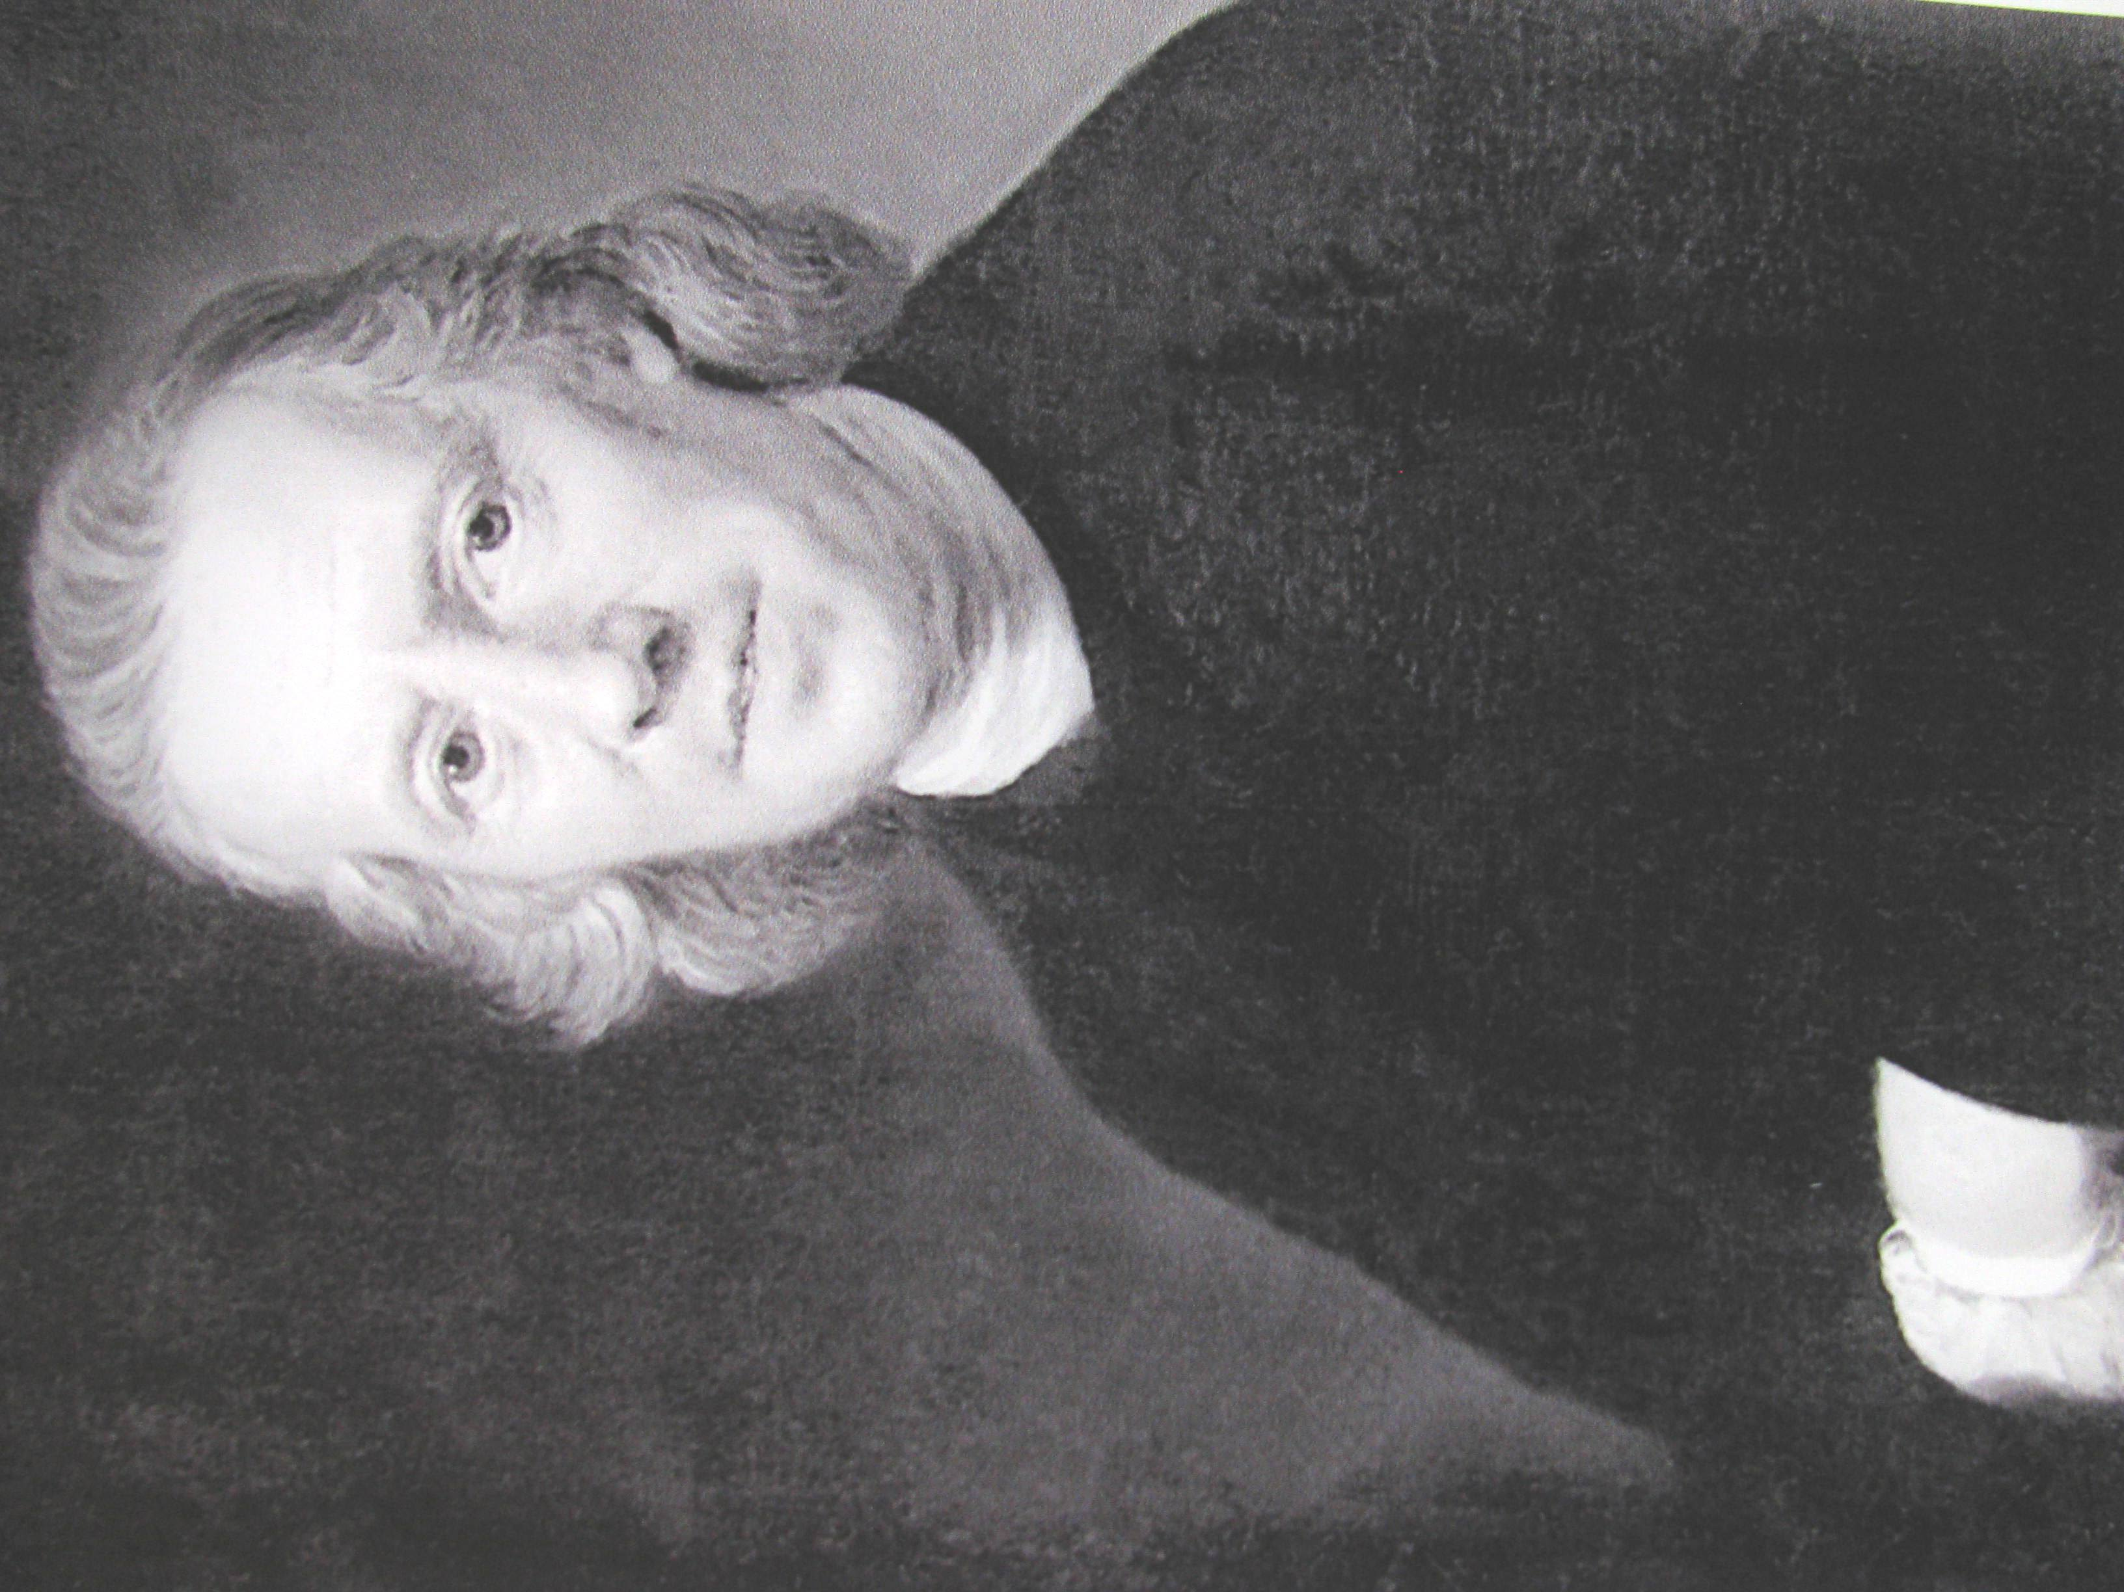
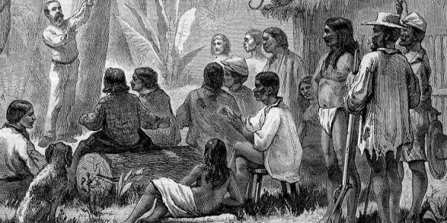

Slide 27
“Though He was a Son, yet He learned obedience by the things which He suffered,” (Heb. 5:8).

Slide 28
GENESIS 16
¹² He will be a wild donkey of a man; his hand will be against everyone and everyone’s hand against him, and he will live in hostility toward all his brothers.”

Slide 29
GENESIS 16
¹³ She gave this name to the Lord who spoke to her: “You are the God who sees me,” for she said, “I have now seen the One who sees me.” ¹⁴ That is why the well was called Beer Lahai Roi; it is still there, between Kadesh and Bered.

Slide 30
Angel in the Outback
(Genesis 16)

