Slide 1
Philippians 3:17-4:1

Slide 4
Philippians 3:17
Brothers, join in imitating me, and keep your eyes on those who walk according to the example you have in us.

Slide 5
Imitating:
τυπον [MARK]
to strike
beat
Print
1 Corinthian 10:32–11:1

Slide 6
Philippians 3:18
For many, of whom I have often told you and now tell you even with tears, walk as enemies of the cross of Christ.

Slide 7
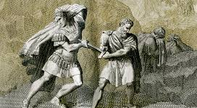
Caesar and Brutus Et tu, Brute, then fall, Caesar

Slide 8
Philippians 3:19
Their end is destruction, their god is their belly, and they glory in their shame, with minds set on earthly things.

Slide 9
Philippians 3:20
But our citizenship is in heaven, and from it we await a Savior, the Lord Jesus Christ,

Slide 10
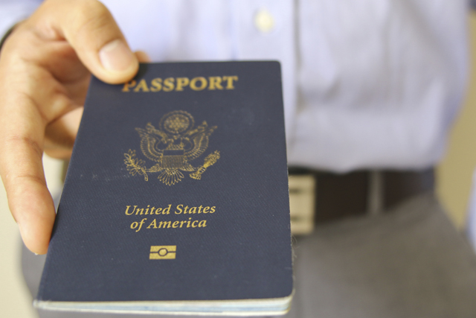

Slide 11
Philippians 3:21
who will transform our lowly body to be like his glorious body, by the power that enables him even to subject all things to himself.

Slide 12
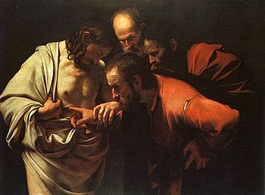

Slide 13
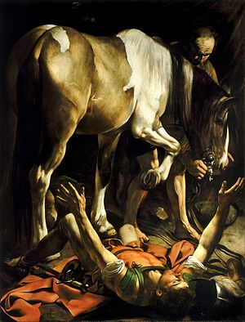

Slide 14
Philippians 2:5-9
⁵ Have this mind among yourselves, which is yours in Christ Jesus, ⁶ who, though he was in the form of God, did not count equality with God a thing to be grasped, ⁷ but emptied himself, by taking the form of a servant, being born in the likeness of men. ⁸ And being found in human form, he humbled himself by becoming obedient to the point of death, even death on a cross. ⁹

Slide 15
Philippians 2:17
17 Even if I am to be poured out as a drink offering upon the sacrificial offering of your faith, I am glad and rejoice with you all.

Slide 16
Philippians 3:8-11
8 Indeed, I count everything as loss because of the surpassing worth of knowing Christ Jesus my Lord. For his sake I have suffered the loss of all things and count them as rubbish, in order that I may gain Christ 9 and be found in him, not having a righteousness of my own that comes from the law, but that which comes through faith in Christ, the righteousness from God that depends on faith— 10 that I may know him and the power of his resurrection, and may share his sufferings, becoming like him in his death, 11 that by any means possible I may attain the resurrection from the dead.

Slide 17
Philippians 4:1
4:1 Therefore, my brothers,[a] whom I love and long for, my joy and crown, stand firm thus in the Lord, my beloved.

