Slide 1
Tell someone about one of your more memorable experiences of losing something.

Slide 2
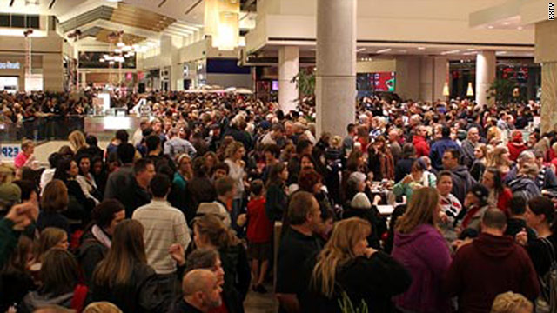
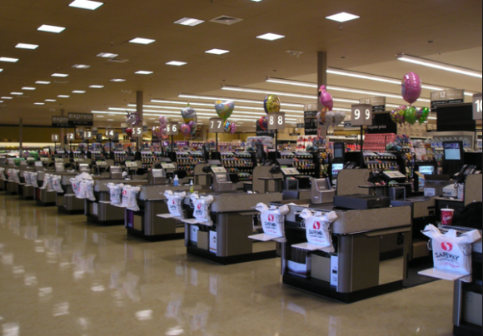

Slide 3
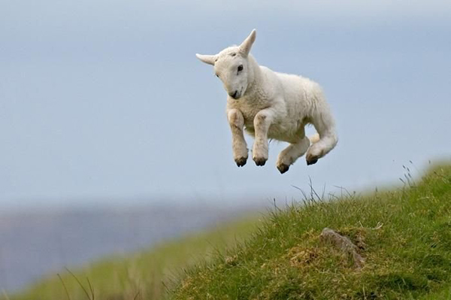
Parable of the AWOL Ovine

Slide 4
Matthew 18 At that time the disciples came to Jesus and asked, “Who, then, is the greatest in the kingdom of heaven?” ² He called a little child to him, and placed the child among them. ³ And he said: “Truly I tell you, unless you change and become like little children, you will never enter the kingdom of heaven. ⁴ Therefore, whoever takes the lowly position of this child is the greatest in the kingdom of heaven. ⁵ And whoever welcomes one such child in my name welcomes me.

Slide 5
Matthew 18 ⁶ “If anyone causes one of these little ones—those who believe in me—to stumble, it would be better for them to have a large millstone hung around their neck and to be drowned in the depths of the sea. ⁷ Woe to the world because of the things that cause people to stumble! Such things must come, but woe to the person through whom they come!

Slide 6
Matthew 18 ⁸ If your hand or your foot causes you to stumble, cut it off and throw it away. It is better for you to enter life maimed or crippled than to have two hands or two feet and be thrown into eternal fire. ⁹ And if your eye causes you to stumble, gouge it out and throw it away. It is better for you to enter life with one eye than to have two eyes and be thrown into the fire of hell.

Slide 7
¹⁰ “See that you do not despise one of these little ones. For I tell you that their angels in heaven always see the face of my Father in heaven.^{[11] [a]} ¹² “What do you think? If a man owns a hundred sheep, and one of them wanders away, will he not leave the ninety-nine on the hills and go to look for the one that wandered off? ¹³ And if he finds it, truly I tell you, he is happier about that one sheep than about the ninety-nine that did not wander off. ¹⁴ In the same way your Father in heaven is not willing that any of these little ones should perish.

Slide 8
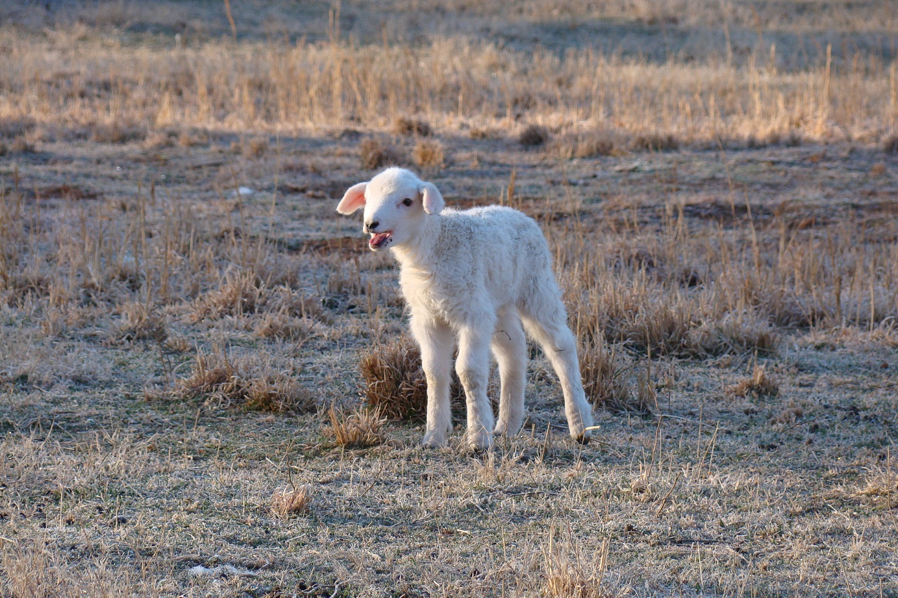

Slide 9
Deuteronomy 6:4-9
Malachi 2:15 “Has not the one God made you? You belong to him in body and spirit. And what does the one God seek? Godly offspring. So be on your guard, and do not be unfaithful to the wife of your youth.”

Slide 10
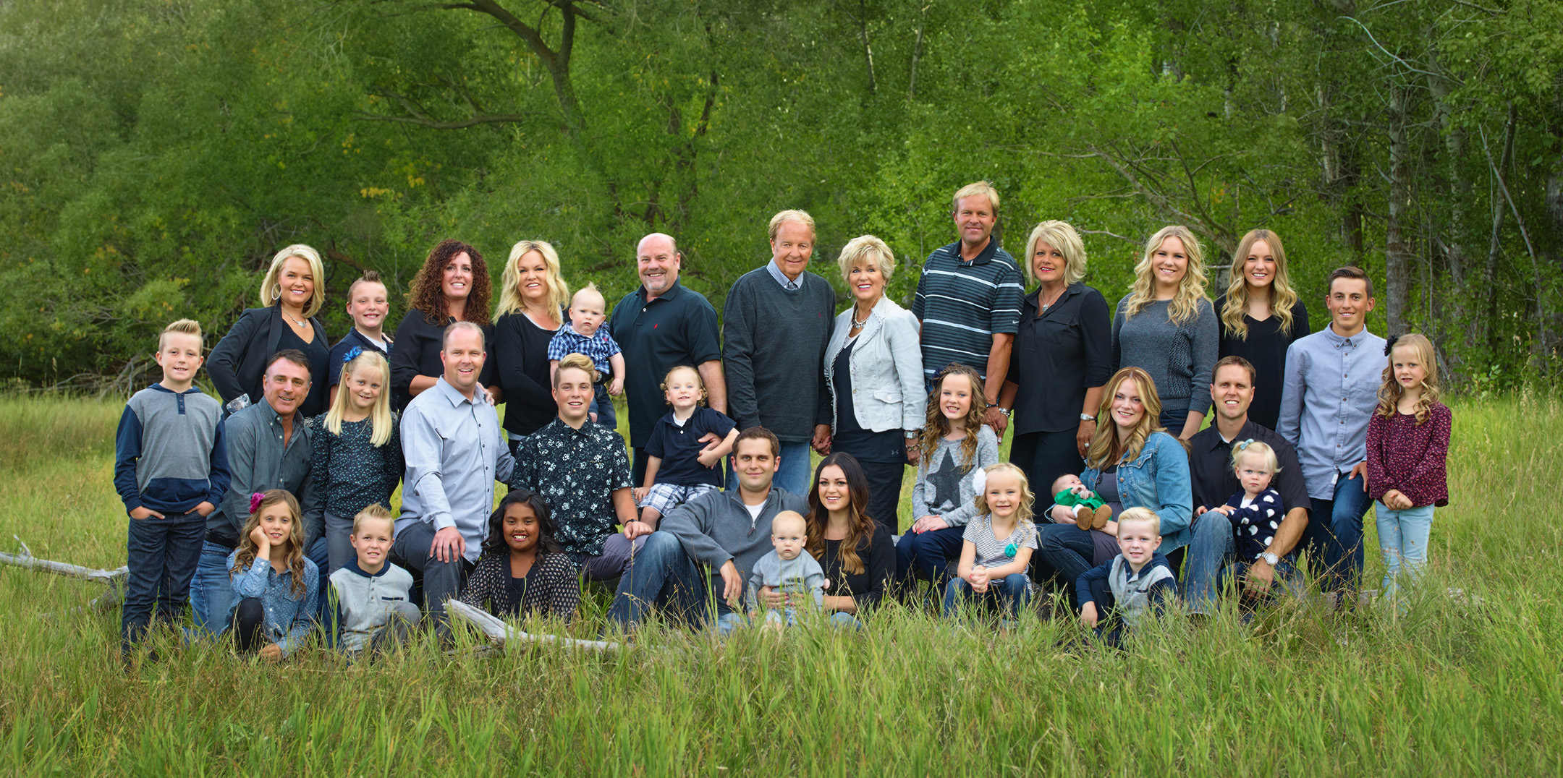

Slide 12
LUKE 15
Now the tax collectors and sinners were all gathering around to hear Jesus. ² But the Pharisees and the teachers of the law muttered, “This man welcomes sinners and eats with them.”
³ Then Jesus told them this parable: ⁴ “Suppose one of you has a hundred sheep and loses one of them. Doesn’t he leave the ninety-nine in the open country and go after the lost sheep until he finds it? ⁵ And when he finds it, he joyfully puts it on his shoulders

Slide 13
LUKE 15
⁶ and goes home. Then he calls his friends and neighbors together and says, ‘Rejoice with me; I have found my lost sheep.’ ⁷ I tell you that in the same way there will be more rejoicing in heaven over one sinner who repents than over ninety-nine righteous persons who do not need to repent.

Slide 14
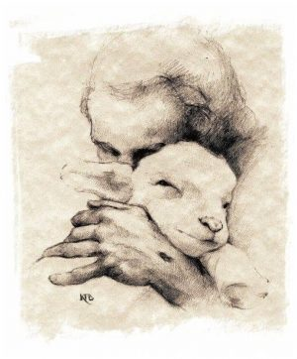
God puts a priority on 1 lost sheep over many more safe & sane ones.

Slide 15
God does the going, the searching, the finding and the carrying back to the flock.

Slide 16
God does the going, the searching, the finding and the carrying back to the flock… and so must we!

Slide 17
“You have to go out…but you don’t have to come back.”

Slide 19
God’s joy is greater over rescued strays than over safe sheep.

Slide 20
God’s joy is greater over rescued strays than over safe sheep. “I tell you that in the same way there will be more rejoicing in heaven over one sinner who repents than over ninety-nine righteous persons who do not need to repent.”

