Slide 2
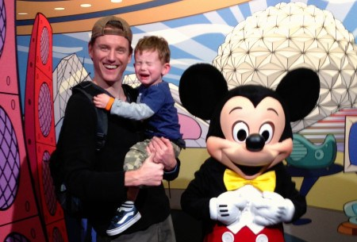
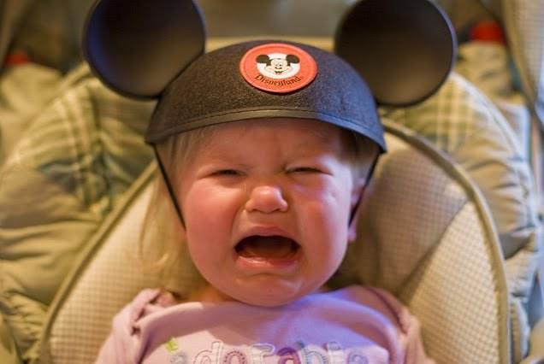
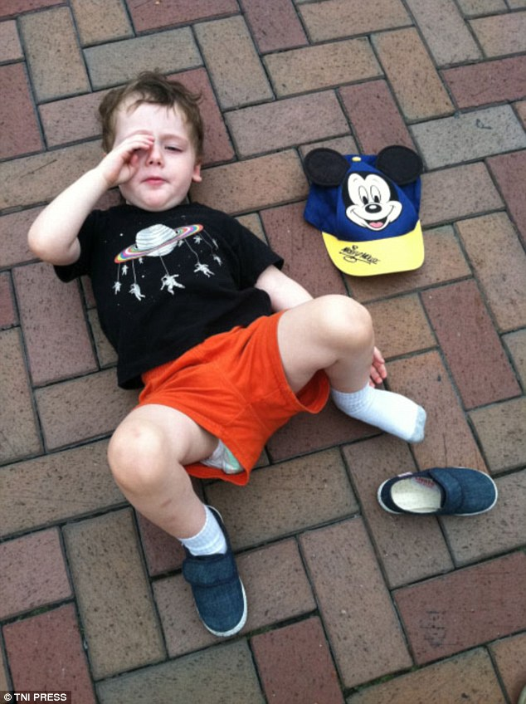

Slide 3
“The kingdom of heaven is like…???

Slide 4
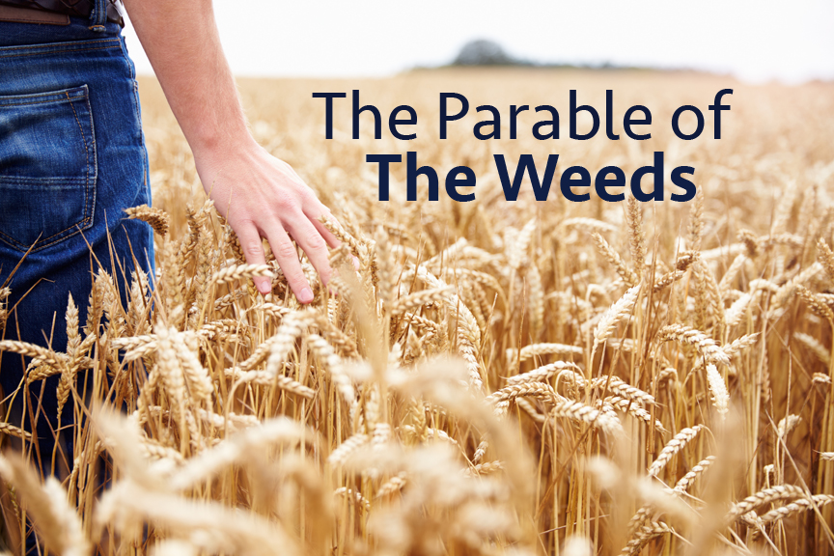
Matthew 13

Slide 5
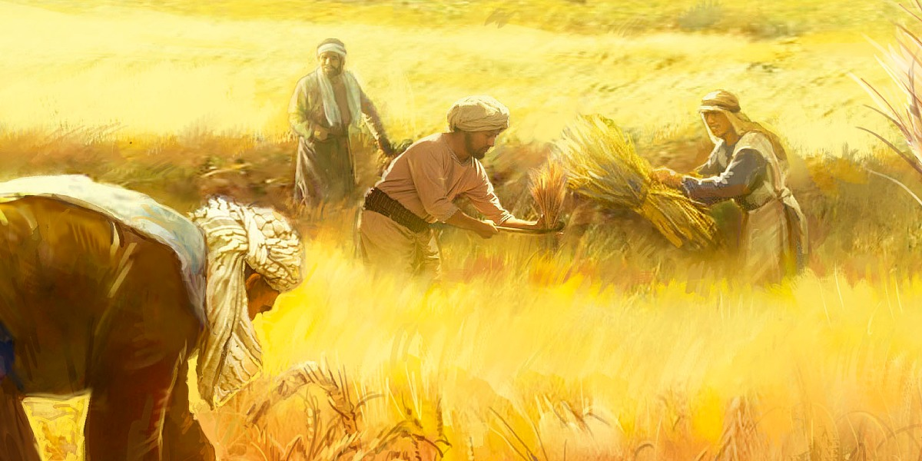
Matthew 13--“The kingdom of heaven is like a man who sowed good seed in his field. ²⁵ But while everyone was sleeping, his enemy came and sowed weeds among the wheat, and went away. ²⁶ When the wheat sprouted and formed heads, then the weeds also appeared. ²⁷ “The owner’s servants came to him and said, ‘Sir, didn’t you sow good seed in your field? Where then did the weeds come from?’

Slide 6
Matthew 13 ²⁸ “‘An enemy did this,’ he replied. “The servants asked him, ‘Do you want us to go and pull them up?’ ²⁹ “‘No,’ he answered, ‘because while you are pulling the weeds, you may uproot the wheat with them. ³⁰ Let both grow together until the harvest. At that time I will tell the harvesters: First collect the weeds and tie them in bundles to be burned; then gather the wheat and bring it into my barn.’”

Slide 7
Matthew 13 ³⁶ Then he left the crowd and went into the house. His disciples came to him and said, “Explain to us the parable of the weeds in the field.” ³⁷ He answered, “The one who sowed the good seed is the Son of Man.³⁸ The field is the world, and the good seed stands for the people of the kingdom. The weeds are the people of the evil one, ³⁹ and the enemy who sows them is the devil. The harvest is the end of the age, and the harvesters are angels.

Slide 8
Matthew 13 ⁴⁰ “As the weeds are pulled up and burned in the fire, so it will be at the end of the age. ⁴¹ The Son of Man will send out his angels, and they will weed out of his kingdom everything that causes sin and all who do evil.⁴² They will throw them into the blazing furnace, where there will be weeping and gnashing of teeth. ⁴³ Then the righteous will shine like the sun in the kingdom of their Father. Whoever has ears, let them hear.

Slide 9
Mt. 13--Parable of the Weeds & Good Seed
Sower of good seed = the Son of Man/Jesus
The field = the world
The good seed = sons/daughters of the kingdom
The weeds = sons/daughters of the evil one
The enemy who sows bad seed = the devil
The harvest = the end of the age
The harvesters = angels

Slide 10
Matthew 13
While Christ is raising up
a harvest of fruitful, righteous people, Satan is raising up
evil and unrighteous people
in the same field
at the same time.

Slide 11
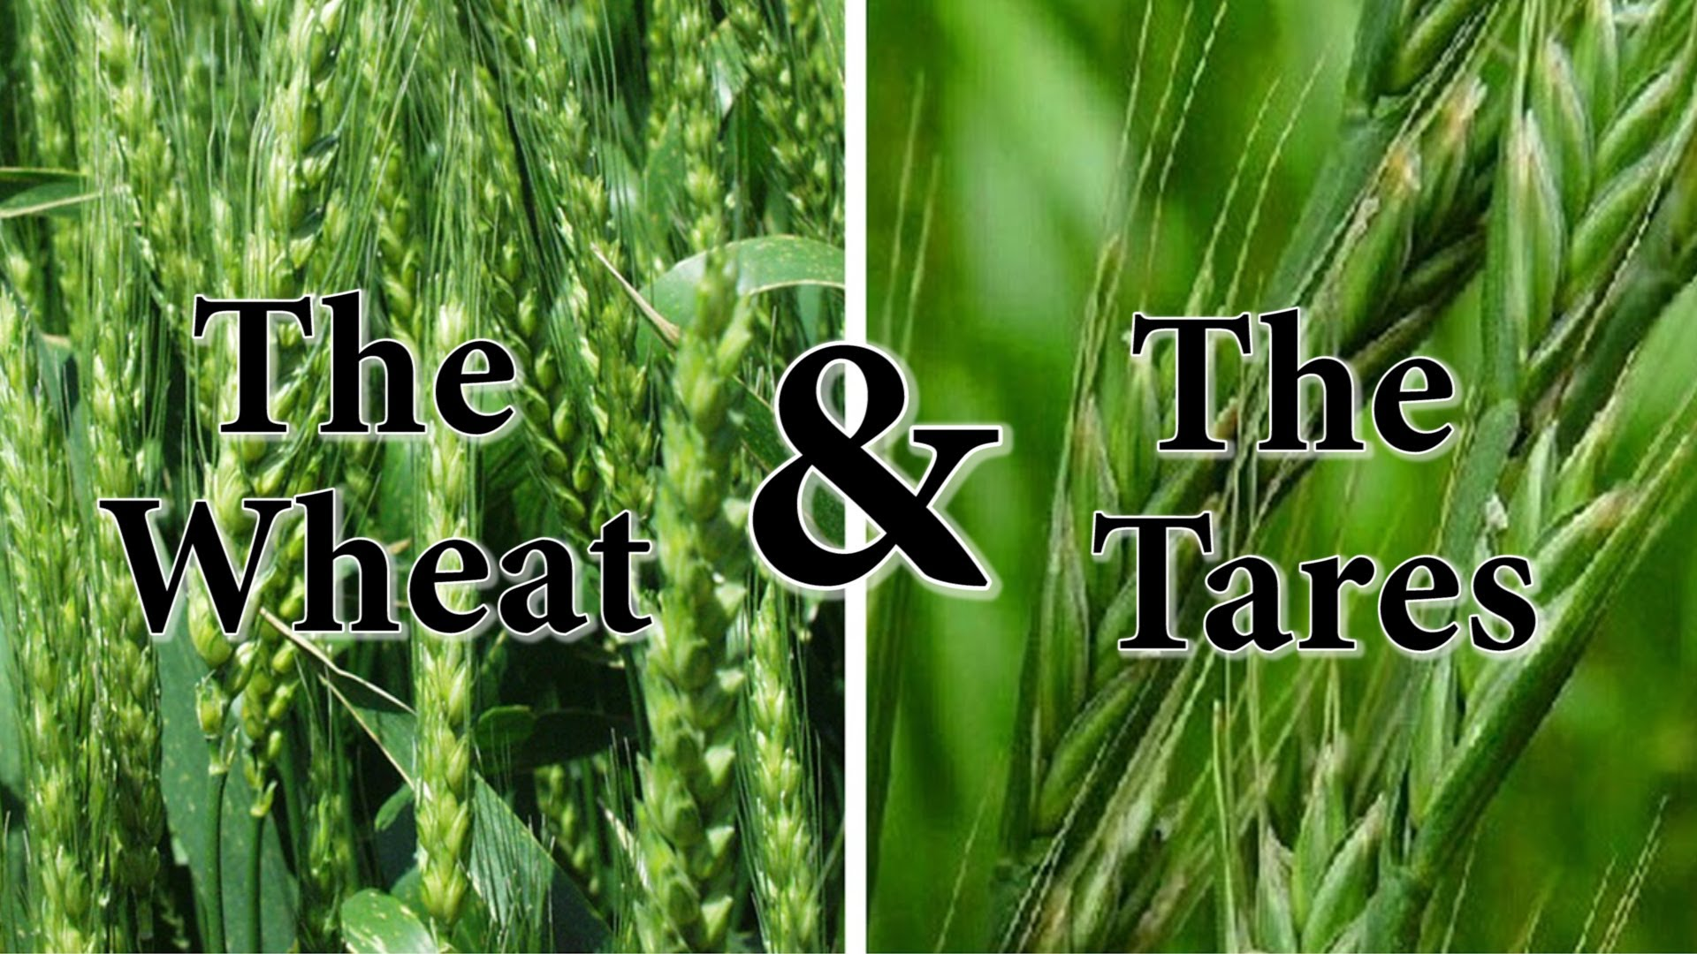

Slide 12
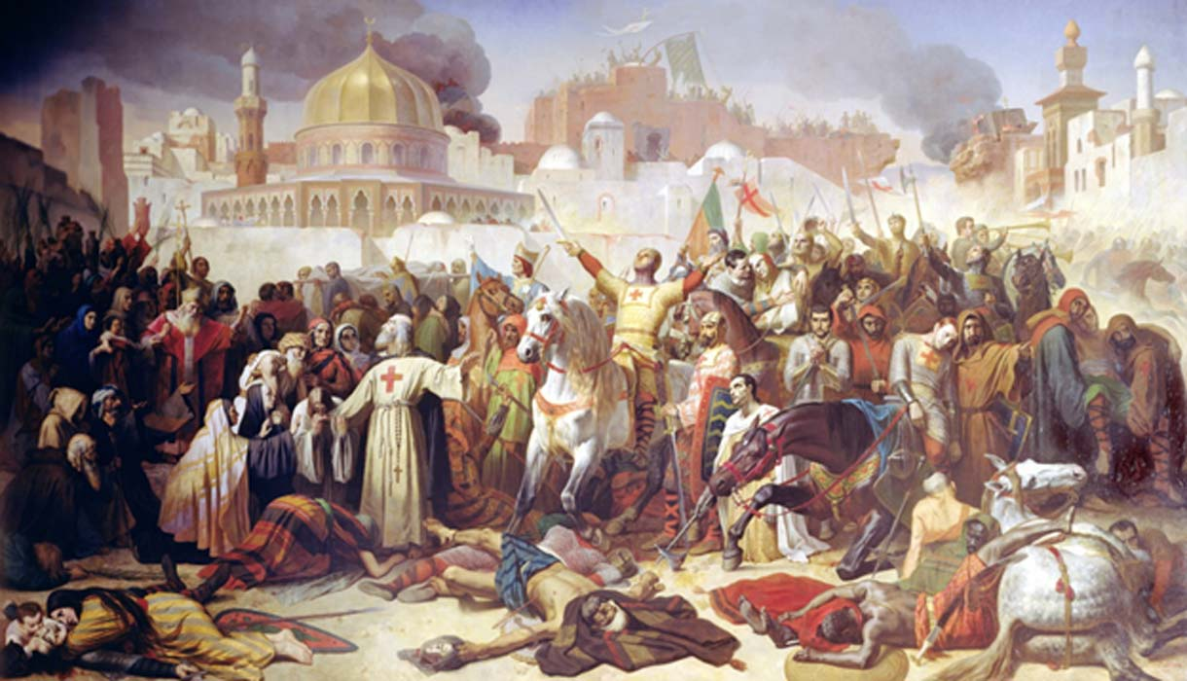

Slide 13
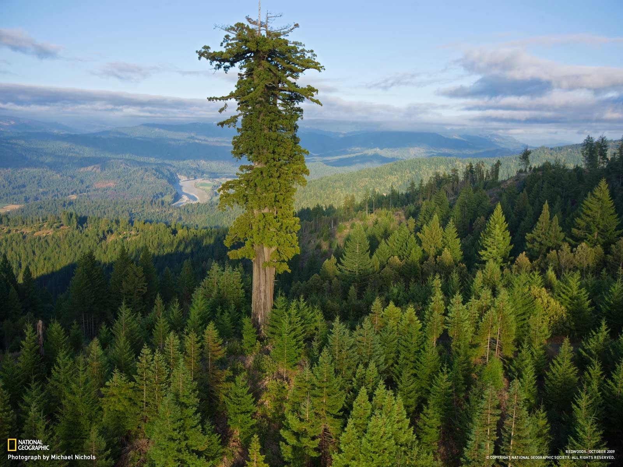
What’s the best way for good seed to diminish the effect of bad seed?

Slide 14
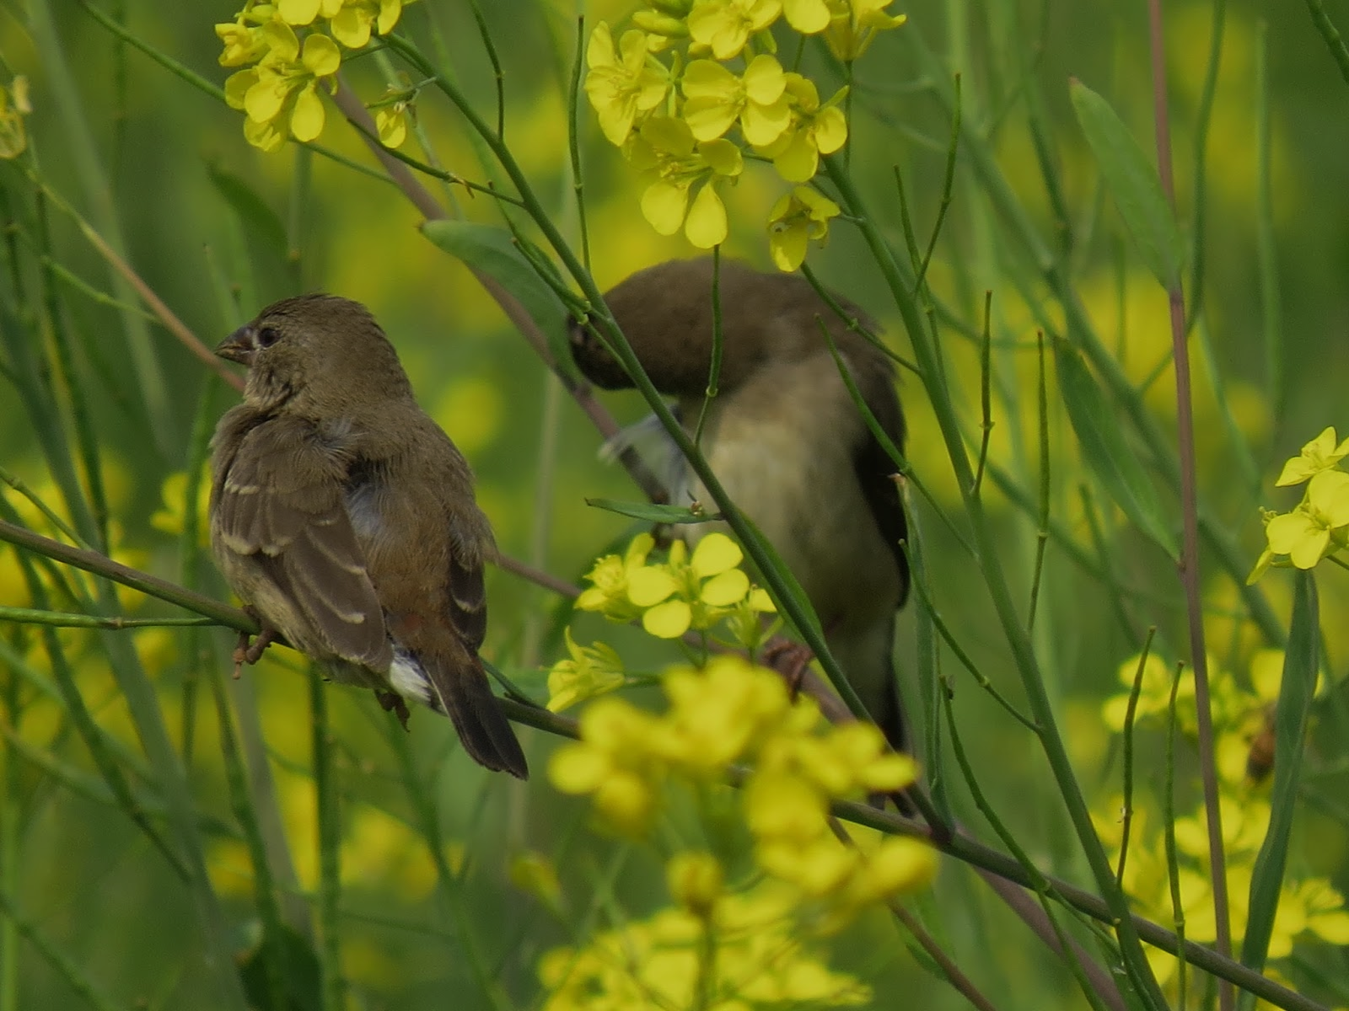
The Parable of the Mustard Seed (Matt. 13)
³¹ He told them another parable: “The kingdom of heaven is like a mustard seed, which a man took and planted in his field. ³² Though it is the smallest of all seeds, yet when it grows, it is the largest of garden plants and becomes a tree, so that the birds come and perch in its branches.”

Slide 15
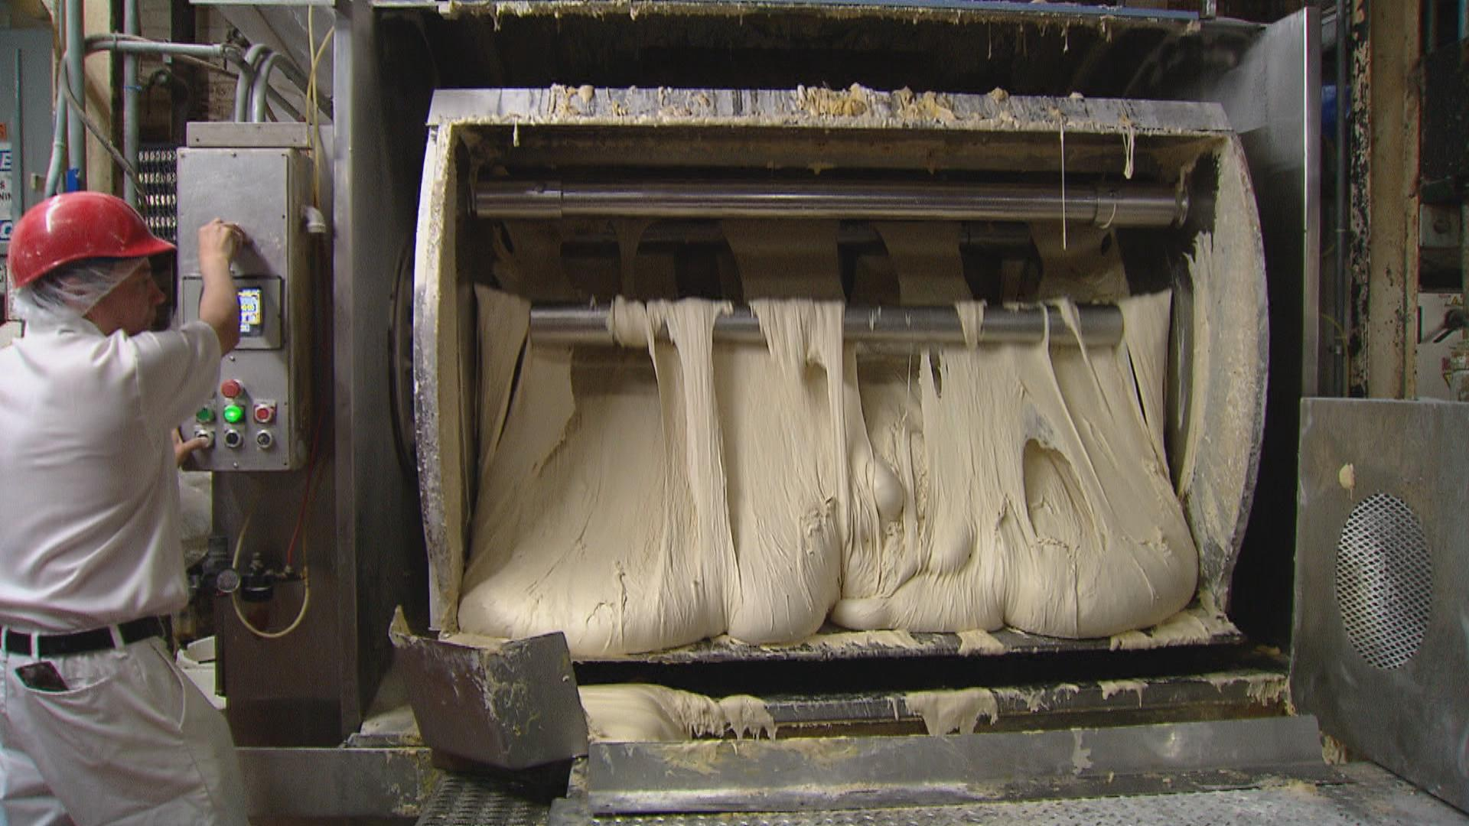
Matthew 13:33—Yeast in the Dough
He told them still another parable: “The kingdom of heaven is like yeast that a woman took and mixed into about sixty pounds of flour until it worked all through the dough.”

Slide 16
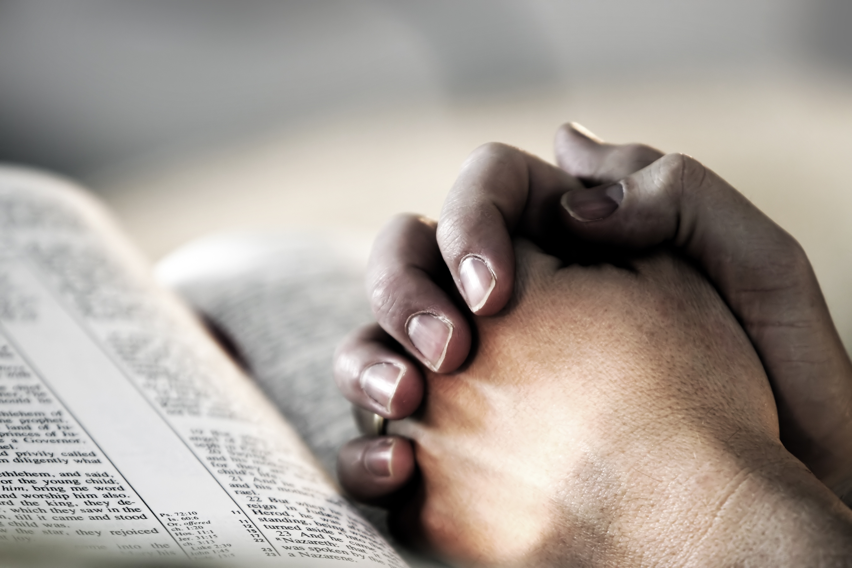

Slide 18
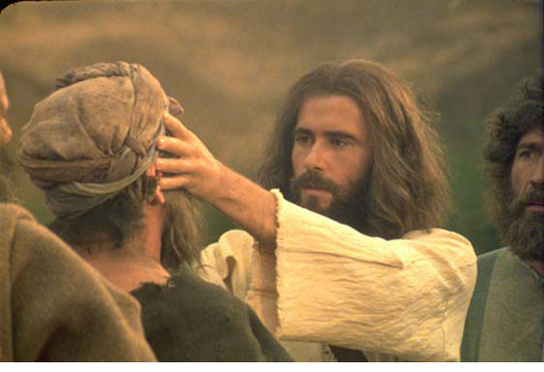

Slide 19
James 5
¹³ Is anyone among you in trouble? Let them pray. Is anyone happy? Let them sing songs of praise. ¹⁴ Is anyone among you sick? Let them call the elders of the church to pray over them and anoint them with oil in the name of the Lord. ¹⁵ And the prayer offered in faith will make the sick person well; the Lord will raise them up. If they have sinned, they will be forgiven. ¹⁶ Therefore confess your sins to each other and pray for each other so that you may be healed. The prayer of a righteous person is powerful and effective.

