Slide 1
﻿To the Church in Laodicea

Slide 2
Story Time
David Lanham

Slide 3
Externally they looked good, but internally they were struggling

Slide 4
John the Apostle
THE LORD OF THE CHURCHES by John Moody

Slide 5
Nero (AD 54-68)
Heavy persecution
Muratorian fragment (170-190)
Smyrna

Slide 6
Domitian (AD95)
Church Father Irenaeus (AD 185)

Slide 8
‘The words of the Amen, the faithful and true witness, the beginning of God's creation.

Slide 9
15 “‘I know your works: you are neither cold nor hot. Would that you were either cold or hot! 16 So, because you are lukewarm, and neither hot nor cold, I will spit you out of my mouth.

Slide 10
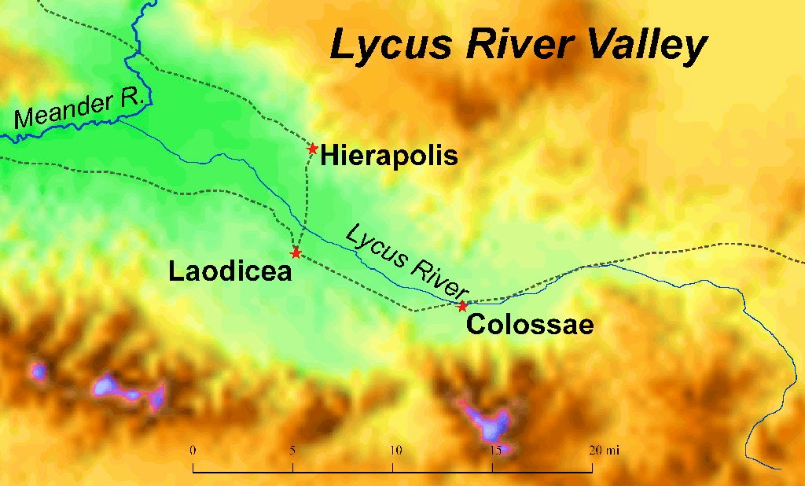

Slide 11
17 For you say, I am rich, I have prospered, and I need nothing, not realizing that you are wretched, pitiable, poor, blind, and naked.

Slide 12
(Hos 12:8) Israel boasts, I am rich! I’ve made a fortune all by myself! No one has caught me cheating! My record is spotless!
Deuteronomy 8:11-20

Slide 13
18 I counsel you to buy from me gold refined by fire, so that you may be rich, and white garments so that you may clothe yourself and the shame of your nakedness may not be seen, and salve to anoint your eyes, so that you may see.

Slide 14
What does it mean to refined by fire?

Slide 15
1 Peter 1:6-7 “In this you rejoice, though now for a little while, if necessary, you have been grieved by various trials, so that the tested genuineness of your faith—more precious than gold that perishes though it is tested by fire—may be found to result in praise and glory and honor at the revelation of Jesus Christ.”

Slide 16
19 Those whom I love, I reprove and discipline, so be zealous and repent. 20 Behold, I stand at the door and knock. If anyone hears my voice and opens the door, I will come in to him and eat with him, and he with me.

Slide 17
The word (paidue/παιδευω “discipline”) is closely related to (paidi/παιδια “children”)

Slide 18
21 The one who conquers, I will grant him to sit with me on my throne, as I also conquered and sat down with my Father on his throne. 22 He who has an ear, let him hear what the Spirit says to the churches.

Slide 19
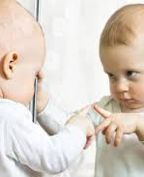
Application
Internally:
buy from me
White garment
Salve for the eyes…

Slide 20
End of the Series…
Ephesus (2:1-7) Rekindling love by Jesse
Smyrna (2:8-11) Jesus Last Message to Suffering Saint By Pastor John
Pergamum (2:12-17) A Serpent’s tale by Eric
Adultery and Ideas
Thyatira (2:18-29) a Church of Holy Living by Worship Leader Andrew
Sardis (3:1-6) a Wake-Up-Call- by Pastor John
Philadelphia (3:7-13) the Little Church That Could That Can Grow. By Elder Bob
Laodicea (3:14-22) Externally it looked good, but internally it is a struggle

