Slide 1
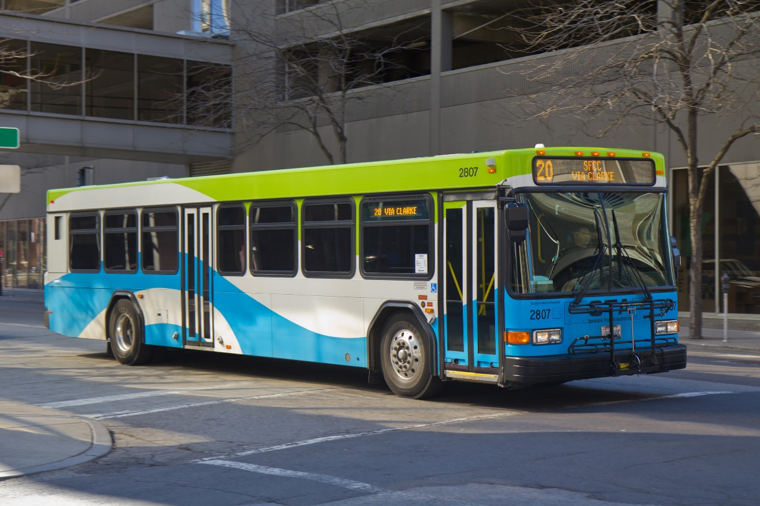
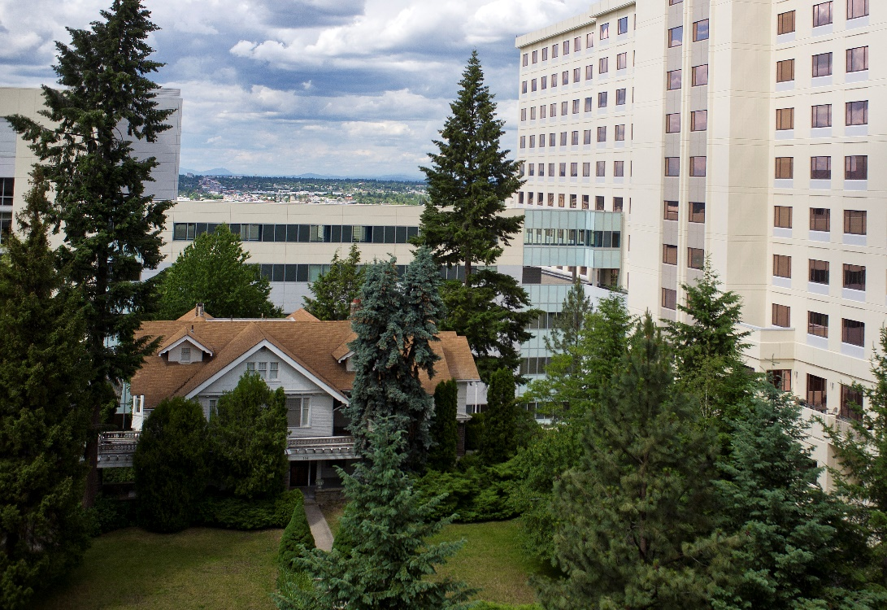
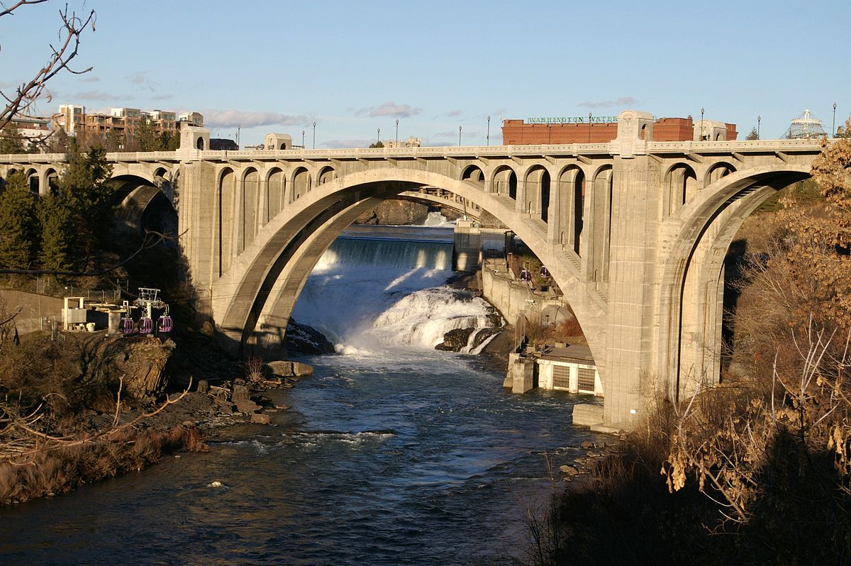
What are some things you responsible for taking care of that you don't fully own?

Slide 2
Luke 16 Jesus told his disciples: “There was a rich man whose manager was accused of wasting his possessions. ² So he called him in and asked him, ‘What is this I hear about you? Give an account of your management, because you cannot be manager any longer.’ ³ “The manager said to himself, ‘What shall I do now? My master is taking away my job. I’m not strong enough to dig, and I’m ashamed to beg— ⁴ I know what I’ll do so that, when I lose my job here, people will welcome me into their houses.’

Slide 3
Luke 16 ⁵ “So he called in each one of his master’s debtors. He asked the first, ‘How much do you owe my master?’ ⁶ “‘Nine hundred gallons of olive oil,’ he replied. “The manager told him, ‘Take your bill, sit down quickly, and make it four hundred and fifty.’ ⁷ “Then he asked the second, ‘And how much do you owe?’ “‘A thousand bushels of wheat,’ he replied. “He told him, ‘Take your bill and make it eight hundred.’

Slide 4
Luke 16 ⁸ “The master commended the dishonest manager because he had acted shrewdly. For the people of this world are more shrewd in dealing with their own kind than are the people of the light. ⁹ I tell you, use worldly wealth to gain friends for yourselves, so that when it is gone, you will be welcomed into eternal dwellings. ¹⁰ “Whoever can be trusted with very little can also be trusted with much, and whoever is dishonest with very little will also be dishonest with much.

Slide 5
Luke 16 ¹¹ So if you have not been trustworthy in handling worldly wealth, who will trust you with true riches? ¹² And if you have not been trustworthy with someone else’s property, who will give you property of your own? ¹³ “No one can serve two masters. Either you will hate the one and love the other, or you will be devoted to the one and despise the other. You cannot serve both God and money.”

Slide 6
Luke 16 ¹⁴ The Pharisees, who loved money, heard all this and were sneering at Jesus. ¹⁵ He said to them, “You are the ones who justify yourselves in the eyes of others, but God knows your hearts. What people value highly is detestable in God’s sight.

Slide 8
IEEE 802.11b Direct Sequence

Slide 9
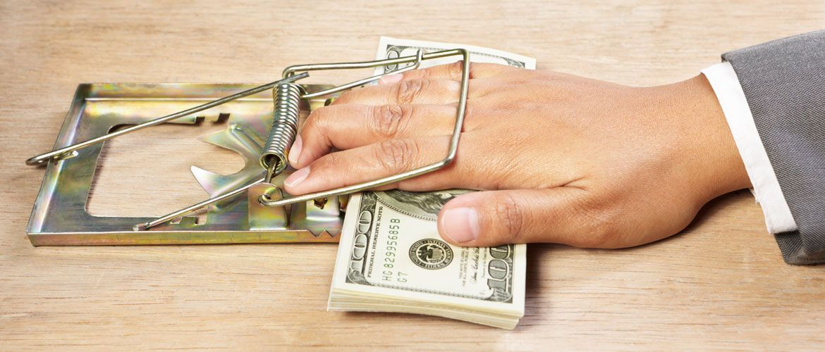
Usury?
Ex. 22:25; Lev. 25:36; Deut 15:8; 23:19

Slide 10
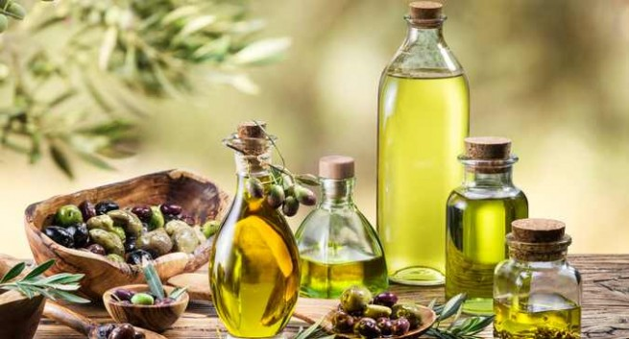
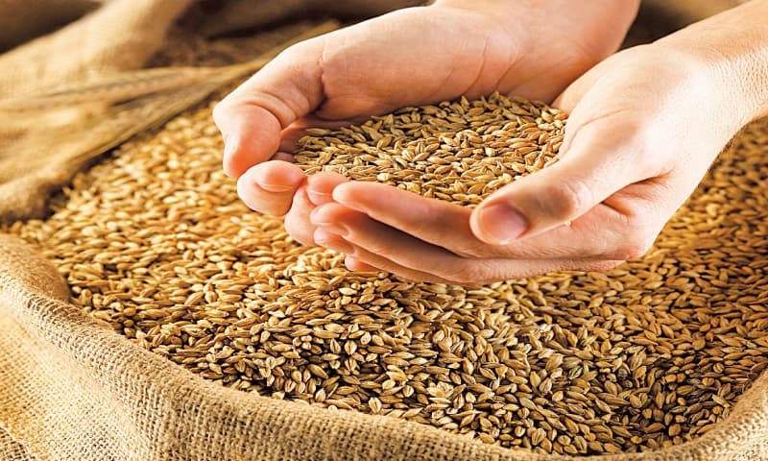

Slide 11
Luke 16 Jesus told his disciples: “There was a rich man whose manager was accused of wasting his possessions.
What does God give to us that is identical?
What does God give to us that may differ in quantity or quality?

Slide 12
What does God put under our care that is…
Public property?
Someone else’s private property?
Your property?
Non-tangible things?
God’s things?

Slide 13
Luke 16 ² So he called him in and asked him, ‘What is this I hear about you? Give an account of your management, because you cannot be manager any longer
WHEN will we be called to give an account to God? [See Hebrews 4:13; I Peter 4:5; Mt. 12:36; Romans 14:10; 2 Cor. 5:10]
WHEN will we stop managing all that God has given us in this life?

Slide 14
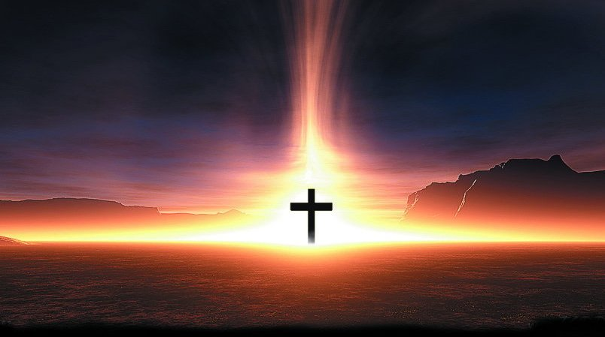
How will this look from the vantage point of eternity?

Slide 15
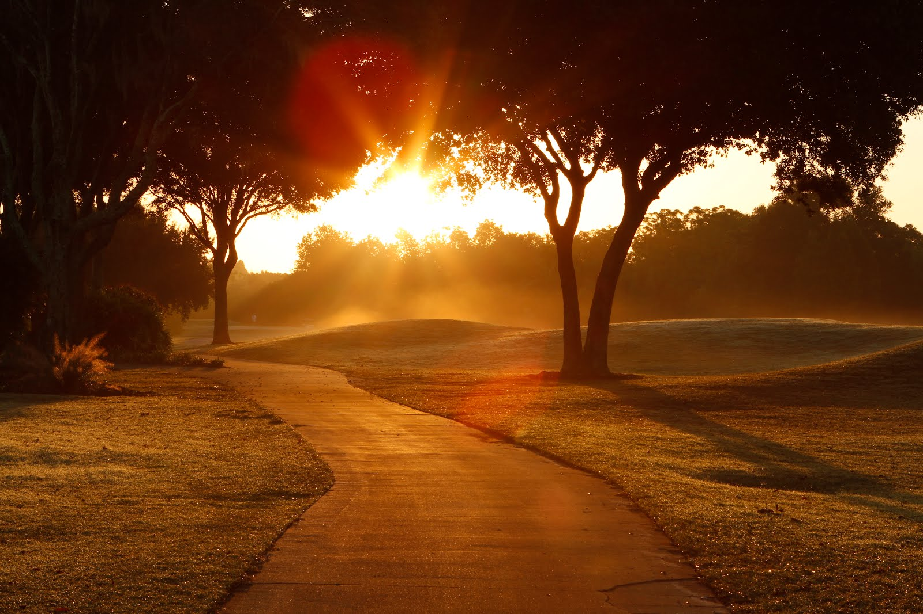
Every day is another do-over opportunity!

Slide 16
Luke 16 ³ “The manager said to himself, ‘What shall I do now? My master is taking away my job. I’m not strong enough to dig, and I’m ashamed to beg— ⁴ I know what I’ll do so that, when I lose my job here, people will welcome me into their houses.’

Slide 17
We of all people should recognize the need for a plan NOW that will make preparations for a life LATER.

Slide 18
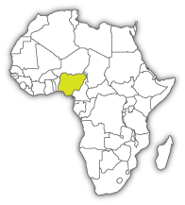
Roger & Dottie Morhlang

Slide 19
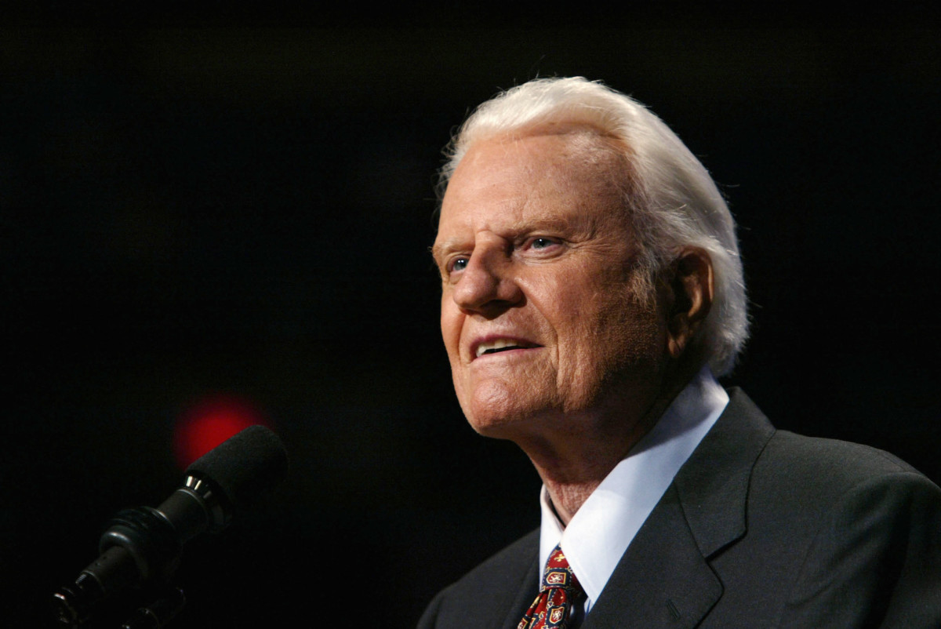

Slide 20
Luke 16 ⁸ “The master commended the dishonest manager because he had acted shrewdly. For the people of this world are more shrewd in dealing with their own kind than are the people of the light. ⁹ I tell you, use worldly wealth to gain friends for yourselves, so that when it is gone, you will be welcomed into eternal dwellings.

Slide 21
Shrewd = “to act with great practical intelligence,” “prudently” or “sensibly.”

Slide 22
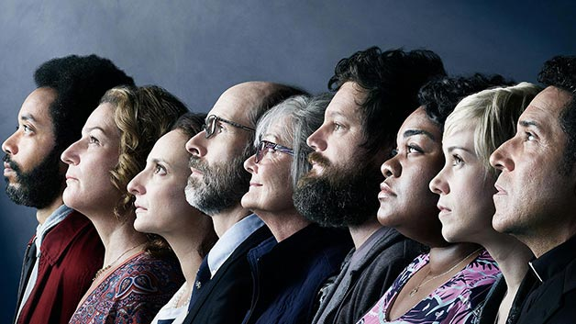
Know the value of people and friendship in comparison with all else in life.

Slide 23
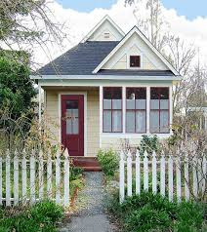
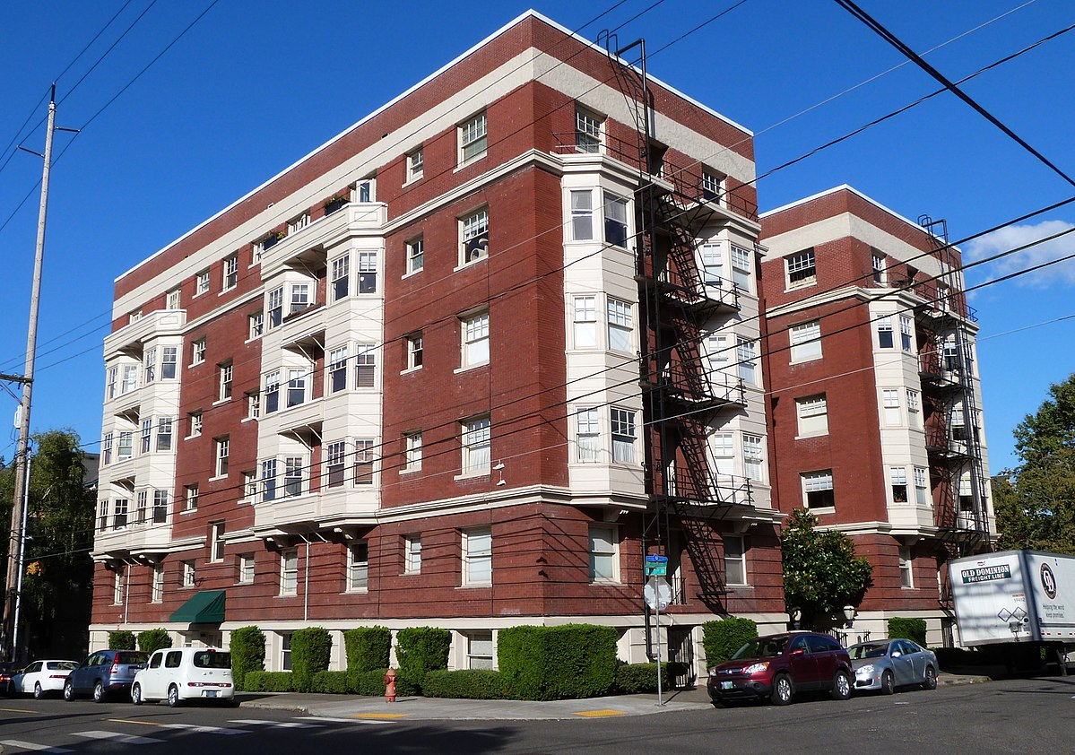
How can we use our housing to make friends?

Slide 24
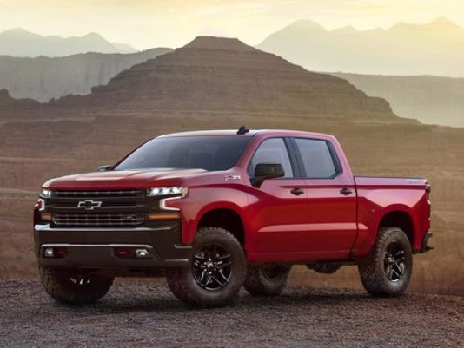
How can we use our transportation to make friends for eternity?

Slide 25
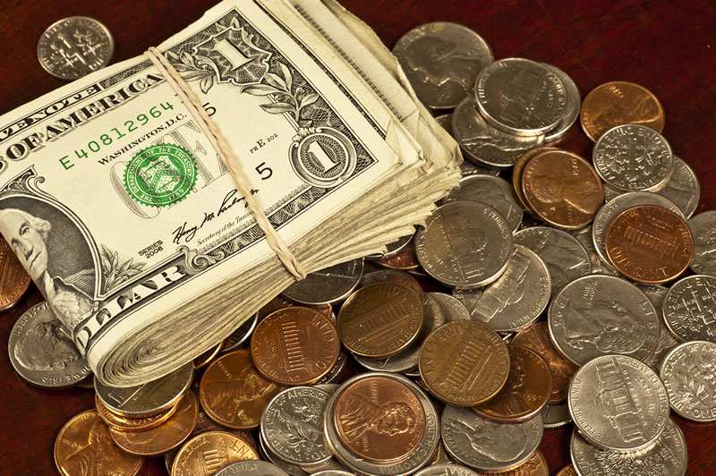
How can we use our money to make friends for eternity?

Slide 26
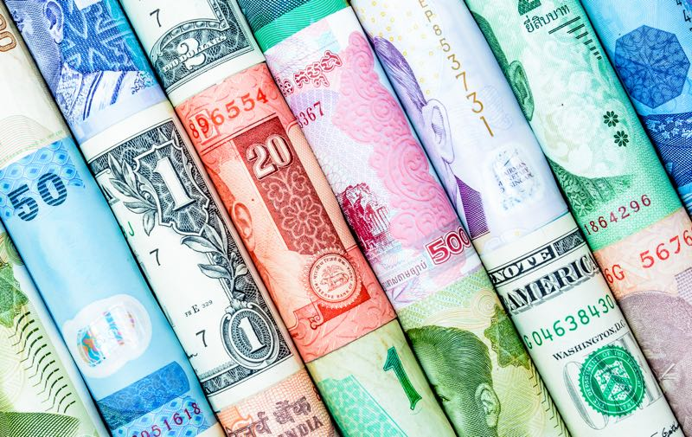

Slide 27
Luke 16 ¹⁴ The Pharisees, who loved money, heard all this and were sneering at Jesus. ¹⁵ He said to them, “You are the ones who justify yourselves in the eyes of others, but God knows your hearts. What people value highly is detestable in God’s sight.

Slide 28
What did we do last week to use our resources to build friendships that can have eternal consequences?

Slide 29
What resources might God want me to ‘repurpose’ for Kingdom work?

Slide 30
Luke 16 ¹¹ So if you have not been trustworthy in handling worldly wealth, who will trust you with true riches? ¹² And if you have not been trustworthy with someone else’s property, who will give you property of your own? ¹³ “No one can serve two masters. Either you will hate the one and love the other, or you will be devoted to the one and despise the other.

