Slide 1
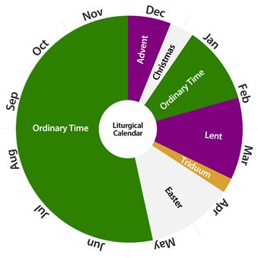
The “Church Calendar”

Slide 2
la·ment: a passionate expression of grief or sorrow.

Slide 3
Perhaps the simplest way of understanding lament is that it is an expression of human experience.
It is part of creaturely life in a broken world.

Slide 4
Biblically, lament is not just a feeling of deep sorrow, mournfulness or regret, it is an action on the part of the believer to articulate those feelings in the presence of God.
-Katie Clum

Slide 5
Transparency is an essential part of relationships

Slide 6
Psalm 13:1-2
How long, O Lord? Will you forget me forever? How long will you hide your face from me? How long must I take counsel in my soul and have sorrow in my heart all the day? How long shall my enemy be exalted over me?

Slide 7
Psalm 22:1-2
My God, my God, why have you forsaken me? Why are you so far from saving me, from the words of my groaning? ² O my God, I cry by day, but you do not answer, and by night, but I find no rest.

Slide 8
Job 3:24
…sighing has become my daily food;
my groans pour out like water.

Slide 9
Lamentations 1:1
How lonely sits the city That was full of people! She has become like a widow who was once great among the nations!
She who was a princess among the provinces Has become a forced laborer!

Slide 10
Christianity is a religion for those who are wretched.
The believer finds a force in Christianity that is elevating, but elevation comes in the midst of suffering.

Slide 11
Sincere lament requires full acknowledgement of the sorrow…
in order to move the despair and grief towards hope and trust in God.

Slide 12
Summary
Purposes of Lament:
Total transparency with God is essential for having a healthy relationship with Him.
After recognizing how we and others fall short of God’s design we are aware of our need for Him. We then must choose to place our hope and trust in Him.

Slide 13
The 2 improper ways of dealing with lamentable things:
a. Not allowing ourselves to feel and express lamentable things to God and others.
b. Wallowing in self-expression of grief with no intention of trusting God.

Slide 14
Psalm 109:1-5
¹Be not silent, O God of my praise! ² For wicked and deceitful mouths are opened against me, speaking against me with lying tongues. ³ They encircle me with words of hate, and attack me without cause. ⁴ In return for my love they accuse me, but I give myself to prayer.

Slide 15
Psalm 5:1-3
Give ear to my words, O Lord; consider my groaning. ² Give attention to the sound of my cry, my King and my God, for to you do I pray.

Slide 16
Psalm 30:8-10
To you, O Lord, I cry, and to the Lord I plead for mercy: ⁹ “What profit is there in my death, if I go down to the pit? Will the dust praise you? Will it tell of your faithfulness? ¹⁰ Hear, O Lord, and be merciful to me! O Lord, be my helper!”

Slide 17
Psalm 13
How long, O Lord? Will you forget me forever? How long will you hide your face from me? ² How long must I take counsel in my soul and have sorrow in my heart all the day? How long shall my enemy be exalted over me?

Slide 18
³ Consider and answer me, O Lord my God; light up my eyes, lest I sleep the sleep of death, ⁴ lest my enemy say, “I have prevailed over him,” lest my foes rejoice because I am shaken.

Slide 19
⁵ But I have trusted in your steadfast love; my heart shall rejoice in your salvation. ⁶ I will sing to the Lord, because he has dealt bountifully with me.

Slide 20
Some example reasons to lament:
Psalm 38 or 41: Physical ailment
Psalm 51: Guilt and shame for personal sin
Psalm 69: Being publicly ostracized or unjustly shamed (specifically for living righteously)
Psalm 71: Afflictions of old age
Psalm 88: Depression/despair
Psalm 143: Oppression or victimization

