Slide 1
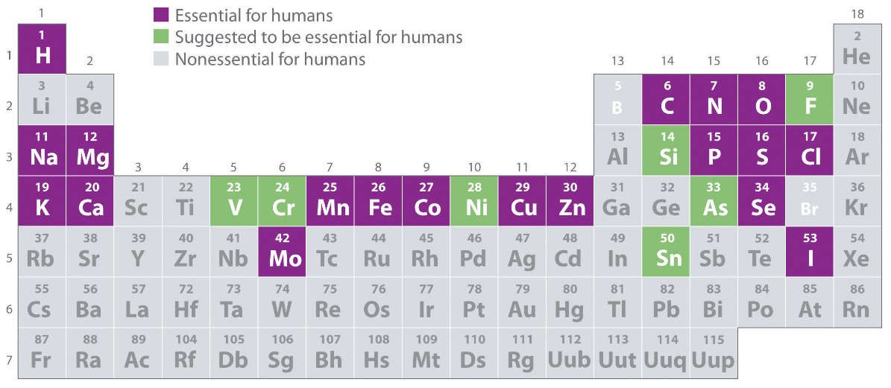
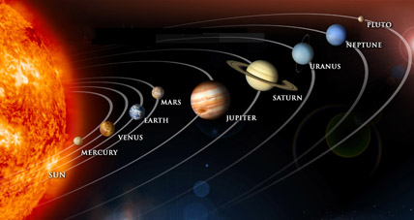
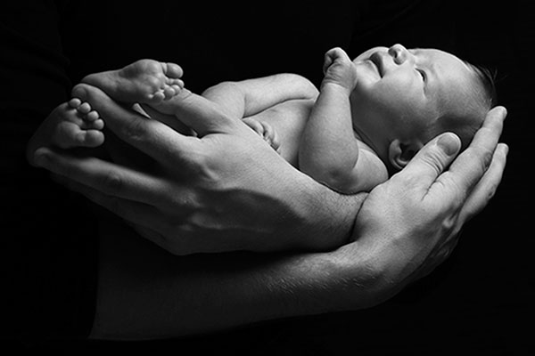
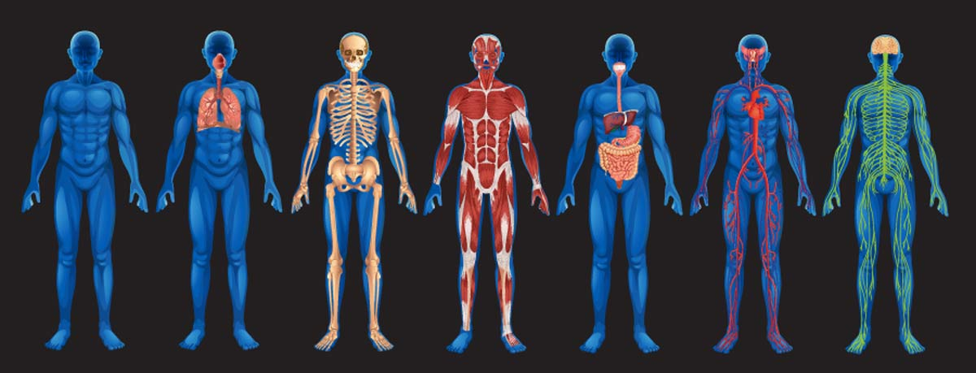

Slide 2
-11 m3 kg-1 s-2
Gravitational Constant: G=6.673 x 10

Slide 3
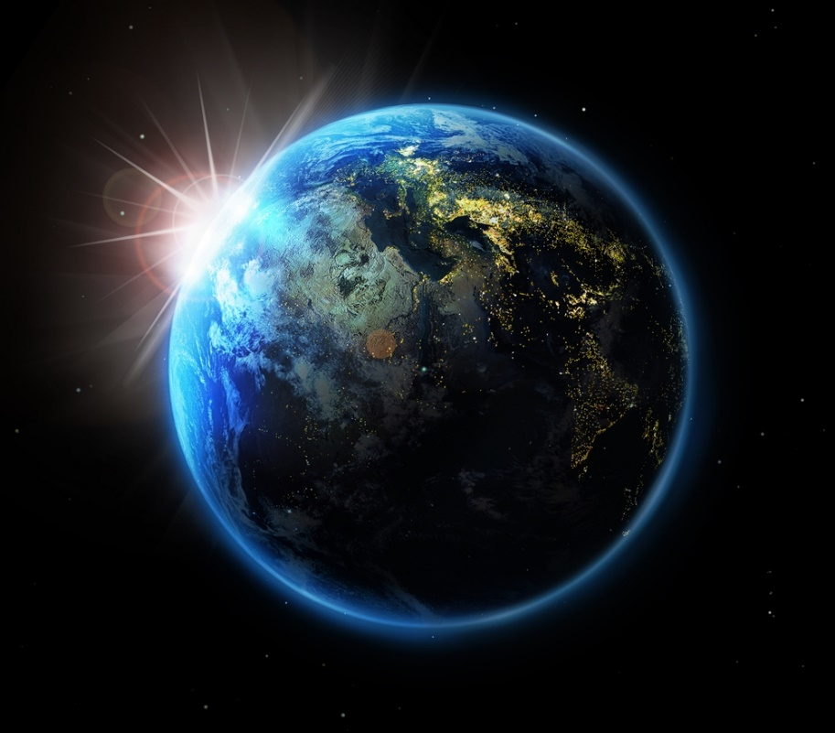

Slide 4
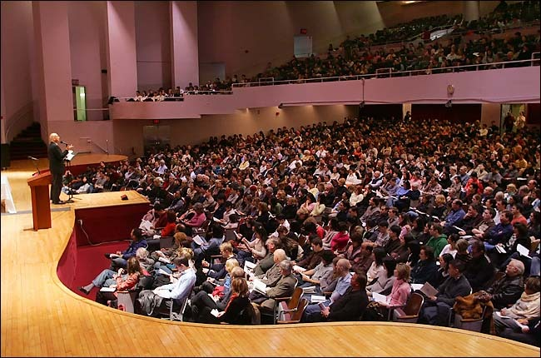
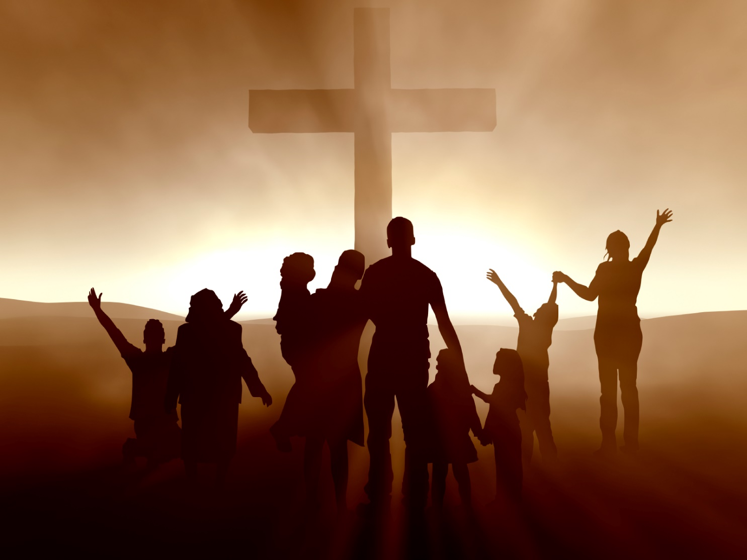
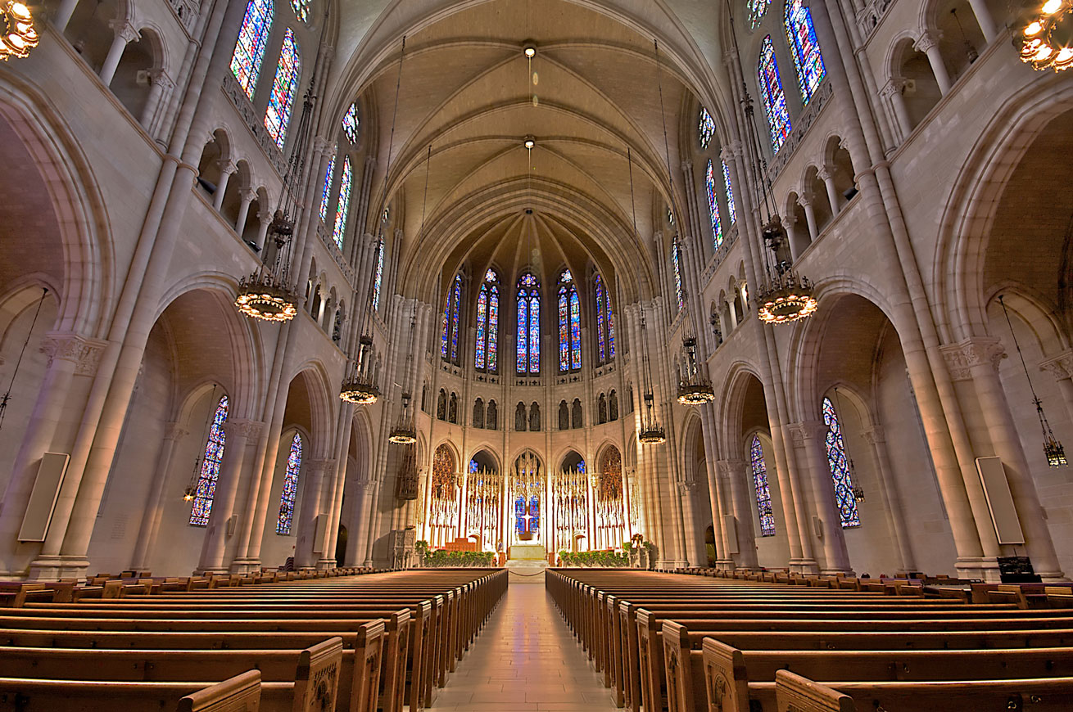
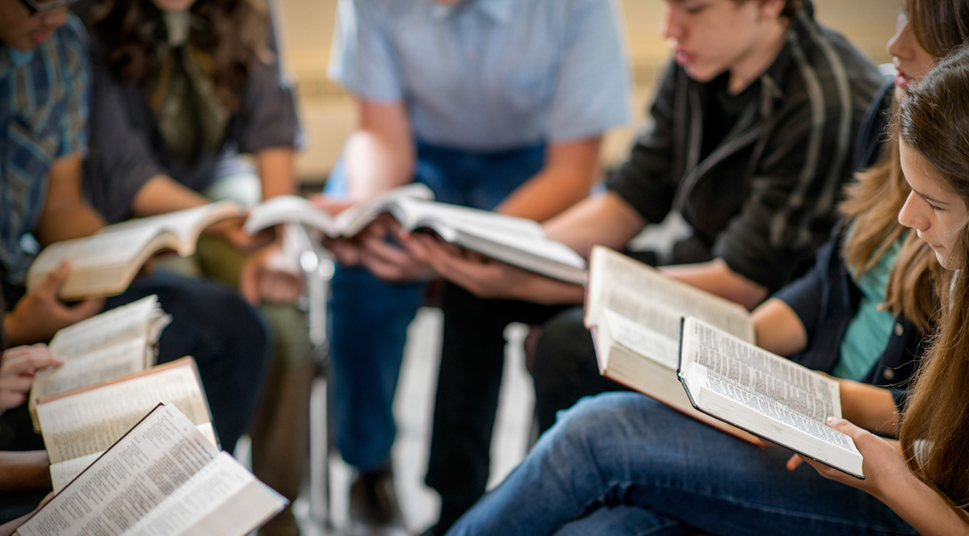

Slide 5
Did you go to church last week?

Slide 6
Did you go to church last week?
Tell me about your church.

Slide 7
I’m a Christian and I don’t think I have to be part of any organized church.
Did you go to church last week?
Tell me about your church.

Slide 9
Acts 2 When the day of Pentecost came, they were all together in one place.² Suddenly a sound like the blowing of a violent wind came from heaven and filled the whole house where they were sitting. ³ They saw what seemed to be tongues of fire that separated and came to rest on each of them. ⁴ All of them were filled with the Holy Spirit and began to speak in other tongues as the Spirit enabled them.

Slide 10
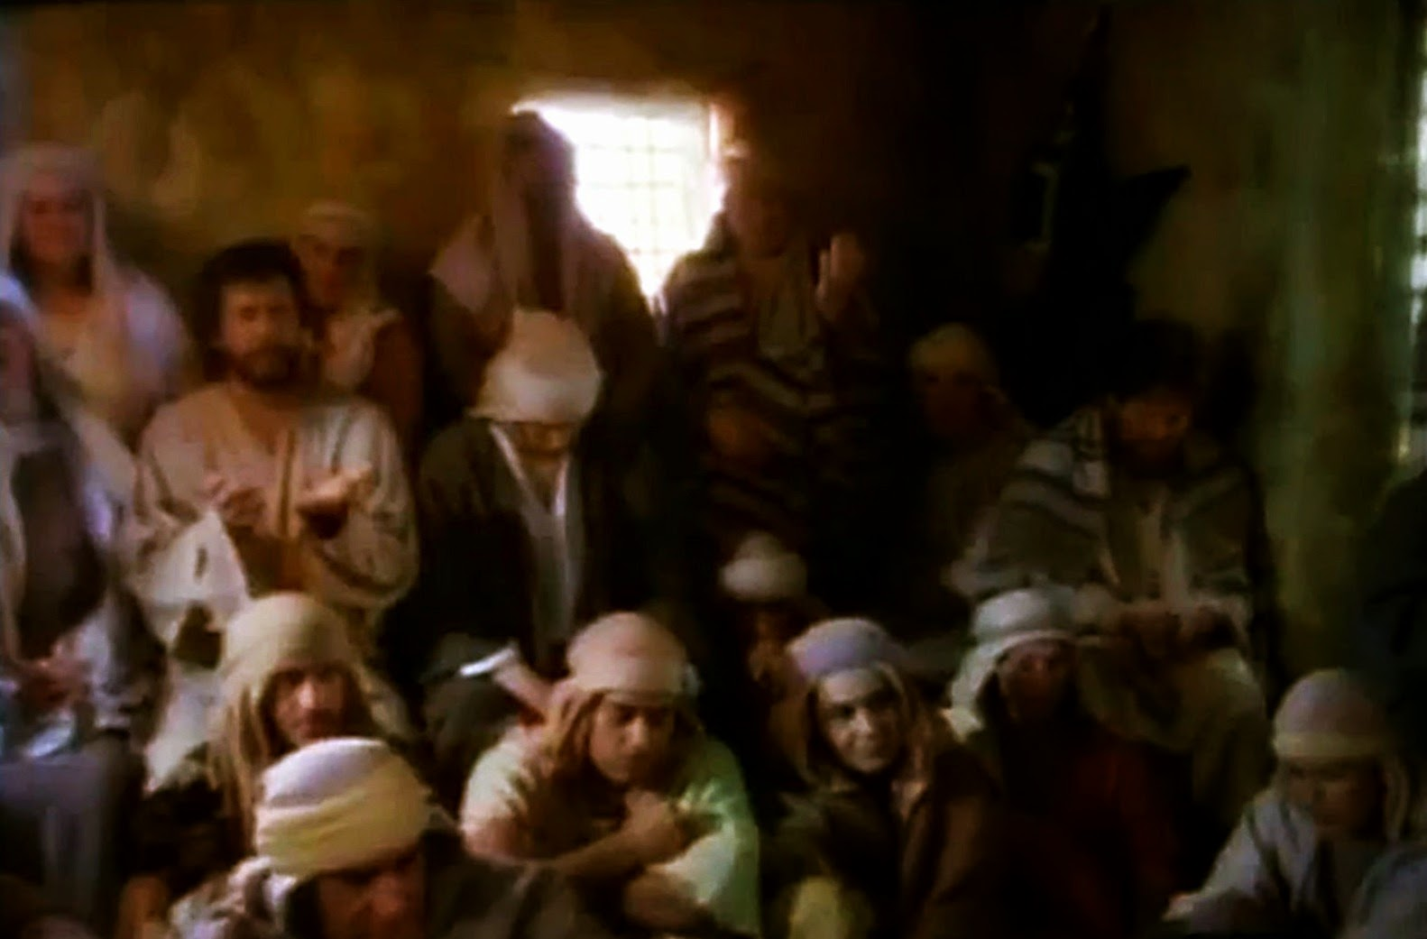
Matthew 12

Slide 11
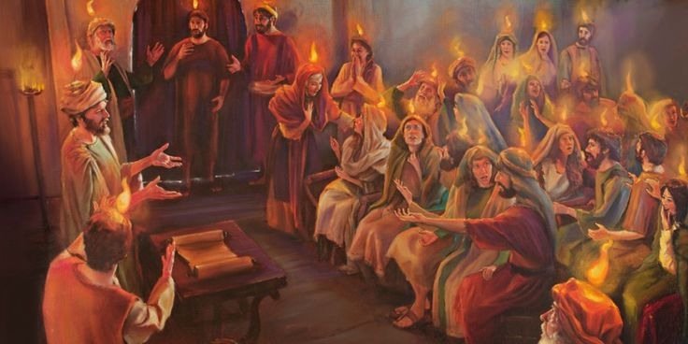
Matthew 12

Slide 12
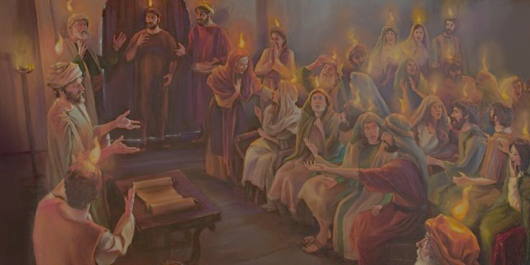
Acts 1:5-- For John baptized with water, but in a few days you will be baptized with the Holy Spirit.”

Slide 13
Acts 1:8-- But you will receive power when the Holy Spirit comes on you; and you will be my witnesses in Jerusalem, and in all Judea and Samaria, and to the ends of the earth.

Slide 14
Acts 2:4-- All of them were filled with the Holy Spirit and began to speak in other tongues as the Spirit enabled them.

Slide 15
¹⁷ “‘In the last days, God says, I will pour out my Spirit on all people. Your sons and daughters will prophesy, your young men will see visions, your old men will dream dreams. ¹⁸ Even on my servants, both men and women, I will pour out my Spirit in those days, and they will prophesy.

Slide 16
Acts 2:38-- Peter replied, “Repent and be baptized, every one of you, in the name of Jesus Christ for the forgiveness of your sins. And you will receive the gift of the Holy Spirit.

Slide 17
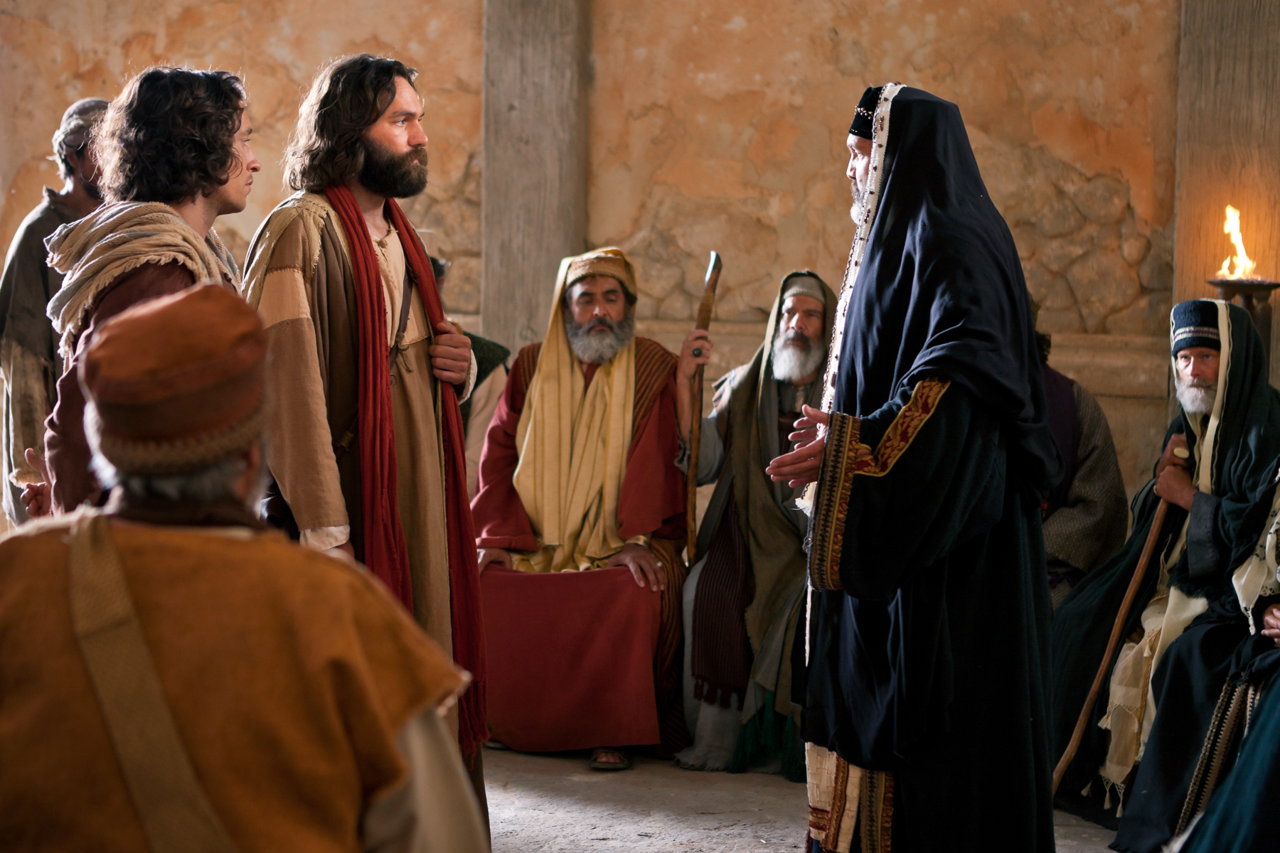
Acts 4:8-- Then Peter, filled with the Holy Spirit, said to them: “Rulers and elders of the people….”

Slide 18
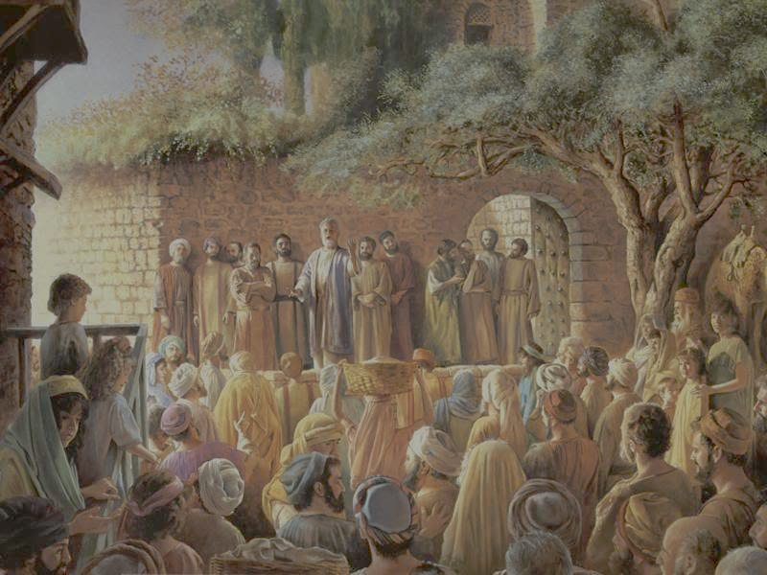
Acts 4:31-- After they prayed, the place where they were meeting was shaken. And they were all filled with the Holy Spirit and spoke the word of God boldly.

Slide 19
ESSENTIAL #1

Slide 20
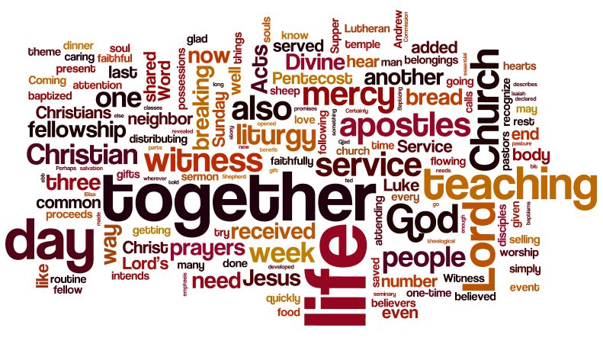
ACTS 2:42 ⁴² They devoted themselves to the apostles’ teaching and to fellowship, to the breaking of bread and to prayer.

Slide 21
ESSENTIAL #2: Teaching
ESSENTIAL #3: Fellowship
ESSENTIAL #4: Breaking Bread
ESSENTIAL #5: Prayer

Slide 22
Acts 2 ⁴³ Everyone was filled with awe at the many wonders and signs performed by the apostles. ⁴⁴ All the believers were together and had everything in common. ⁴⁵ They sold property and possessions to give to anyone who had need. ⁴⁶ Every day they continued to meet together in the temple courts. They broke bread in their homes and ate together with glad and sincere hearts, ⁴⁷ praising God and enjoying the favor of all the people. And the Lord added to their number daily those who were being saved.

