Slide 1
Week 1—Pastor Andrew Paul’s Definition of the Gospel—Romans 1:16--For I am not ashamed of the gospel, for it is the power of God for salvation to everyone who believes, to the Jew first and also to the Greek.

Slide 2
Week 2—Pastor John How the Gospel changes our PAST by forgiveness, redemption, justification, peace with God, etc. We have been saved from all our sin and darkness.

Slide 3
Week 3—Pastor Bob How the Gospel changes our PRESENT by giving us a new life in Christ to live every day. We are being saved every day from darkness and evil.

Slide 4
Week 4—Pastor Jesse How the Gospel changes our FUTURE by giving us a new hope in Christ—life forever in the presence of God. We are being saved every day from darkness and evil.

Slide 5
Week 5—Matt Lewis Through the Gospel, Jesus has invited us to live a bigger and better story with Him in His Kingdom…to join Him in His Story in this world.

Slide 6
Week 6—Jerry Larson The Gospel is THE BEST gift we have ever received and are called to share with every person needing Christ in this life. NOTE: If you didn’t get a copy of A Life That Matters by Ron Hutchcraft, let us know and we’ll order one for you.

Slide 7
2 Peter 3:9 The Lord is not slow in keeping his promise, as some understand slowness. Instead he is patient with you, not wanting anyone to perish, but everyone to come to repentance.

Slide 11
BC: Before Christ
MC: Meeting Christ
WC: With Christ (now)

Slide 12
B.C.: Before Christ
Childhood
Places lived
Spiritual journey…religious history
Successes & failures
Addictions and obsessions

Slide 13
B.C.: Before Christ: What experiences in your life can be points of contact with other people?
Family/lack of family
Birthplace
Childhood—good and bad experiences
Youth—ditto
Education/lack of education
Religious/non-religious experiences
Stuff you’re proud of
Stuff you’re not so proud of

Slide 14
2. M.C.: Meeting Christ
What’s your conversion story?
What happened that brought you to Jesus?
What circumstances did God use to turn your heart to Him?

Slide 15
3. W.C.: With Christ
What changes has Jesus brought to your life?
New purpose, passion, problems, message, meaning, experiences?
From what has/is Jesus saving you?

Slide 16
End with a QUESTION or two.
What can I do to help you get closer to God?
Have you ever surrendered your life to Jesus Christ?
Is there anything keeping you from giving your life to Jesus Christ right now?
If you were to stand before God today and He were to ask you, “Why should I let you into heaven,” what would you say?
How is it with your soul?

Slide 17
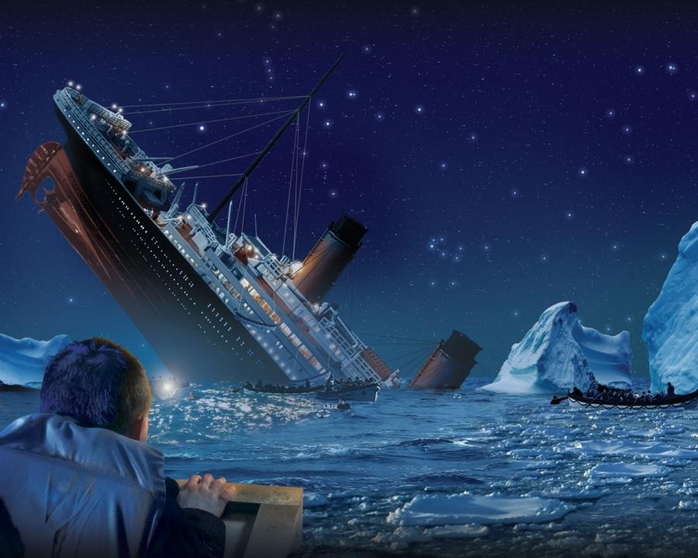
Your personal Titanic

Slide 18
I Corinthians 5:14-15
For Christ’s love compels us, because we are convinced that one died for all, and therefore all died. And he died for all, that those who live should no longer live for themselves but for Him who died for them and was raised again.

