Slide 1
James 5:7—Be patient, then, brothers and sisters, until the Lord’s coming.
Come up with your best definition of “patience”.
What is so attractive about patience?
How does godly/Christ-like patience differ from merely human patience?
How is perseverance different from patience?

Slide 2
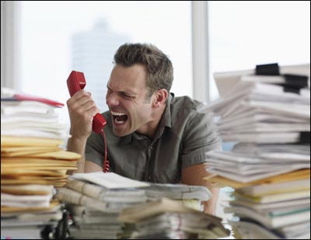
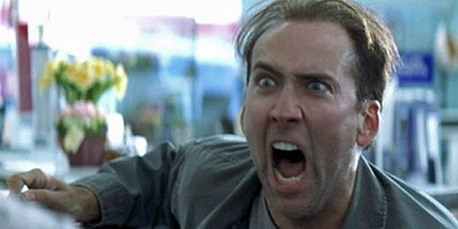

Slide 3
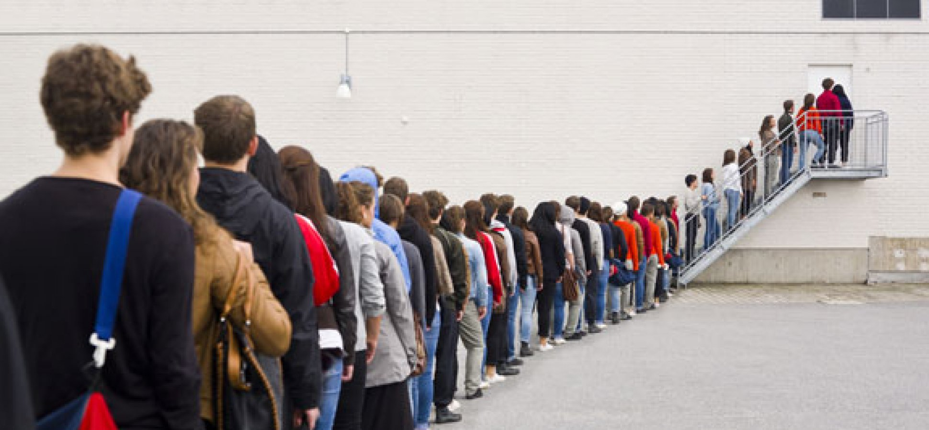
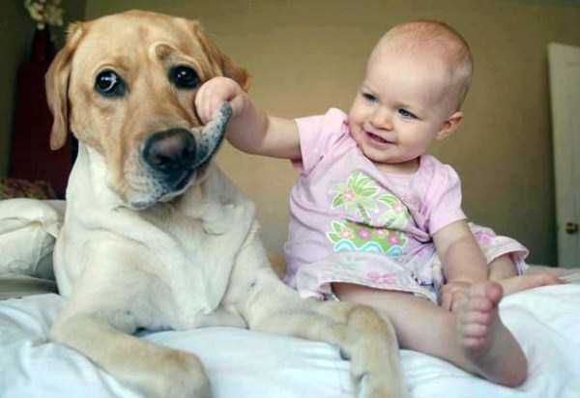

Slide 4
Romans 9:22
What if God, although choosing to show his wrath and make his power known, bore with great patience the objects of his wrath—prepared for destruction?
Romans 2:4
Or do you show contempt for the riches of his kindness, forbearance and patience, not realizing that God’s kindness is intended to lead you to repentance?

Slide 5
I Timothy 1:4
But for that very reason I was shown mercy so that in me, the worst of sinners, Christ Jesus might display his immense patience as an example for those who would believe in him and receive eternal life.

Slide 6
2 Peter 3:9, 15
⁹ The Lord is not slow in keeping his promise, as some understand slowness. Instead he is patient with you, not wanting anyone to perish, but everyone to come to repentance.
¹⁵ Bear in mind that our Lord’s patience means salvation,

Slide 7
James 5:7-9
⁷ Be patient, then, brothers and sisters, until the Lord’s coming. See how the farmer waits for the land to yield its valuable crop, patiently waiting for the autumn and spring rains. ⁸ You too, be patient and stand firm, because the Lord’s coming is near. ⁹ Don’t grumble against one another, brothers and sisters, or you will be judged. The Judge is standing at the door!

Slide 8
How does God reveal our impatience?

Slide 9
What might being patient with God sound like?
Look like?

Slide 10
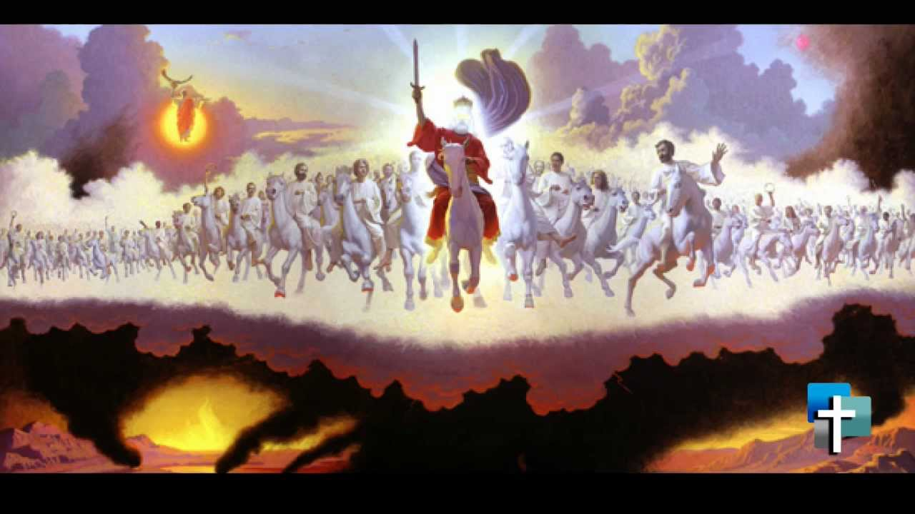
Patience is required until…

Slide 11
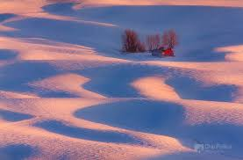
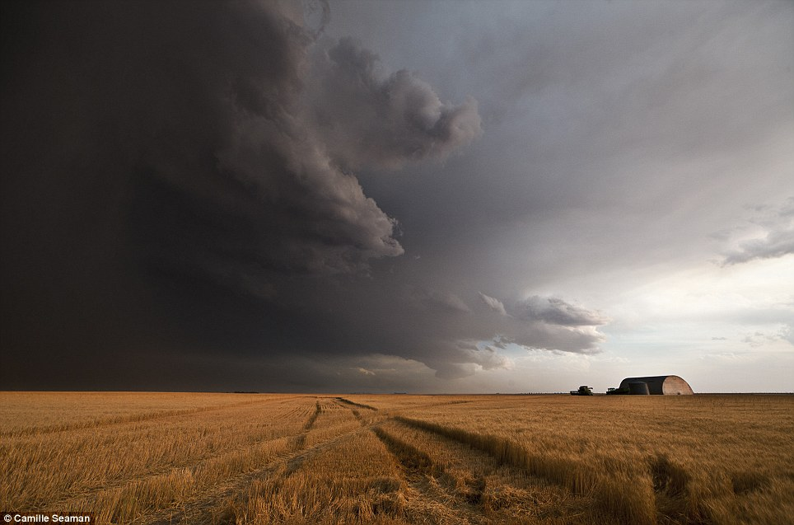
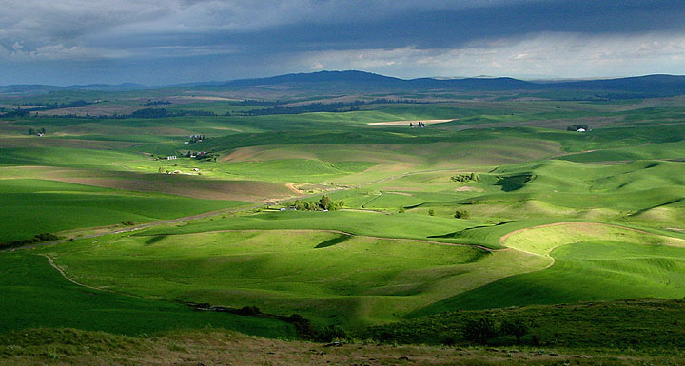

Slide 12
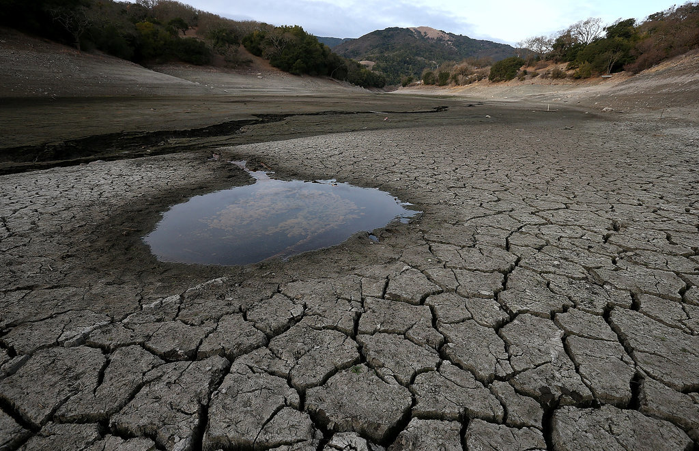

Slide 13
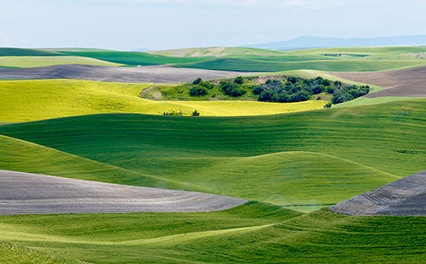

Slide 14
James 5 ⁸ You too, be patient and stand firm, because the Lord’s coming is near. ⁹ Don’t grumble against one another, brothers and sisters, or you will be judged. The Judge is standing at the door!

Slide 15
James 5 ¹⁰ Brothers and sisters, as an example of patience in the face of suffering, take the prophets who spoke in the name of the Lord. ¹¹ As you know, we count as blessed those who have persevered. You have heard of Job’s perseverance and have seen what the Lord finally brought about. The Lord is full of compassion and mercy.

Slide 16
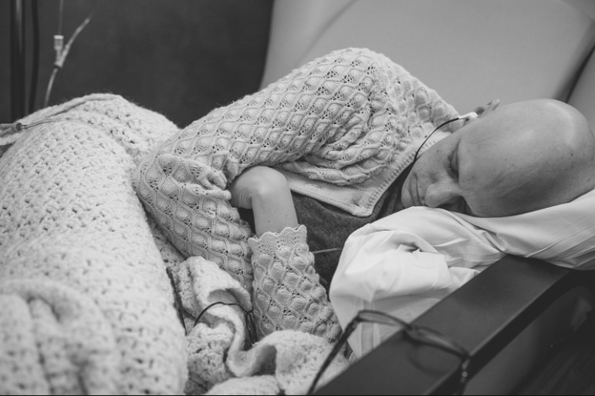
Embracing godly patience often involves suffering.

Slide 17
Growing in godly patience requires PERSEVERANCE.
¹¹ As you know, we count as blessed those who have persevered. You have heard of Job’s perseverance and have seen what the Lord finally brought about.

Slide 18
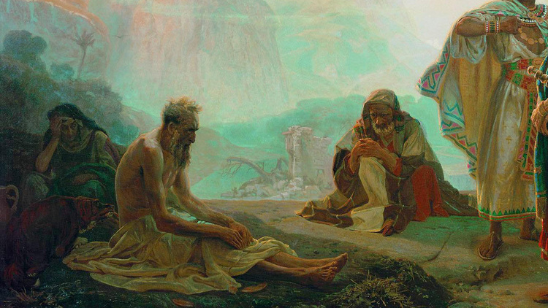

Slide 19
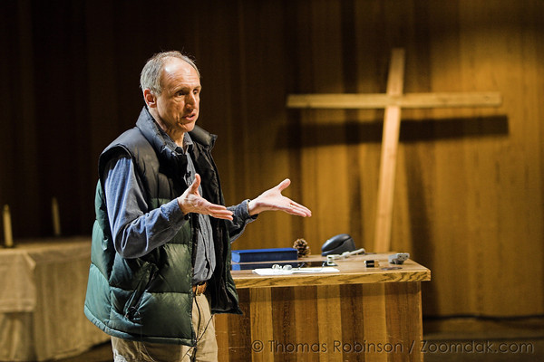

Slide 20
JAMES 5:10
Brothers and sisters, as an example of patience in the face of suffering, take the prophets who spoke in the name of the Lord.
#3. Maintaining godly patience involves godly examples.

Slide 21
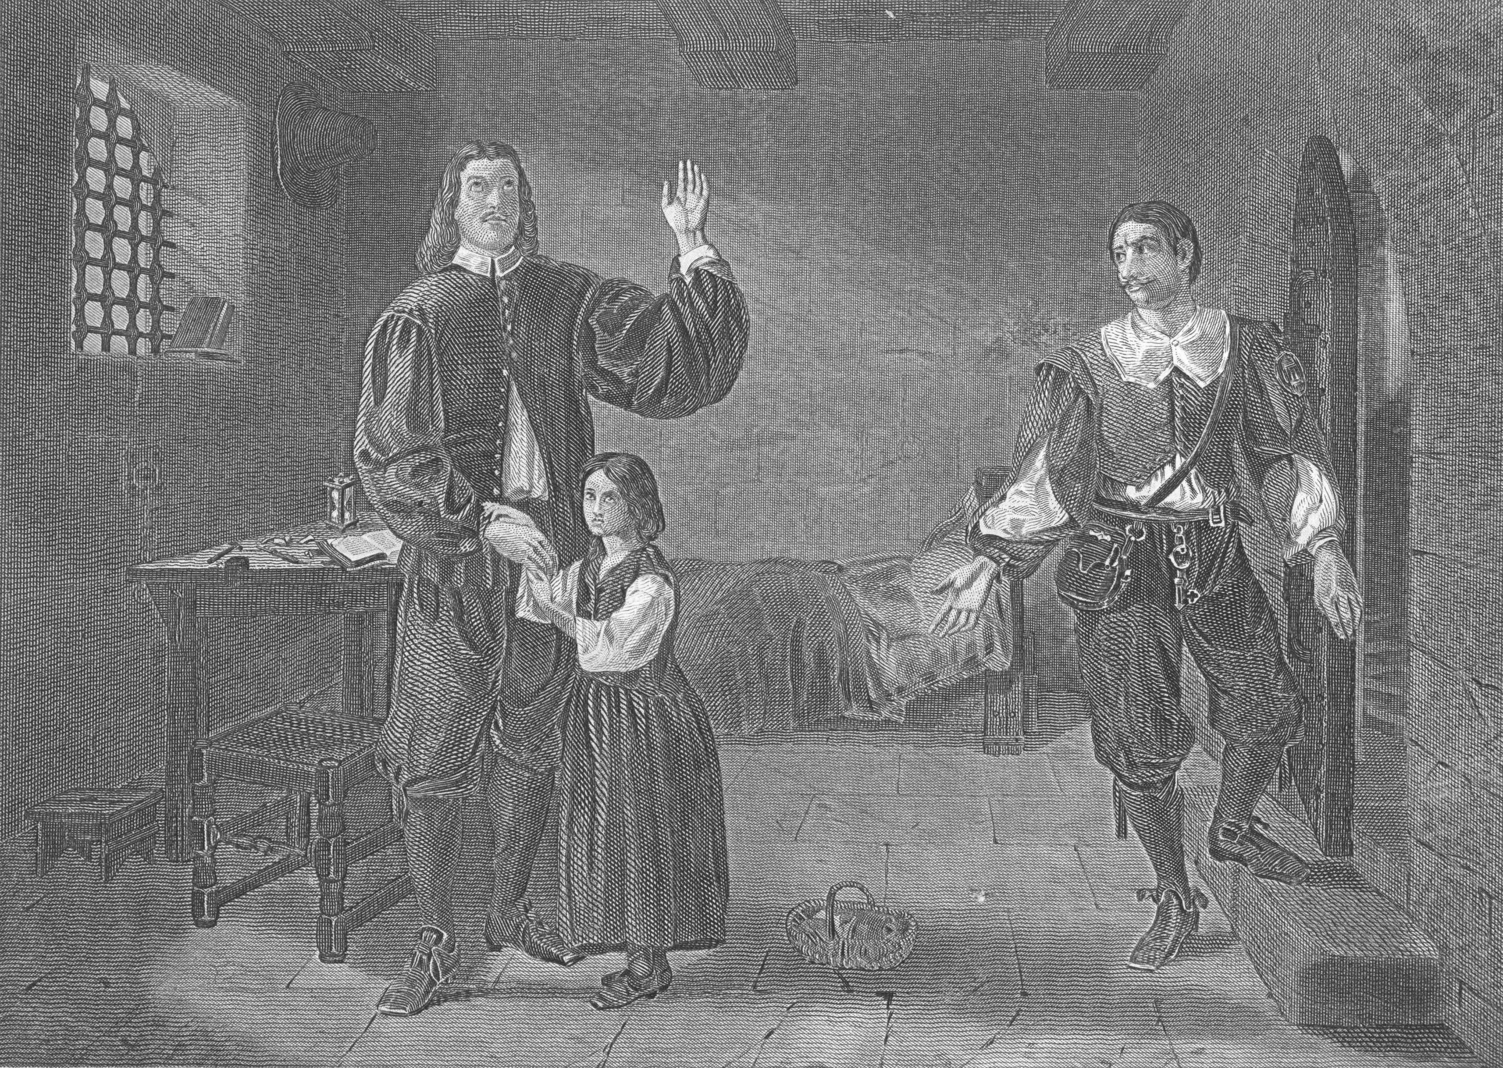
John Bunyan
1628-1688

Slide 22
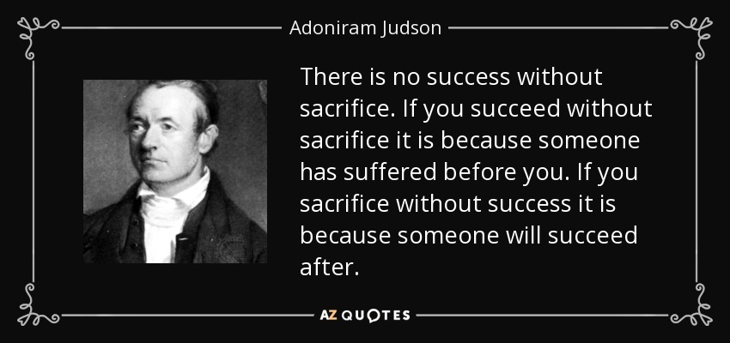

Slide 23
What in your life
is calling for perseverance
in your faith?

