Slide 2
DEPTMENT of IMAGINATION

Slide 3
James 5
Now listen, you rich people, weep and wail because of the misery that is coming on you. ² Your wealth has rotted, and moths have eaten your clothes. ³ Your gold and silver are corroded. Their corrosion will testify against you and eat your flesh like fire. You have hoarded wealth in the last days.

Slide 4
James 5
⁴ Look! The wages you failed to pay the workers who mowed your fields are crying out against you. The cries of the harvesters have reached the ears of the Lord Almighty. ⁵ You have lived on earth in luxury and self-indulgence. You have fattened yourselves in the day of slaughter. ⁶

Slide 5
James 5
⁶ You have condemned and murdered the innocent one, who was not opposing you.

Slide 6
$5,000 per year
(Top 30%)

Slide 7
$11,000 per year
(top 20%)

Slide 8
$20,000 per year
(Top 10%)

Slide 9
James 5
Now listen, you rich people, weep and wail because of the misery that is coming on you. ² Your wealth has rotted, and moths have eaten your clothes. ³ Your gold and silver are corroded. Their corrosion will testify against you and eat your flesh like fire. You have hoarded wealth in the last days.

Slide 10
James 5
⁴ Look! The wages you failed to pay the workers who mowed your fields are crying out against you. The cries of the harvesters have reached the ears of the Lord Almighty. ⁵ You have lived on earth in luxury and self-indulgence. You have fattened yourselves in the day of slaughter. ⁶ You have condemned and murdered the innocent one, who was not opposing you.

Slide 11
#1.) Wealth wrongly handled leads to sorrow unnecessarily stockpiled.
Vs. 1—Now listen, you rich people, weep and wail because of the misery that is coming on you.

Slide 12
² Your wealth has rotted, and moths have eaten your clothes. ³ Your gold and silver are corroded.

Slide 13
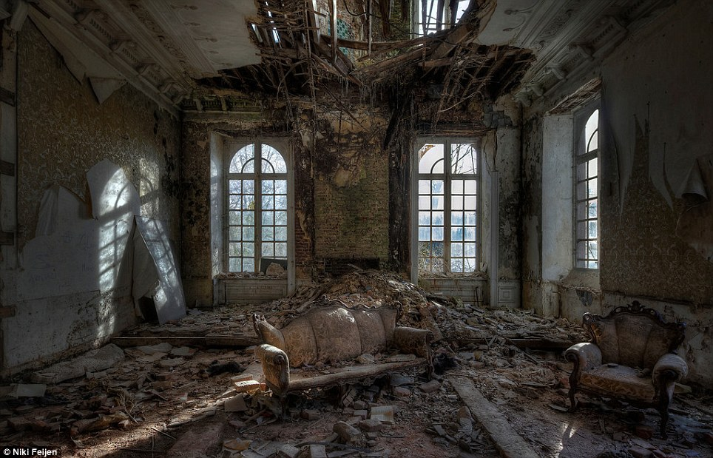
#2. Earthly wealth is always temporary and fading.

Slide 14
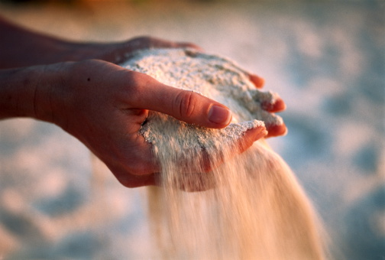

Slide 15
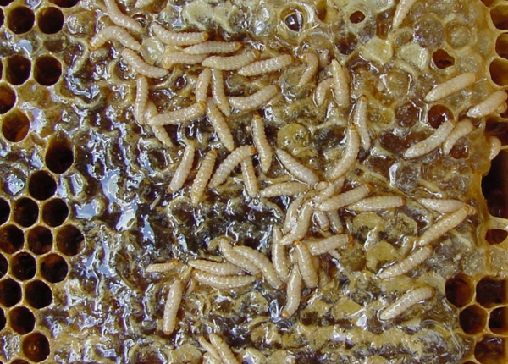
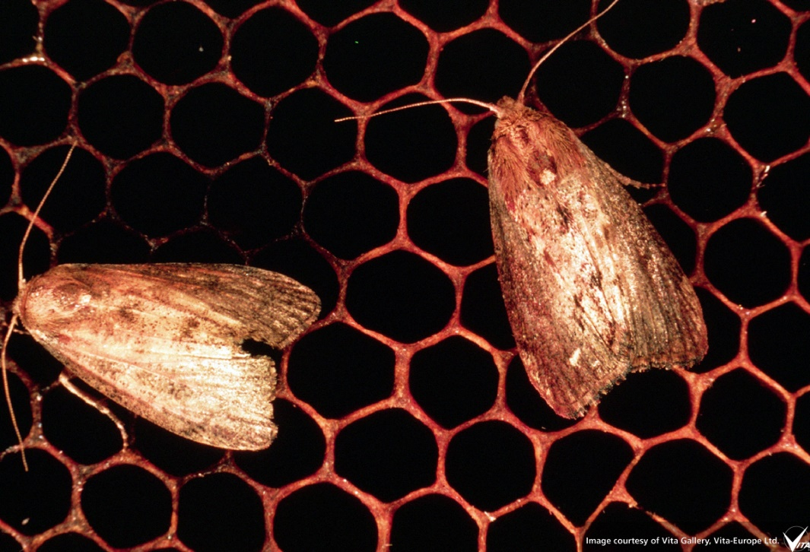

Slide 18
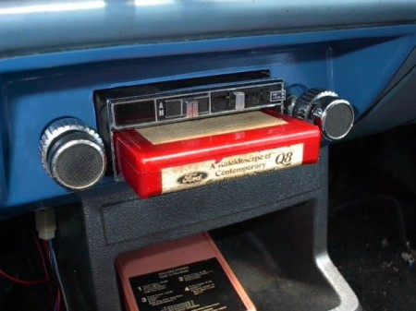
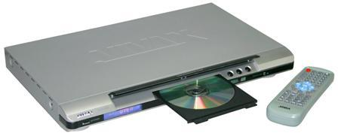

Slide 19
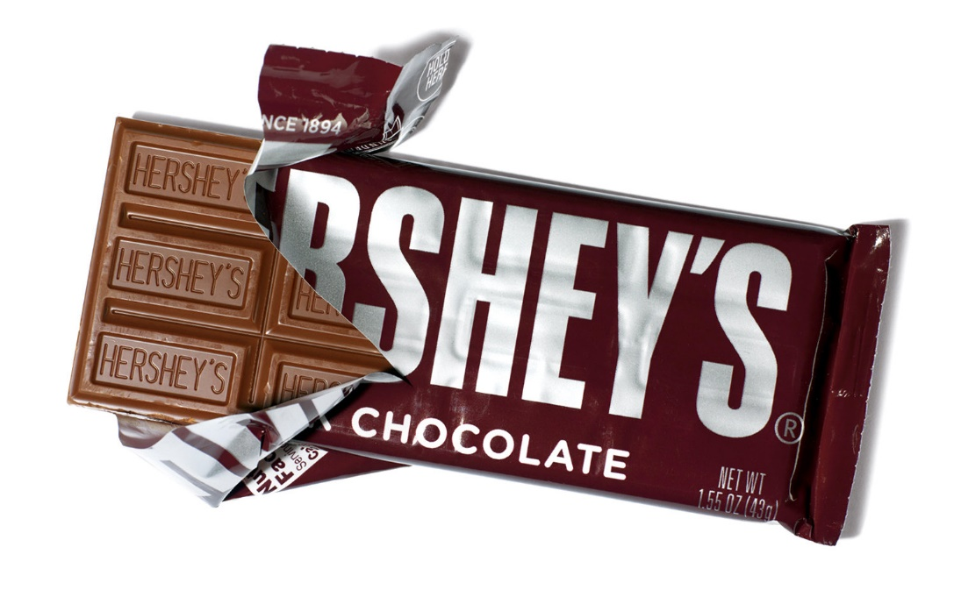
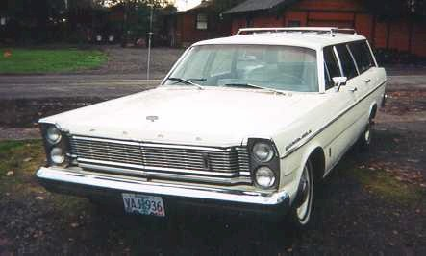
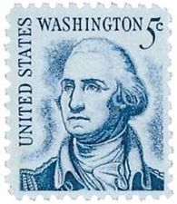
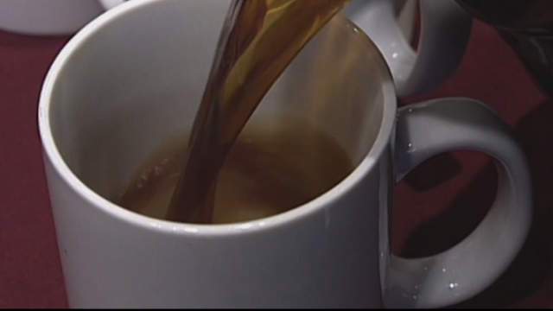
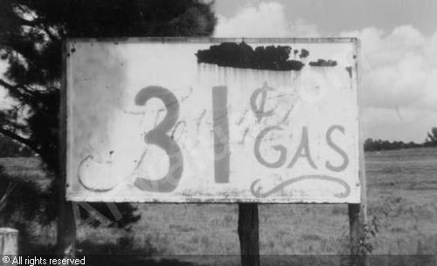

Slide 21
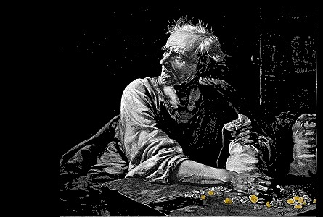
#3. Hoarded wealth brings judgment…
Shared wealth brings blessings.

Slide 22
James 5 You have hoarded wealth in the last days.⁴ Look! The wages you failed to pay the workers who mowed your fields are crying out against you. The cries of the harvesters have reached the ears of the Lord Almighty.

Slide 23
#3. Hoarded wealth brings judgment…
Shared wealth brings blessings.

Slide 24
What determines when hanging onto something has become hoarding?

Slide 25
James 5 ⁴ Look! The wages you failed to pay the workers who mowed your fields are crying out against you. The cries of the harvesters have reached the ears of the Lord Almighty.

Slide 26
James 5:5 You have lived on earth in luxury and self-indulgence. You have fattened yourselves in the day of slaughter.

Slide 27
1.) God does not see wealth as usually beneficial for developing the heart and life of Christ in his children. 2.) God does not want His children spending their God-given days and years chasing wealth as the world does. 3.) Coveting wealth or envying those with wealth is NOT God’s desire for His children.

Slide 28
What regular practices will help us guard against SELF-INDULGENCE?
What regular practices will help us guard against living in LUXURY?

