Slide 1
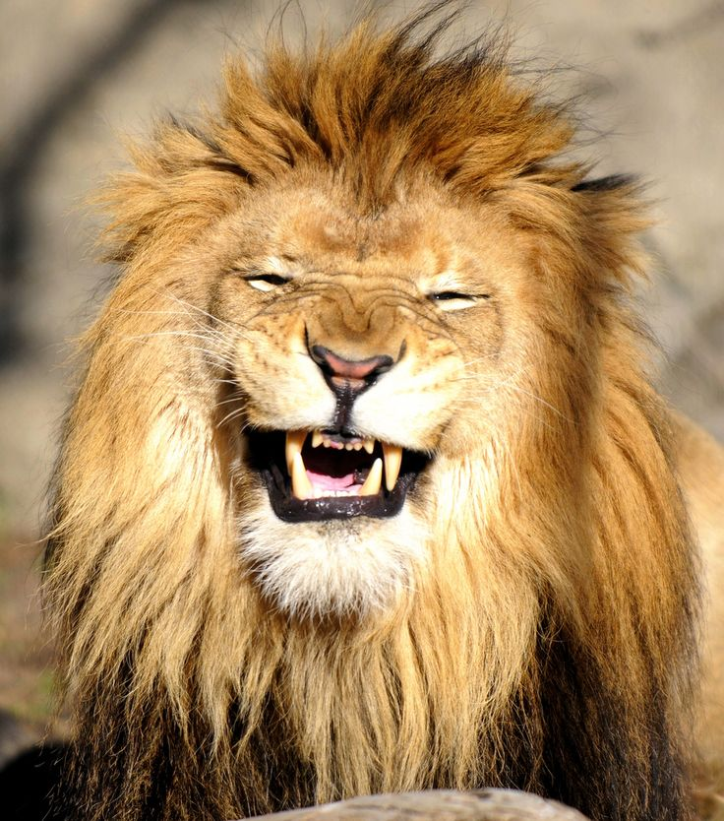
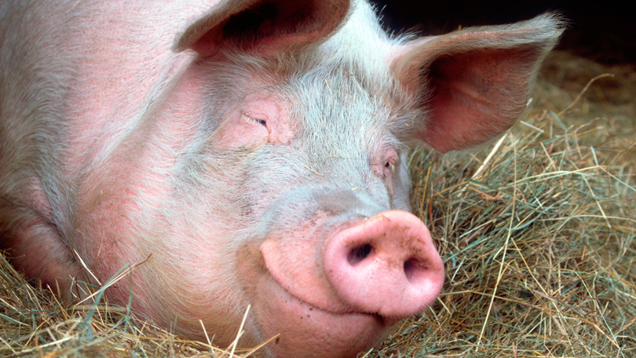
Secrets of Contentment Philippians 4:10-23 July 14, 2019

Slide 2
#1. What is the opposite of contentment when it comes to emotions?
#2. How would you define contentment?
#3. In your life right now, what are the immediate/presenting circumstances that threaten to rob you of contentment?

Slide 3
Philippians 4:10-13
I rejoiced greatly in the Lord that at last you renewed your concern for me. Indeed, you were concerned, but you had no opportunity to show it. ¹¹ I am not saying this because I am in need, for I have learned to be content whatever the circumstances.

Slide 4
Philippians 4:10-13
¹² I know what it is to be in need, and I know what it is to have plenty. I have learned the secret of being content in any and every situation, whether well fed or hungry, whether living in plenty or in want. ¹³ I can do all this through him who gives me strength.

Slide 5
Philippians 4:4
Rejoice in the Lord always.
I will say it again: Rejoice!

Slide 6
Philippians 4:10-13
I rejoiced greatly in the Lord that at last you renewed your concern for me. Indeed, you were concerned, but you had no opportunity to show it. ¹¹ I am not saying this because I am in need, for I have learned to be content whatever the circumstances.

Slide 7
Circumstances can change us and life, but they can never change the Lord.

Slide 8
Contentment will require
that I learn to frame all of life
“in the Lord.”

Slide 9
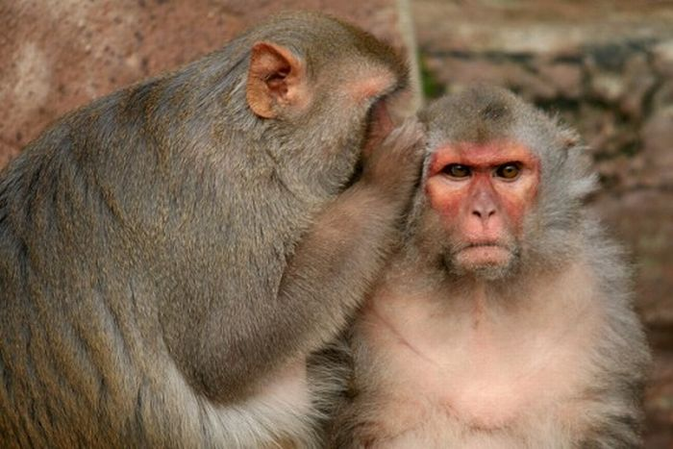
SECRET #1
As Christ-followers, our contentment will come when our hearts are fixed on growing up in the Lord Jesus in every experience of life.

Slide 10
A Difficult Corolary to this truth:
Discontentment with life will ultimately lead to discontentment with God.

Slide 11
Apply this “secret”:
Stop and think about one of the things threatening your contentment in life right now.
What about God is unchanged despite that threat? What realities about God can you rejoice in despite that threat?

Slide 12
Philippians 4:10-11a
I rejoiced greatly in the Lord that at last you renewed your concern for me.
Indeed, you were concerned, but you had no opportunity to show it. ¹¹ I am not saying this because I am in need….

Slide 13
Philippians 4:18
I have received full payment and have more than enough. I am amply supplied, now that I have received from Epaphroditus the gifts you sent.

Slide 14
Philippians 4:10, 18
I rejoiced greatly in the Lord that at last you renewed your concern for me.
Indeed, you were concerned, but you had no opportunity to show it.
¹⁸ Not that I desire your gifts; what I desire is that more be credited to your account.

Slide 15
Philippians 4:10, 18
I rejoiced greatly in the Lord that at last you renewed your concern for me.
Indeed, you were concerned, but you had no opportunity to show it.
¹⁸ Not that I desire your gifts; what I desire is that more be credited to your account.

Slide 16
Philippians 4:10, 18
¹⁰ I rejoiced greatly in the Lord that at last you renewed your concern for me.
Indeed, you were concerned, but you had no opportunity to show it…
¹⁸ Not that I desire your gifts; what I desire is that more be credited to your account.

Slide 18
Philippians 4:10 & 18 show that Paul was not as interested in the gift as he was in the GROWTH of the Philippians.

Slide 19
Secret #2: A contentment-filled Christian is one who is an AFFIRMING Christian.

Slide 20
Philippians 4:10-13
¹¹ I am not saying this because I am in need, for I have learned to be content
whatever the circumstances. ¹² I know what it is to be in need, and I know what it is to have plenty. I have learned the secret of being content in any and every situation, whether well fed or hungry,
whether living in plenty or in want.

Slide 21
Secret #3:
Contentment-filled Christ-followers understand that contentment is something LEARNED.

Slide 24
What NEEDS do we often find ourselves discontent in?
What ABUNDANCE do we often find ourselves discontent in?

Slide 25
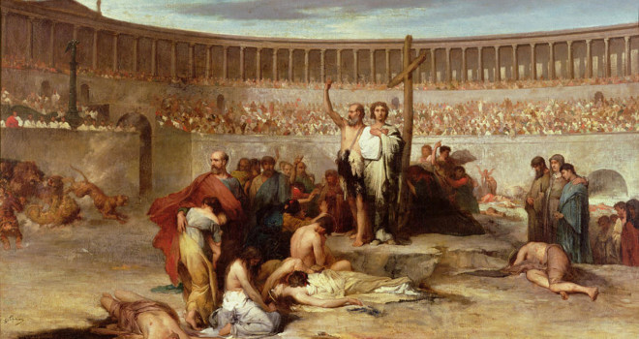

Slide 27
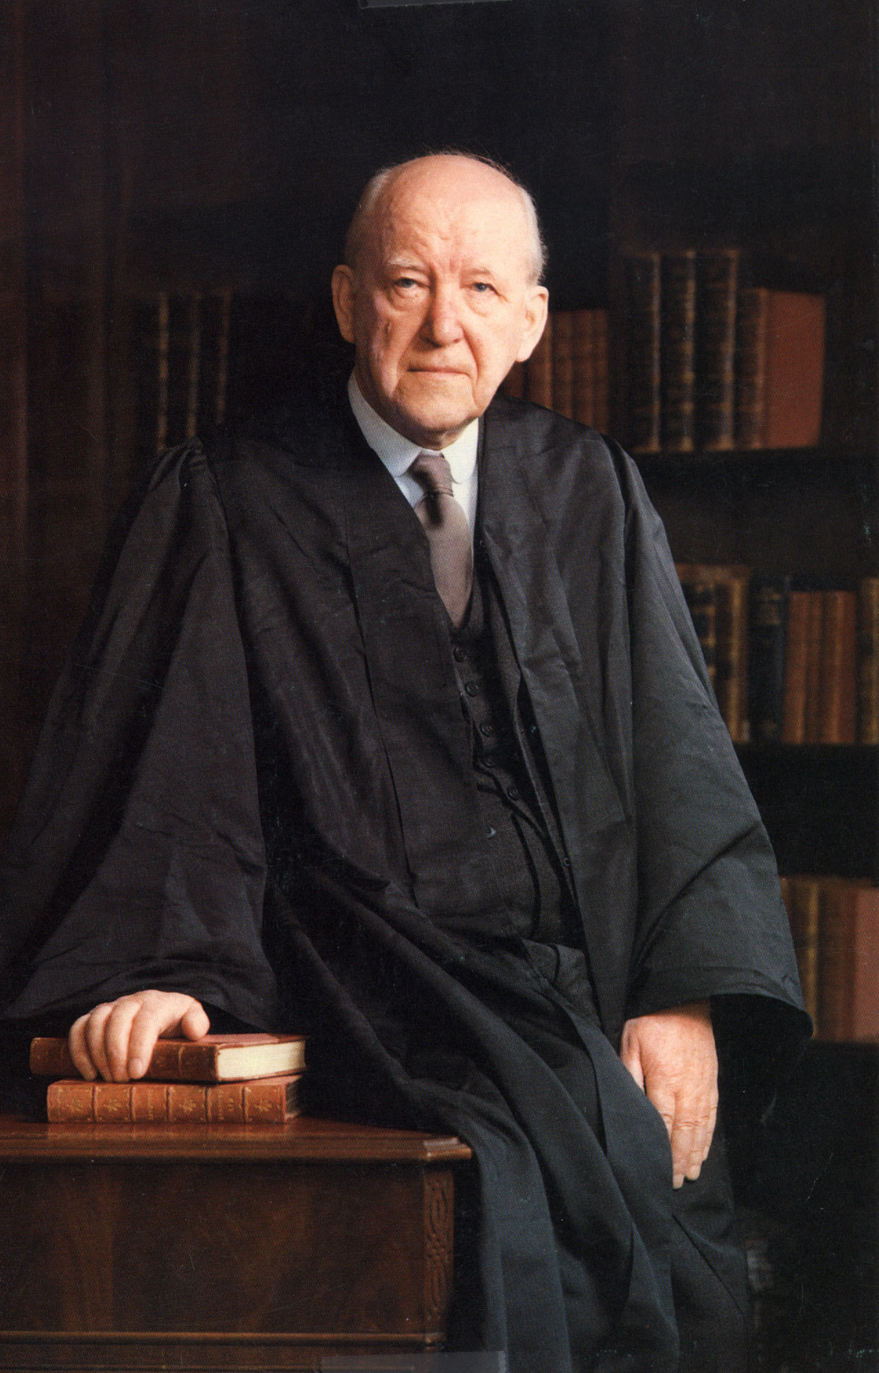
Martyn Lloyd-Jones
1899-1981

Slide 28
“Contentment is realizing that God has already provided everything we need for our present happiness.”

Slide 30
Philippians 4:13
I can do all this through him who gives me strength.

