Slide 2
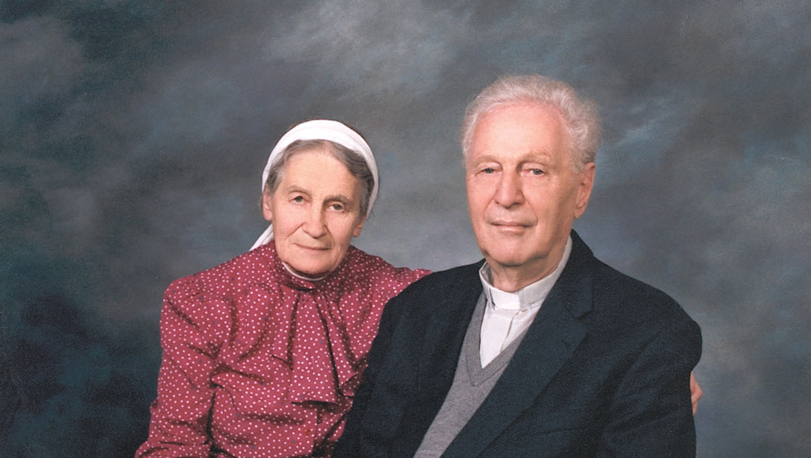
Richard & Sabina Wurmbrand

Slide 3
Colossians 4:2-4 Devote yourselves to prayer, being watchful and thankful. ³ And pray for us, too, that God may open a door for our message, so that we may proclaim the mystery of Christ, for which I am in chains. ⁴ Pray that I may proclaim it clearly, as I should.

Slide 4
HOW are we to pray?
1.) PERSISTENTLY
Colossians 4:3, 4--“And pray for us, too, that God may open a door for our message, so that we may proclaim the mystery of Christ, for which I am in chains. ⁴ Pray that I may proclaim it clearly, as I should.”

Slide 5
HOW we are to pray
1.) PERSISTENTLY
Acts 1:14--“These all with one mind were continually devoting themselves to prayer….”

Slide 6
HOW we are to pray
1.) PERSISTENTLY
Acts 2:42-- “They were continually devoting themselves to the apostles’ teaching and to fellowship, to the breaking of bread and to prayer.”

Slide 7
HOW we are to pray
1.) PERSISTENTLY
Acts 6:4— “But we will devote ourselves to prayer and to the ministry of the word.”

Slide 8
HOW we are to pray
1.) PERSISTENTLY
Romans 12:12--“…rejoicing in hope, persevering in tribulation, [and] devoted to prayer.”

Slide 9
HOW we are to pray
1.) PERSISTENTLY
Ephesians 6:18, Paul commands us to pray “with all perseverance and petition for all the saints.”
Colossians 1:3--“praying always for you.”

Slide 10
HOW we are to pray
1.) PERSISTENTLY
Colossians 1:9— “For this reason also, since the day we heard of it, we have not ceased to pray for you and to ask that you may be filled with the knowledge of His will in all spiritual wisdom and understanding.”

Slide 11
HOW we are to pray
1.) PERSISTENTLY
Colossians 4:12—Epaphras was “always laboring earnestly for you in his prayers.”

Slide 12
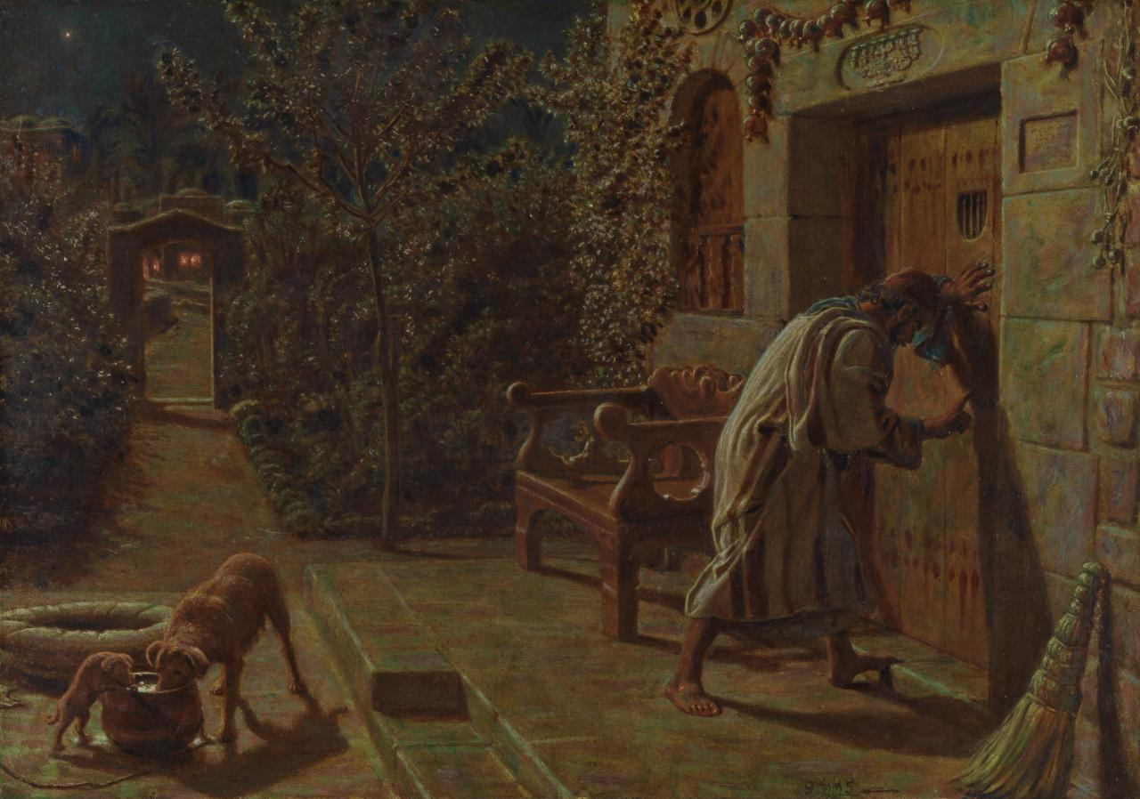
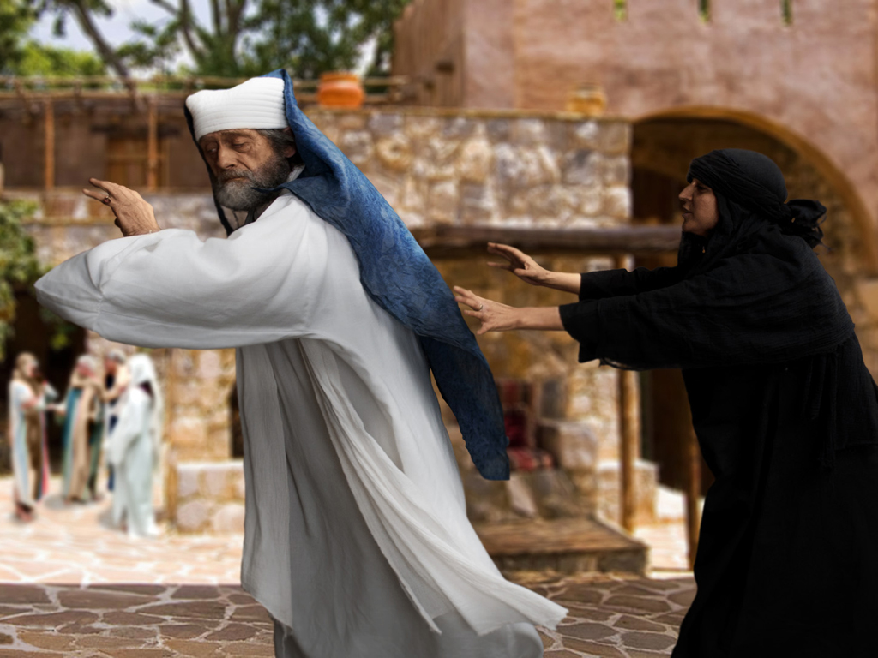
Luke 11
Luke 18

Slide 13
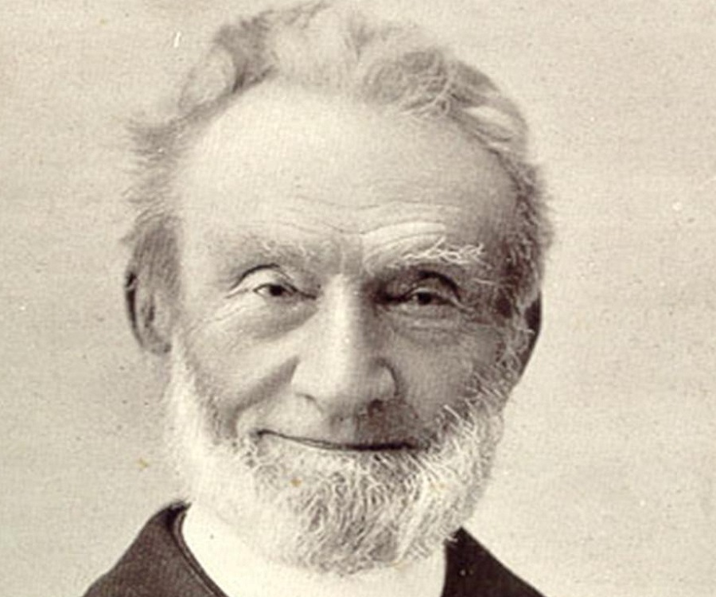
George Muller

Slide 14
HOW we are to pray
2.) WATCHFULLY… “being watchful”
1 Peter 5:8--“Be of sober spirit, be on the alert. Your adversary, the devil, prowls around like a roaring lion, seeking someone to devour.”

Slide 15
HOW we are to pray
2.) WATCHFULLY… “being watchful”
Matthew 26:41--“Keep watching and praying that you may not enter into temptation; the spirit is willing, but the flesh is weak.”

Slide 16
HOW we are to pray
3.) THANKFULLY… “being…thankful”

Slide 17
WHO we are to pray for?
1.) The Persecuted Church believers
Colossians 4:3,4—And pray for us, too, that God may open a door for our message, so that we may proclaim the mystery of Christ, for which I am in chains. ⁴ Pray that I may proclaim it clearly, as I should.

Slide 18
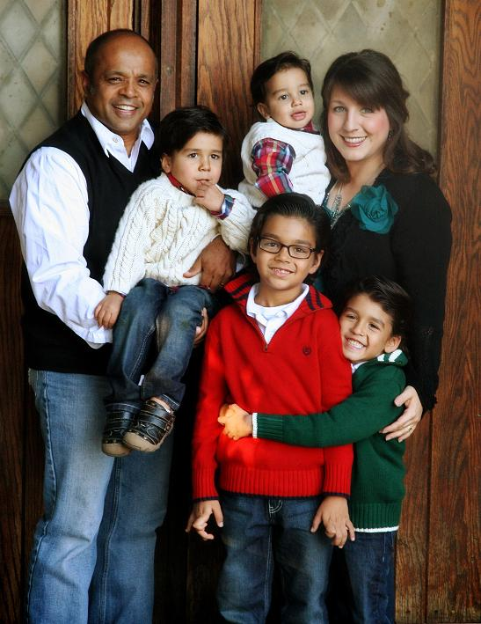

Slide 19
INIM, PO Box 2603, Forest, VA 24551

Slide 20
WHAT to Pray for When Praying for Persecuted Christians
Pray for those in the midst of persecution, (Hebrews 13:3).
Pray for those who are doing the persecuting (Matthew 5:44).
Pray for the families and loved ones of those being persecuted (Heb. 4:16).

Slide 21
WHAT to Pray for When Praying for Persecuted Christians
4. Pray that we/churches would rise up with help and support, (Acts 4:23-35).
5. Pray that world leaders would do all they can to fight this persecution (Psalm 2:10-11).

Slide 22
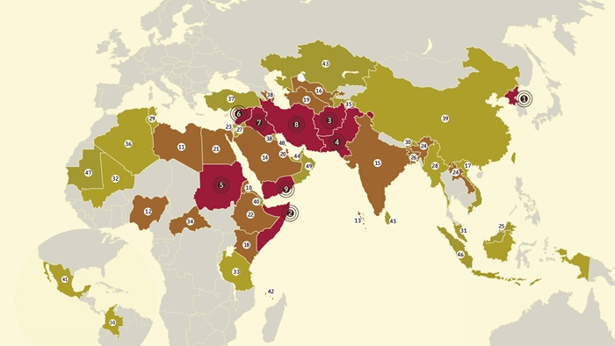

Slide 23
See “How To Pray for the Persecuted Church” handout.
Go to www.persecuted.com to support families of persecuted Christians.

