Slide 1
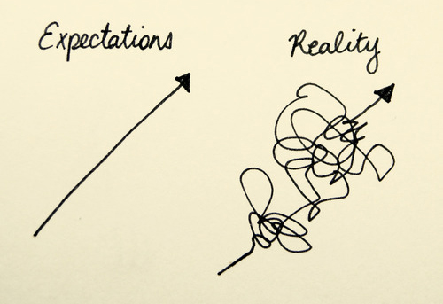

Slide 2
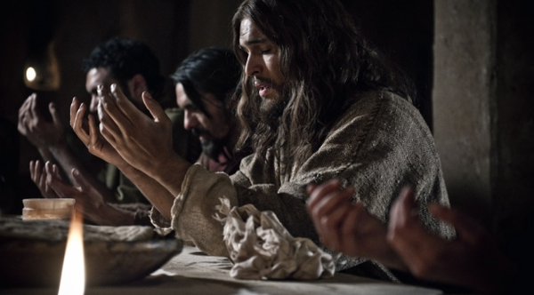
John 17:13-26

Slide 3
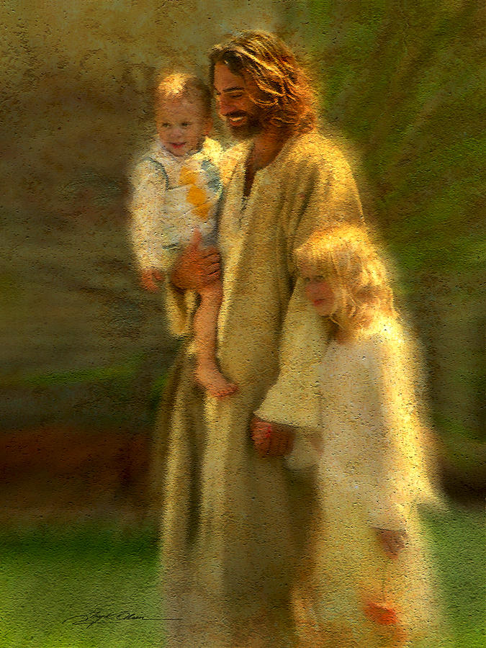
What expectations do you have about JOY in your journey with Jesus in this life?

Slide 4
John 17:13 “I am coming to you now, but I say these things while I am still in the world, so that they may have the full measure of my joy within them.”

Slide 5
John 15:11 “I have told you this so that my joy may be in you and that your joy may be complete.”

Slide 6
Luke 10:21 At that time Jesus, full of joy through the Holy Spirit, said, “I praise you, Father, Lord of heaven and earth, because you have hidden these things from the wise and learned, and revealed them to little children.”

Slide 7
John 17:14 I have given them your word and the world has hated them, for they are not of the world any more than I am of the world.

Slide 8
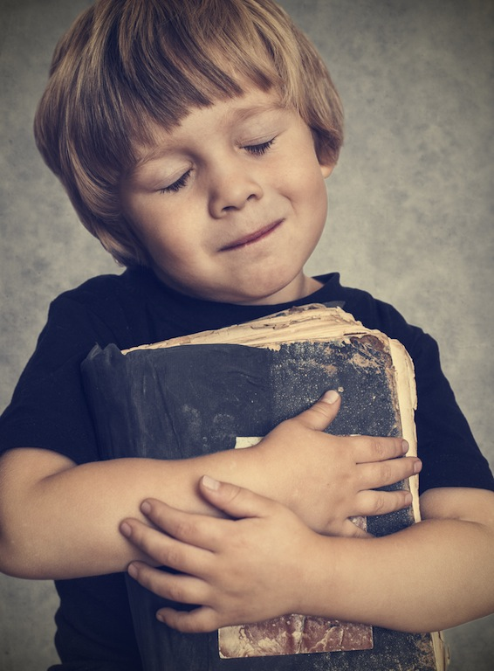
Joy in the journey comes from embracing and living
God’s truth, His Word.

Slide 9
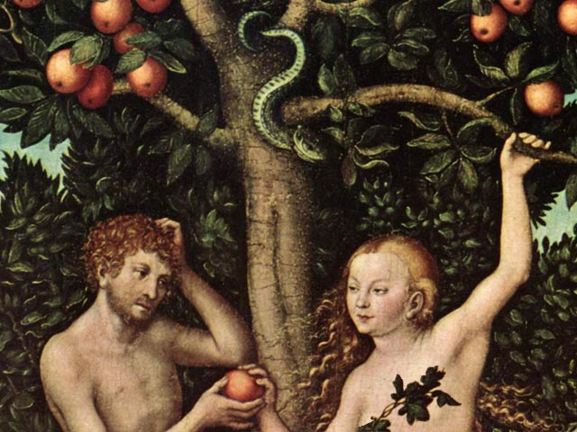
WORK
FREEDOM
FAMILY
HIGHER STANDARD OF LIVING
PROPERTY
LEISURE
FRIENDS
LAZINESS
ENTERTAINMENT

Slide 10
Vs. 6—“I have revealed you to those whom you gave me out of the world. They were yours; you gave them to me….”

Slide 11
When we embrace the Word, we will have to let go of the world. John 17:14 I have given them your word and the world has hated them, for they are not of the world any more than I am of the world.

Slide 12
When we embrace the Word, we will have to let go of the world. John 17:15 “My prayer is not that you take them out of the world but that you protect them from the evil one.”

Slide 13
Luke 6:22, 23 Blessed are you when people hate you, when they exclude you and insult you and reject your name as evil, because of the Son of Man. ²³ “Rejoice in that day and leap for joy, because great is your reward in heaven. For that is how their ancestors treated the prophets.

Slide 14
Acts 13:49-52 The word of the Lord spread through the whole region. ⁵⁰ But the Jewish leaders incited the God-fearing women of high standing and the leading men of the city. They stirred up persecution against Paul and Barnabas, and expelled them from their region. ⁵¹ So they shook the dust off their feet as a warning to them and went to Iconium. ⁵² And the disciples were filled with joy and with the Holy Spirit.

Slide 15
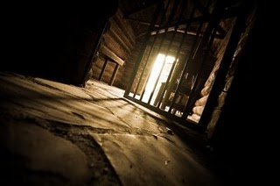
Acts 16 ²⁵ About midnight Paul and Silas were praying and singing hymns to God, and the other prisoners were listening to them.

Slide 16
1 Thessalonians 1:6 “You became imitators of us and of the Lord, for you welcomed the message in the midst of severe suffering with the joy given by the Holy Spirit.”

Slide 17
John 17 ¹⁶ They are not of the world, even as I am not of it. ¹⁷ Sanctify them by the truth; your word is truth.

Slide 18
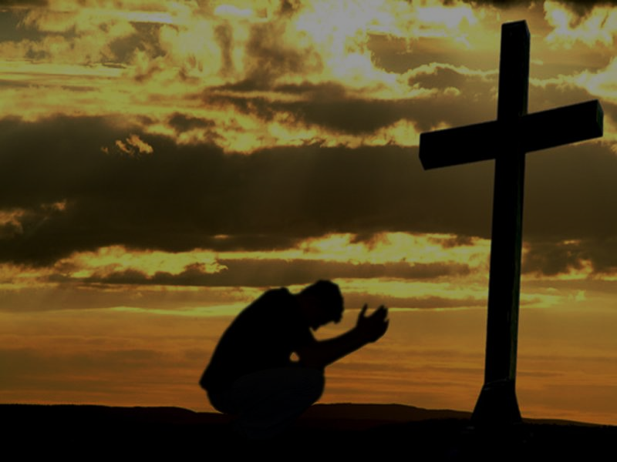
GLORY John 17:22 I have given them the glory that you gave me, that they may be one as we are one.
Just what is the “glory” that Jesus gave to his disciples?
Just how does the oneness Jesus prayed for become reality through that glory?

Slide 19
John 1:14 “The Word became flesh and made his dwelling among us. We have seen his glory, the glory of the one and only Son, who came from the Father, full of grace and truth.”

Slide 20
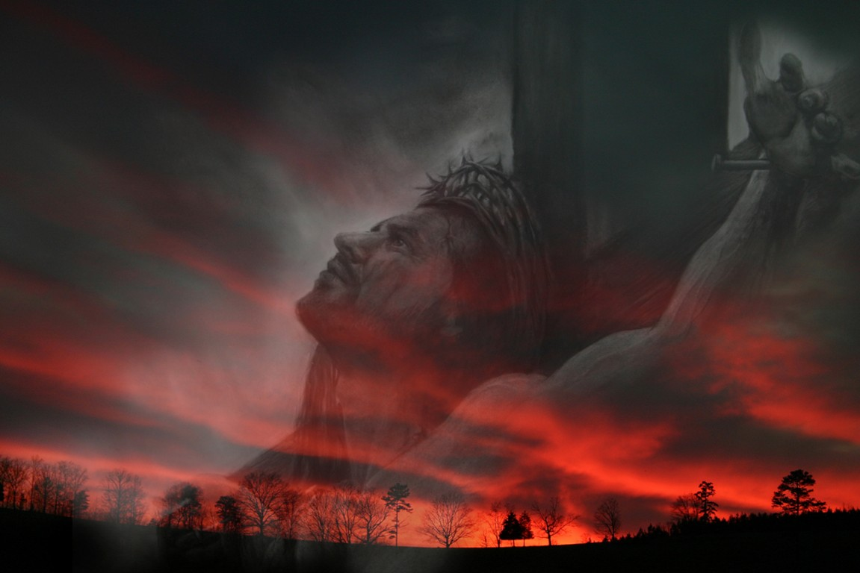
THE GLORY OF THE CROSS…

Slide 21
2 Corinthians 4 ⁶ For God, who said, “Let light shine out of darkness,” made his light shine in our hearts to give us the light of the knowledge of God’s glory displayed in the face of Christ. ⁷ But we have this treasure in jars of clay to show that this all-surpassing power is from God and not from us. ⁸ We are hard pressed on every side, but not crushed; perplexed, but not in despair; ⁹ persecuted, but not abandoned; struck down, but not destroyed.

Slide 22
2 Corinthians 4 ¹⁰ We always carry around in our body the death of Jesus, so that the life of Jesus may also be revealed in our body. ¹¹ For we who are alive are always being given over to death for Jesus’ sake, so that his life may also be revealed in our mortal body.

Slide 24
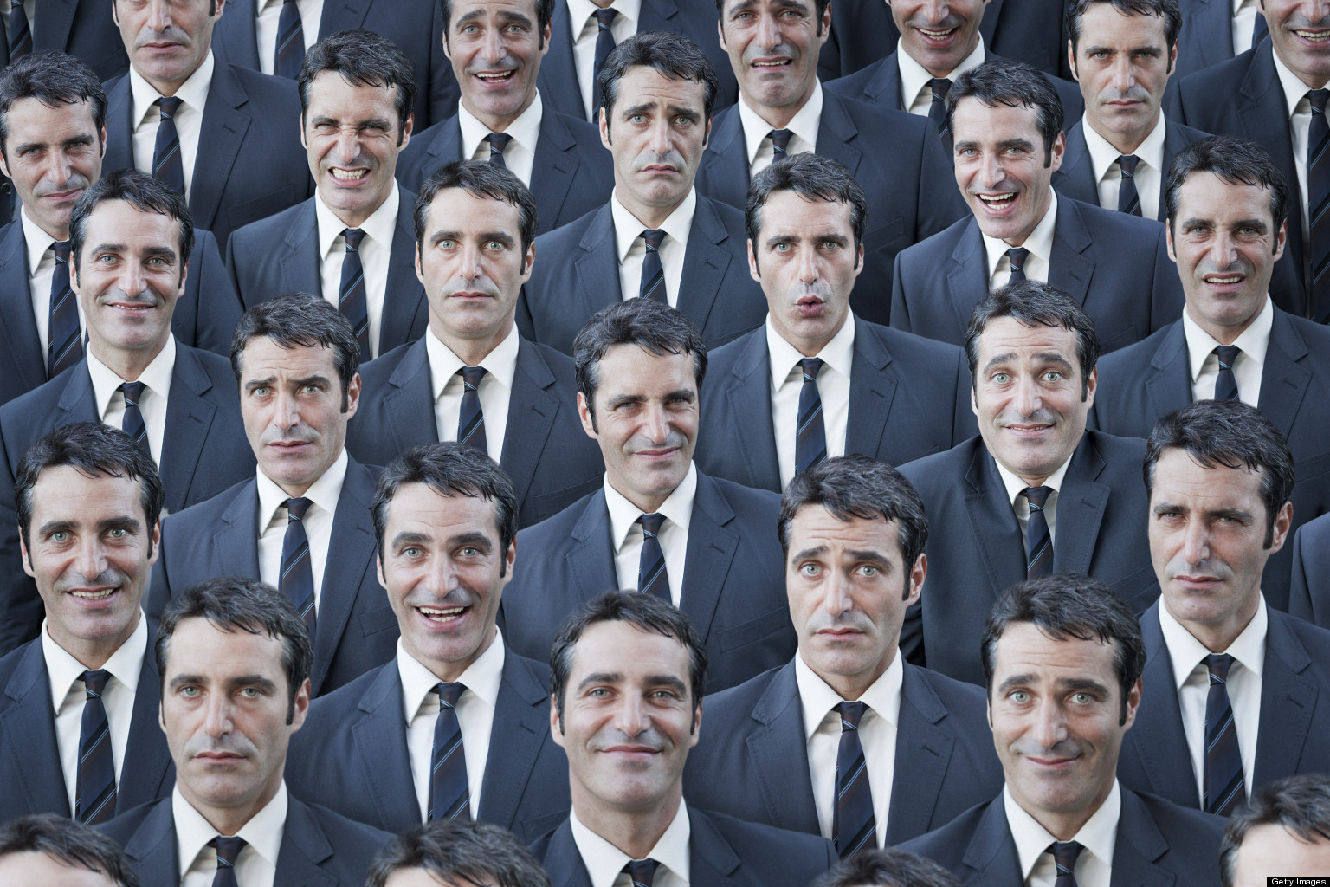
UNITY???

Slide 25
John 17:23, 26 ²³ I in them and you in me—so that they may be brought to complete unity. Then the world will know that you sent me and have loved them even as you have loved me. ²⁶ I have made you known to them, and will continue to make you known in order that the love you have for me may be in them and that I myself may be in them.”

Slide 26
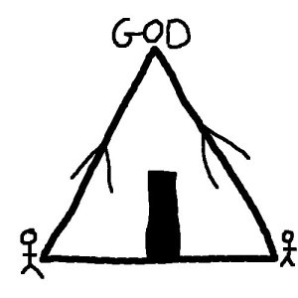

Slide 27
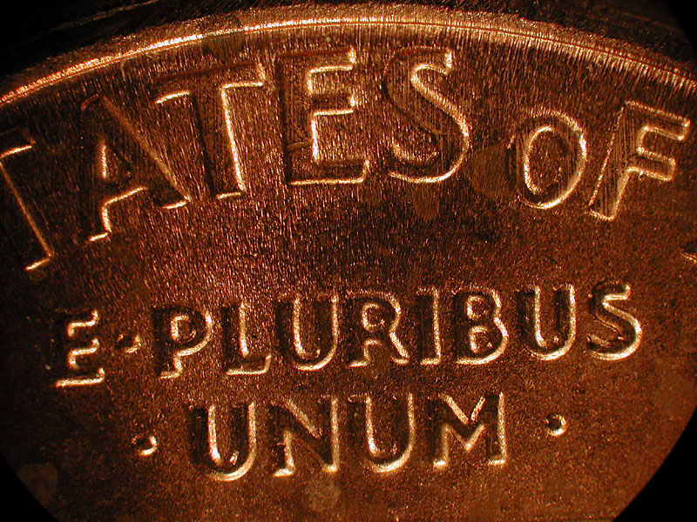

Slide 28
