Slide 1
Of all the different roles you’ve had in life (sibling, parent, student, employee, etc.), what are 1 or 2 that have been your favorites…and why?

Slide 2
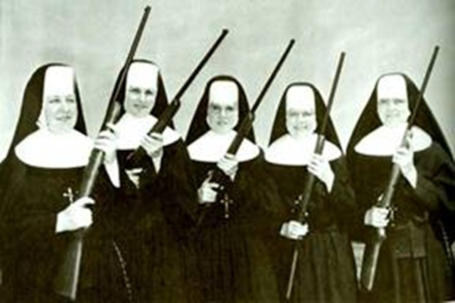
ROMANS 3:25-31
Competing Character

Slide 3
ROMANS 3
²¹ But now the righteousness of God has been manifested apart from the law, although the Law and the Prophets bear witness to it— ²² the righteousness of God through faith in Jesus Christ for all who believe. For there is no distinction:
²³ for all have sinned and fall short of the glory of God,

Slide 4
ROMANS 3
²⁴ and are justified by his grace as a gift, through the redemption that is in Christ Jesus, ²⁵ whom God put forward as a propitiation by his blood, to be received by faith. This was to show God's righteousness, because in his divine forbearance he had passed over former sins. ²⁶ It was to show his righteousness at the present time, so that he might be just and the justifier of the one who has faith in Jesus.

Slide 5
Quality/Role Potential Competition
Righteous (“became sin for us”
2 Cor. 5:21)
Glory (Sin-bearer)
Just Justifier
Grace-filled (holy)
Gives freely (“gift”) (Sanctifier)
Redeemer (Just Judge)
Forbearance (Judge/holy anger)

Slide 6
QUALITIES OF GOD
FROM ROMANS 3:21-23
Righteous/righteousness: perfect outworking/living out of moral perfection.
Glory: unfiltered splendor of God’s holiness
Justified: God’s declaration of His righteousness to our account
Grace: God’s undeserved positive good blessing to us

Slide 7
QUALITIES OF GOD
FROM ROMANS 3:21-23
Gift: blessing that cannot be earned by the receiver.
Redemption: RANSOME—“deliverance at a cost” or “release by payment” of a price, i.e. the life of Jesus Christ.

Slide 8
QUALITIES OF GOD
FROM ROMANS 3:25
“…Christ Jesus, ²⁵ whom God put forward as a propitiation by his blood….” (ESV)
“God presented Christ as a sacrifice of atonement, through the shedding of his blood—to be received by faith.” (NIV)

Slide 9
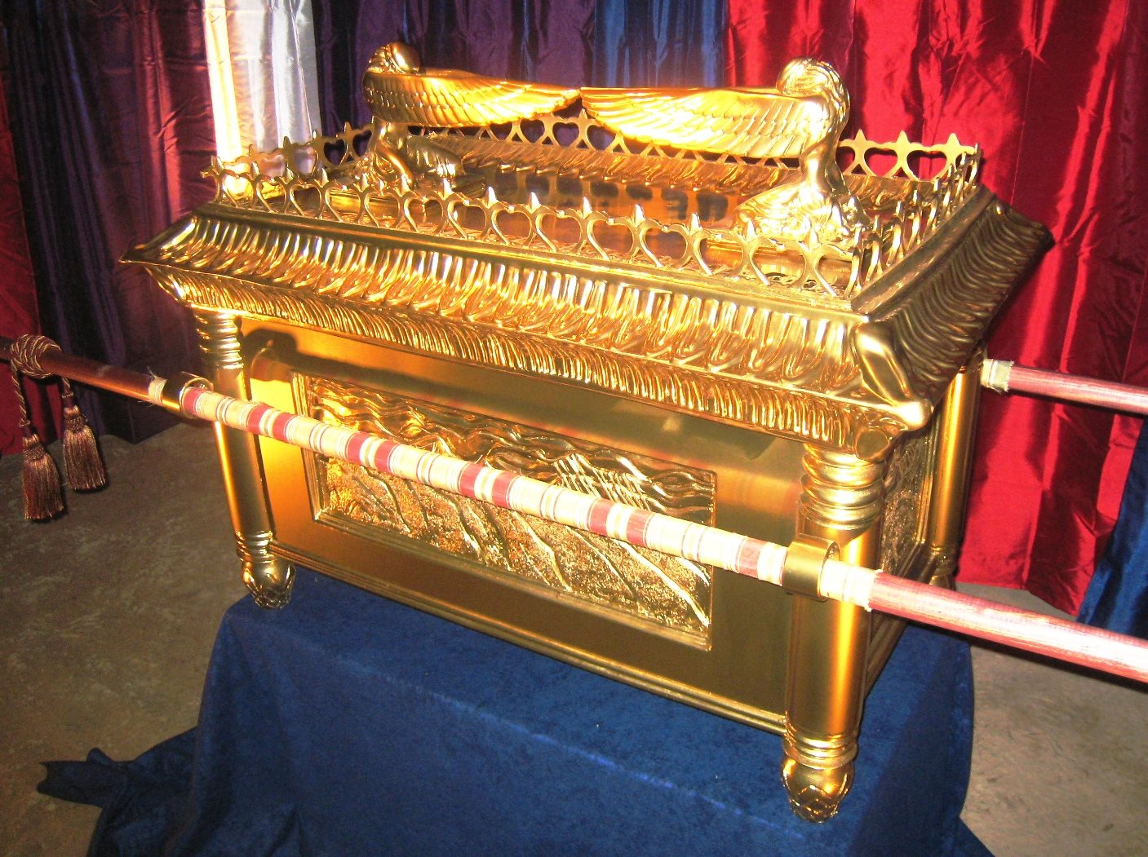

Slide 10
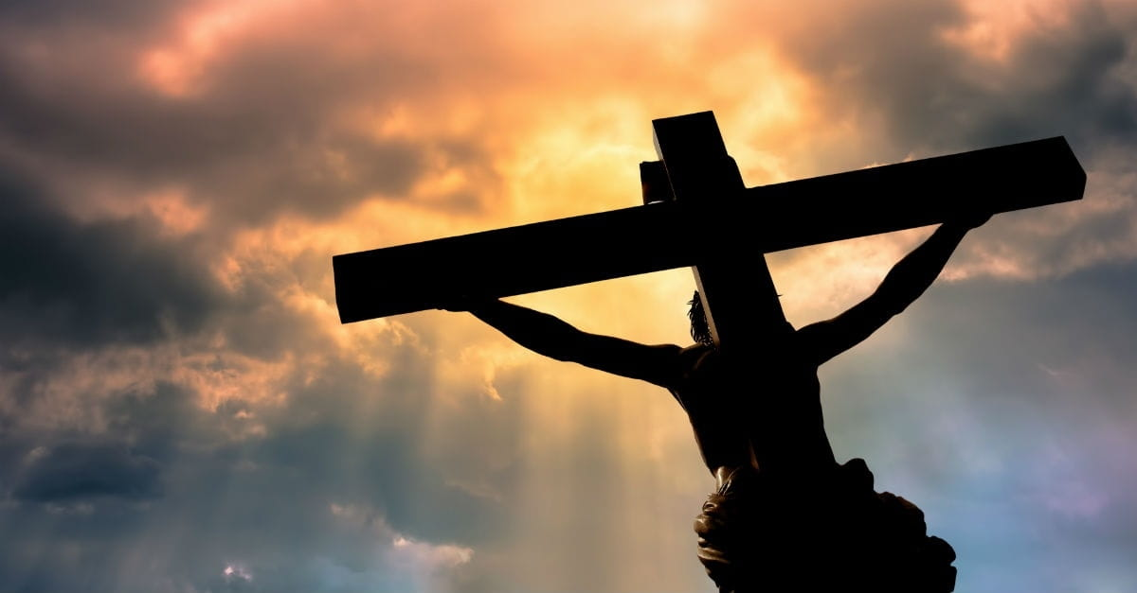

Slide 11
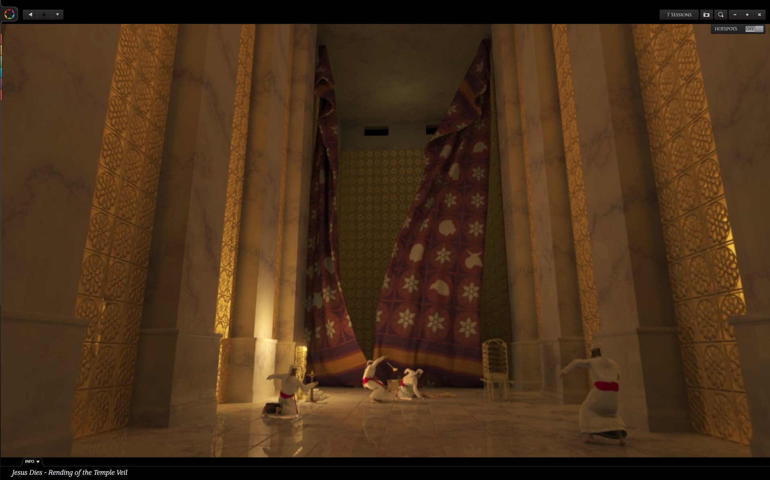

Slide 12
QUALITIES OF GOD
FROM ROMANS 3:25
Propitiation/atonement = a satisfying of God’s wrath towards our sin.

Slide 13
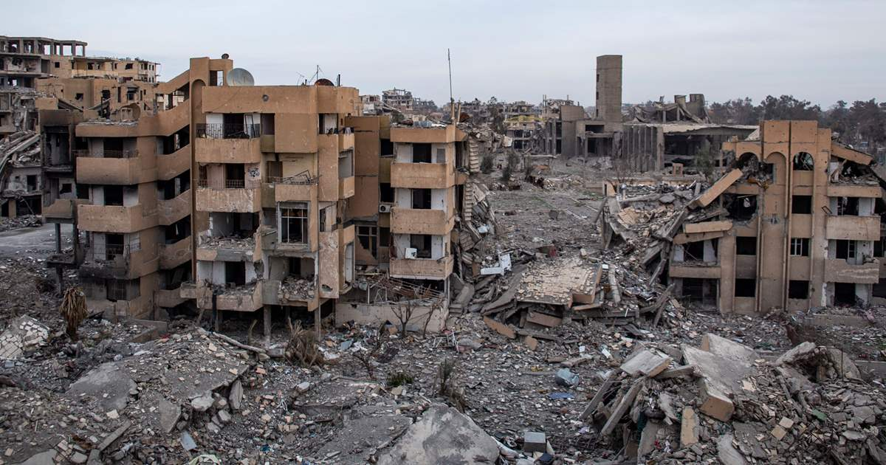
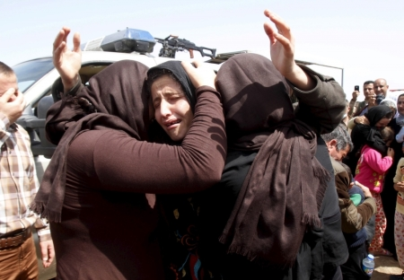
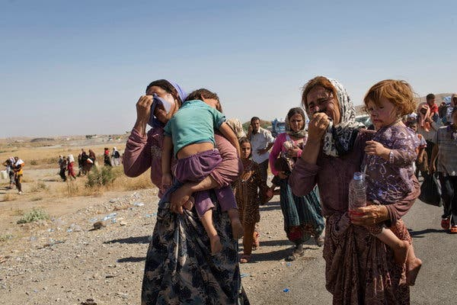

Slide 14
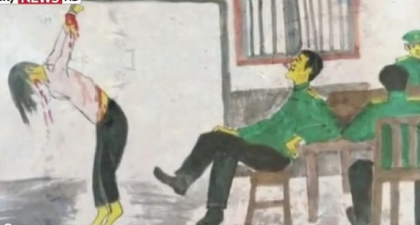

Slide 15
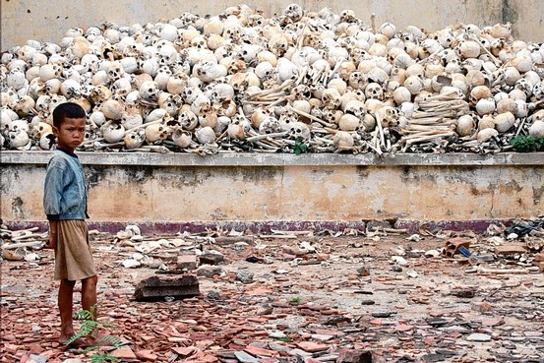
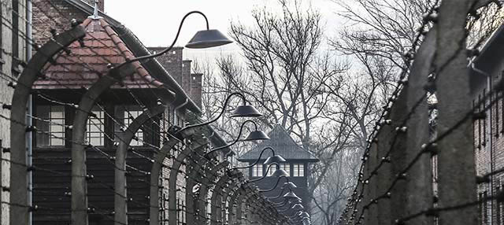

Slide 16
ROMANS 3
This was to show God's righteousness, because in his divine forbearance he had passed over former sins.

Slide 17
ROMANS 3
This was to show God's righteousness, because in his divine forbearance he had passed over former sins. ²⁶ It was to show his righteousness at the present time, so that he might be just and the justifier of the one who has faith in Jesus.

Slide 18
ROMANS 3
²⁷ Then what becomes of our boasting? It is excluded. By what kind of law? By a law of works? No, but by the law of faith. ²⁸ For we hold that one is justified by faith apart from works of the law. ²⁹ Or is God the God of Jews only? Is he not the God of Gentiles also? Yes, of Gentiles also, ³⁰ since God is one—who will justify the circumcised by faith and the uncircumcised through faith.

Slide 19
ROMANS 3
³¹ Do we then overthrow the law by this faith? By no means! On the contrary, we uphold the law.

Slide 20
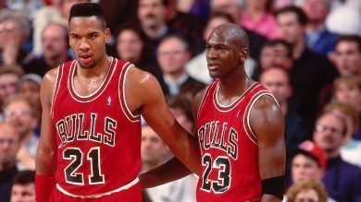

Slide 21
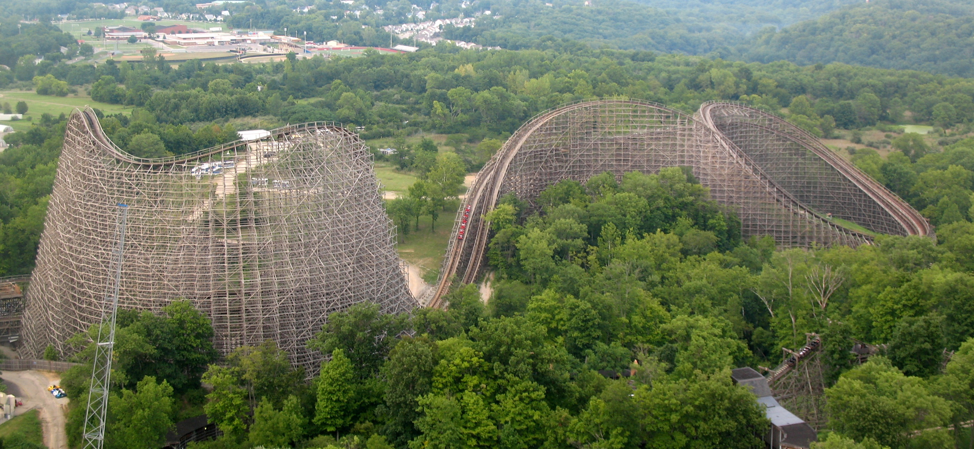

Slide 22
There is a fountain filled with blood
Drawn from Immanuel’s veins,
And sinners plunged beneath that flood
Lose all their guilty stains.
Lose all their guilty stains
Lose all their guilty stains,
And sinners plunged beneath that flood
Lose all their guilty stains.

Slide 23
The dying thief rejoiced to see
That fountain in his day;
And there may I
Though sinful too,
Wash all my sins away.
Wash all my sins away.
Wash all my sins away.
And there may I
Though sinful too,
Wash all my sins away.

Slide 24
Dear dying Lamb,
They precious blood
Shall never lose its power
‘Til all the ransomed
Church of God
Be saved to sin no more.
Be saved to sin no more
Be saved to sin no more.
‘Til all the ransomed
Church of God
Be saved to sin no more.

Slide 25
When this poor lisping, stammering tongue
Lies silent in the grave
Then in a nobler, sweeter song
I’ll sing thy power to save
I’ll sing thy power to save
I’ll sing thy power to save
Then in a nobler, sweeter song
I’ll sing thy power to save.

