Slide 1
Ever been drafted?

Slide 2
The Grade School Draft…

Slide 4
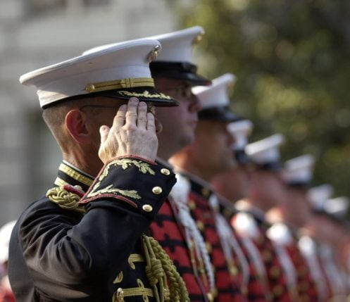
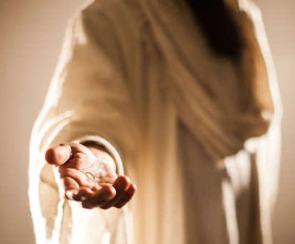
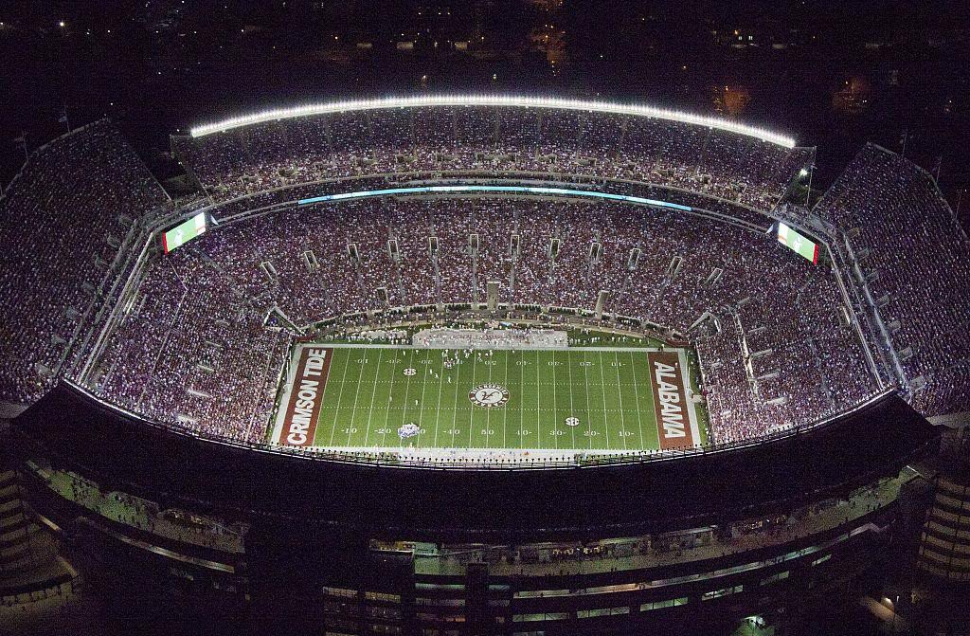
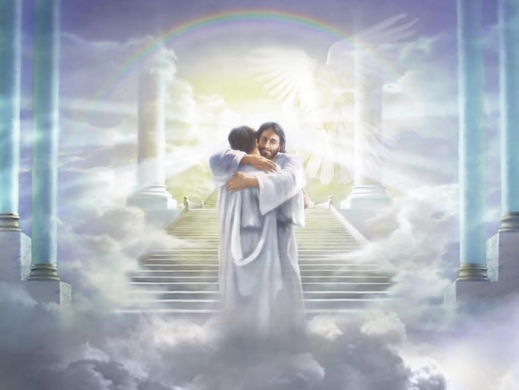
Who Drafted You?

Slide 5
Philippians 3:10-11 (Amplified Bible)
“…so that I may know Him [experientially, becoming more thoroughly acquainted with Him, understanding the remarkable wonders of His Person more completely] and [in that same way experience] the power of His resurrection [which overflows and is active in believers], and [that I may share] the fellowship of His sufferings, by being continually conformed [inwardly into His likeness even] to His death [dying as He did]; ¹¹so that I may attain to the resurrection [that will raise me] from the dead.”

Slide 6
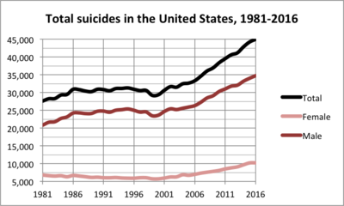
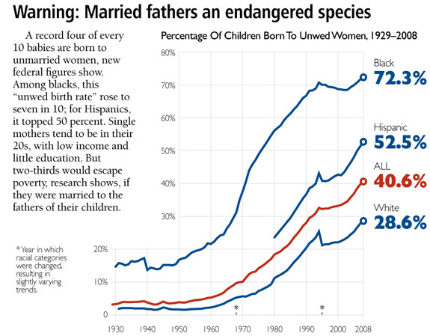

Slide 7
Philippians 3:12-14
Not that I have already obtained all this, or have already arrived at my goal, but I press on to take hold of that for which Christ Jesus took hold of me. ¹³ Brothers and sisters, I do not consider myself yet to have taken hold of it. But one thing I do: Forgetting what is behind and straining toward what is ahead, ¹⁴ I press on toward the goal to win the prize for which God has called me heavenward in Christ Jesus.

Slide 8
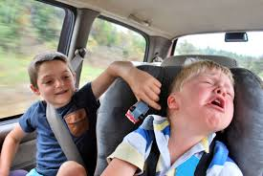
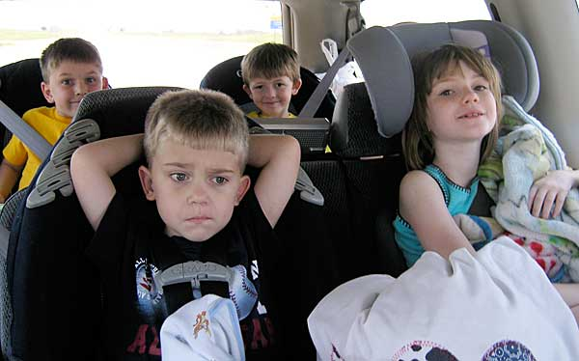

Slide 9
HUMBLE REALISM acknowledges that growing up in Christ is a life-long process (Phil. 3:12). There will always be room for progress.
Philippians 3:12-14
Not that I have already obtained all this, or have already arrived at my goal….

Slide 10
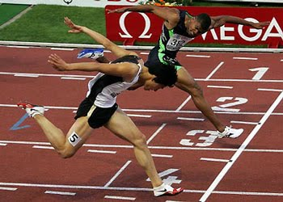

Slide 11
Philippians 3:12-14
Not that I have already obtained all this, or have already arrived at my goal,
but I press on to take hold of that for which Christ Jesus took hold of me.

Slide 12
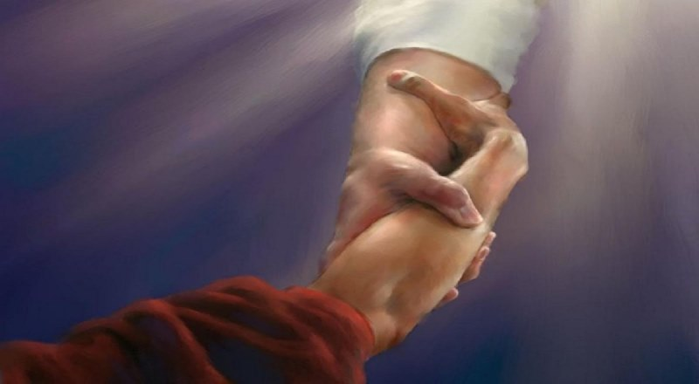
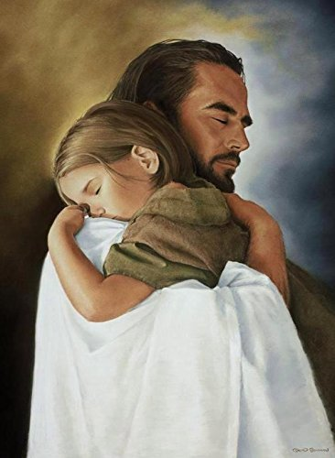

Slide 13
Philippians 3:13
“Brothers and sisters, I do not consider myself yet to have taken hold of it.”

Slide 14
Philippians 3:13
“Brothers and sisters, I do not consider myself yet to have taken hold of it.
But one thing I do:

Slide 15
2. FOCUSED DETERMINATION is critical to experiencing Christ in everything.

Slide 17
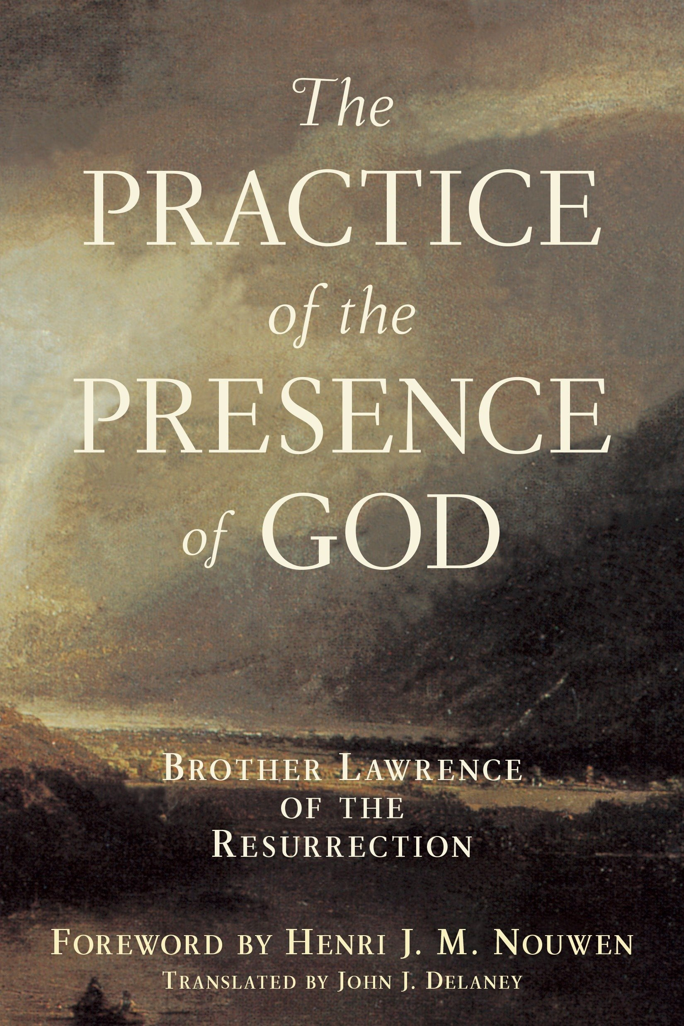

Slide 18
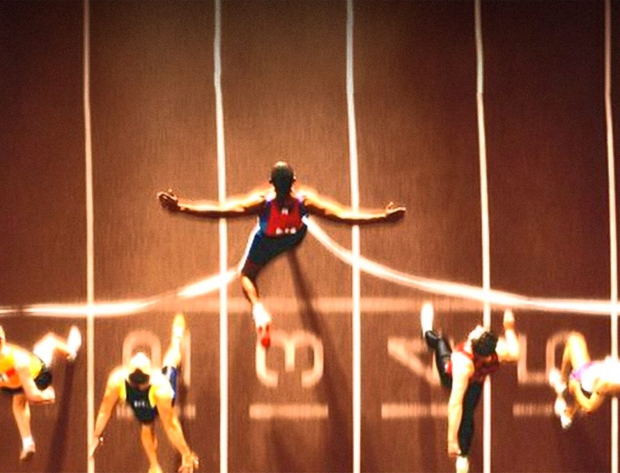
3. CEASELESS PURSUIT is critical to experiencing Christ in everything.

Slide 19
Philippians 3:12
“…I press on to take hold of that for which Christ Jesus took hold of me.
I Corinthians 9:24
“Do you not know that in a race all the runners run, but only one gets the prize? Run in such a way as to get the prize.”

Slide 20
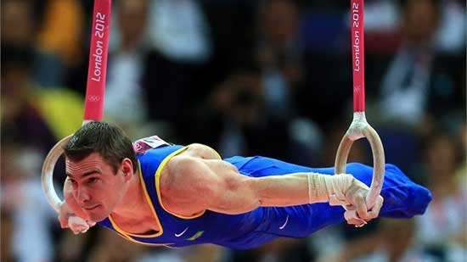
Know the objective.
Train rigorously.

Slide 22
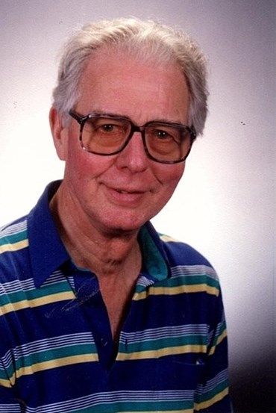
Richard Edward
"Dick" SHANKS
(1923 - 2018)

Slide 23
4. FUTURE ORIENTATION is critical to experiencing Christ in everything.

Slide 24
Avoid twin dangers about the past:
1.) Preoccupation with past FAILURES.
2.) Fixation on past SUCCESSES.

Slide 25
I Corinthians 2:9
“No eye has seen, no ear has heard, no mind has conceived what God has prepared for those who love him.”

