Slide 1
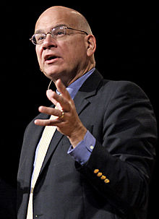
That we are not our own but belong, body and soul, both in life and death, to God and to our Savior Jesus Christ.

Slide 3
Get Acquainted! 1.) What is some of the best news someone ever delivered to you? 2.) When do you remember first recognizing spiritual hunger in your own life & what in your life contributed to that hunger?

Slide 4
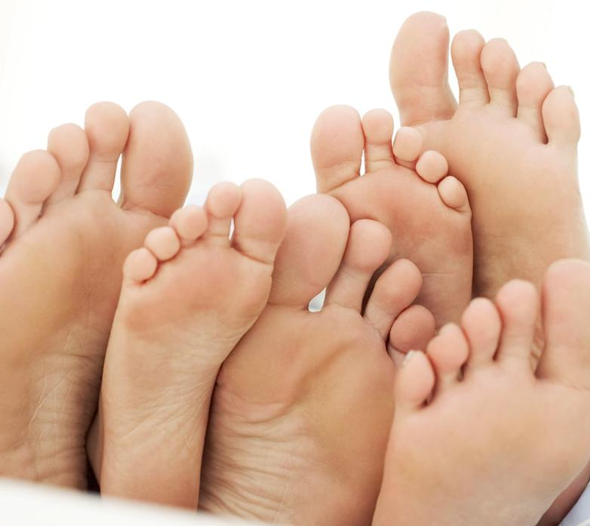
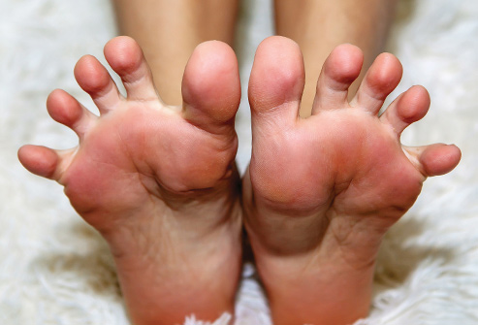

Slide 5
Romans 10:14-15 ¹⁴ How, then, can they call on the one they have not believed in? And how can they believe in the one of whom they have not heard? And how can they hear without someone preaching to them? ¹⁵ And how can anyone preach unless they are sent? As it is written: “How beautiful are the feet of those who bring good news!”

Slide 6
John 3:16 For God so loved the world that he gave his one and only Son, that whoever believes in him shall not perish but have eternal life.

Slide 7
Romans 10:9, 10, 13 If you declare with your mouth, “Jesus is Lord,” and believe in your heart that God raised him from the dead, you will be saved. ¹⁰ For it is with your heart that you believe and are justified, and it is with your mouth that you profess your faith and are saved. ¹³…for, “Everyone who calls on the name of the Lord will be saved.”

Slide 8
STEP 1: Know the simple Gospel
In 60 seconds or less,
share with someone
what they would need to
know and do to experience
the Gospel of Jesus Christ.

Slide 9
STEP 1: KNOW the simple Gospel
STEP 2: Be SENT
STEP 3: Actually GO

Slide 10
Are YOU
?

Slide 11
Who does Jesus send out? Matthew 10:5-8—These twelve Jesus sent out with the following instructions: “Do not go among the Gentiles or enter any town of the Samaritans. ⁶ Go rather to the lost sheep of Israel. ⁷ As you go, proclaim this message: ‘The kingdom of heaven has come near.’ ⁸ Heal the sick, raise the dead, cleanse those who have leprosy, drive out demons. Freely you have received; freely give.

Slide 12
Who does Jesus send out? Matthew 4:19 “Come, follow me,” Jesus said, “and I will send you out to fish for people.”

Slide 13
Who does Jesus send out? The 72—Luke 10:1 “After this the Lord appointed seventy-two others and sent them two by two ahead of him to every town and place where he was about to go.”

Slide 14
All Believers? Matthew 28:18-20—“All authority in heaven and earth has been given to me. Therefore go and make disciples of all nations, baptizing them in the name of the Father and of the Son and of the Holy Spirit, and teaching them to obey everything I have commanded you. And surely I am with you always, to the very end of the age.”

Slide 15
All Believers? Acts 1:8—“But you will receive power when the Holy Spirit comes on you; and you will be my witnesses in Jerusalem, and in all Judea and Samaria, and to the ends of the earth.”

Slide 16
All Believers? John 17:18—“As you sent me into the world, I have sent them into the world.”

Slide 17
All Believers? John 20:20, 21 “Peace be with you! As the Father has sent me, I am sending you.”

Slide 18
All Believers? Matthew 9:37, 38 “Then he said to his disciples, “The harvest is plentiful but the workers are few. Ask the Lord of the harvest, therefore, to send out workers into his harvest field.””

Slide 19
All Believers? Luke 10:2, 3 ² He told them, “The harvest is plentiful, but the workers are few. Ask the Lord of the harvest, therefore, to send out workers into his harvest field. ³ Go! I am sending you out like lambs among wolves.

Slide 20
Who do the disciples send away?
The Crowds who followed Jesus
Matthew 14:15—“As evening approached, the disciples came to him and said, “This is a remote place, and it’s already getting late.
Send the crowds away, so they can go to the villages and buy themselves some food.””

Slide 21
Who do the disciples send away?
The Canaanite Woman
Matthew 15:23—“Jesus did not answer a word. So his disciples came to him and urged him, “Send her away, for she keeps crying out after us.””

Slide 22
“I willingly accept and embrace Jesus’ commission to go and make disciples!”

Slide 23
STEP 1: KNOW the simple Gospel
STEP 2: Be SENT
STEP 3: Actually GO

Slide 24
What are the potential UPSIDES to our lives of actually…

Slide 25
What are the potential “DOWNSIDES” to our lives of actually…

Slide 26
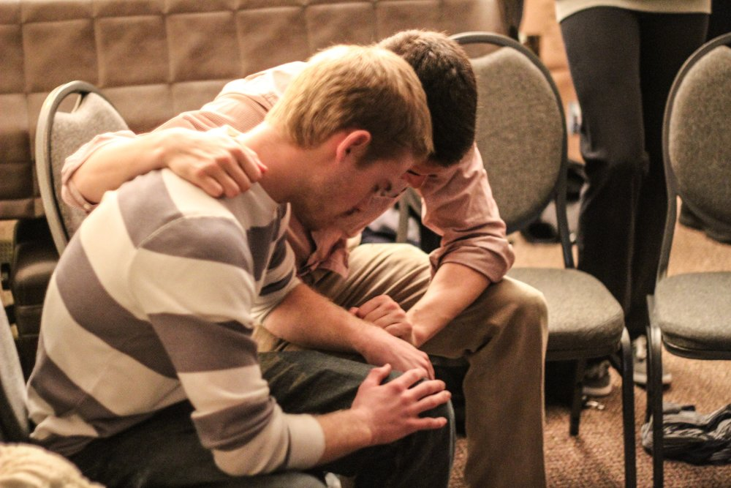
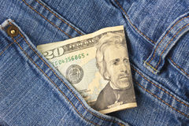

Slide 27
What is it that keeps us from sharing the Gospel freely most of the time?

Slide 28
Galatians 6:19, 20 “Pray also for me, that whenever I speak, words may be given me so that I will fearlessly make known the mystery of the gospel, for which I am an ambassador in chains. Pray that I may declare it fearlessly, as I should.”

Slide 29
2 Corinthians 5:11 “Since then we know what it is to fear the Lord, we try to persuade others.” Vs. 14--“Christ’s love compels us”

