Slide 1
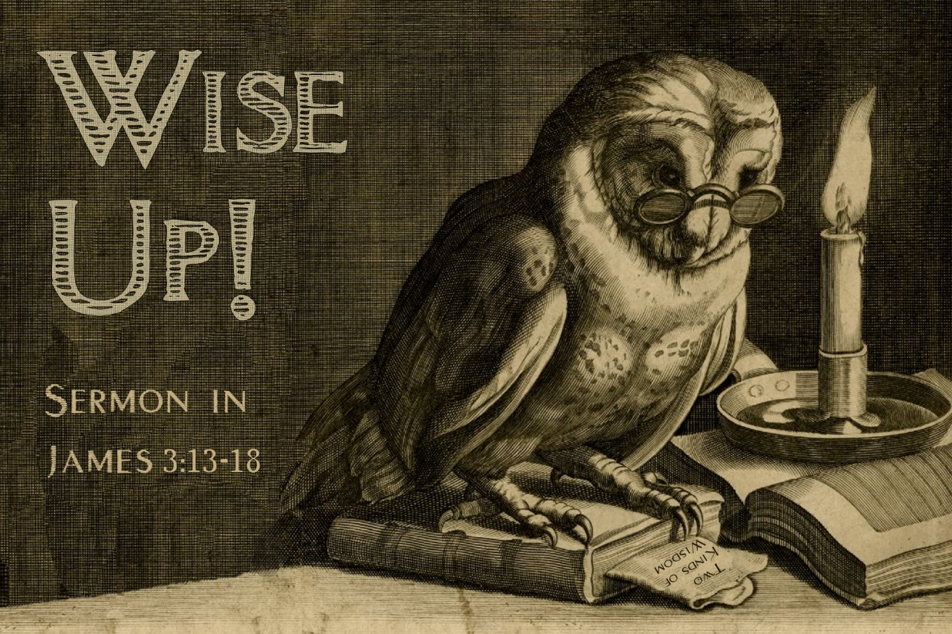

Slide 2
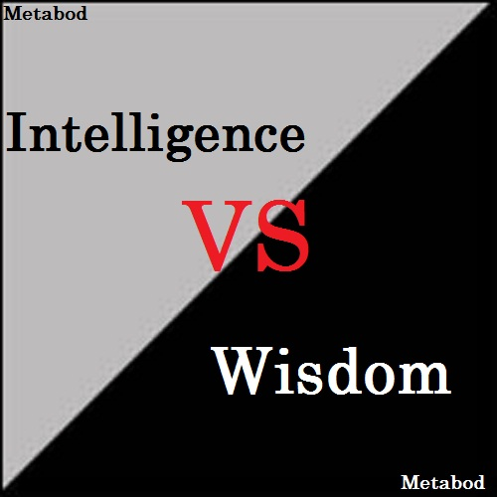

Slide 3
WISDOM
is
the ability to live life
in a sinful, flawed world in such a way that both God,
you
and others
are blessed by your actions.

Slide 4
James 1:5
If any of you lacks wisdom, you should ask God, who gives generously to all without finding fault, and it will be given to you.

Slide 5
James 3:13-18
Who is wise and understanding among you? Let them show it by their good life, by deeds done in the humility that comes from wisdom.¹⁴ But if you harbor bitter envy and selfish ambition in your hearts, do not boast about it or deny the truth.¹⁵ Such “wisdom” does not come down from heaven but is earthly, unspiritual, demonic.

Slide 6
James 3:13-18
¹⁶ For where you have envy and selfish ambition, there you find disorder and every evil practice.
¹⁷ But the wisdom that comes from heaven is first of all pure; then peace-loving, considerate, submissive, full of mercy and good fruit, impartial and sincere. ¹⁸ Peacemakers who sow in peace reap a harvest of righteousness.

Slide 7
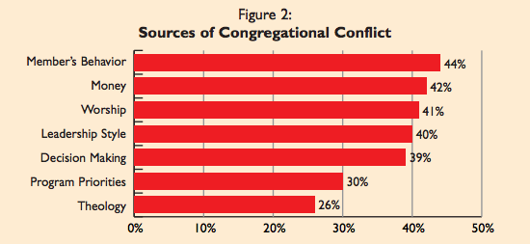

Slide 8
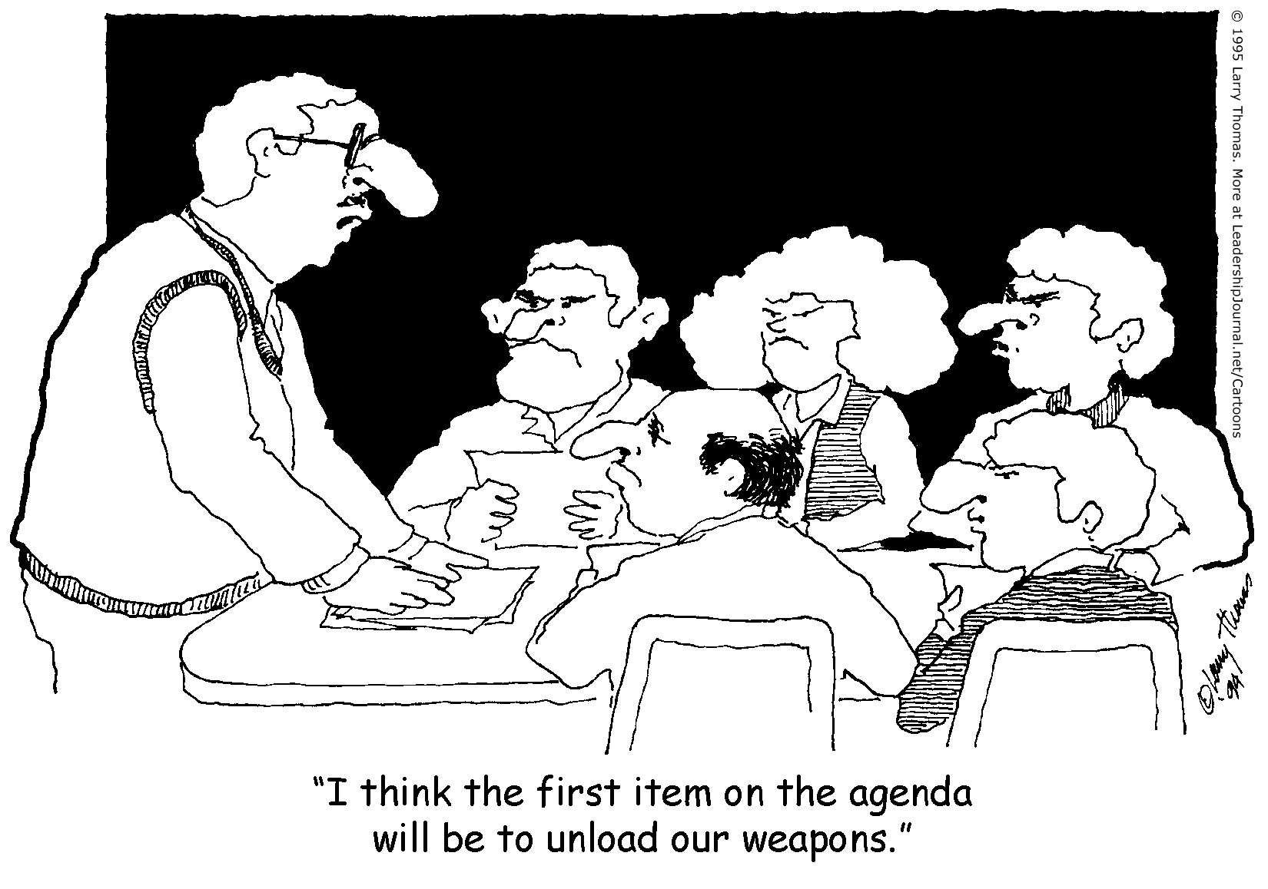

Slide 9
James 3:14
But if you harbor bitter envy and selfish ambition in your hearts, do not boast about it or deny the truth.¹⁵ Such “wisdom” does not come down from heaven but is earthly, unspiritual, demonic.

Slide 10
James 3:14
“But since you harbor envy and selfish ambition in your hearts, do not be boasting or denying the truth about it!”

Slide 11
GODLY WISDOM LEADS TO GREAT RELATIONSHIPS

Slide 12
James 3:13
Who is wise and understanding among you? Let them show it by their good life, by deeds done in the humility that comes from wisdom.

Slide 13
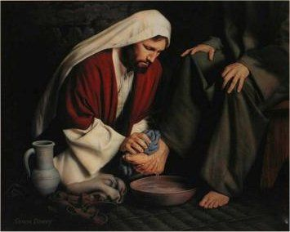
WISDOM’S #1 Quality:
HUMILITY

Slide 14
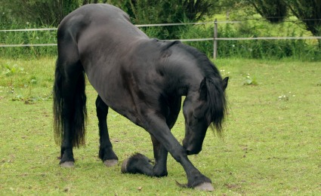
James 3:13-18
Who is wise and understanding among you? Let them show it by their good life, by deeds done in the humility/gentleness/meekness that comes from wisdom.

Slide 15
James 3
¹⁴ But if you harbor bitter envy and selfish ambition in your hearts, do not boast about it or deny the truth. ¹⁵ Such “wisdom” does not come down from heaven but is earthly, unspiritual, demonic.

Slide 16
James 3
¹⁴ But if you harbor bitter envy and selfish ambition in your hearts, do not boast about it or deny the truth. ¹⁵ Such “wisdom” does not come down from heaven but is earthly, unspiritual, demonic.

Slide 17
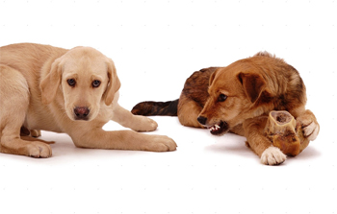
Healthy jealousy protects.
Bitter jealousy wants to possess.

Slide 18
Trait #2 of counterfeit wisdom:
SELFISH AMBITION or SELF-EEKING.
Vs. 14--“But if you harbor bitter envy and selfish ambition in your hearts, do not boast about it or deny the truth.”

Slide 19
The final traits of worldly wisdom: DISORDER & EVIL
¹⁶ For where you have envy and selfish ambition, there you find disorder and every evil practice.

Slide 20
James 3:17
¹⁷ But the wisdom that comes from heaven is first of all pure; then peace-loving, considerate, submissive, full of mercy and good fruit, impartial and sincere.

Slide 21
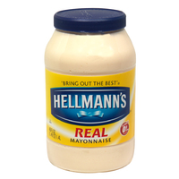
Trait #1 of Godly Wisdom:
PURE

Slide 22
Trait #2 of Godly Wisdom:
PEACE-LOVING
James 3:17
¹⁷ But the wisdom that comes from heaven is first of all pure; then peace-loving,
considerate, submissive, full of mercy and good fruit, impartial and sincere.

Slide 23
Ephesians 4:3
“Be diligent to preserve the unity of the Spirit in the bond of peace.”

Slide 24
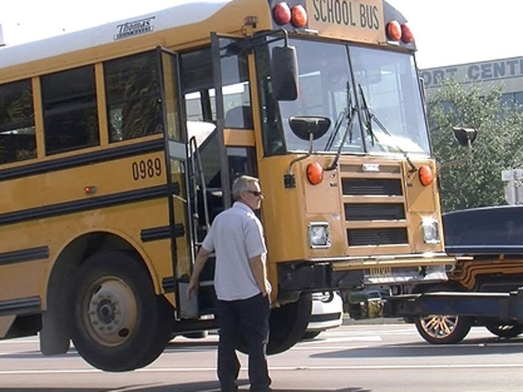

Slide 25
Trait #3 of Godly Wisdom:
CONSIDERATE
James 3:17
¹⁷ But the wisdom that comes from heaven is first of all pure; then peace-loving,
considerate, submissive, full of mercy and good fruit, impartial and sincere.

Slide 26
Trait #4 of Godly Wisdom:
SUBMISSIVE
James 3:17
¹⁷ But the wisdom that comes from heaven is first of all pure; then peace-loving,
considerate, submissive, full of mercy and good fruit, impartial and sincere.

Slide 27
Trait #5 of Godly Wisdom:
MERCY & GOOD FRUITS
James 3:17
¹⁷ But the wisdom that comes from heaven is first of all pure; then peace-loving,
considerate, submissive, full of mercy and good fruit, impartial and sincere.

Slide 28
Trait #6 of Godly Wisdom:
IMPARTIALITY
James 3:17
¹⁷ But the wisdom that comes from heaven is first of all pure; then peace-loving,
considerate, submissive, full of mercy and good fruit, impartial and sincere.

Slide 29
Trait #7 of Godly Wisdom:
SINCERITY/LACK OF HYPOCRISY
James 3:17
¹⁷ But the wisdom that comes from heaven is first of all pure; then peace-loving,
considerate, submissive, full of mercy and good fruit, impartial and sincere.

Slide 30
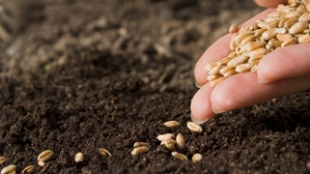
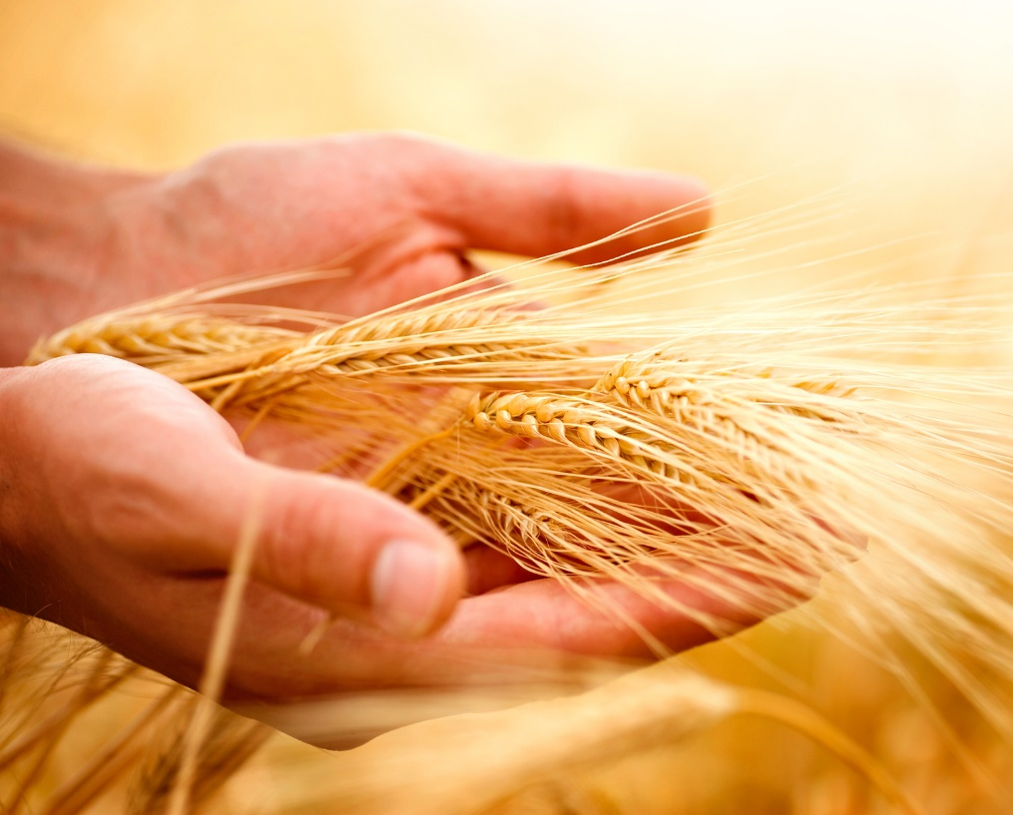
James 3:18
“Peacemakers who
sow in peace…
…reap a harvest of
righteousness.”

