Slide 1
Tell someone about one of the follow: 1.) The sibling you feel closest to in your family of origin and WHY you think that is. 2.) The name of one of your closest life-long friends and WHAT you think made you close friends.

Slide 3
If we are people cultivating a large heart for God, we will be a people with a large heart for God’s family. I John 4:7-8—“Dear friends [agapetoi], let us love [agapomen, from agapao] one another, for love [agape] comes from God. Everyone who loves has been born of God and knows God. Whoever does not love does not know God, because God is love.”

Slide 4
Colossians 4:7, 8 Tychicus will tell you all the news about me. He is a dear brother, a faithful minister and fellow servant in the Lord. ⁸ I am sending him to you for the express purpose that you may know about our circumstances and that he may encourage your hearts.

Slide 5
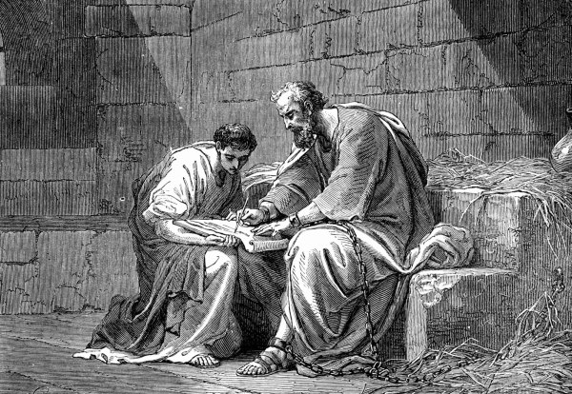
1.) We bond when we SERVE FAITHFULLY in the SMALL THINGS.
There is greatness and deep bonding in the smallest things done for Christ.

Slide 6
2.) We bond when we SHARE HARDSHIP.
Vs. 10—
“My fellow prisoner Aristarchus sends you his greetings….”

Slide 7
3.) We bond when we acknowledge that PEOPLE CAN CHANGE… and we GIVE THEM ADDITIONAL CHANCES to do so!
Vs. 10—My fellow prisoner Aristarchus sends you his greetings, as does Mark, the cousin of Barnabas. (You have received instructions about him; if he comes to you, welcome him.)

Slide 8
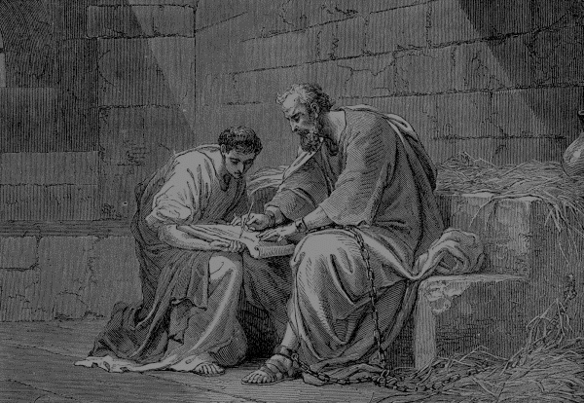
4.) Bonding sometimes involves shared culture, language, history or race.
Colossians 4:10-11
My fellow prisoner Aristarchus sends you his greetings, as does Mark, the cousin of Barnabas. (You have received instructions about him; if he comes to you, welcome him.) ¹¹ Jesus, who is called Justus, also sends greetings. These are the only Jews among my co-workers for the kingdom of God, and they have proved a comfort to me.

Slide 12
4.) Bonding sometimes involves shared culture, language, history or race.
Colossians 4:10-11
My fellow prisoner Aristarchus sends you his greetings, as does Mark, the cousin of Barnabas. (You have received instructions about him; if he comes to you, welcome him.) ¹¹ Jesus, who is called Justus, also sends greetings. These are the only Jews among my co-workers for the kingdom of God, and they have proved a comfort to me.

Slide 13
What are some of the critical factors for bonding of people together who have not been family previously?
The Power of Vulnerability
(TED Talk with Brene Brown)

Slide 14
What is RAD and how do you see RAD operating in the church today? What are some of the important truths about RAD that could help God's people bond in Christ?

Slide 15
Does RAD spill over into sibling-to-sibling issues sometimes? What helps siblings bond together emotionally?
What/how did YOU have to change to bring bonding to your "second family"?

Slide 16
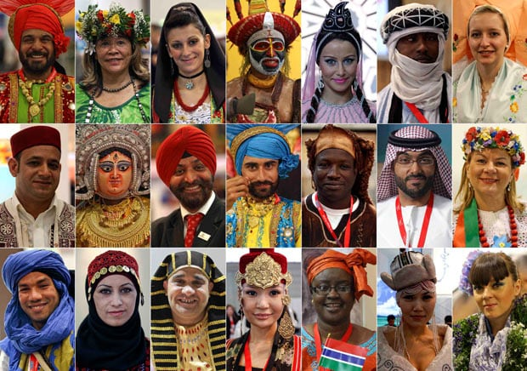
5.) We bond when we APPRECIATE OUR DIFFERENCES rather than AVOID those who are different. Epaphras-- (vss. 12-13) Luke and Demas (vs. 14)

