Slide 1
BENEFITS OF BEING GOD’S KIDS
“[He] has qualified you to share in the inheritance of the saints in light.”
(Colossians 1:12)
AN AMAZING INHERITANCE

Slide 2
BENEFITS OF BEING GOD’S KIDS
“He has delivered us from the domain of darkness….”
(Colossians 1:13)
AN AMAZING RESCUE

Slide 3
BENEFITS OF BEING GOD’S KIDS
“He has…transferred us to the kingdom of his beloved Son.”
(Colossians 1:13)
AN AMAZING CITIZENSHIP

Slide 4
BENEFITS OF BEING GOD’S KIDS
“…His beloved Son, in whom we have redemption.”
(Colossians 1:13)
AN AMAZING BUY-BACK

Slide 5
BENEFITS OF BEING GOD’S KIDS
“…His beloved Son, in whom we have redemption, the forgiveness of sins.” (Colossians 1:13)
AN AMAZING PARDON

Slide 6
Name 1 issue in your life in which you would like to know the will of God.
Name 1 issue in your life in which you know you are doing God’s will…and you are enjoying His blessing.
Think of (don’t share) one issue in your life where you know what God’s will is for you but are finding it hard to do.

Slide 7
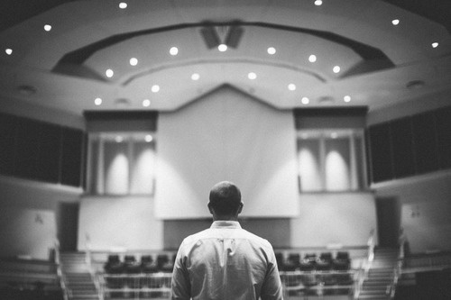
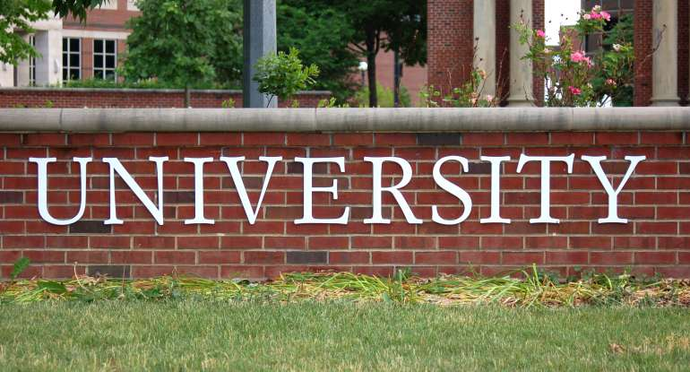
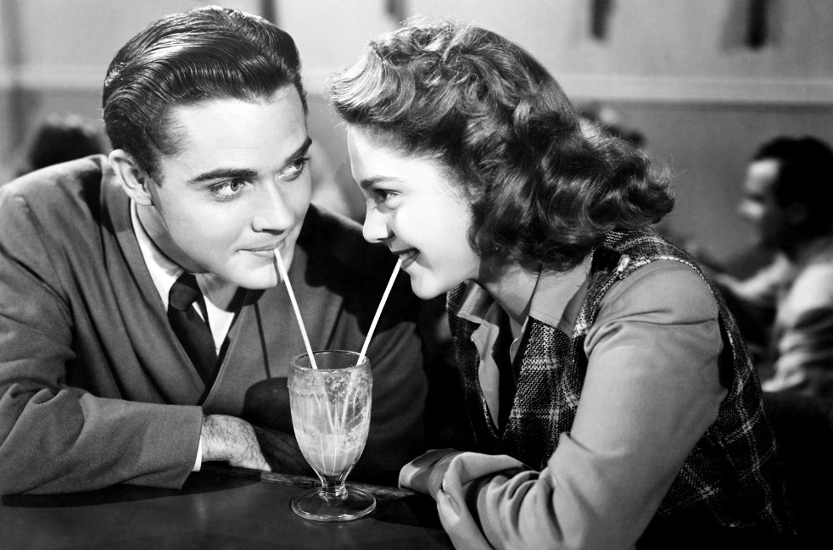
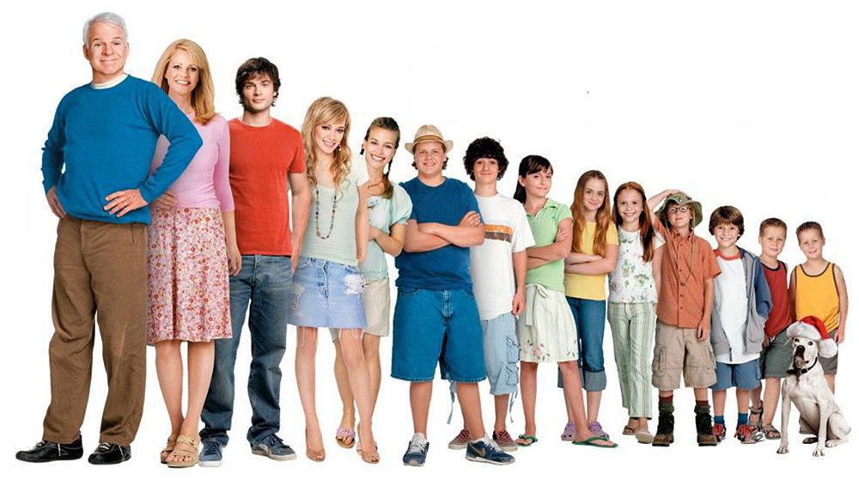
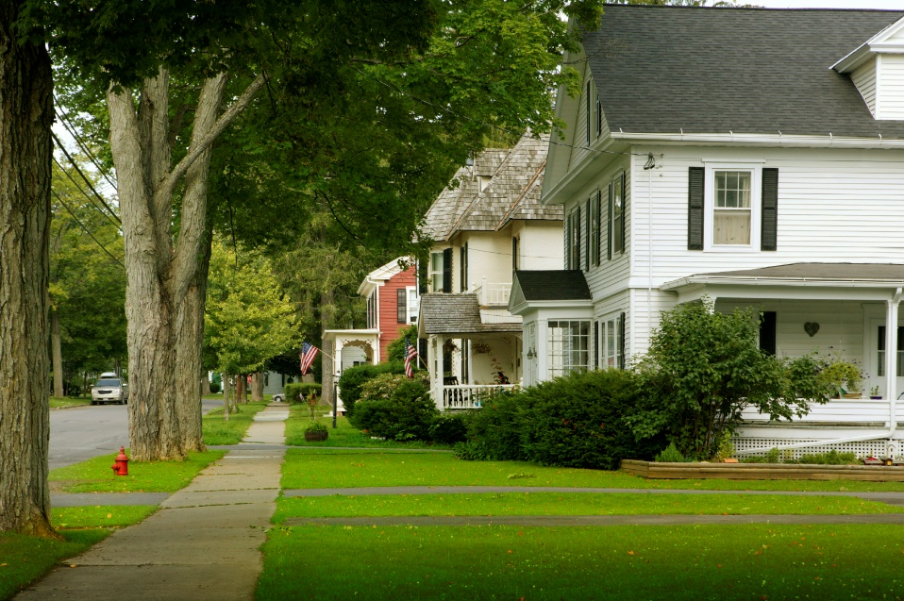

Slide 9
Write down 2 issues in life in which you would like to know
and do God’s will.

Slide 10
Colossians 1:9-10
⁹ And so, from the day we heard, we have not ceased to pray for you, asking that you may be filled with the knowledge of his will in all spiritual wisdom and understanding,
¹⁰ so as to walk in a manner worthy of the Lord, fully pleasing to him: bearing fruit in every good work and increasing in the knowledge of God;

Slide 11
¹¹ being strengthened with all power, according to his glorious might, for all endurance and patience with joy;¹² giving thanks to the Father, who has qualified you to share in the inheritance of the saints in light. ¹³ He has delivered us from the domain of darkness and transferred us to the kingdom of his beloved Son, ¹⁴ in whom we have redemption, the forgiveness of sins.

Slide 12
2nd Peter 3:16
“[Paul] writes the same way in all his letters, speaking in them of these matters [the return of Christ]. His letters contain some things that are hard to understand….”

Slide 13
Colossians 1:9-14
⁹ And so, from the day we heard, we have not ceased to pray for you, asking that you may be filled with the knowledge of his will in all spiritual wisdom and understanding,
¹⁰ so as to walk in a manner worthy of the Lord, fully pleasing to him: bearing fruit in every good work and increasing in the knowledge of God; ¹¹ being strengthened with all power, according to his glorious might, for all endurance and patience with joy;¹² giving thanks to the Father, who has qualified you to share in the inheritance of the saints in light. ¹³ He has delivered us from the domain of darkness and transferred us to the kingdom of his beloved Son, ¹⁴ in whom we have redemption, the forgiveness of sins.

Slide 14
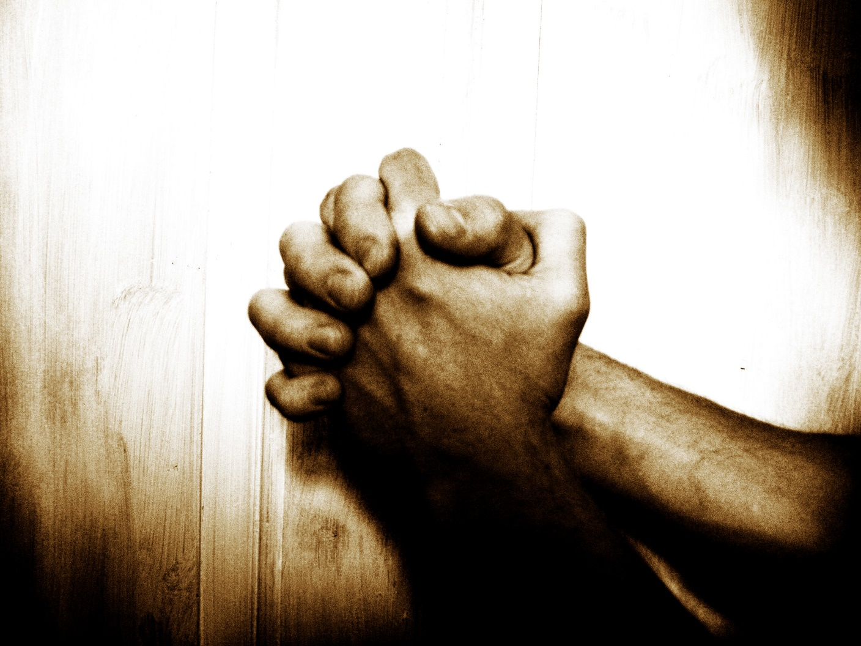
Part 1: What KIND of prayer is Paul praying here?
REQUEST

Slide 15
Part 2: What is the CONTENT of his prayer?
“… asking that you may be filled with the knowledge of his will….”

Slide 16
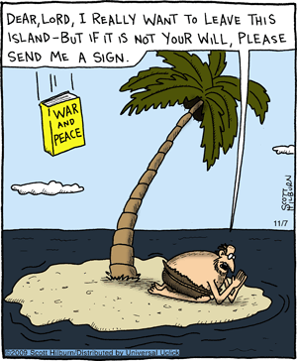
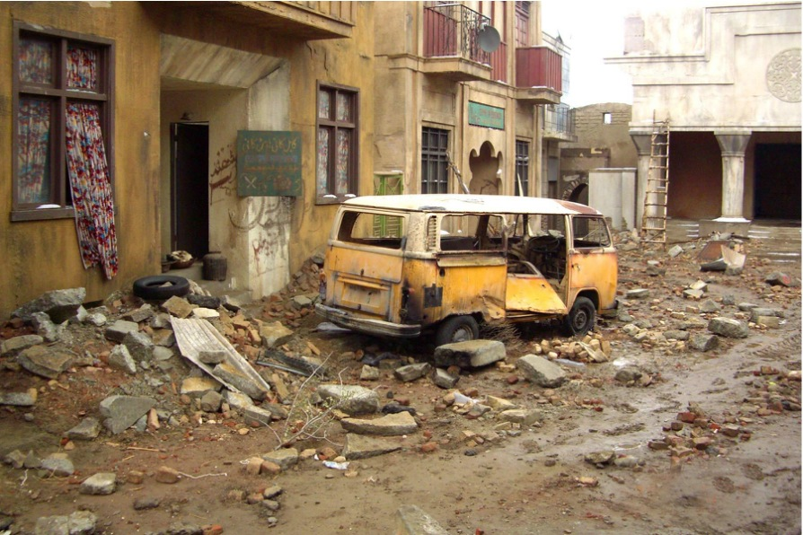

Slide 17
James 1:5
“If any of you lacks wisdom, you should ask God, who give generously to all without finding fault, and it will be given to you.”
“But when you ask, you must believe and not doubt…”

Slide 19
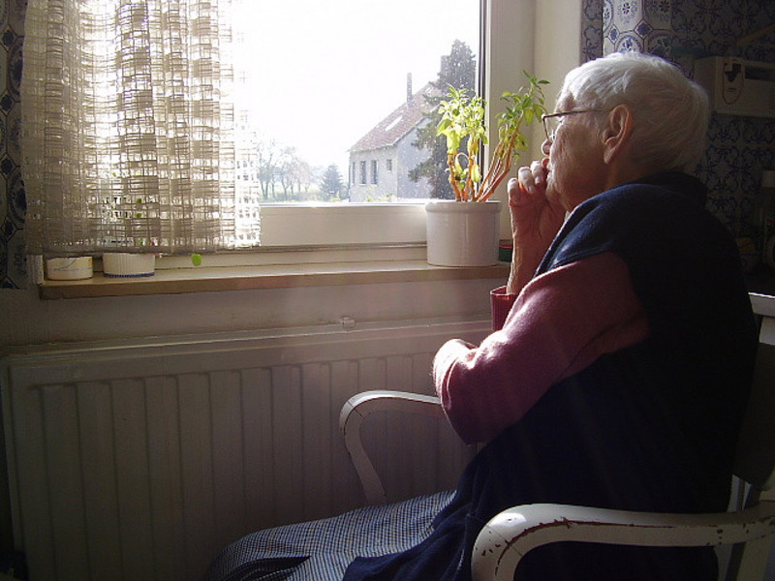

Slide 20
HOW does God teach us His will?
“…in all spiritual wisdom and understanding that the Spirit gives….” (vs. 9)
QUESTIONS???

Slide 21
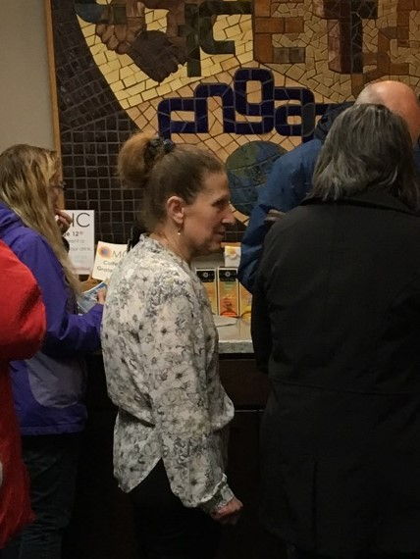
What happens when you are filled with God’s wisdom?
1.) “…bearing fruit in every good work…” (vs. 10)

Slide 22
What happens when you are filled with God’s wisdom?
1.) “…bearing fruit in every good work…” (vs. 10)
2.) “…increasing in the knowledge of God….” (vs. 10)

Slide 23
What happens when you are filled with God’s wisdom?
3.) ¹¹“being strengthened [empowered] with all power, according to his glorious might, for all endurance and patience with joy….”

Slide 24
What happens when you are filled with God’s wisdom?
3.) ¹¹“being strengthened [empowered] with all power, according to his glorious might, for all endurance and patience with joy….”

Slide 25
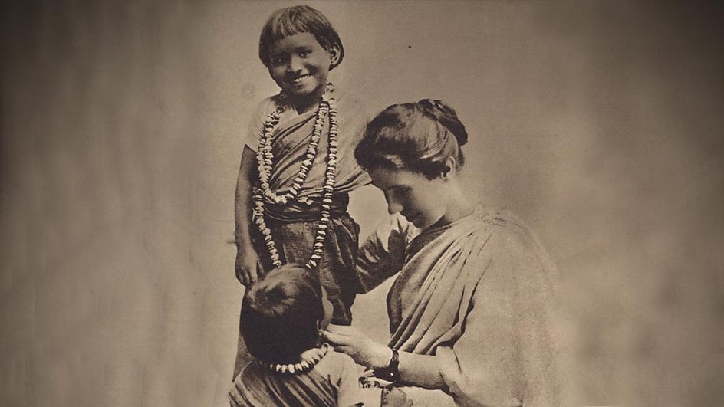
Amy
Carmichael
(1867-1951)

Slide 26
What happens when you are filled with God’s wisdom?
#4.) ¹² “giving thanks to the Father, who has qualified you to share in the inheritance of the saints in light.”

Slide 27
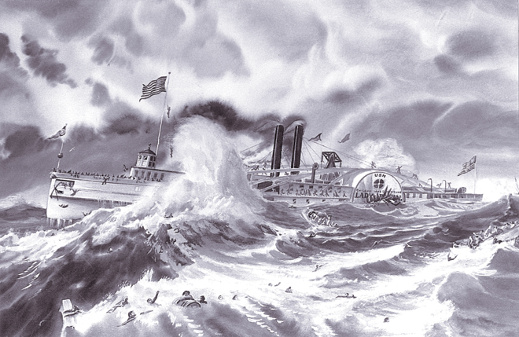
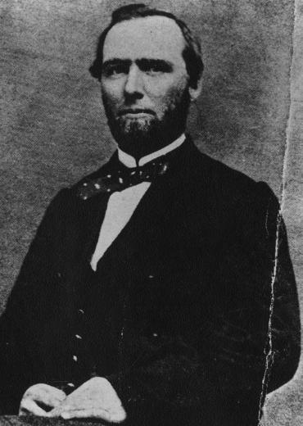

Slide 28
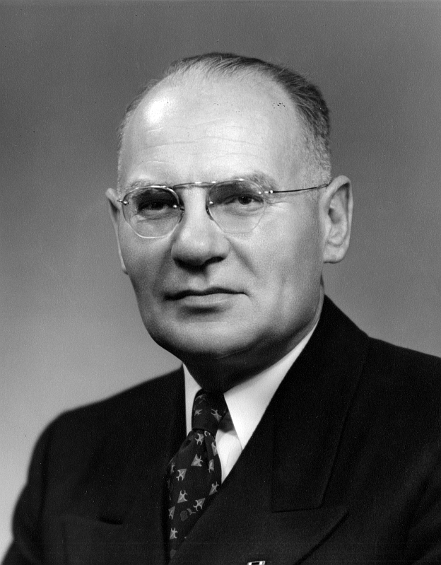
KNOWING the life of Christ
DOING what Jesus does
BEING what Christ is
to others

