Slide 2
What did you hope for when you were a teenager?

Slide 3
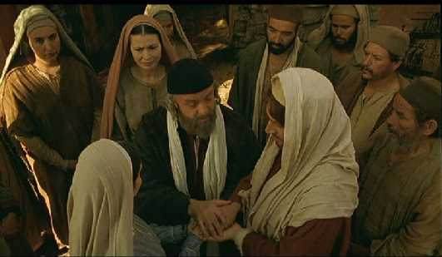
Jewish betrothal & marriage…

Slide 5
Luke 1:26-29 In the sixth month of Elizabeth’s pregnancy, God sent the angel Gabriel to Nazareth, a town in Galilee, ²⁷ to a virgin pledged to be married to a man named Joseph, a descendant of David. The virgin’s name was Mary. ²⁸ The angel went to her and said, “Greetings, you who are highly favored! The Lord is with you.” ²⁹ Mary was greatly troubled at his words and wondered what kind of greeting this might be.

Slide 6
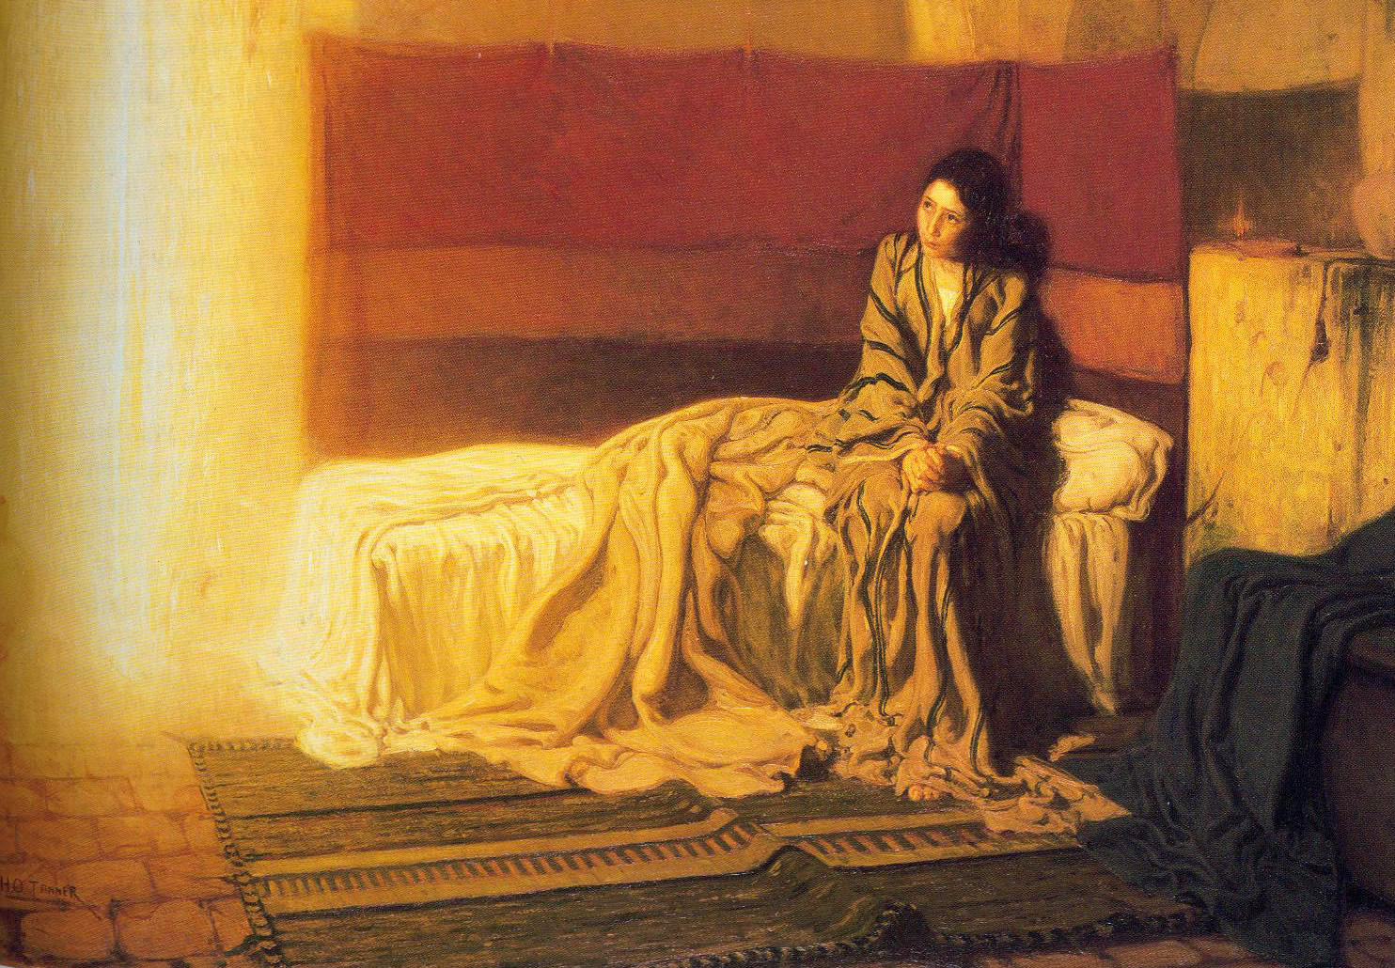
You are highly favored…
The Lord is with you.

Slide 7
³⁰ But the angel said to her, “Do not be afraid, Mary; you have found favor with God.”

Slide 8
³¹ You will conceive and give birth to a son, and you are to call him Jesus.

Slide 9
³² He will be great and will be called the Son of the Most High. The Lord God will give him the throne of his father David, ³³ and he will reign over Jacob’s descendants forever; his kingdom will never end.”

Slide 10
³⁵ The angel answered, “The Holy Spirit will come on you, and the power of the Most High will overshadow you. So the holy one to be born will be called the Son of God. ³⁶ Even Elizabeth your relative is going to have a child in her old age, and she who was said to be unable to conceive is in her sixth month. ³⁷ For no word from God will ever fail.”

Slide 11
God-grounded hope comes to people who are willing to exchange their personal “hopes & dreams” for God’s (sometimes disruptive) divine plans.

Slide 12
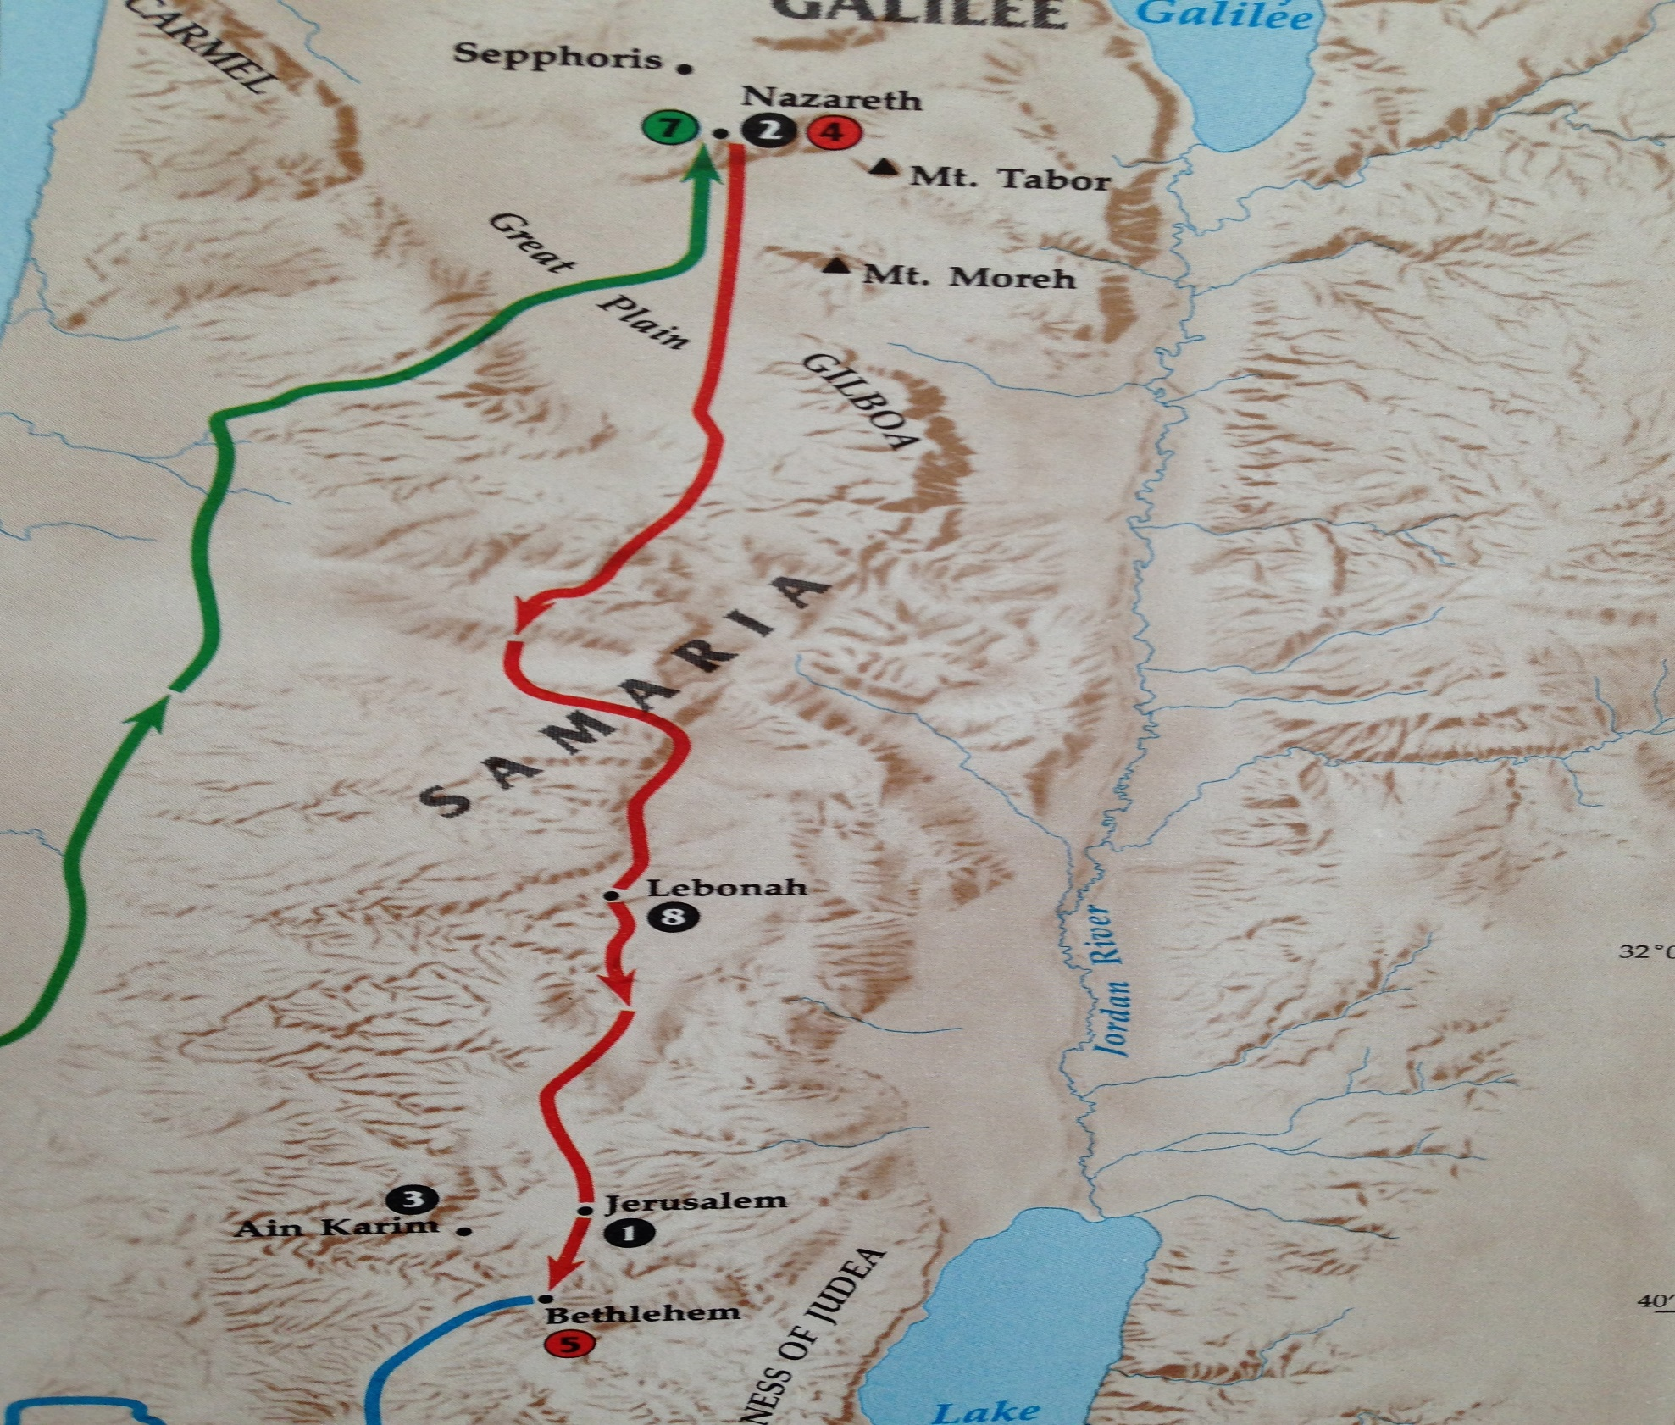

Slide 13
God-grounded hope is always greater than our private dreams…even dreams seeded by God.

Slide 14
³⁷ For no word from God will ever fail.”

Slide 15
³⁸ “I am the Lord’s servant,” Mary answered. “May your word to me be fulfilled.” Then the angel left her.

Slide 16
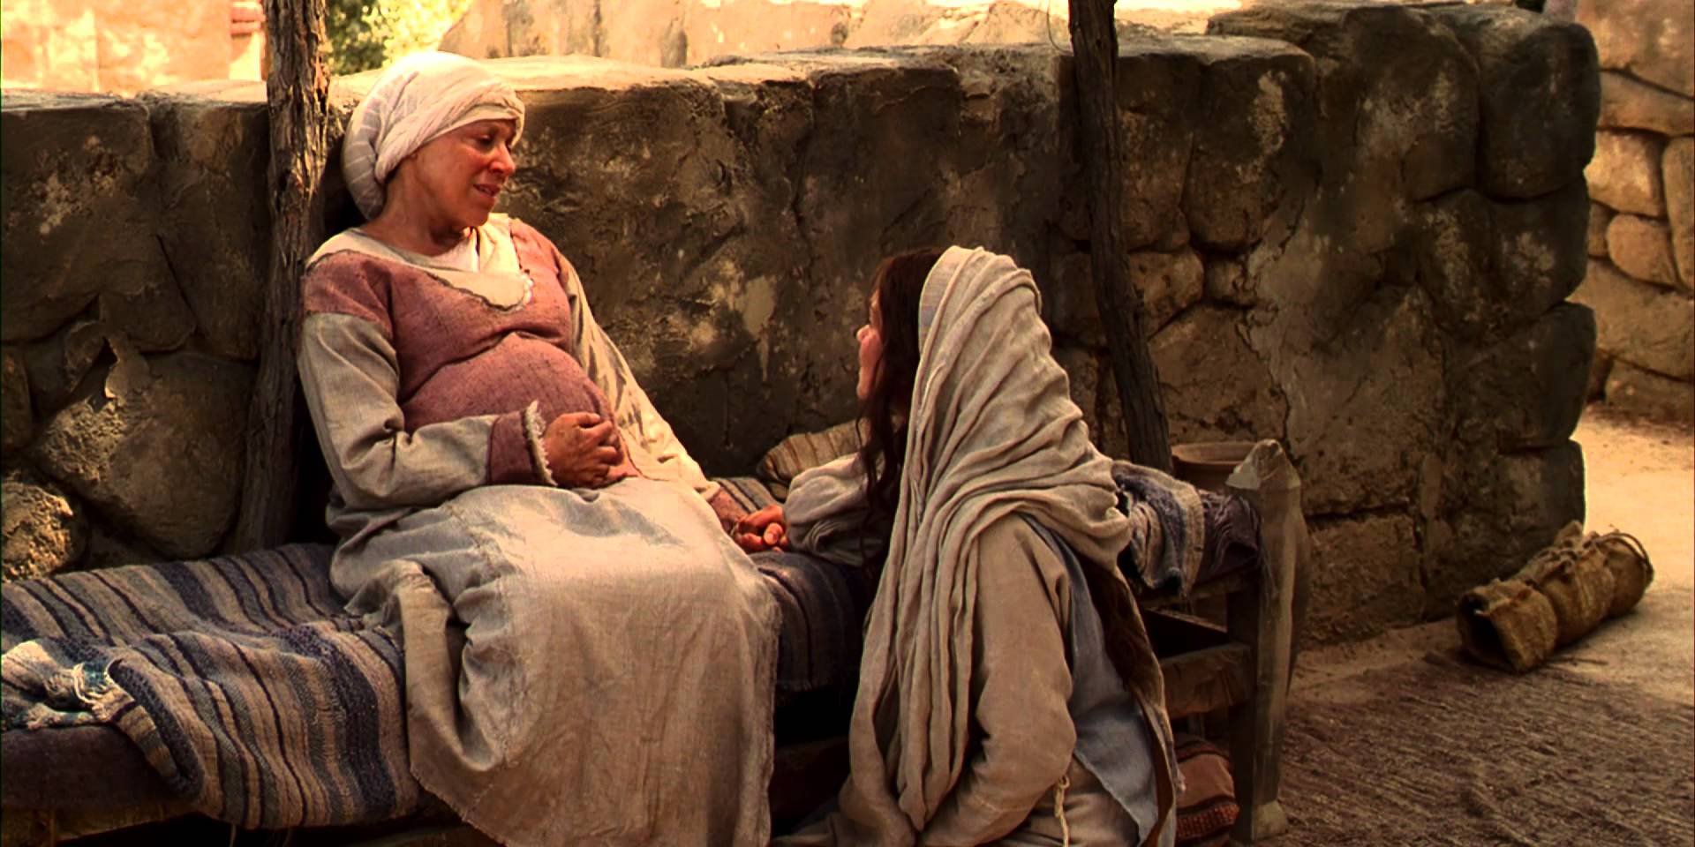
⁴⁵ Blessed is she who has believed that the Lord would fulfill his promises to her!”

Slide 17
God-grounded HOPE grows in the soil of Word-based conviction.

Slide 18
Luke 1:46-48
⁴⁶ And Mary said:
“My soul glorifies the Lord ⁴⁷ and my spirit rejoices in God my Savior, ⁴⁸ for he has been mindful of the humble state of his servant.

Slide 19
God-grounded HOPE believes that God turns the world’s notion of “success” on its head.

Slide 20
Luke 1:46-48
“My soul glorifies the Lord ⁴⁷ and my spirit rejoices in God my Savior, ⁴⁸ for he has been mindful of the humble state of his servant. From now on all generations will call me blessed, ⁴⁹ for the Mighty One has done great things for me— holy is his name.

Slide 21
Jude 24—“To him who is able to keep you from stumbling and to present you before his glorious presence without fault and with great joy…be glory, majesty, power and authority, through Jesus Christ our Lord….”
Philippians 1:6—“He who began a good work in you will carry it on to completion until the day of Christ Jesus.”

Slide 22
Hebrews 13:5—“God has said, “Never will I leave you; never will I forsake you.”
Romans 8:28—“And we know that in all things God works for the good of those who love him….”
John 15:7—“If you remain in me and my words remain in you, ask whatever you wish, and it will be done for you.”

Slide 23
Luke 1
⁴⁹ for the Mighty One has done great things for me— holy is his name. ⁵⁰ His mercy extends to those who fear him, from generation to generation. ⁵¹ He has performed mighty deeds with his arm;

Slide 24
Luke 1
⁴⁹ for the Mighty One has done great things for me— holy is his name. ⁵⁰ His mercy extends to those who fear him, from generation to generation. ⁵¹ He has performed mighty deeds with his arm;

Slide 25
Luke 1
⁴⁹ for the Mighty One has done great things for me— holy is his name. ⁵⁰ His mercy extends to those who fear him, from generation to generation. ⁵¹ He has performed mighty deeds with his arm;

Slide 26
Luke 1 ⁵¹ He has performed mighty deeds with his arm;
³² “He will be great and will be called the Son of the Most High. The Lord God will give him the throne of his father David, and he will reign over Jacob’s descendants forever; his kingdom will never end.”

Slide 27
⁵¹ He [God] has scattered those who are proud in their inmost thoughts. ⁵² He has brought down rulers from their thrones but has lifted up the humble. ⁵³ He has filled the hungry with good things but has sent the rich away empty. ⁵⁴ He has helped his servant Israel, remembering to be merciful ⁵⁵ to Abraham and his descendants forever, just as he promised our ancestors.”

Slide 28
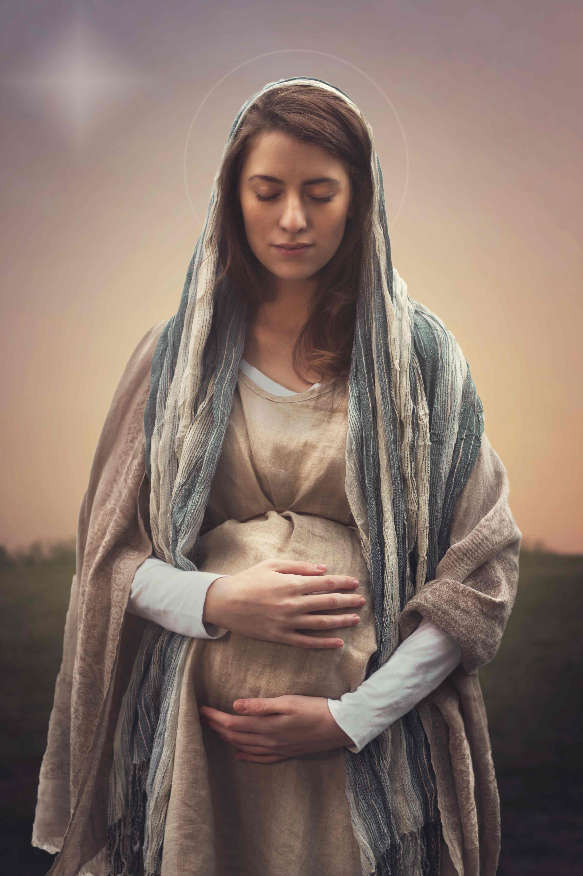
God chooses those the world discards
and humbles those the world chooses.

