Slide 1
JOHN 17
The REAL Lord’s Prayer

Slide 2
“God possesses supreme power and authority so that He is in complete control and accomplishes whatever He pleases anywhere and at all times.”

Slide 3
Daniel 4:34, 35 “At the end of that time, I, Nebuchadnezzar, raised my eyes toward heaven, and my sanity was restored. Then I praised the Most High; I honored and glorified him who lives forever. His dominion is an eternal dominion; his kingdom endures from generation to generation. 35) All the peoples of the earth are regarded as nothing. He does as he pleases with the powers of heaven and the peoples of the earth. No one can hold back his hand or say to him: “What have you done?”

Slide 4
Ephesians 1:11 “In him we were also chosen, having been predestined according to the plan of him who works out everything in conformity with the purpose of his will, 12)in order that we, who were the first to put our hope in Christ, might be for the praise of his glory.”

Slide 5
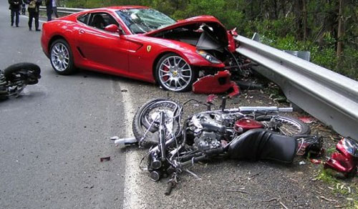
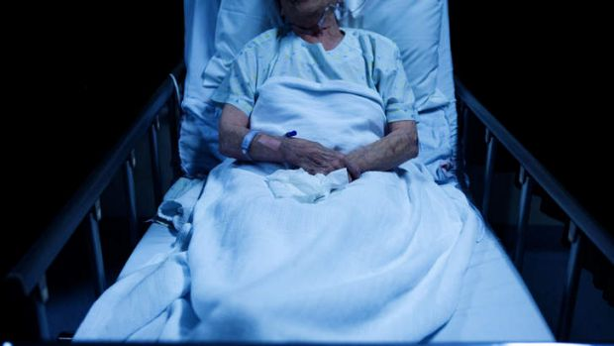
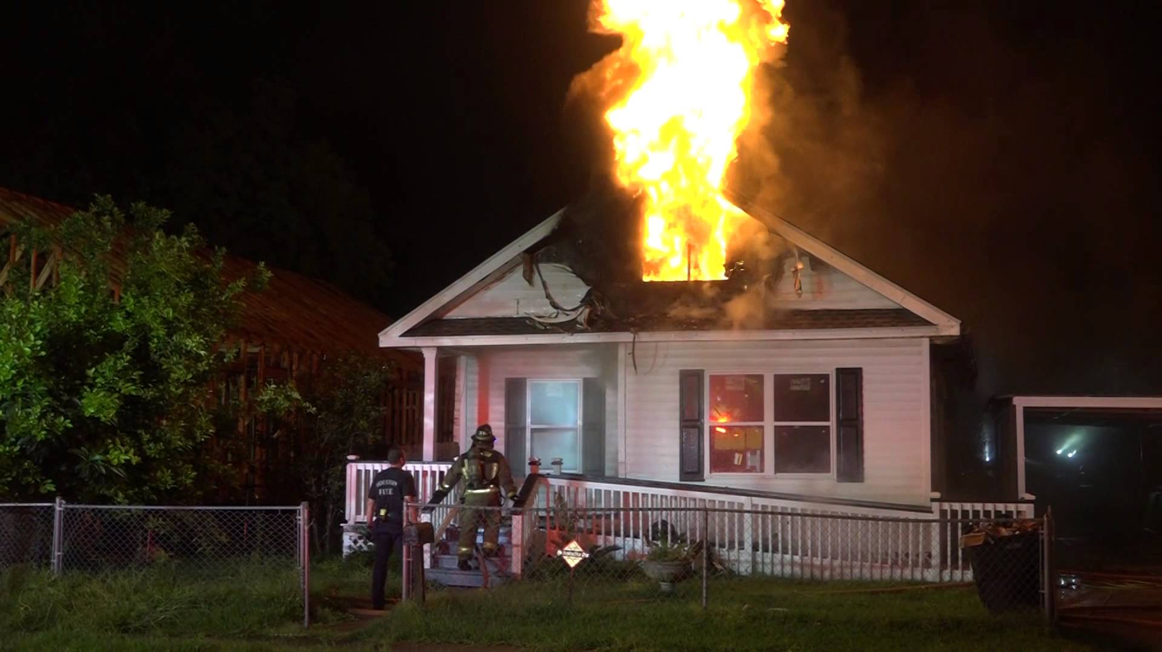
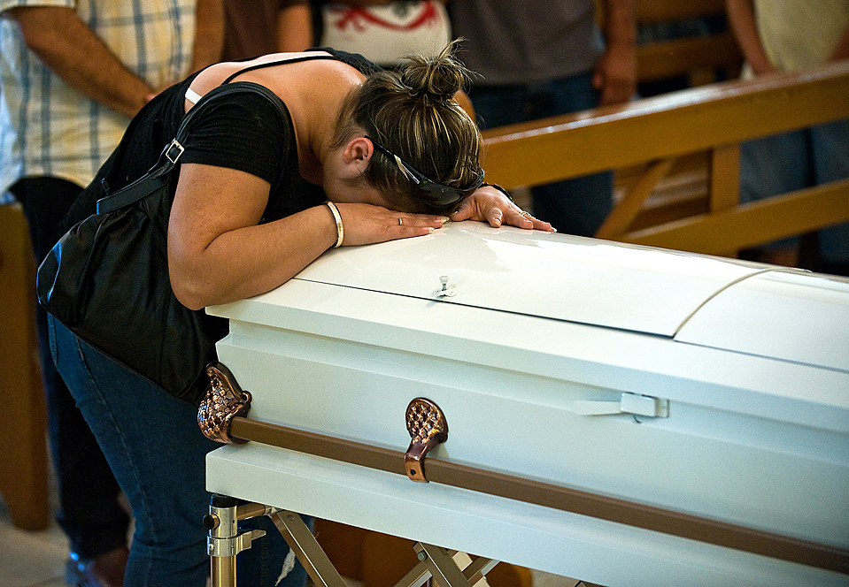
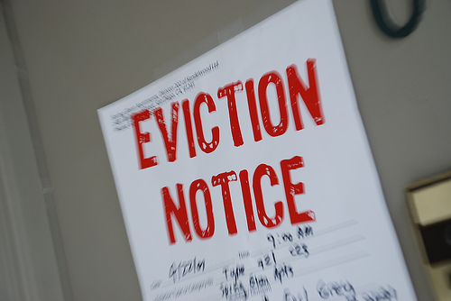
???

Slide 6
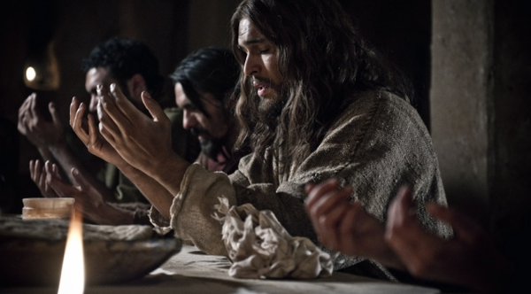
John 17

Slide 7
John 17:1—After Jesus said this, he looked toward heaven and prayed: “Father, the hour has come.”
1. Praying with Jesus engages our body, soul and spirit with the greatness of God.

Slide 8
John 17:1 “Father, the hour has come.”
2. Praying with Jesus recognizes the eternal God’s sovereignty over our fleeting TIME.

Slide 9
John 17:1 “Father, the hour has come.”
3. Praying with Jesus embraces the part of glorifying God that is hard and difficult—suffering.

Slide 11
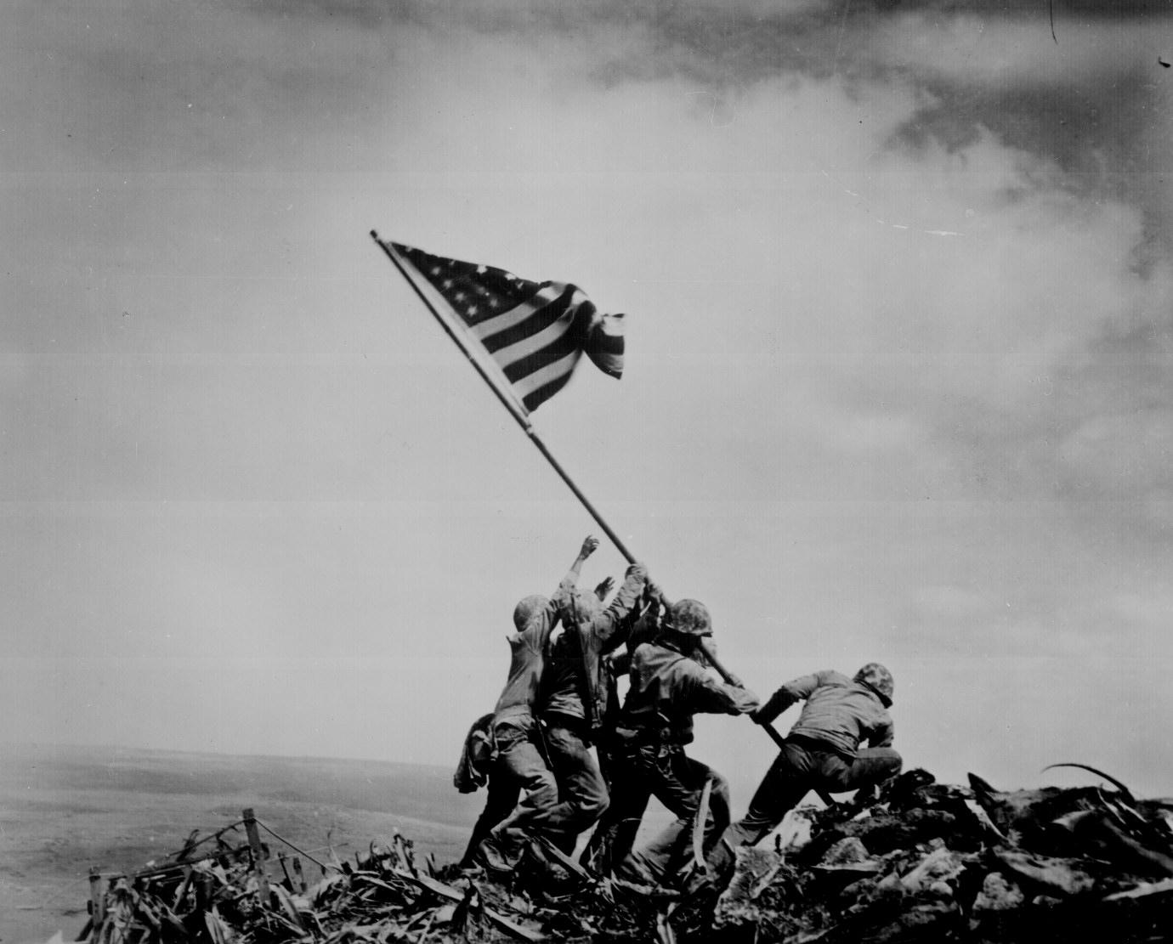

Slide 12
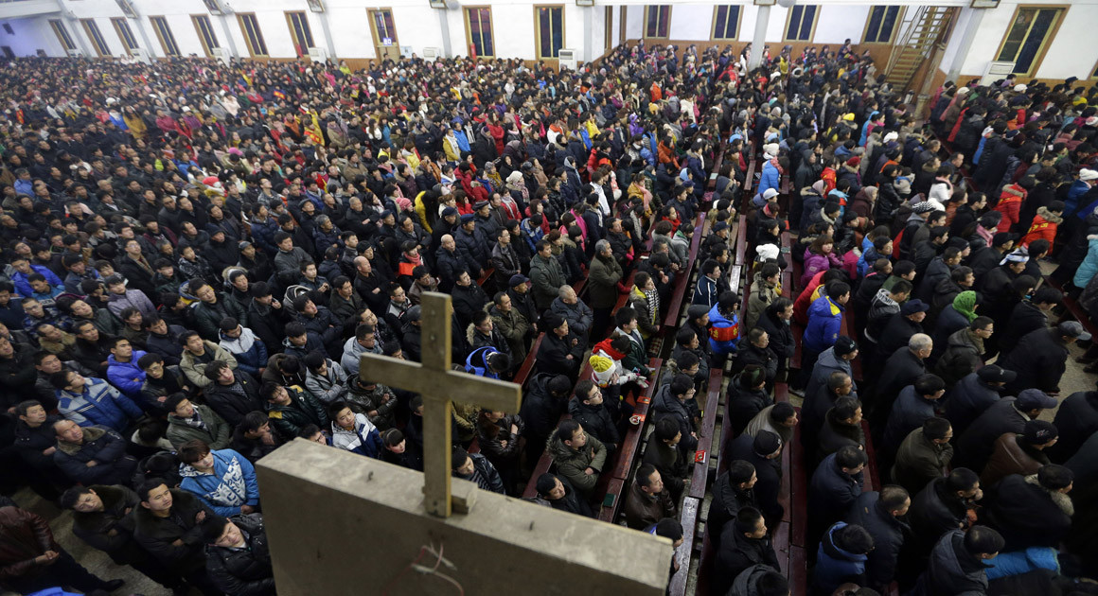
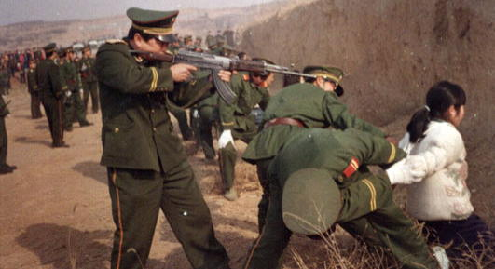
What suffering do you need to pray will glorify God?

Slide 13
John 17:2—“For you [the Father] granted him [the Son] authority over all people that he might give eternal life to all those you have given him.”
4. Praying with Jesus embraces God’s authority over everyone …especially when it comes to their salvation, their relationship with God.

Slide 14
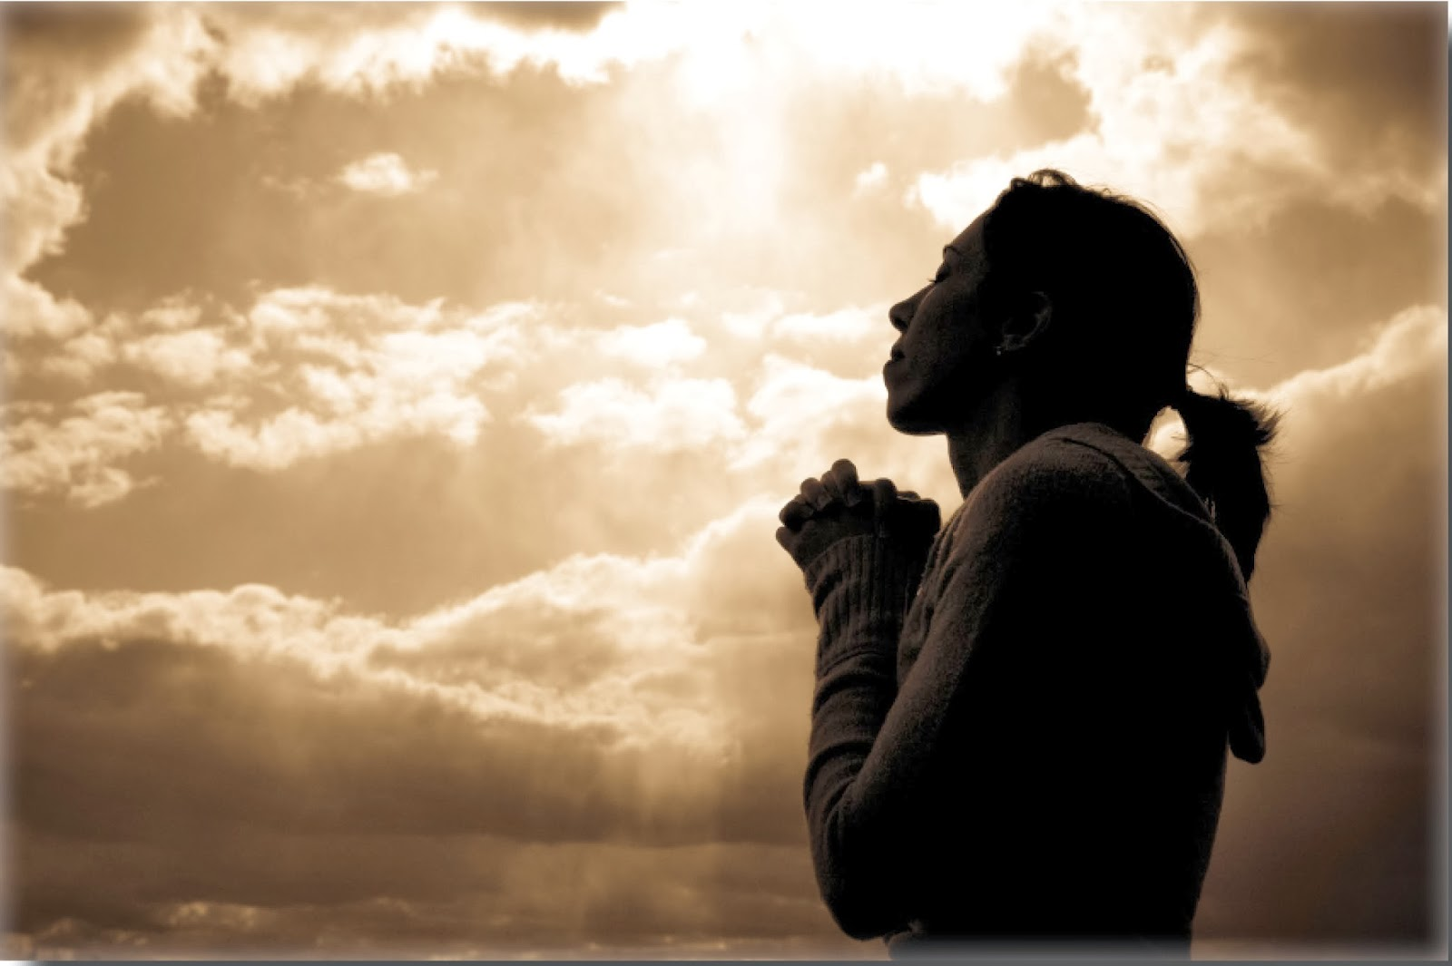
Pray for someone you know who needs Jesus Christ.

Slide 15
John 17:3—“Now this is eternal life: that they know you, the only true God, and Jesus Christ, whom you have sent.”
5. Praying with Jesus acknowledges that experiential knowledge of God IS the life our souls long for.

Slide 16
John 10 Vs. 14—I am the good shepherd; I know my sheep and my sheep know me— Vs. 15—just as the Father knows me and I know the Father—and I lay down my life for the sheep. Vs. 27—My sheep listen to my voice; I know them, and they follow me.”

Slide 17
Invite God to make prayer an experiential encounter with Him.

Slide 18
John 17:4— “I have brought you glory on earth by finishing the work you gave me to do.”
6. Praying with Jesus embraces the work God has given each of us to do.

Slide 19
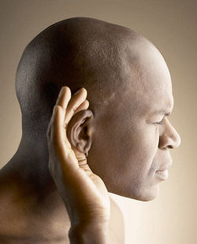
Pray about your Kingdom work… then listen for God… and take action!

