Slide 1
Stewardship of citizenship

Slide 2
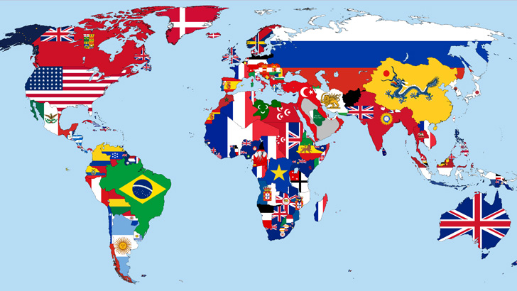

Slide 3
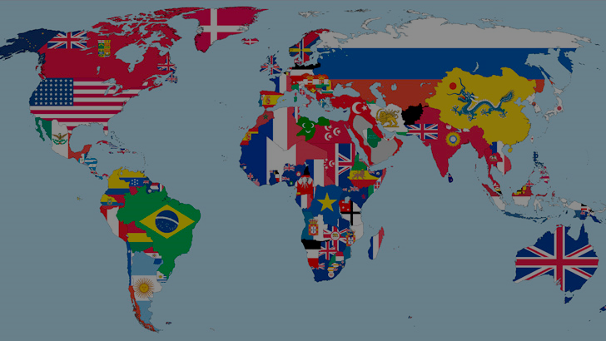
Developing a
theology of citizenship

Slide 4
Developing a theology of citizenship…
requires determining what is “GOOD.”

Slide 5
Forms of Government

Slide 6
Forms of Government
Autocracy
Oligarchy
Republic
Theocracy

Slide 7
Are there biblical forms of Government?
“Good” government is that which
a.) conforms to the just nature of God while
b.) understanding the fallen nature of man.

Slide 8
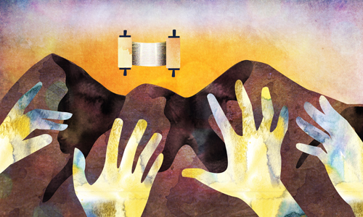
Israel…a theocracy

Slide 9
Israel…a theocracy
Turned monarchy

Slide 10
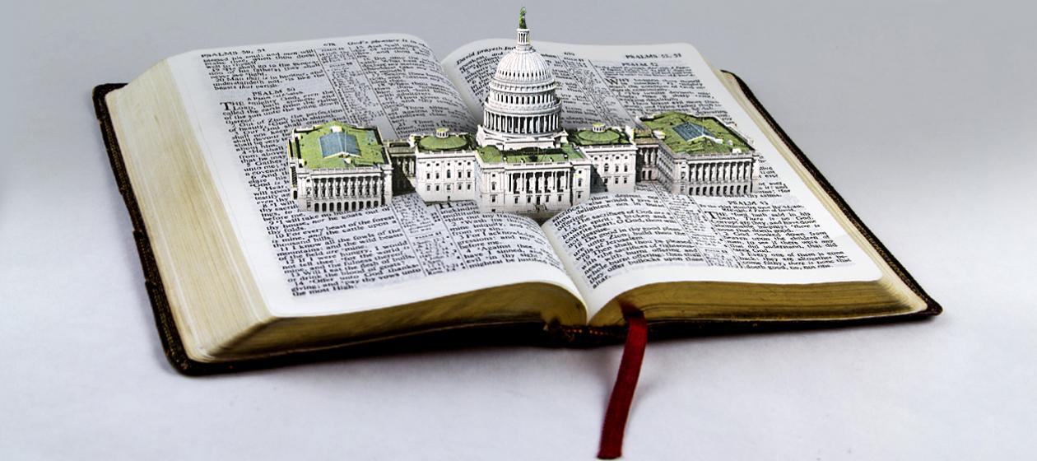
What is the purpose of government?

Slide 11
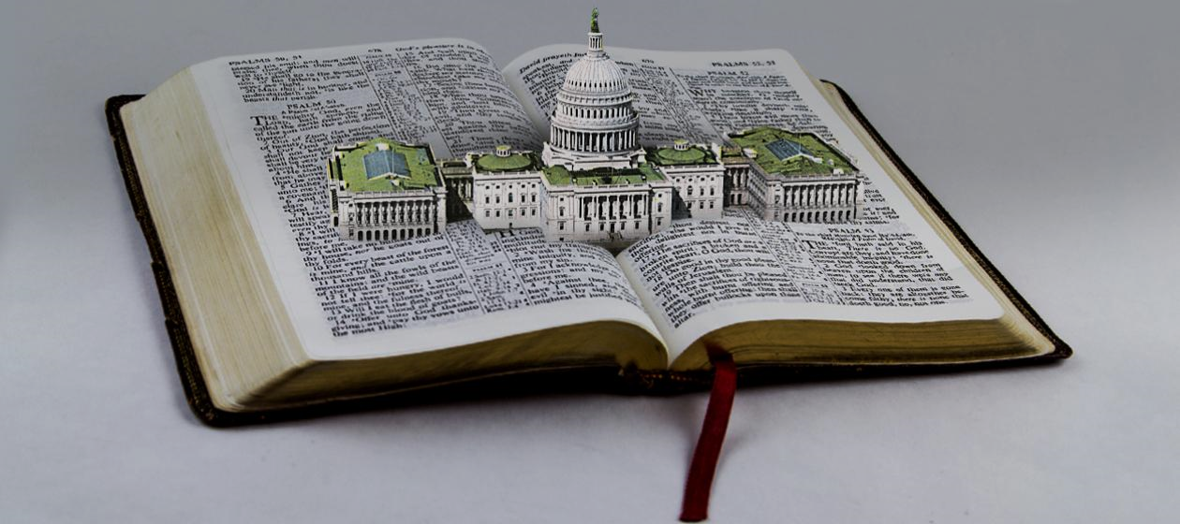
What is the purpose of government?
JUSTICE—the practice of truth (i.e. God’s truth) in human relationships.

Slide 12
What is the good we should all be seeking in our human relationships, i.e. in government?

Slide 13
ELEMENTS OF GOOD CHRISTIAN CITIZENSHIP

Slide 14
ELEMENTS OF GOOD CHRISTIAN CITIZENSHIP
A preeminent commitment to the Lordship of Jesus Christ and the living out of His truth/word.

Slide 15
ELEMENTS OF GOOD CHRISTIAN CITIZENSHIP
2. An attitude/spirit of submission to and respect for authority

Slide 16
1st Peter 2:13-17—Submit yourselves for the Lord’s sake to every human authority: whether to the emperor, as the supreme authority, ¹⁴ or to governors, who are sent by him to punish those who do wrong and to commend those who do right.
¹⁵ For it is God’s will that by doing good you should silence the ignorant talk of foolish people. ¹⁶ Live as free people, but do not use your freedom as a cover-up for evil; live as God’s slaves. ¹⁷ Show proper respect to everyone, love the family of believers, fear God, honor the emperor.

Slide 17
ELEMENTS OF GOOD CHRISTIAN CITIZENSHIP
3. Praying for our rulers:
I Timothy 2:1-2—I urge, then, first of all, that petitions, prayers, intercession and thanksgiving be made for all people— ² for kings and all those in authority, that we may live peaceful and quiet lives in all godliness and holiness.

Slide 18
ELEMENTS OF GOOD CHRISTIAN CITIZENSHIP
4. Paying taxes:
Mt. 22:21--“So give back to Caesar what is Caesar’s, and to God what is God’s.”

Slide 19
ELEMENTS OF GOOD CHRISTIAN CITIZENSHIP
5. Be a GOOD STEWARD of whatever form of government God places you under!
Matthew 25

Slide 20
Being a GOOD STEWARD of government…
1. VOTING wisely

Slide 21
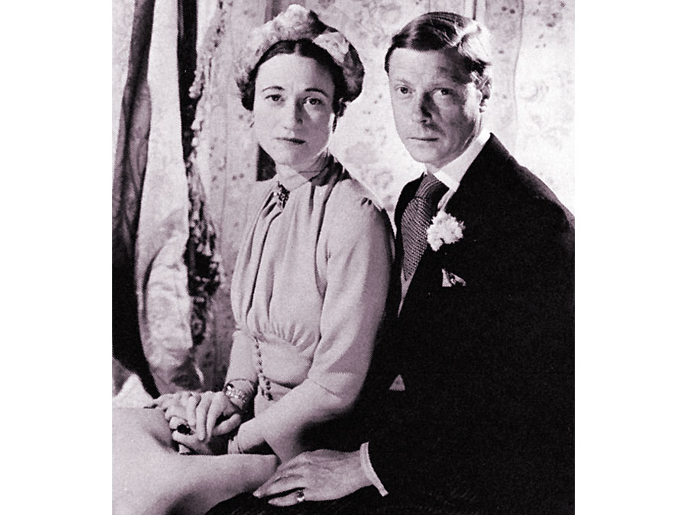

Slide 22
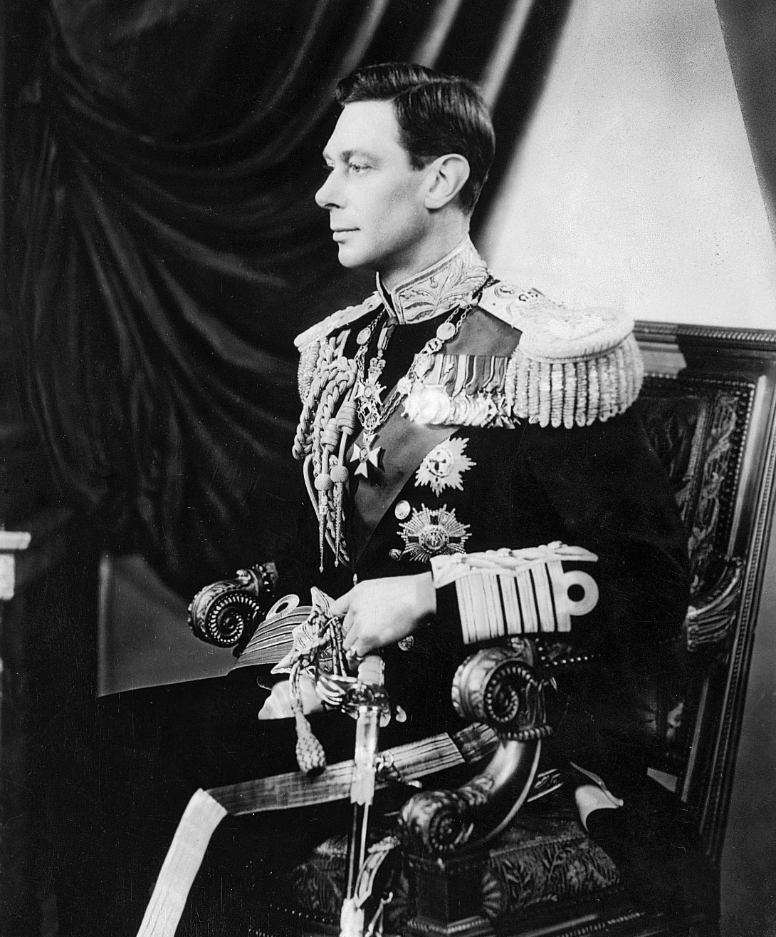

Slide 23
Are all political issues
of equal moral impact
for followers of Jesus Christ?

Slide 24
QUESTIONS???

Slide 25
2 Timothy 2:2-4 (NIV)
And the things you have heard me say in the presence of many witnesses entrust to reliable people who will also be qualified to teach others. ³Join with me in suffering, like a good soldier of Christ Jesus. ⁴ No one serving as a soldier gets entangled in civilian affairs, but rather tries to please his commanding officer.

