Slide 1
The bad news about the good news

Slide 2
Romans 1:18-23
¹⁸ The wrath of God is being revealed from heaven against all the godlessness and wickedness of people, who suppress the truth by their wickedness, ¹⁹ since what may be known about God is plain to them, because God has made it plain to them.
²⁰ For since the creation of the world God’s invisible qualities—his eternal power and divine nature—have been clearly seen, being understood from what has been made, so that people are without excuse.

Slide 3
Romans 1:18-23
²¹ For although they knew God, they neither glorified him as God nor gave thanks to him, but their thinking became futile and their foolish hearts were darkened. ²² Although they claimed to be wise, they became fools ²³ and exchanged the glory of the immortal God for images made to look like a mortal human being and birds and animals and reptiles.

Slide 4
Romans 1:18-23
¹⁸ The wrath of God is being revealed from heaven against all the godlessness and wickedness of people, who suppress the truth by their wickedness, ¹⁹ since what may be known about God is plain to them, because God has made it plain to them.
²⁰ For since the creation of the world God’s invisible qualities—his eternal power and divine nature—have been clearly seen, being understood from what has been made, so that people are without excuse.

Slide 5
Romans 1:18-23
¹⁸ The wrath of God is being revealed from heaven against all the godlessness and wickedness of people, who suppress the truth by their wickedness…
Truth = that which conforms to reality or actuality.

Slide 6
Romans 1:18-23
¹⁸ The wrath of God is being revealed from heaven against all the godlessness and wickedness of people, who suppress the truth by their wickedness, ¹⁹ since what may be known about God is plain to them, because God has made it plain to them.
²⁰ For since the creation of the world God’s invisible qualities—his eternal power and divine nature—have been clearly seen, being understood from what has been made, so that people are without excuse.

Slide 7
Romans 1:18-23
¹⁸ The wrath of God is being revealed from heaven against all the godlessness and wickedness of people, who suppress the truth by their wickedness, ¹⁹ since what may be known about God is plain to them, because God has made it plain to them.
²⁰ For since the creation of the world God’s invisible qualities—his eternal power and divine nature—have been clearly seen, being understood from what has been made, so that people are without excuse.

Slide 8
Romans 1:18-23
²¹ For although they knew God, they neither glorified him as God nor gave thanks to him, but their thinking became futile and their foolish hearts were darkened. ²² Although they claimed to be wise, they became fools ²³ and exchanged the glory of the immortal God for images made to look like a mortal human being and birds and animals and reptiles.

Slide 9
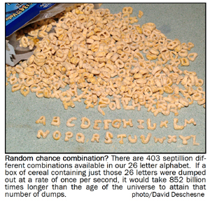

Slide 12
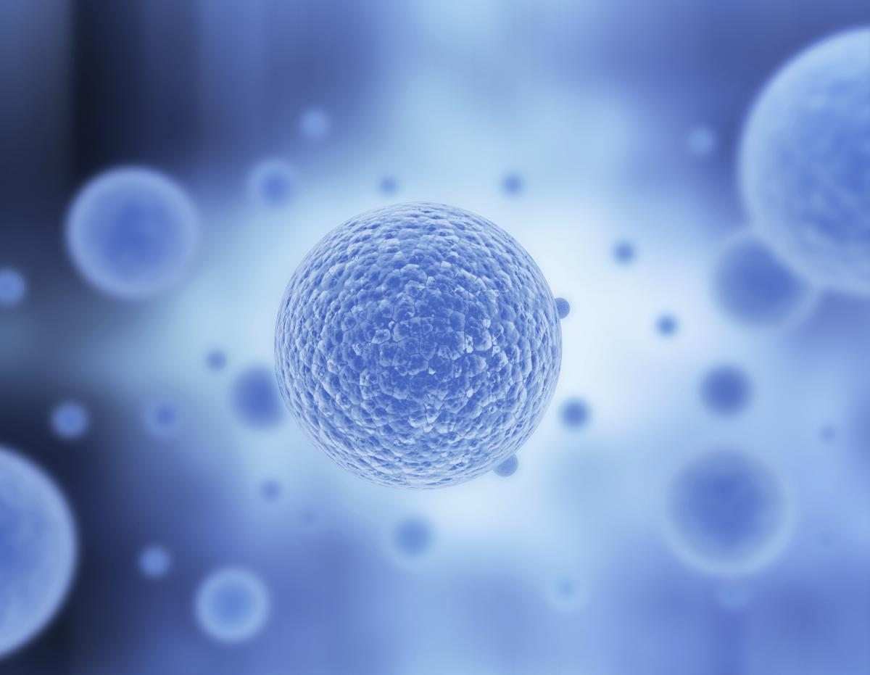

Slide 14
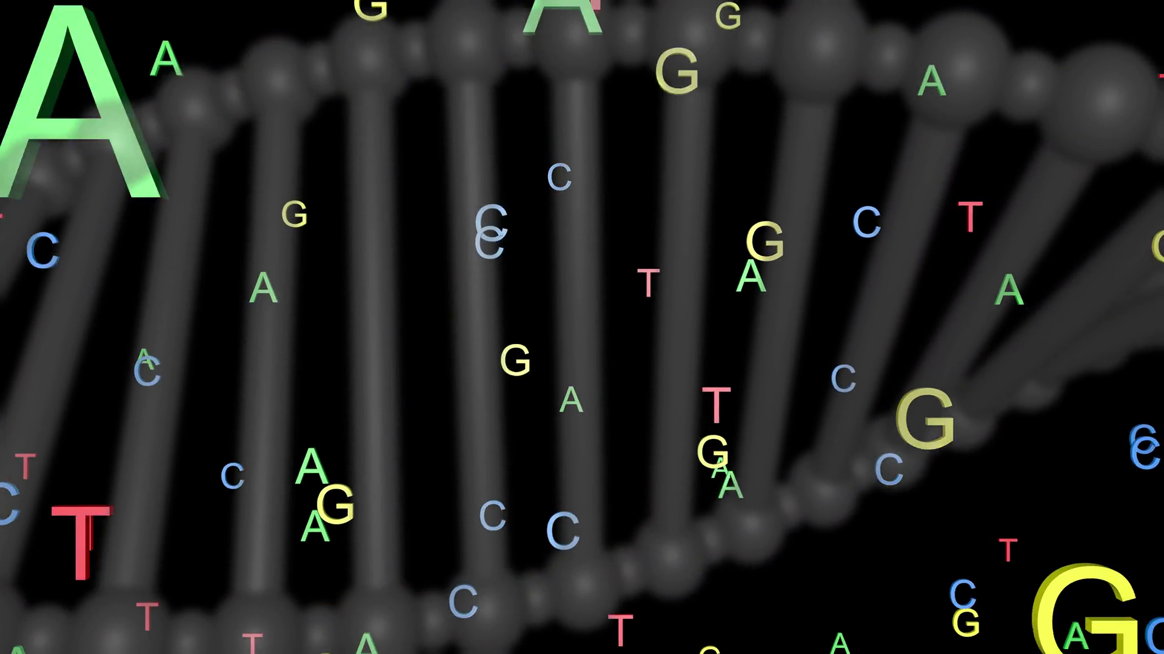

Slide 15
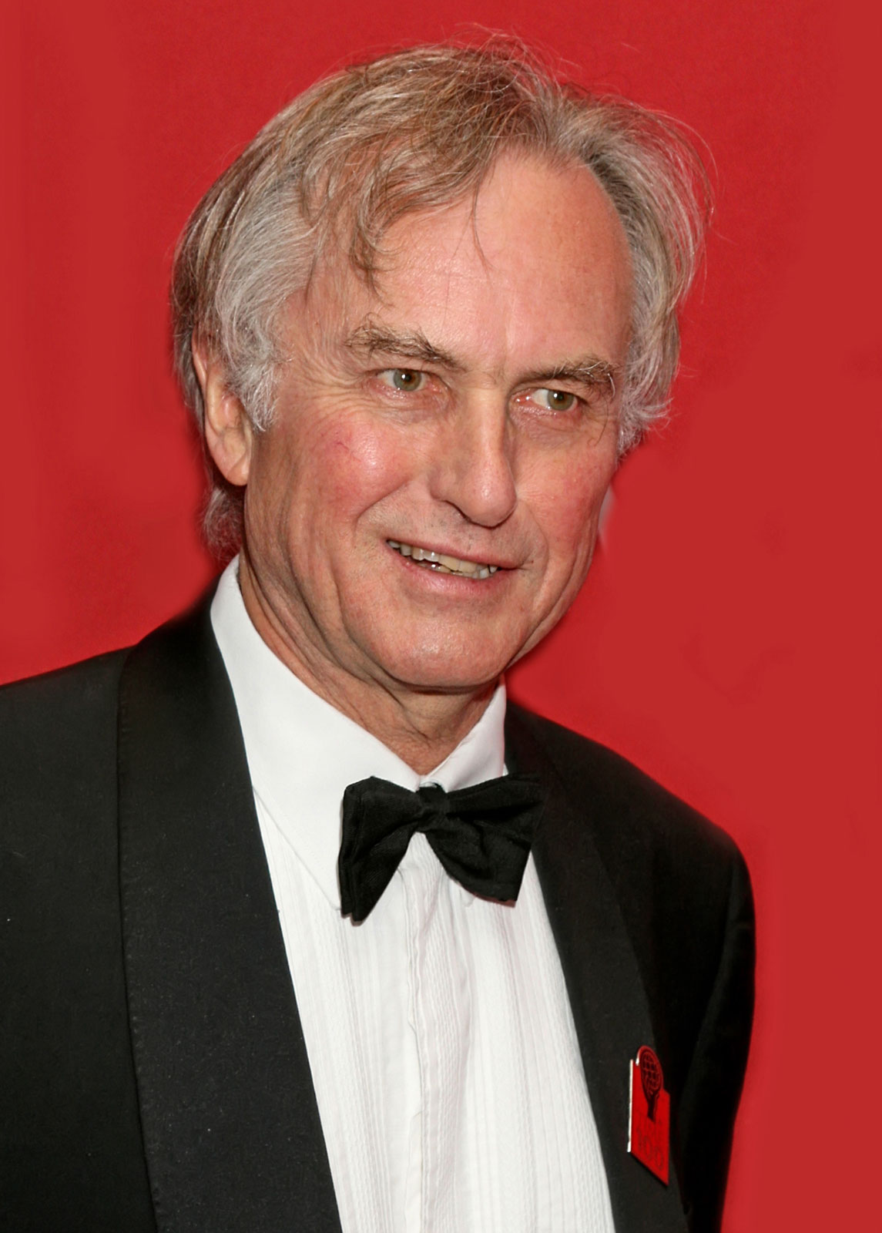
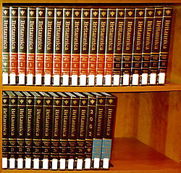
X 1000
33,000,000 pages

Slide 16
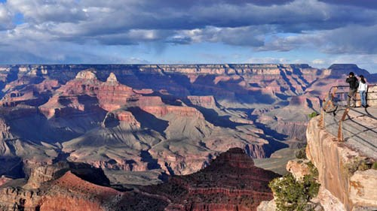
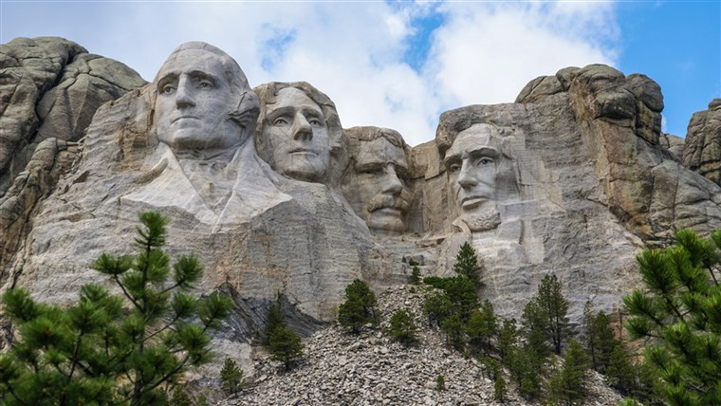

Slide 17
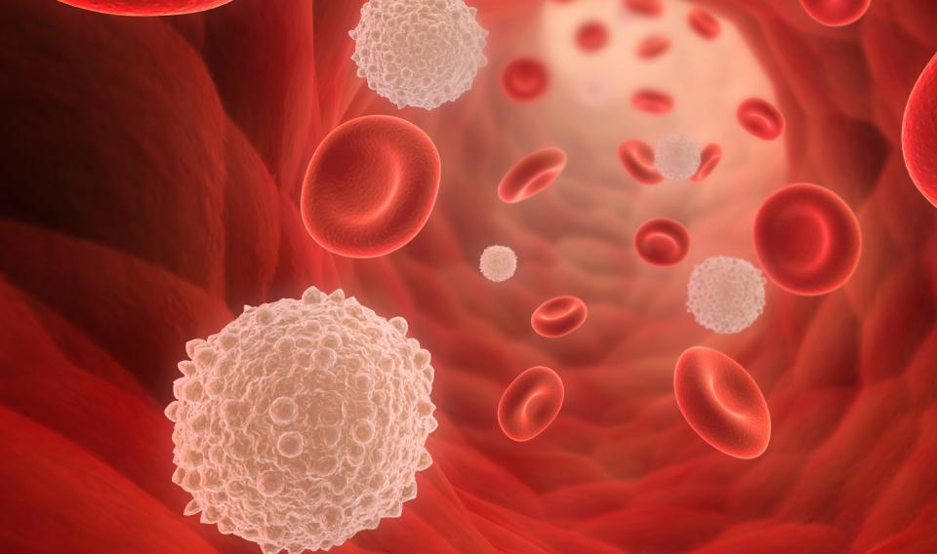
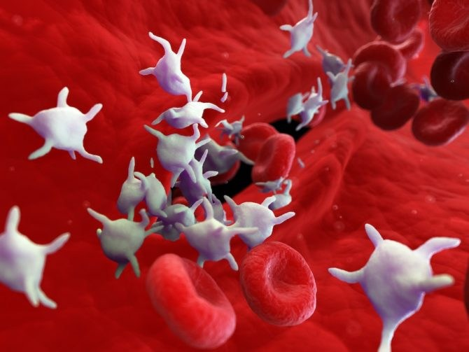
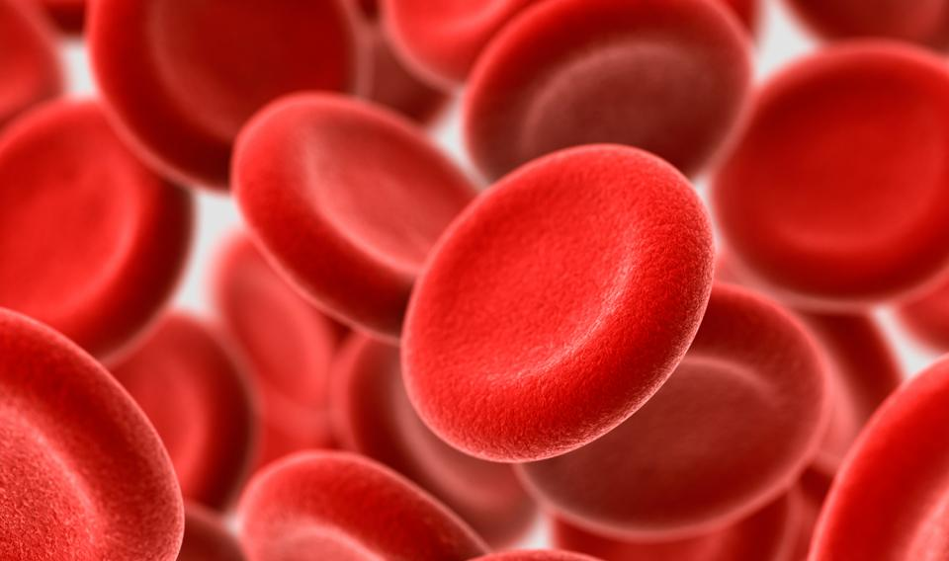

Slide 18
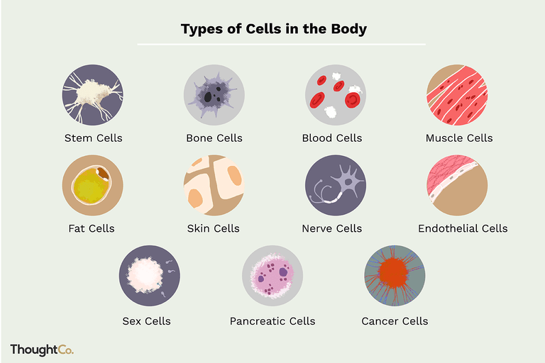

Slide 20
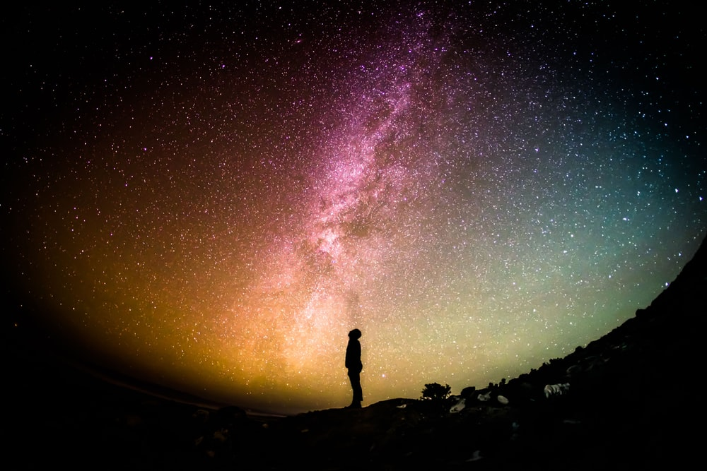

Slide 21
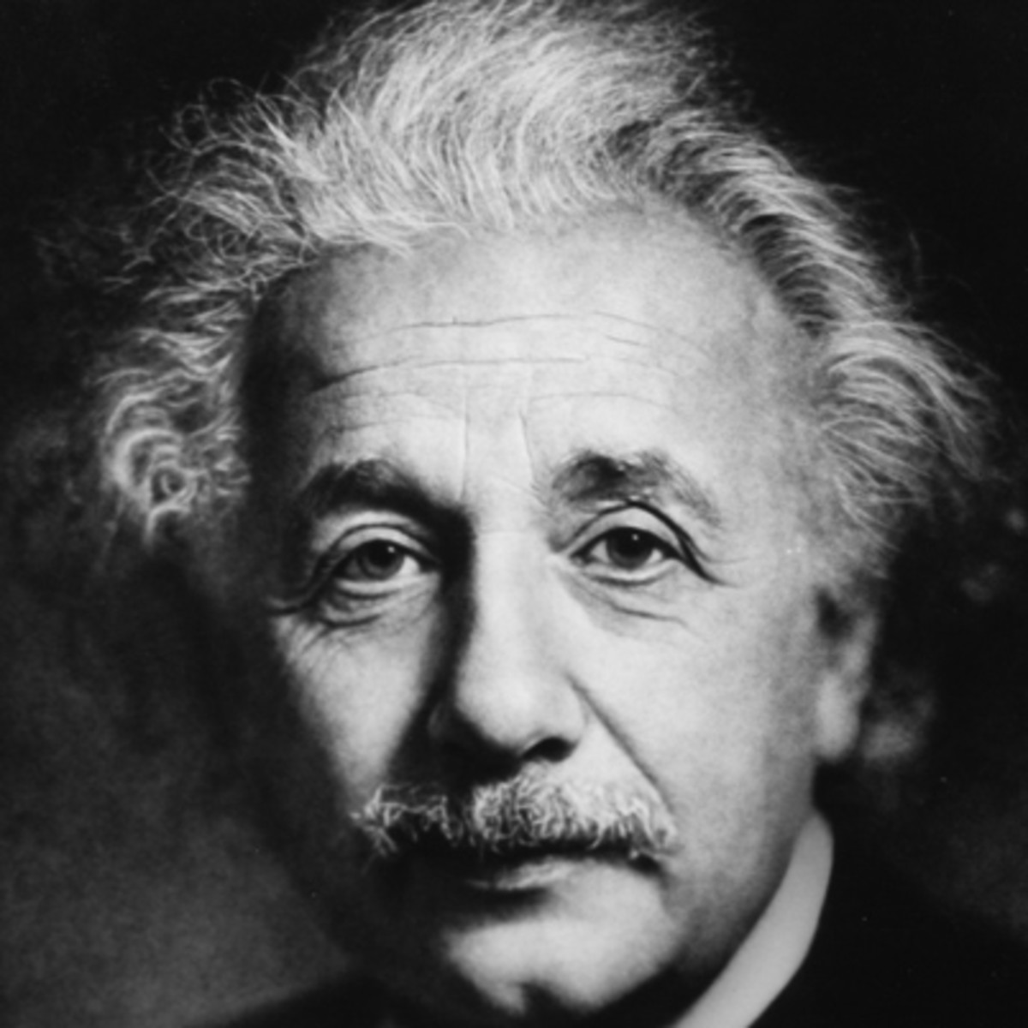
“Science without religion is lame; religion without science is blind.”

Slide 22
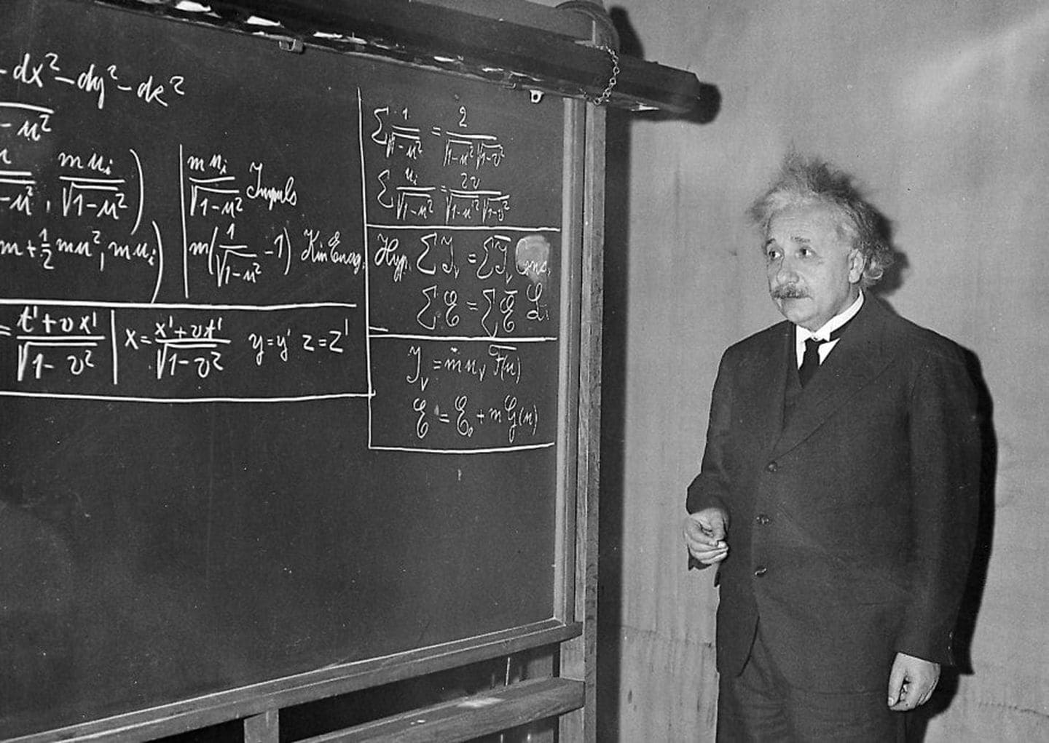
0.00001 degree of accuracy

Slide 23
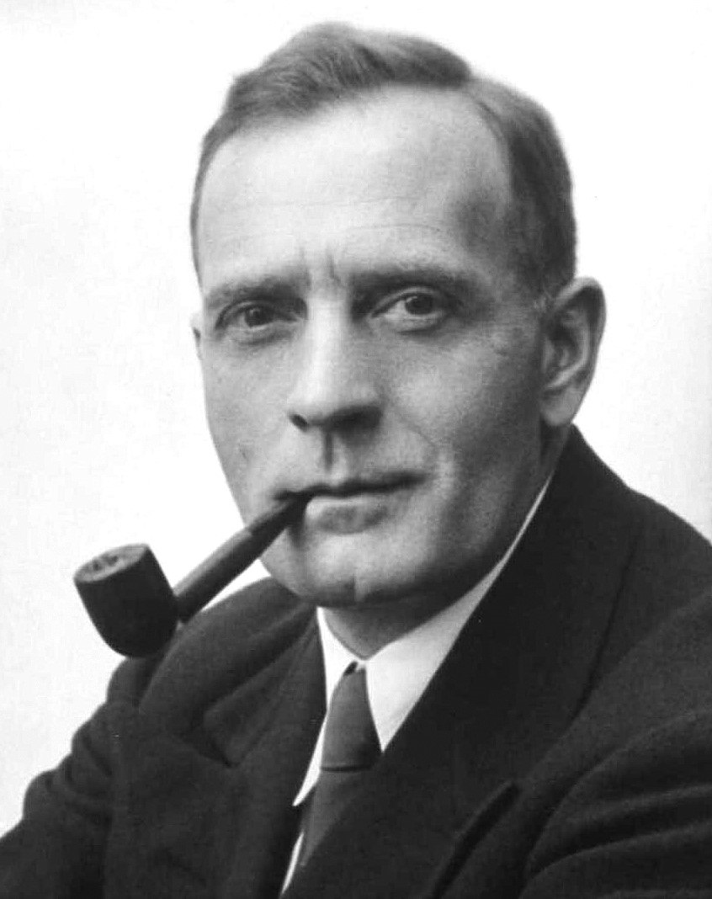
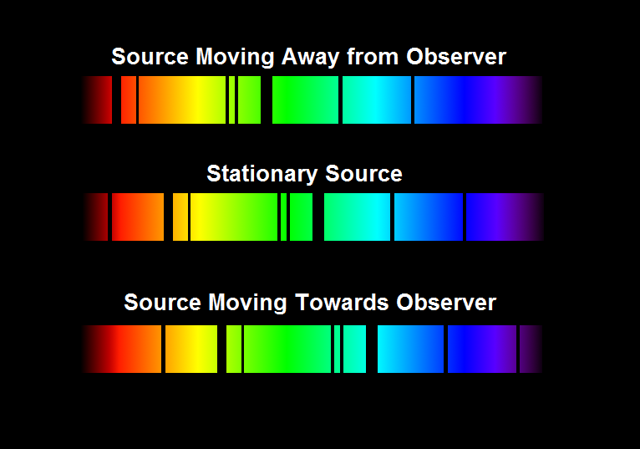
Edwin Hubble
1889-1953

Slide 24
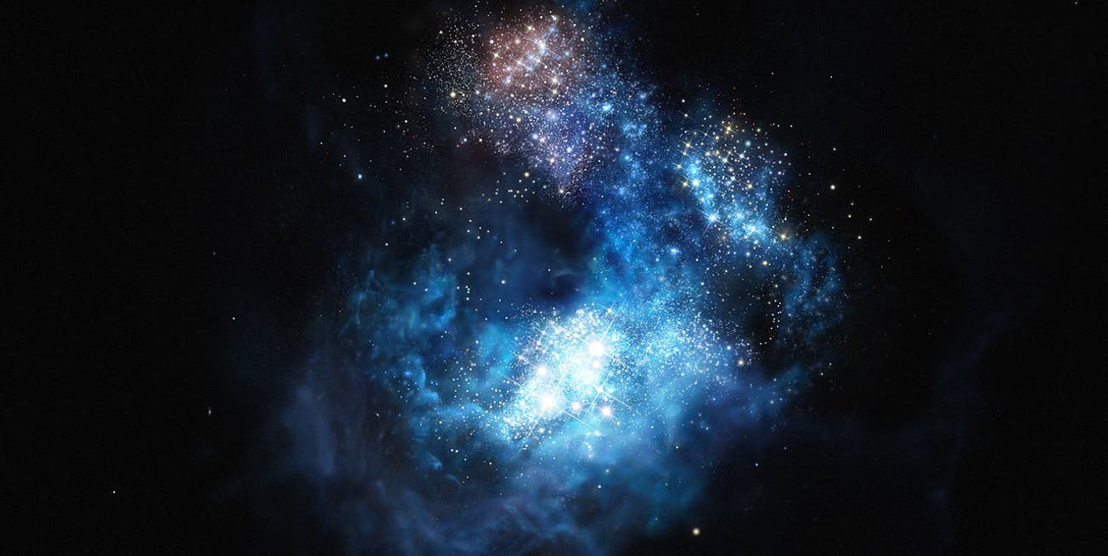

Slide 25
1. Everything that had a beginning had a cause.
2. The universe had a beginning.
3. Therefore the universe had a cause.

Slide 26
1. Everything that had a beginning had a cause.
The Law of Causality

Slide 27
The universe had a beginning.
Second Law of Thermodynamics
U
R
G
E

Slide 28
The universe had a beginning.
Second Law of Thermodynamics
Universe is Expanding
R
G
E

Slide 29
The universe had a beginning.
Second Law of Thermodynamics
Universe is Expanding
Radiation from the Big Bang
G
E

Slide 30
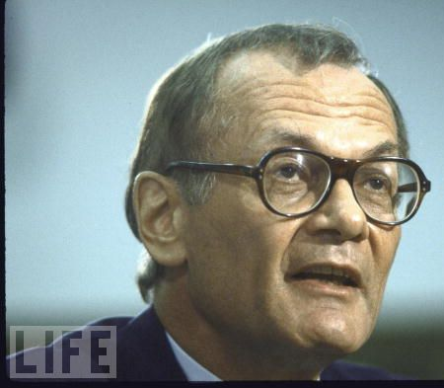
“No explanation other than the Big Bang has been found for the fireball radiation. The clincher, which has convinced almost the last Doubting Thomas, is that the radiation discovered by Penzias and Wilson
has exactly the pattern of wavelengths expected for the light and heat produced in a great explosion. At the present, the Bib Bang theory has no competitors.”

Slide 32
The universe had a beginning.
Second Law of Thermodynamics
Universe is Expanding
Radiation from the Big Bang
Great Galaxy Speeds
E

Slide 33
The universe had a beginning.
Second Law of Thermodynamics
Universe is Expanding
Radiation from the Big Bang
Great Galaxy Speeds
Einstein’s Theory of Relativity

Slide 35
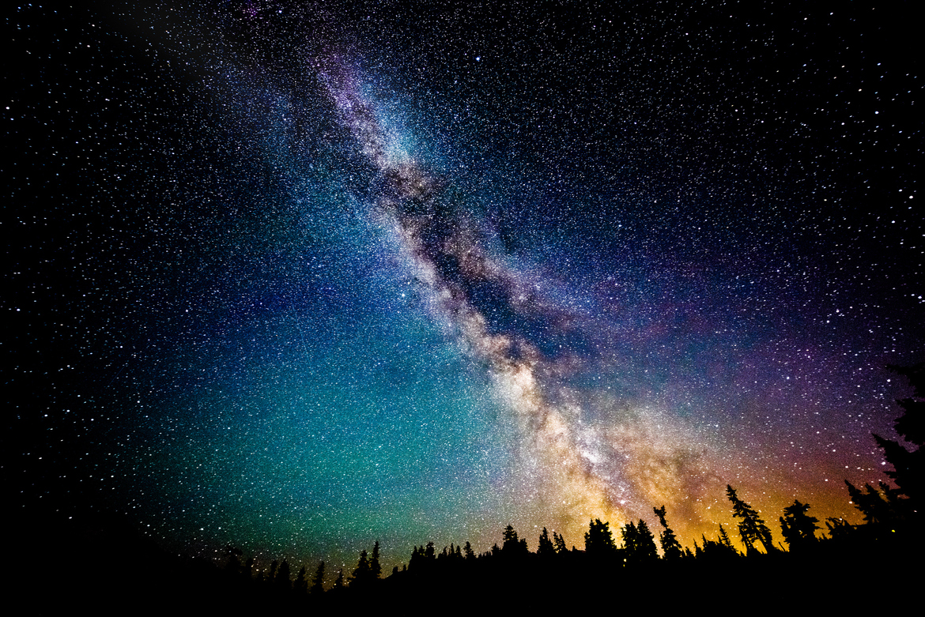
AN ADDITIONAL LINE OF REASONING:
THE ANTHROPIC PRINCIPLE—The design is in the details.

Slide 36
The probability that 122 anthropic constants would exist on any of 10²² planets?
1 x 10¹³⁸
Problem: the number of atoms in the universe is only 1 x 10⁷⁰

Slide 37
Romans 1:20
For since the creation of the world God’s invisible qualities—his eternal power and divine nature—have been clearly seen, being understood from what has been made, so that people are without excuse.

