Slide 1
If you were able to leave one last message with the people you love, what would you want it to include?

Slide 2
Romans 10:14-17 Attractive Feet

Slide 3
Romans 10
⁹ If you declare with your mouth, “Jesus is Lord,” and believe in your heart that God raised him from the dead, you will be saved. ¹⁰ For it is with your heart that you believe and are justified, and it is with your mouth that you profess your faith and are saved.

Slide 4
Romans 10
¹¹ As Scripture says, “Anyone who believes in him will never be put to shame.” ¹² For there is no difference between Jew and Gentile—the same Lord is Lord of all and richly blesses all who call on him, ¹³ for, “Everyone who calls on the name of the Lord will be saved.”

Slide 5
Romans 10
¹⁴ How, then, can they call on the one they have not believed in? And how can they believe in the one of whom they have not heard? And how can they hear without someone preaching to them? ¹⁵ And how can anyone preach unless they are sent? As it is written: “How beautiful are the feet of those who bring good news!”.

Slide 6
Romans 10
¹⁶ But not all the Israelites accepted the good news. For Isaiah says, “Lord, who has believed our message?” ¹⁷ Consequently, faith comes from hearing the message, and the message is heard through the word about Christ.

Slide 7
Romans 10
¹² For there is no difference between Jew and Gentile—the same Lord is Lord of all and richly blesses all who call on him, ¹³ for, “Everyone who calls on the name of the Lord will be saved.”

Slide 8
Romans 10
¹⁴ How, then, can they call on the one they have not believed in? And how can they believe in the one of whom they have not heard? And how can they hear without someone preaching to them? ¹⁵ And how can anyone preach unless they are sent? As it is written: “How beautiful are the feet of those who bring good news!”.

Slide 9
WHO should be doing the sending…and WHO should go?

Slide 10
Matthew 22—Parable of the King & His Son’s Wedding Feast

Slide 11
1st John 4
⁹ This is how God showed his love among us: He sent his one and only Son into the world that we might live through him.
¹⁰ This is love: not that we loved God, but that he loved us and sent his Son as an atoning sacrifice for our sins.
¹⁴ And we have seen and testify that the Father has sent his Son to be the Savior of the world.

Slide 12
Jesus has SENT His followers & us to bring the Gospel to the world:
Luke 9:2—Jesus sent the 12 into Israel
Luke 10:1—Jesus sent the 72 into Israel
John 17:18—as God sent the Son, so He sent his disciples into the world.
John 20:21—Jesus re-sends them just as the Father sent Him.
The Great Commission: Mt. 28:18-20, Mk. 16:15

Slide 13
The Holy Spirit SENT His followers & us to bring the Gospel to the world:
Acts 1:8—But you will receive power when the Holy Spirit comes on you; and you will be my witnesses in Jerusalem, and in all Judea and Samaria, and to the ends of the earth.

Slide 14
The Holy Spirit & the Church SENT missionaries to other cities, peoples and nations:
Acts 13:2-3—While they were worshiping the Lord and fasting, the Holy Spirit said, “Set apart for me Barnabas and Saul for the work to which I have called them.” ³ So after they had fasted and prayed, they placed their hands on them and sent them off. ⁴ The two of them, sent on their way by the Holy Spirit, went down to Seleucia and sailed from there to Cyprus.

Slide 16
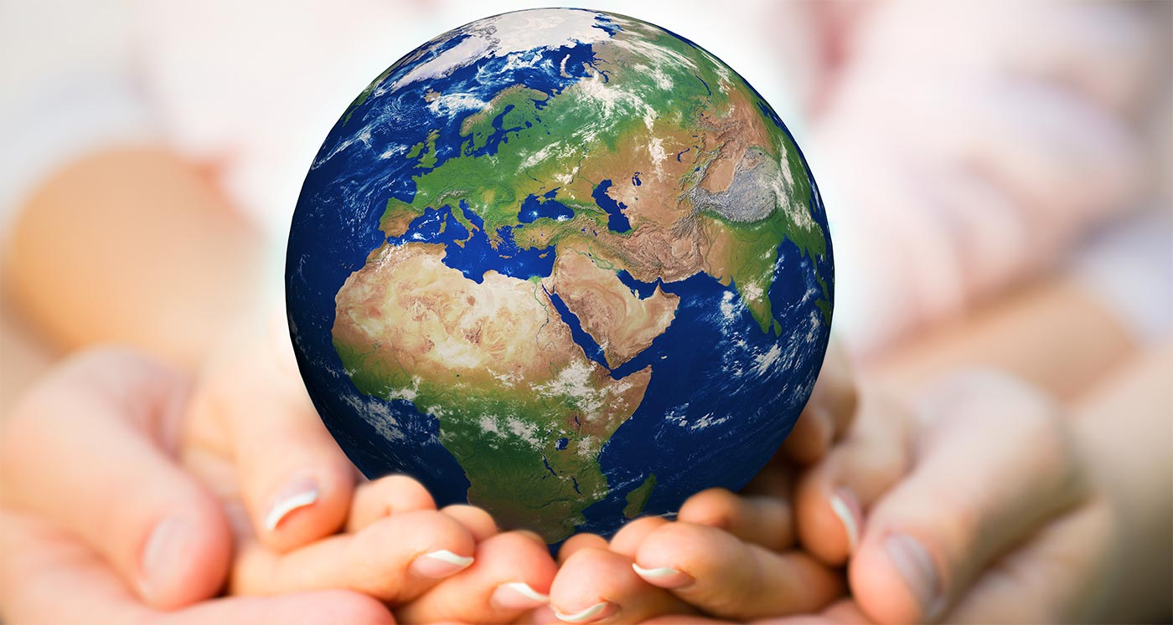
“The fate of the world is in the hands of nameless saints.” --Dr. Paul Billheimer

Slide 17
A CHALLENGE
1.) Choose 1 or MORE missionaries among us to support for as long as you can…
OR
2.) Support ALL of them for some amount as long as you possibly can.

Slide 18
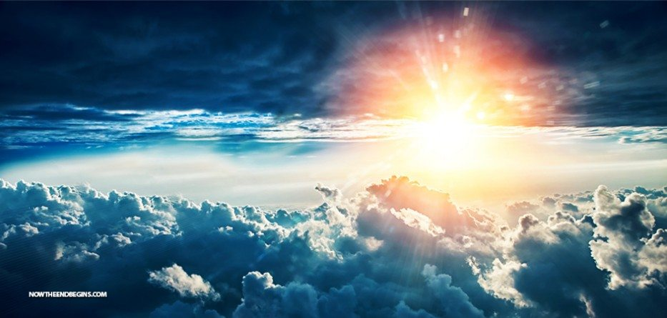
2 Corinthians 5:10
For we must all appear before the judgment seat of Christ, so that each of us may receive what is due us for the things done while in the body, whether good or bad.

Slide 19
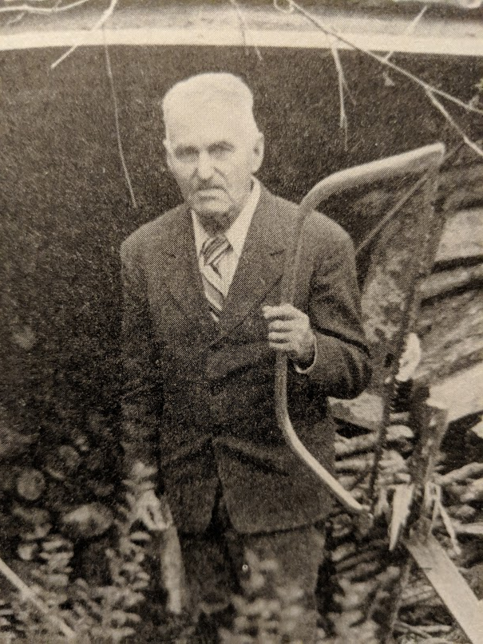
Frank C. Case
1896-1976

Slide 20
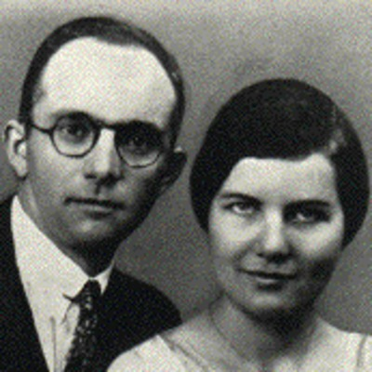
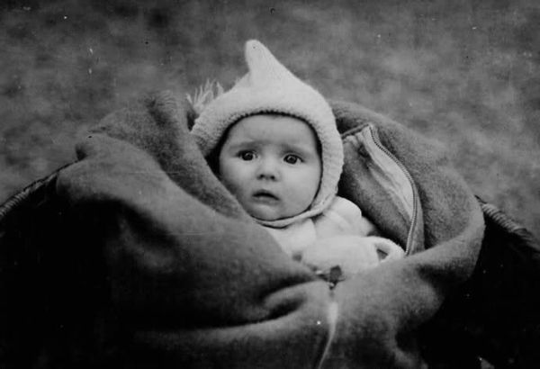
John & Betty Stam
1906/7-1934

Slide 21
“The fate of the world is in the hands of nameless saints.”.”

