Slide 1
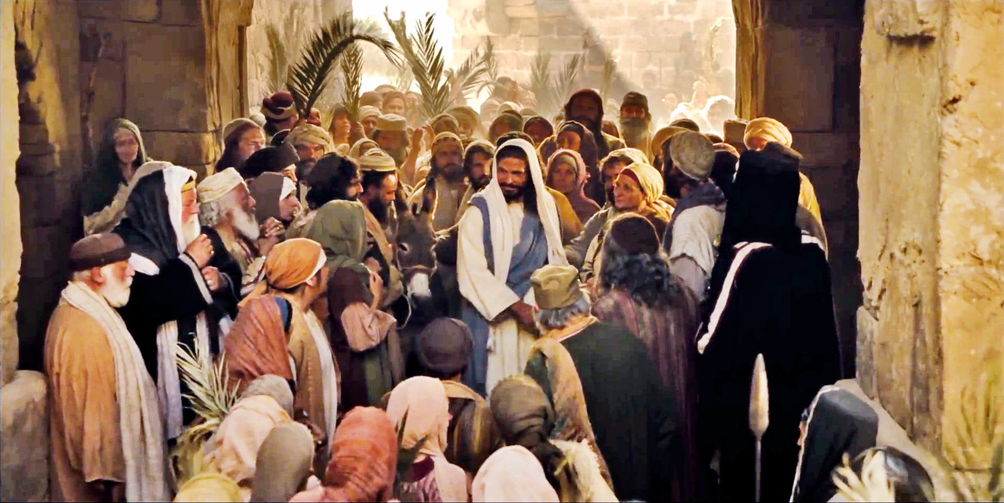
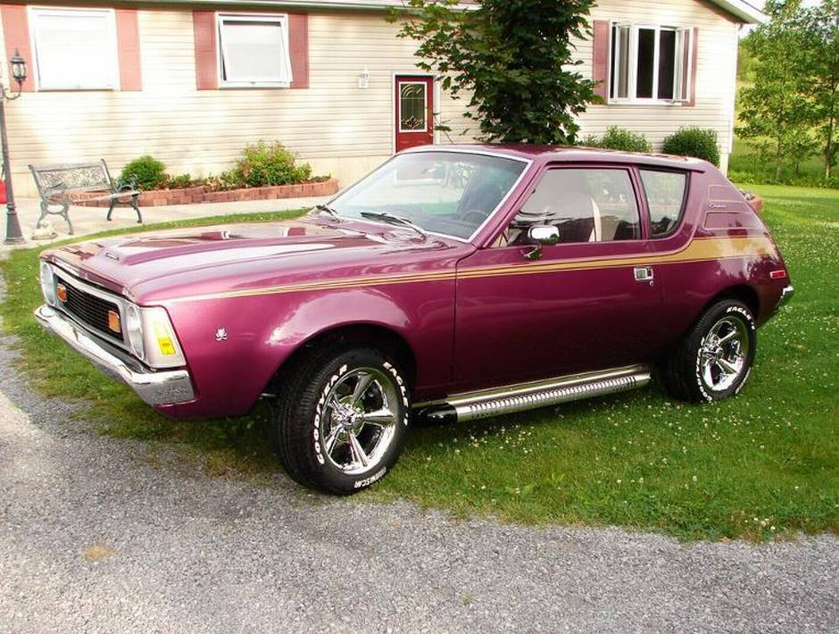

Slide 2
Philippians 1:27-30
²⁷ Whatever happens, conduct yourselves in a manner worthy of the gospel of Christ. Then, whether I come and see you or only hear about you in my absence, I will know that you stand firm in the one Spirit, striving together as one for the faith of the gospel ²⁸ without being frightened in any way by those who oppose you. This is a sign to them that they will be destroyed, but that you will be saved—and that by God.

Slide 3
Philippians 1:27-30
²⁹ For it has been granted to you on behalf of Christ not only to believe in him, but also to suffer for him, ³⁰ since you are going through the same struggle you saw I had, and now hear that I still have.

Slide 4
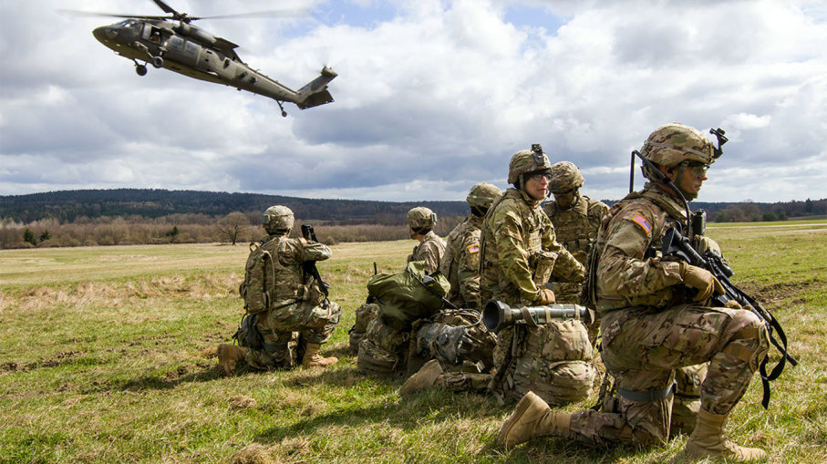

Slide 5
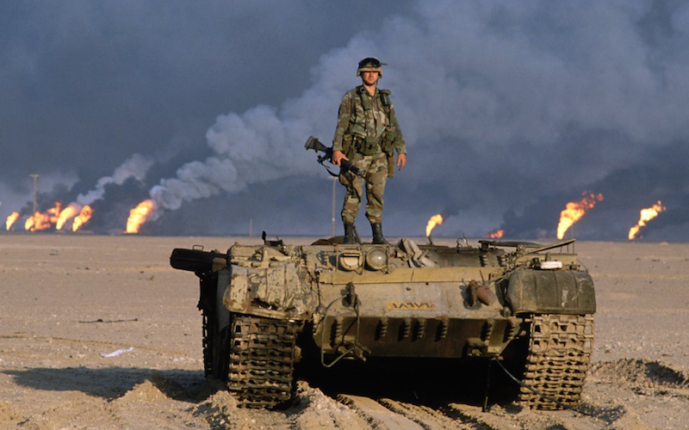
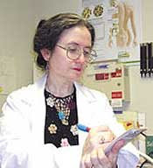

Slide 6
Philippians 1:27
Whatever happens, conduct yourselves in a manner worthy of the gospel of Christ.
#1.) CONDUCT CONSISTENT WITH
OUR CALLING

Slide 7
Philippians 1:27
Whatever happens, conduct yourselves in a manner worthy of the gospel of Christ.
#1.) CONDUCT CONSISTENT WITH
OUR CALLING
“Citizenship” from Greek politeou

Slide 9
OATH OF CITIZENSHIP
I hereby declare, on oath, that I absolutely and entirely renounce and abjure all allegiance and fidelity to any foreign prince, potentate, state, or sovereignty of whom or which I have heretofore been a subject or citizen; that I will support and defend the Constitution and laws of the United States of America against all enemies, foreign and domestic; that I will bear true faith and allegiance to the same;

Slide 10
OATH OF CITIZENSHIP
…that I will bear arms on behalf of the United States when required by law; that I will perform noncombatant service in the Armed Forces of the United States when required by the law; that I will perform work of national importance under civilian direction when required by the law; and that I take this obligation freely without any mental reservation or purpose of evasion; so help me God. In acknowledgement whereof I have hereunto affixed my signature.

Slide 11
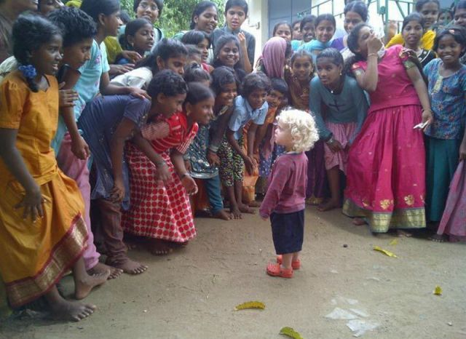

Slide 12
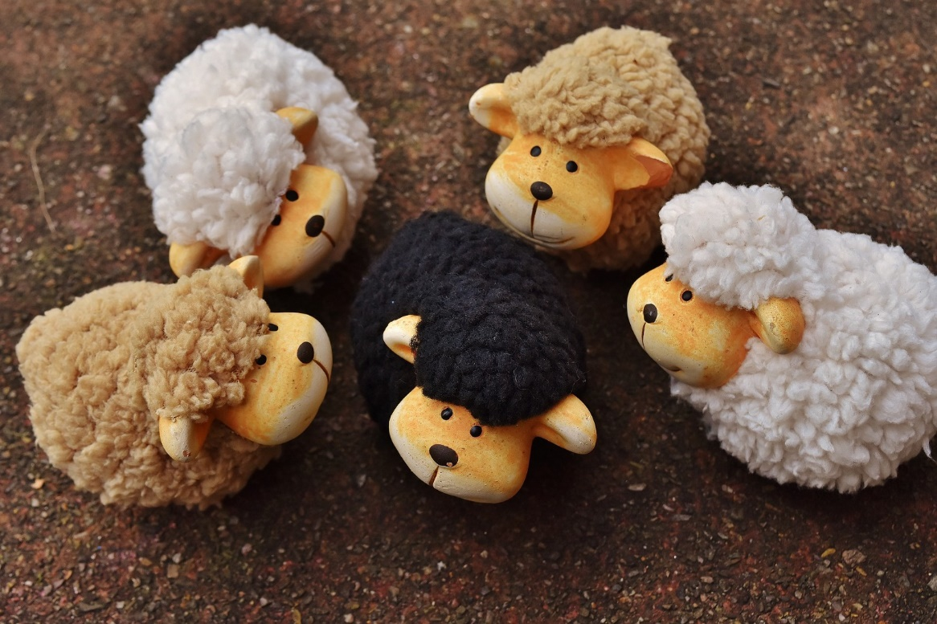
What are for you the most frequent or forceful reminders that you are living in a culture that really isn’t yours…
a country that doesn’t quite fit???

Slide 13
What are people hearing and seeing about us, God’s people, at Mosaic and in Spokane?

Slide 14
Philippians 1:27
“Then, whether I come and see you or only hear about you in my absence, I will know that you stand firm in one spirit, contending as one man (soul) for the faith of the gospel….”
#2.) Teamwork Consistent with
our Calling

Slide 15
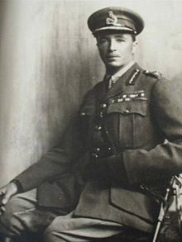
“The impression I had of Tudor was of an iron peg, hammered into the frozen ground, immovable.”
--Winston Churchill

Slide 16
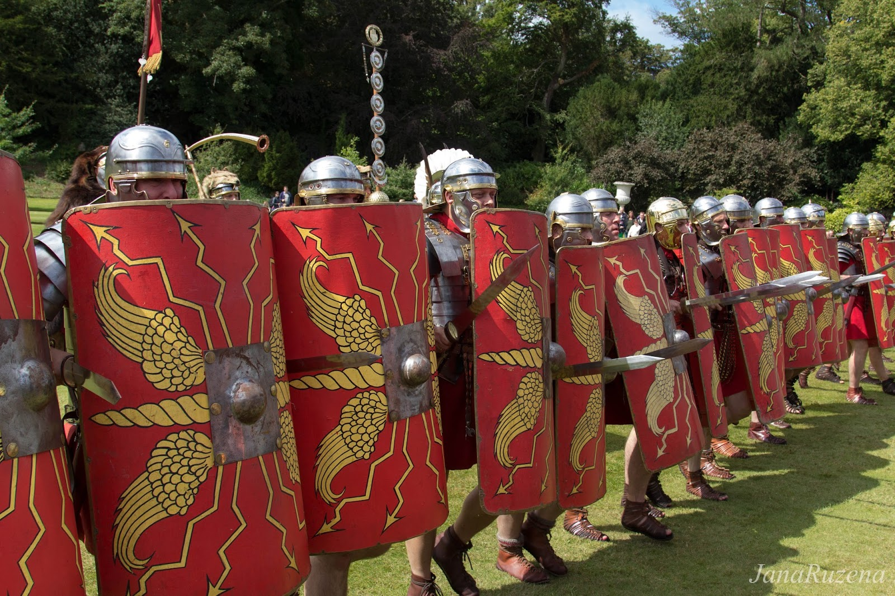

Slide 17
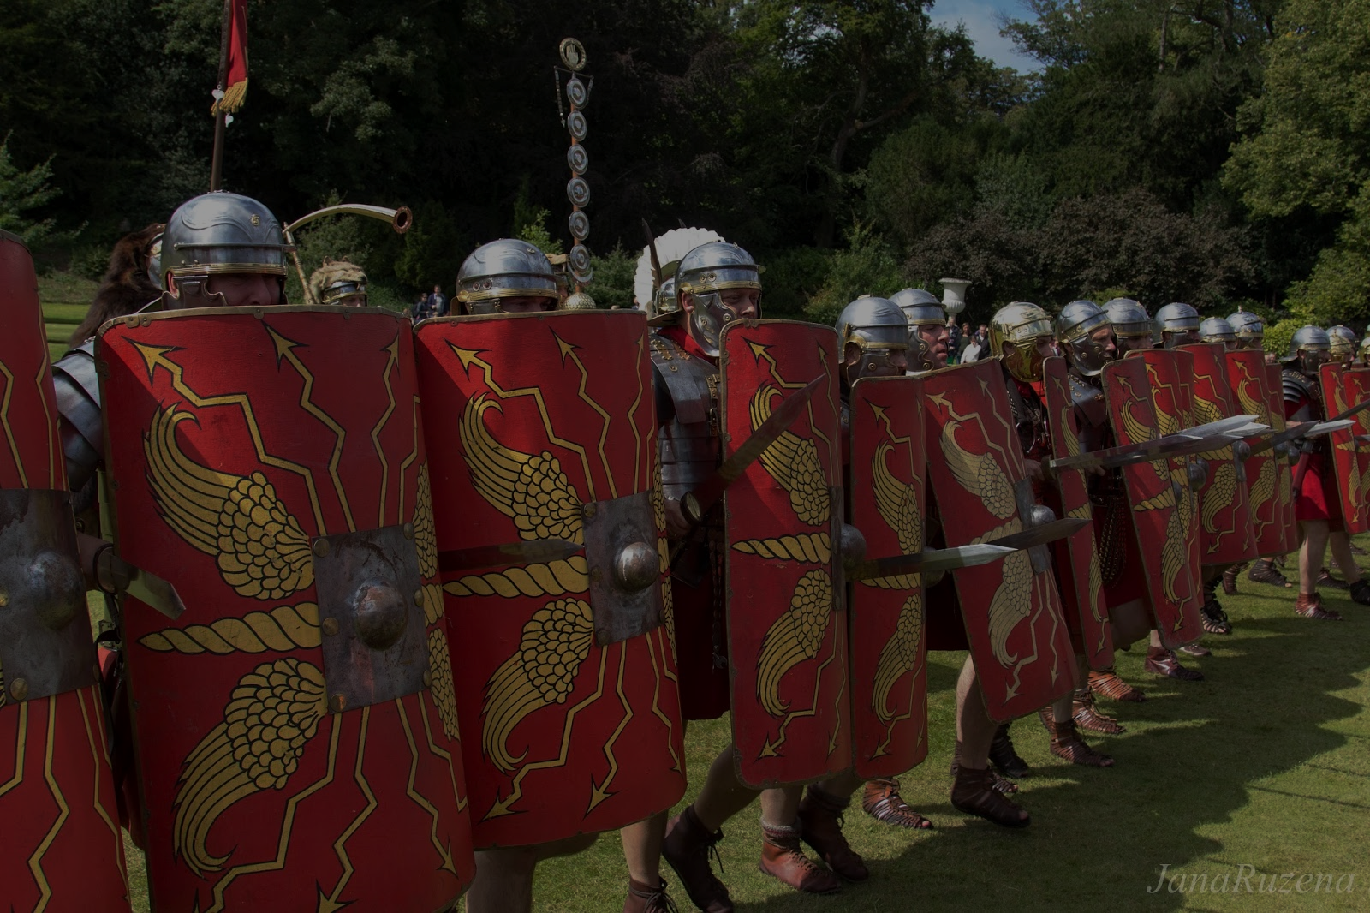
1.) When do you find it particularly hard to stand your ground spiritually?
2.) WHO is “on your team/squad” spiritually, regularly checking in, locking arms, providing fellowship and encouragement?

Slide 18
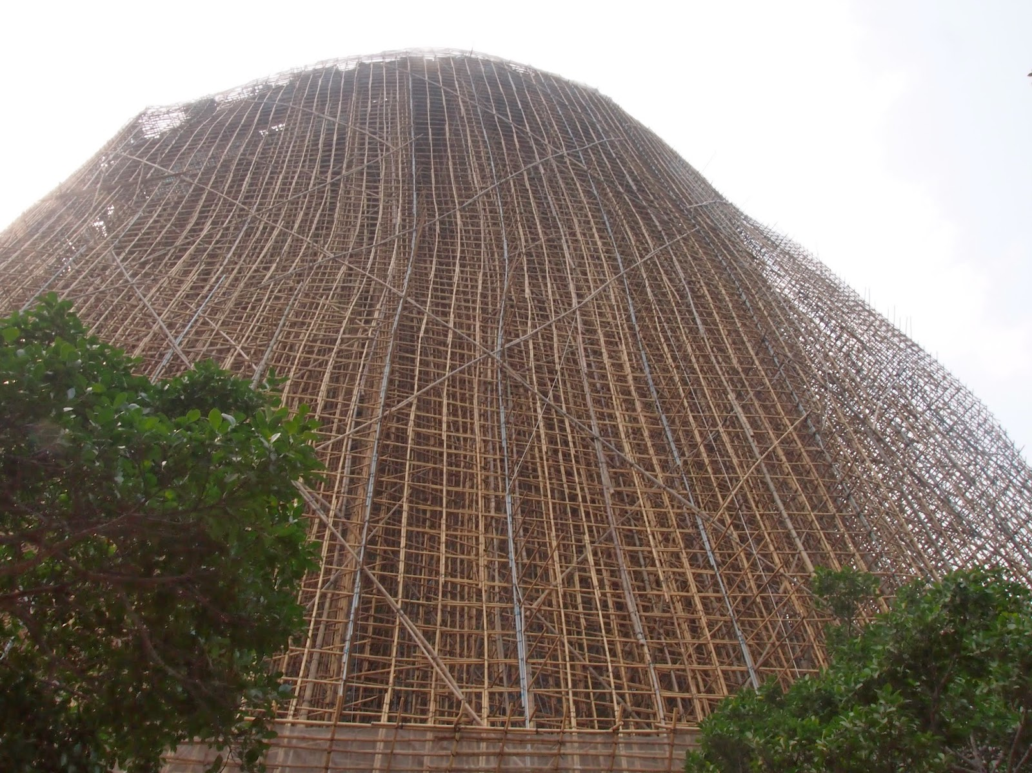

Slide 19
Philippians 1:27
“Then, whether I come and see you or only hear about you in my absence, I will know that you stand firm in one spirit, contending as one man (soul) for the faith of the gospel….”

Slide 20
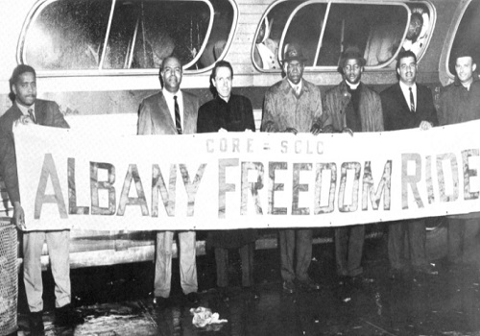

Slide 21
#3.) Suffering that is Consistent with
our Savior.

Slide 22
Philippians 1:27-29
“…striving together as one for the faith of the gospel ²⁸ without being frightened in any way by those who oppose you. This is a sign to them that they will be destroyed, but that you will be saved—and that by God. ²⁹ For it has been granted to you on behalf of Christ not only to believe in him, but also to suffer for him….”

Slide 23
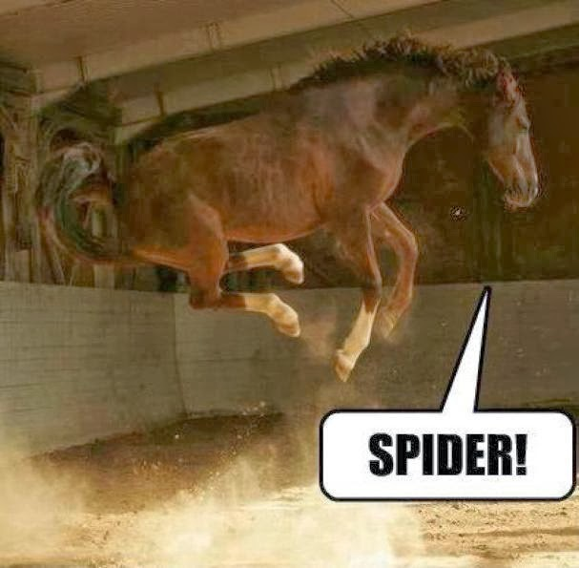

Slide 24
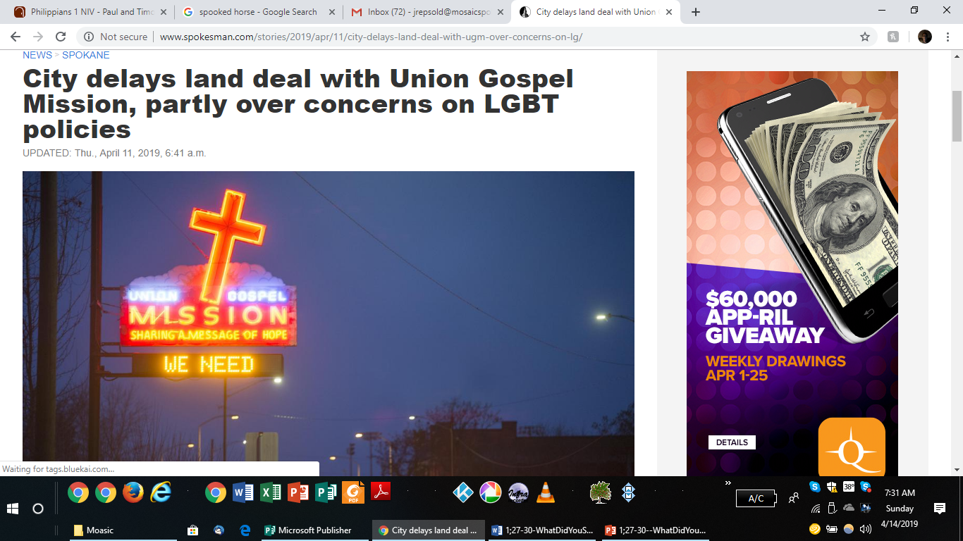

Slide 25
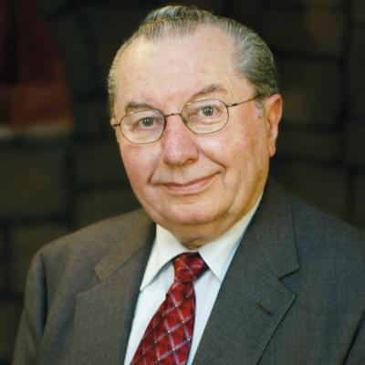
Josef Tson
Romanian Pastor

Slide 26
Philippians 1:27-29
“... without being frightened in any way by those who oppose you. This is a sign to them that they will be destroyed, but that you will be saved—and that by God. ²⁹ For it has been granted to you on behalf of Christ not only to believe in him, but also to suffer for him….”

Slide 28
1.) Am I living in a manner consistent with my heavenly citizenship?
2.) With whom is God asking me to be part of His team?
3.) What opposition is God inviting me to suffer for the sake of Christ?

