Slide 1
How would you define “beauty”? (No Googling definitions!)
If someone said, “You have a beautiful heart,” to what might they be referring?

Slide 3
Beautiful…or not-so-much?

Slide 4
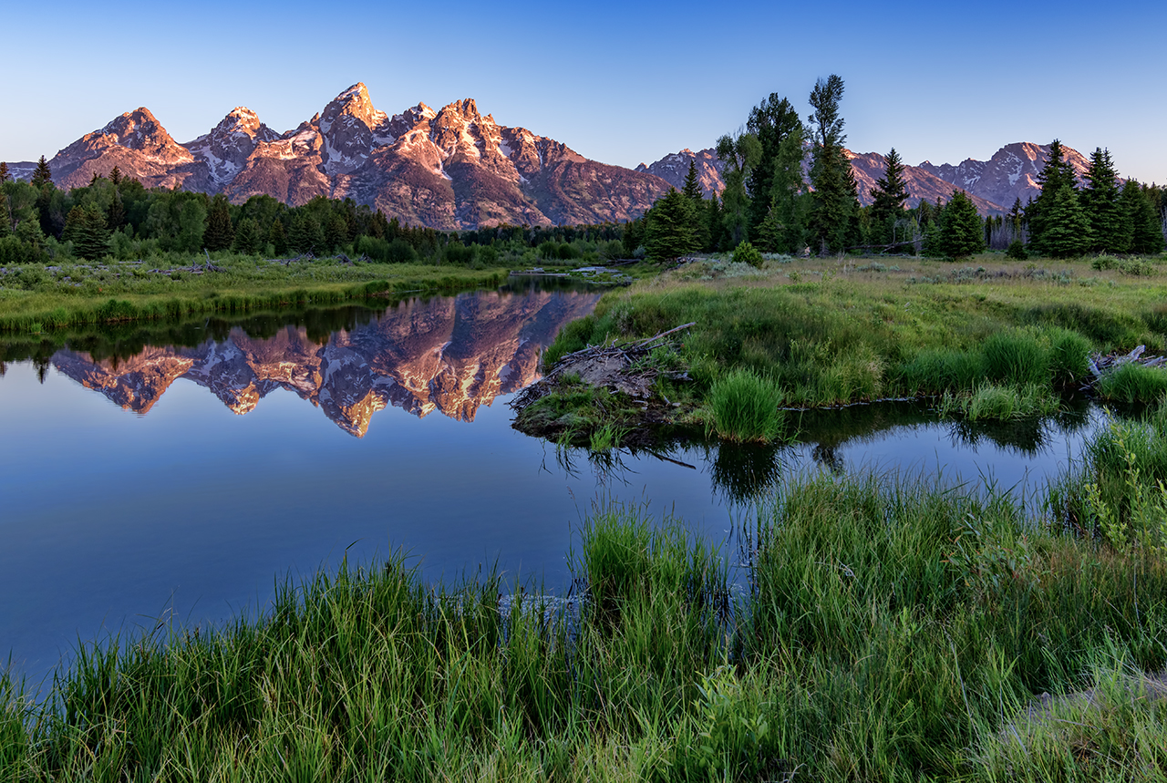

Slide 5
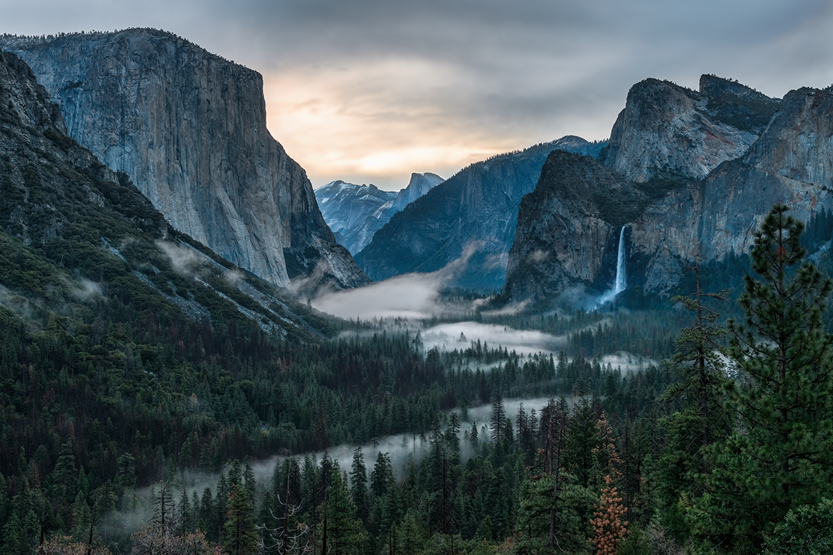

Slide 6
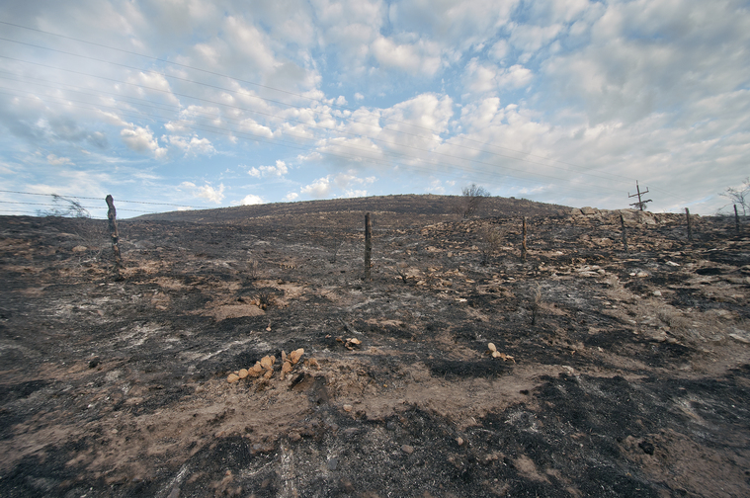

Slide 7
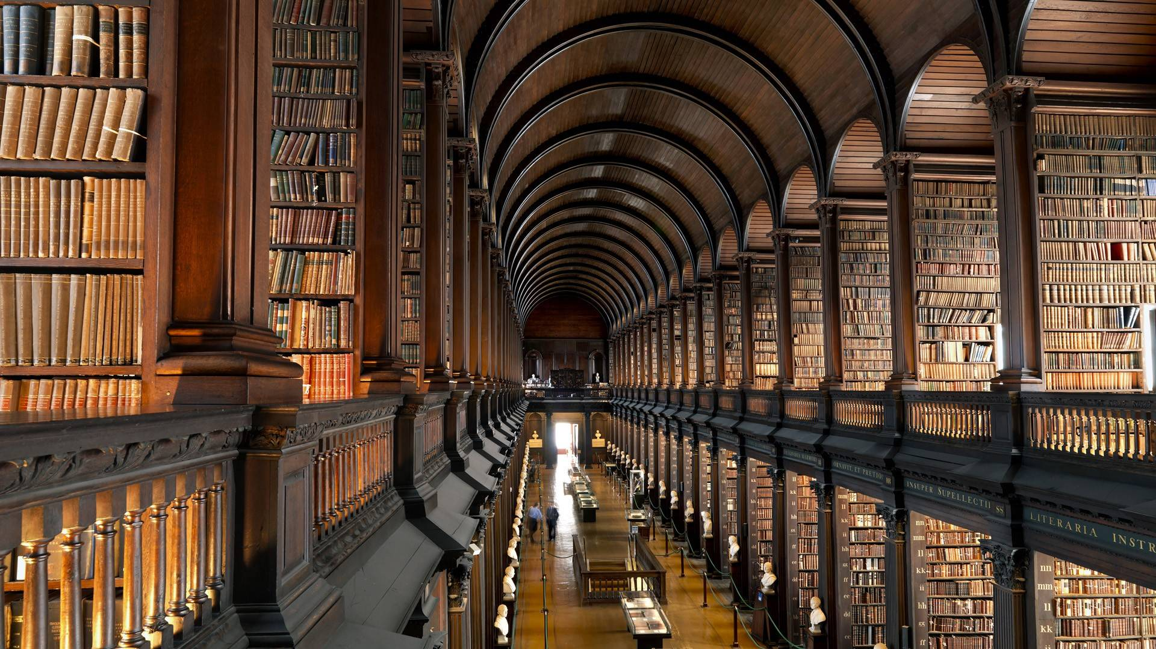

Slide 8
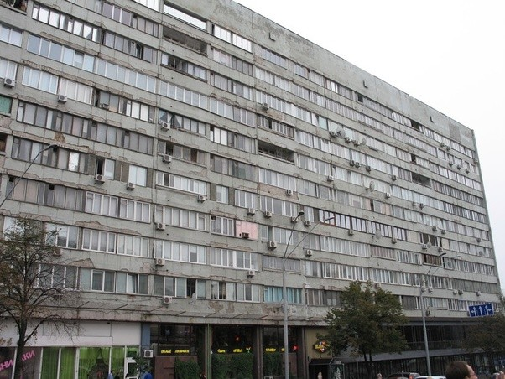

Slide 9
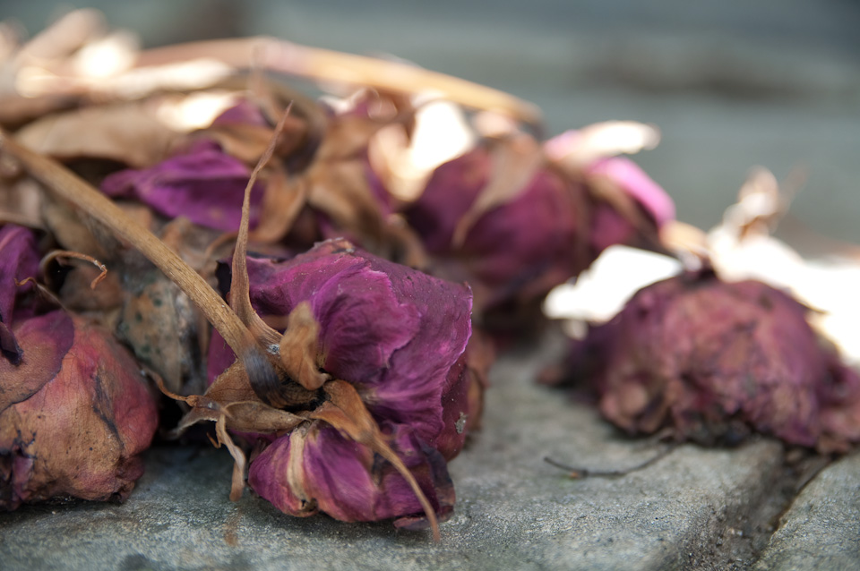

Slide 10
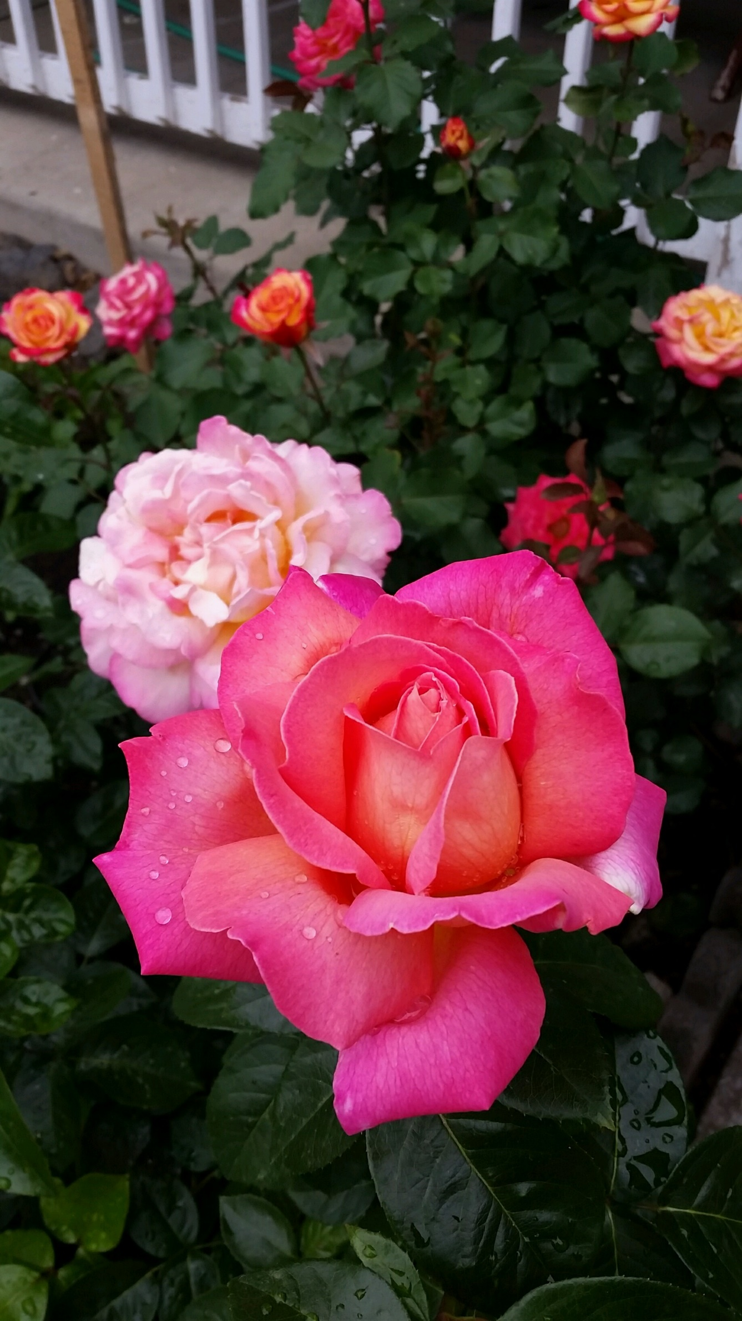
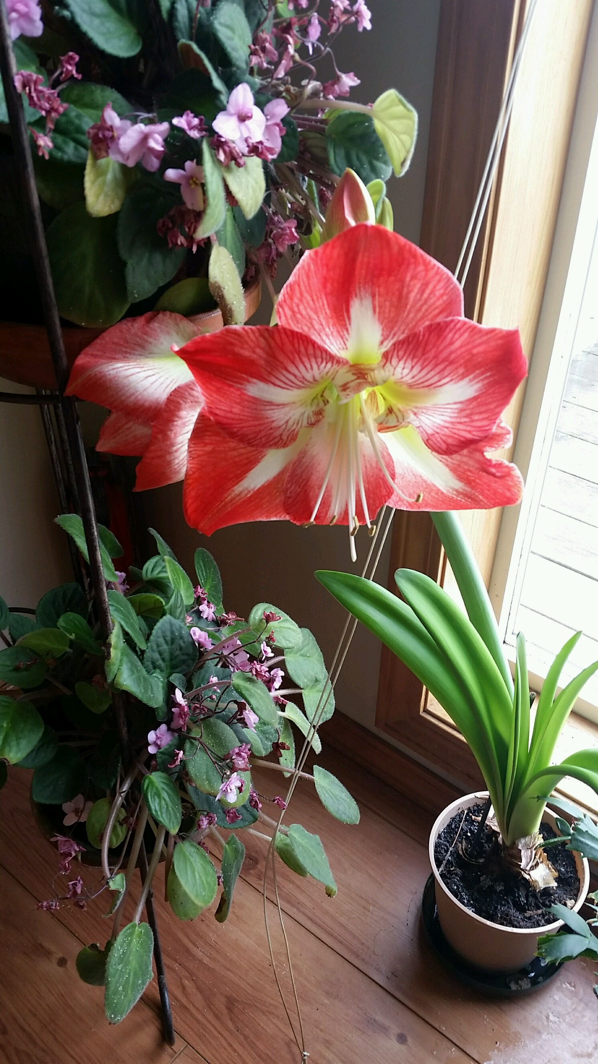

Slide 13
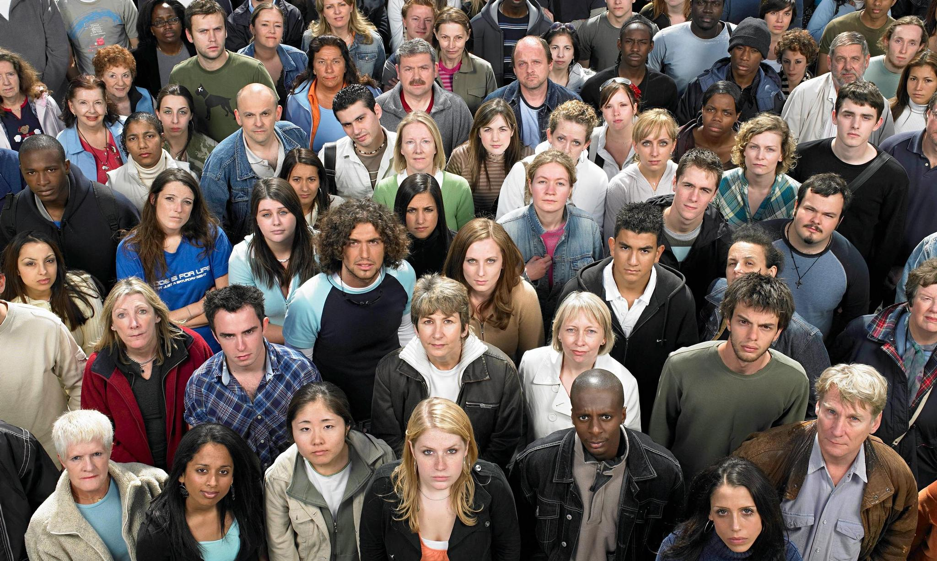

Slide 14
What does God consider
a beautiful church?
Luke 16:15--“You are the ones who justify your-selves in the eyes of others, but God knows your hearts.”
Acts 1:24--“Lord, you know everyone’s heart. Show us which of these two you have chosen to take over this apostolic ministry….”

Slide 15
What does God consider
a beautiful church?
Acts 15:8--“God, who knows the heart, showed that he accepted them [Gentiles] by giving the Holy Spirit to them, just as He did us.”
Romans 8:27--“And he who searches our hearts knows the mind of the Spirit….”

Slide 16
What does God consider
a beautiful church?
Psalm 19:2--““But who can discern their own errors? Forgive my hidden faults.”

Slide 17
What does God consider
a beautiful church?
1 Corinthians 4:5--“Therefore judge nothing before the appointed time; wait until the Lord comes. He will bring to light what is hidden in darkness and will expose the motives of the heart. At that time each will receive their praise from God.”

Slide 18
What does God consider
a beautiful church?
James 5:16--“Confess your sins to each other and pray for each other so that you may be healed”

Slide 19
James 5:16--“Confess your sins to each other and pray for each other so that you may be healed”
What might our worship or fellowship look like if we made confession of sin a normal part of our experience together?

Slide 20
Matthew 5:8--“Blessed are the pure in heart, for they will see God.”
What POSITIVE steps might we take
to develop purity of heart?

Slide 21
Heavenly Father, we come to confession as a community of believers, admitting that we do not always live as the body of Christ. We isolate ourselves from one another, we gossip, we criticize, we speak words of pain, and we harbor grudges. Forgive us for the many ways we fail in our relationships with others and with You.

Slide 22
As we seek to be a covenant community, we ask that You help us to pursue deep relationships with one another, to restore what is broken, to give grace even when it might not be deserved. Help us to forgive just as You forgave us. And help us to love each other as You have loved us. In Jesus Name we pray, Amen.

Slide 23
ACTS 2
⁴² They devoted themselves to the apostles’ teaching and to fellowship, to the breaking of bread and to prayer. ⁴³ Everyone was filled with awe at the many wonders and signs performed by the apostles. ⁴⁴ All the believers were together and had everything in common. ⁴⁵ They sold property and possessions to give to anyone who had need. ⁴⁶ Every day they continued to meet together in the temple courts. They broke bread in their homes and ate together with glad and sincere hearts, ⁴⁷ praising God and enjoying the favor of all the people. And the Lord added to their number daily those who were being saved.

Slide 24
ACTS 2
⁴² They devoted themselves to the apostles’ teaching and to fellowship, to the breaking of bread and to prayer. ⁴³ Everyone was filled with awe at the many wonders and signs performed by the apostles. ⁴⁴ All the believers were together and had everything in common. ⁴⁵ They sold property and possessions to give to anyone who had need. ⁴⁶ Every day they continued to meet together in the temple courts. They broke bread in their homes and ate together with glad and sincere hearts, ⁴⁷ praising God and enjoying the favor of all the people. And the Lord added to their number daily those who were being saved.

Slide 25
ACTS 2
⁴² They devoted themselves to the apostles’ teaching and to fellowship, to the breaking of bread and to prayer. ⁴³ Everyone was filled with awe at the many wonders and signs performed by the apostles. ⁴⁴ All the believers were together and had everything in common. ⁴⁵ They sold property and possessions to give to anyone who had need. ⁴⁶ Every day they continued to meet together in the temple courts. They broke bread in their homes and ate together with glad and sincere hearts, ⁴⁷ praising God and enjoying the favor of all the people. And the Lord added to their number daily those who were being saved.

Slide 26
ACTS 2
⁴² They devoted themselves to the apostles’ teaching and to fellowship, to the breaking of bread and to prayer. ⁴³ Everyone was filled with awe at the many wonders and signs performed by the apostles. ⁴⁴ All the believers were together and had everything in common. ⁴⁵ They sold property and possessions to give to anyone who had need. ⁴⁶ Every day they continued to meet together in the temple courts. They broke bread in their homes and ate together with glad and sincere hearts, ⁴⁷ praising God and enjoying the favor of all the people. And the Lord added to their number daily those who were being saved.

Slide 27
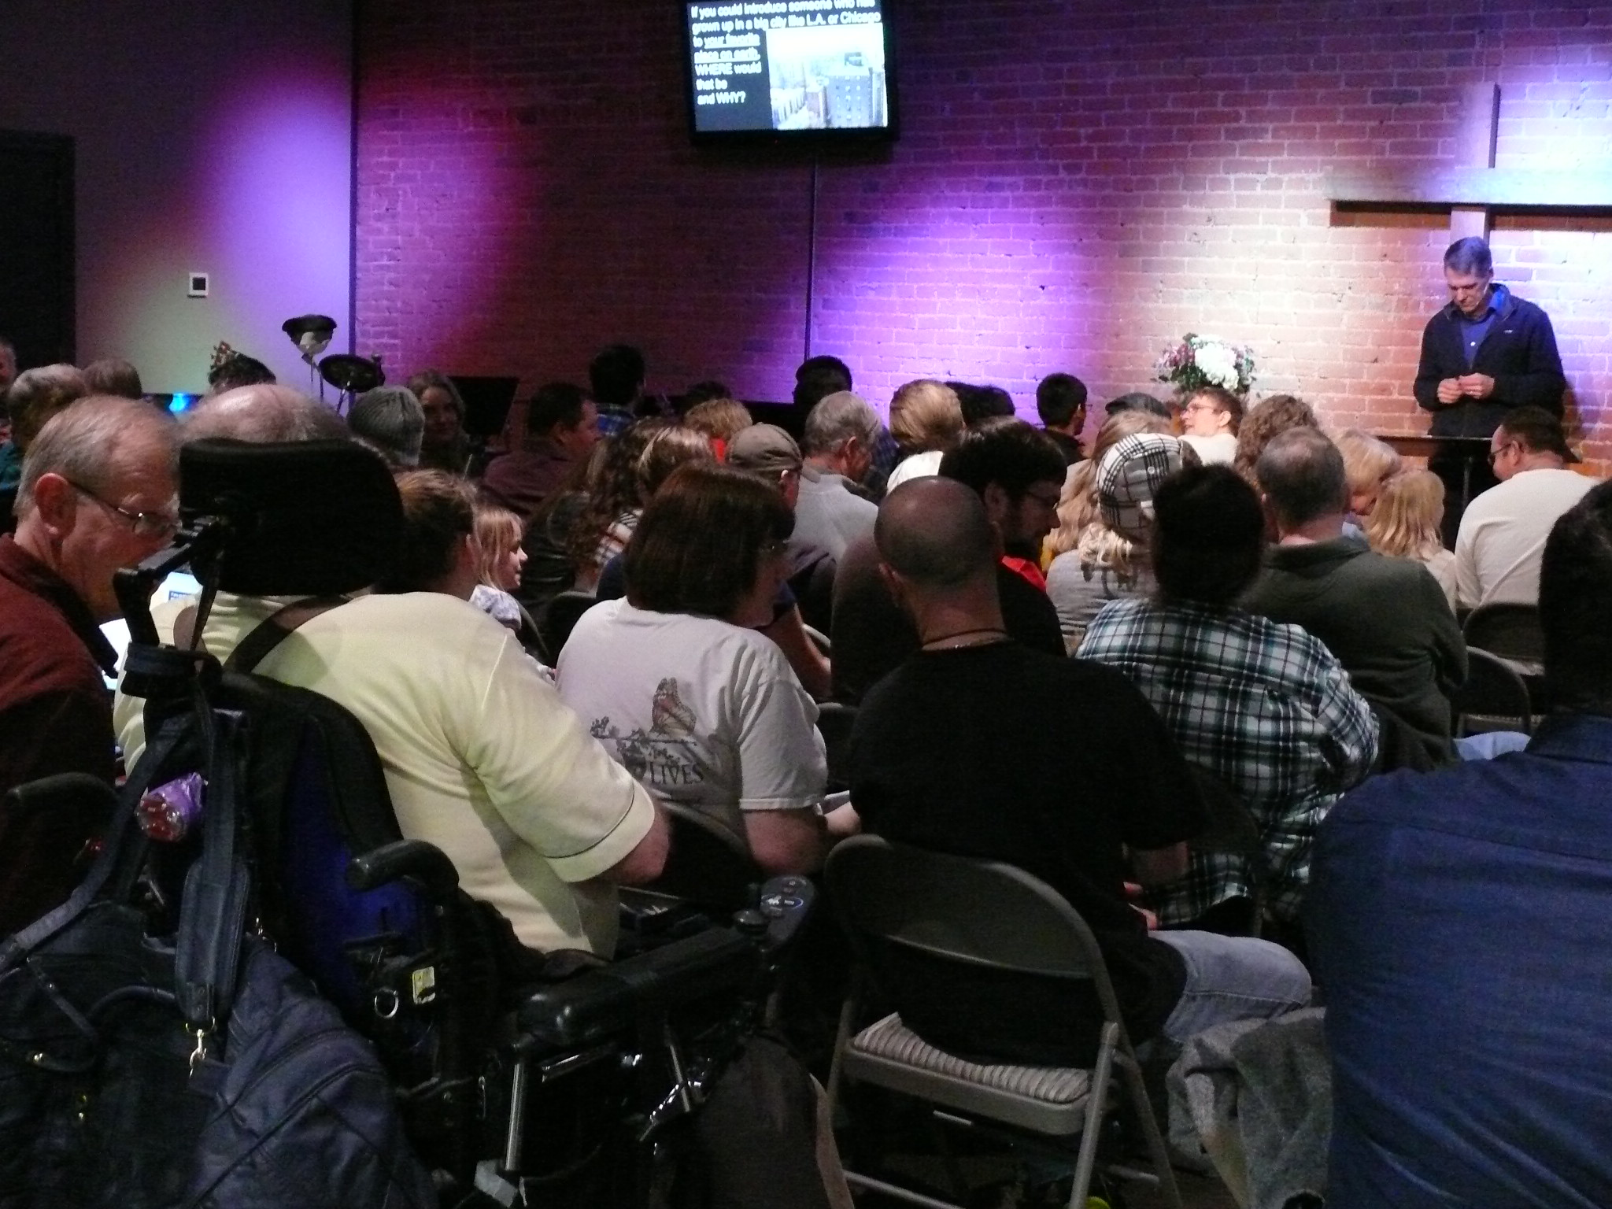

Slide 28
ACTS 4:32
“All the believers were one in heart and mind.”

Slide 29
1 PETER 1:22
“Now that you have purified yourselves by obeying the truth so that you have sincere love for each other, love one another deeply, from the heart.”
SHALLOW LOVE DEEP LOVE

Slide 30
What was it that someone did that enabled you to have that experience of being deeply loved?

Slide 31
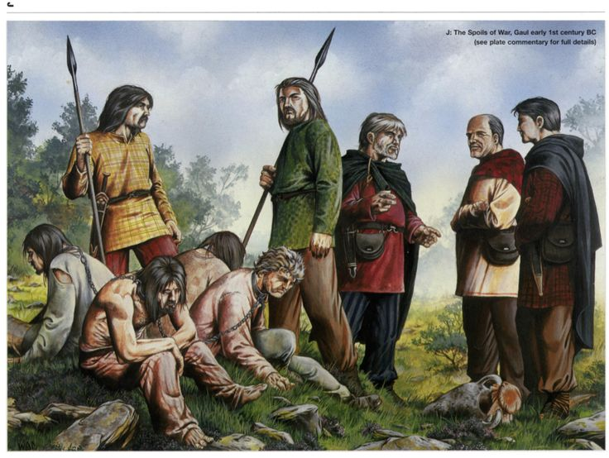
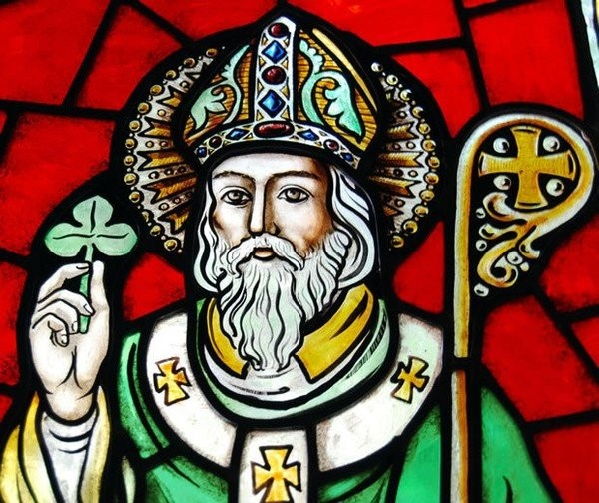

Slide 32
A beautiful church…
…experiences humility through confession.
…loves deeply through meaningful fellowship and worship.

Slide 33
1 PETER 1:22
“Now that you have purified yourselves by obeying the truth so that you have sincere love for each other, love one another deeply, from the heart.”
How can that happen
when we gather as Mosaic?

