Slide 1
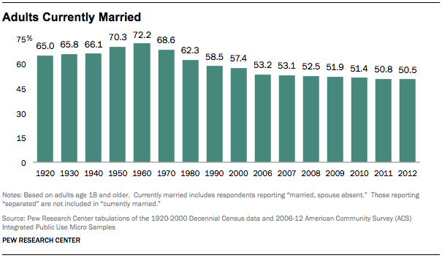

Slide 2
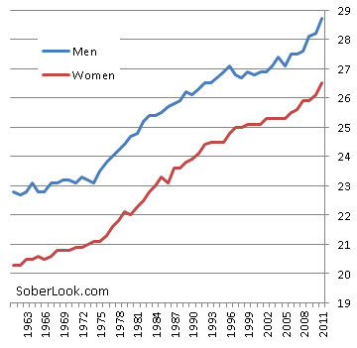
AGE @ MARRIAGE

Slide 3
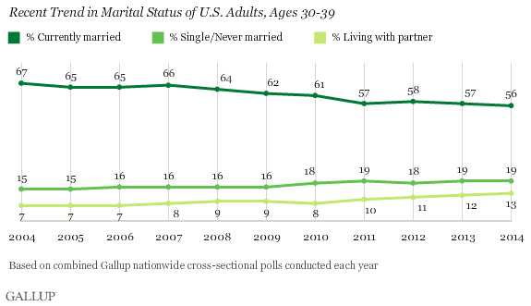

Slide 4
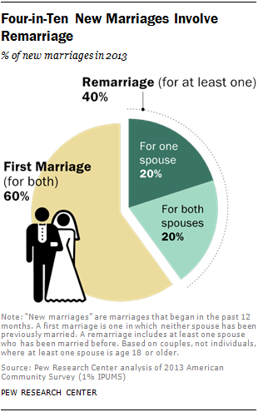

Slide 5
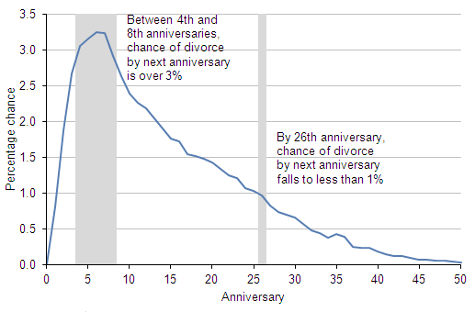

Slide 7
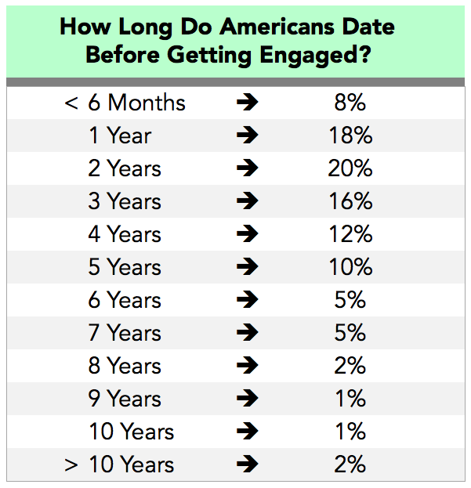

Slide 8
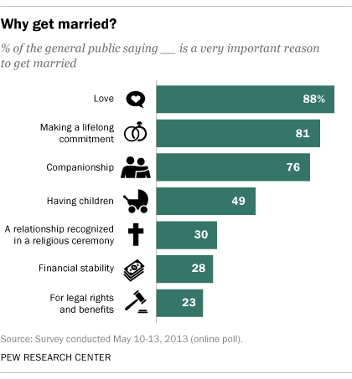

Slide 9
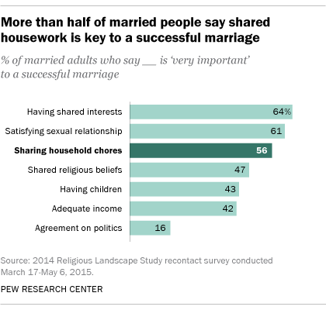

Slide 10
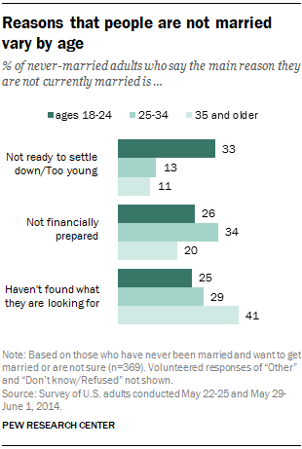

Slide 12
“Under Jewish law a woman was a thing; she was the possession of her husband, just as much as his house or his flocks of his material goods were. She had no legal right whatever. For instance, under Jewish law, a husband could divorce his wife for any cause, while a wife had no rights whatever in the initiation of divorce. In Greek society a respectable woman lived a life of entire seclusion. She never appeared on the streets alone, not even to go marketing. She lived in the women’s apartments and did not join her menfolk even for meals.”

Slide 13
“From her there was demanded a complete servitude and chastity; but her husband could go out as much as he chose, and could enter into as many relationships outside marriage as he liked and incur no stigma. Both under Jewish and under Greek laws and customs, all the privileges belonged to the husband, and all the duties to the wife.”
(William Barclay)

Slide 14
Colossians 3:17-19 ¹⁷ And whatever you do, whether in word or deed, do it all in the name of the Lord Jesus, giving thanks to God the Father through him. ¹⁸ Wives, submit yourselves to your husbands, as is fitting in the Lord. ¹⁹ Husbands, love your wives and do not be harsh with them.

Slide 15
Marriage and family is primarily to be an outworking of our life in Jesus and an expression of our gratitude to God.

Slide 16
Colossians 3:18 Wives, submit yourselves to your husbands, as is fitting in the Lord.

Slide 17
Ephesians 5:21-24
Submit to one another out of reverence for Christ. ²² Wives, submit yourselves to your own husbands as you do to the Lord.²³ For the husband is the head of the wife as Christ is the head of the church, his body, of which he is the Savior. ²⁴ Now as the church submits to Christ, so also wives should submit to their husbands in everything.

Slide 18
I Peter 3:5, 6
For this is the way the holy women of the past who put their hope in God used to adorn themselves. They submitted themselves to their own husbands, ⁶ like Sarah, who obeyed Abraham and called him her lord. You are her daughters if you do what is right and do not give way to fear.

Slide 19
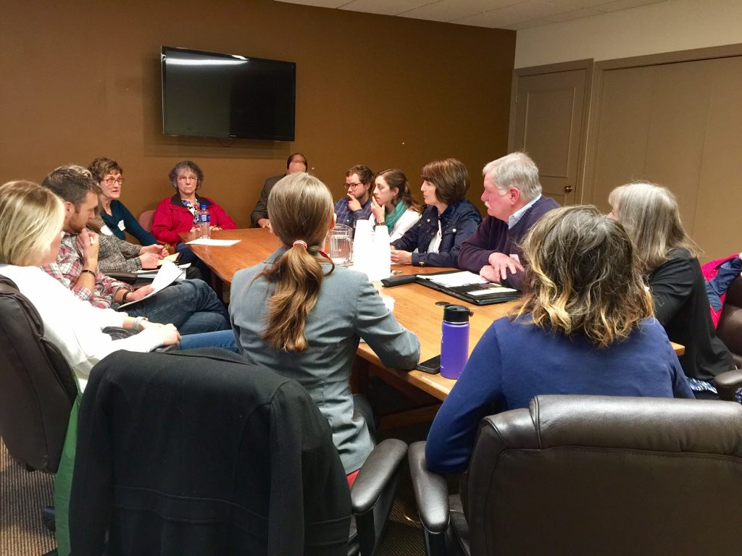

Slide 20
Colossians 3:18 Wives, submit yourselves to your husbands, as is fitting in the Lord.

Slide 21
I Corinthians 15:27, 28 For “God has put all things in subjection under his feet.” But when it says, “all things are put in subjection,” it is plain that he is excepted who put all things in subjection under him.²⁸ When all things are subjected to him, then the Son himself will also be subjected to him who put all things in subjection under him, that God may be all in all.

Slide 22
What should Eve have done with the Serpent’s temptation IF she was living out marital submission to Adam?

Slide 23
1 Timothy 2:11-15 Let a woman learn quietly with all submissiveness. ¹² I do not permit a woman to teach or to exercise authority over a man; rather, she is to remain quiet. ¹³ For Adam was formed first, then Eve; ¹⁴ and Adam was not deceived, but the woman was deceived and became a transgressor.¹⁵ Yet she will be saved through childbearing—if they continue in faith and love and holiness, with self-control.

Slide 24
Ephesians 5:22-24
Wives, submit yourselves to your own husbands as you do to the Lord.²³ For the husband is the head of the wife as Christ is the head of the church, his body, of which he is the Savior. ²⁴ Now as the church submits to Christ, so also wives should submit to their husbands in everything.

Slide 25
Colossians 3:19 Husbands, love your wives and do not be harsh with them.

Slide 26
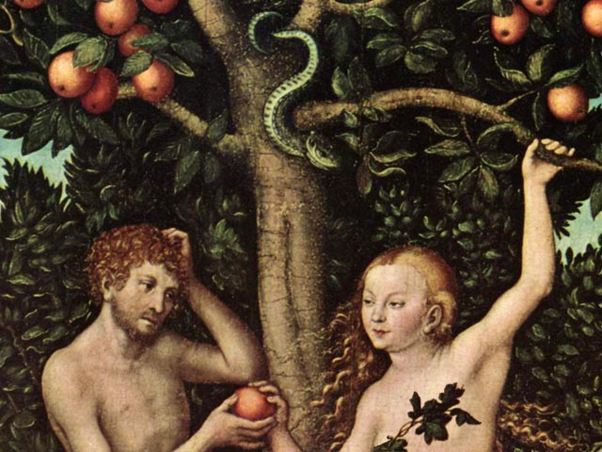

Slide 27
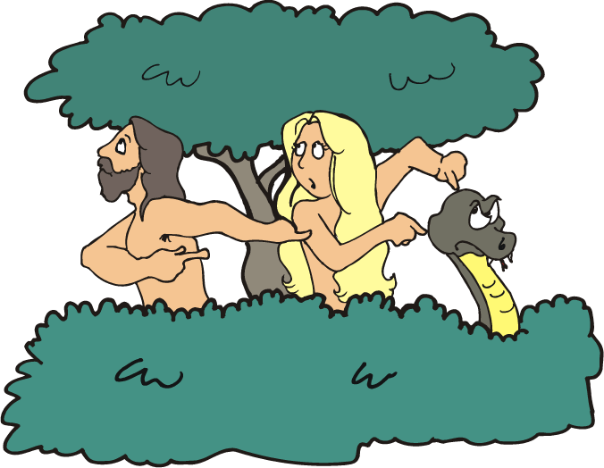

Slide 28
1 Timothy 2:13-15 ¹³ For Adam was formed first, then Eve; ¹⁴ and Adam was not deceived, but the woman was deceived and became a transgressor.¹⁵ Yet she will be saved through childbearing—if they continue in faith and love and holiness, with self-control.

Slide 29
Colossians 3:19 Husbands, love your wives and do not be harsh with them.

Slide 30
++

