Slide 1
COLOSSIANS 3

Slide 3
COLOSSIANS 3:5-11 What are the 3 commands?

Slide 4
Anybody love…

Slide 5
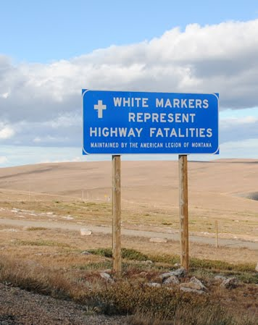
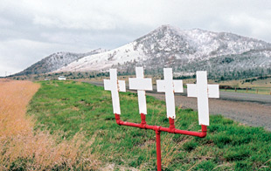
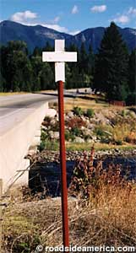
*-

Slide 6
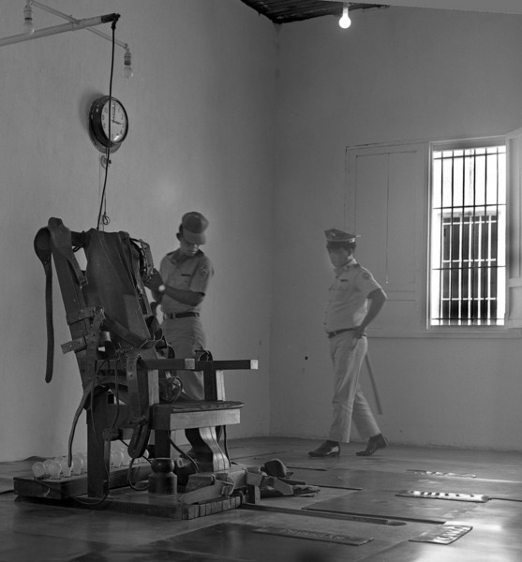
-

Slide 7
COLOSSIANS 3:5 “Put to death, therefore, whatever belongs to your earthly nature….”

Slide 8
2 Corinthians 4:10 “We always carry around in our body the death of Jesus, so that the life of Jesus may also be revealed in our body.”

Slide 10
“Be killing sin or it will be killing you.” (John Owens)

Slide 11
COLOSSIANS 3:5 “Put to death, therefore, whatever belongs to your earthly nature: sexual immorality, impurity, lust, evil desires and greed.”

Slide 12
#1. Masculinity and femininity as well as sex between men and women were designed by God to show of the nature of God in creation.
#2. Both the inherent masculine, feminine and sexual drives of men and women are designed by God to energize Christ-likeness.

Slide 13
Group discussion:
1. How does God want His children today and in every generation to use sex and human sexuality to develop us in Christ?
2. What are some ways we can “put to death” unhealthy, sinful and ‘old nature’/fleshly sexual desires?

