Slide 2
Life’s trials…
and difficulties

Slide 3
James 1:12
Blessed is the one who perseveres under trial because, having stood the test, that person will receive the crown of life that the Lord has promised to those who love him.

Slide 4
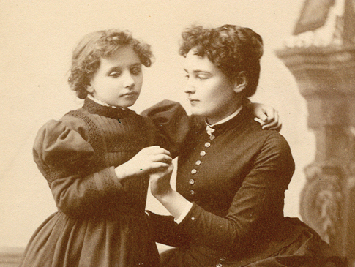
Helen Keller (left)
&
Ann Sullivan (right)

Slide 5
List as many life challenges that you are currently facing as you can in 30 seconds.
Family—marriage, kids, parents, siblings
Friends
Finances
Work
Ministry
Health
School

Slide 6
Let no one say when he is tempted, “I am being tempted by God,” for God cannot be tempted with evil, and he himself tempts no one. (James 1:13)
Closer to God
Farther from God

Slide 7
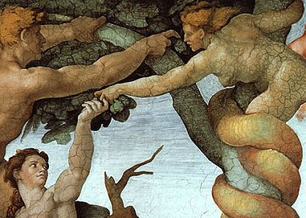
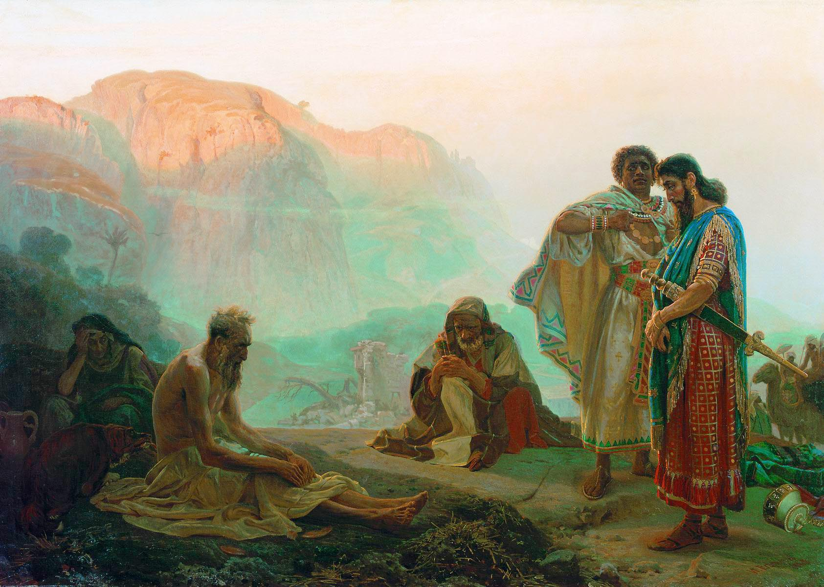

Slide 8
What is TEMPTATION?
An invitation or solicitation to do evil.
A desire to engage in what is contrary to the will, nature and heart of God.

Slide 9
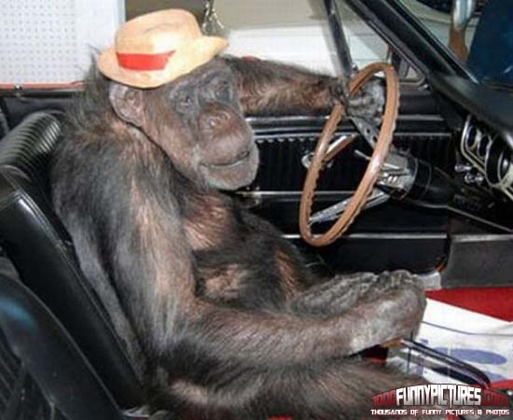
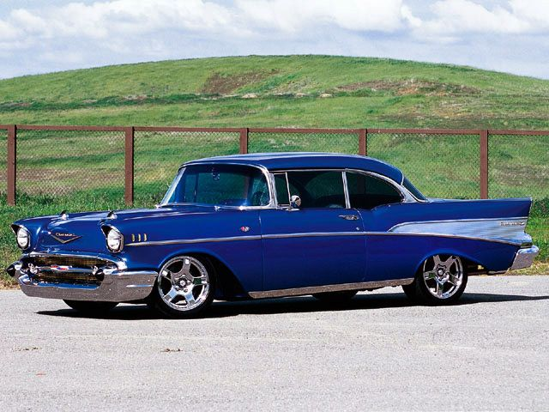
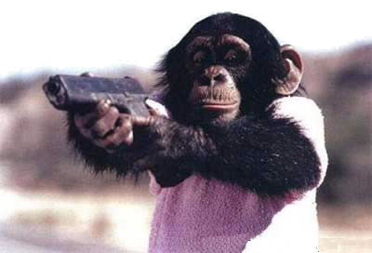

Slide 10
1 Corinthians 10:13
No temptation has overtaken you that is not common to man. God is faithful, and he will not let you be tempted beyond your ability, but with the temptation he will also provide the way of escape, that you may be able to endure it.

Slide 11
Choose a trial or challenge you are currently facing.
What responses to this situation, challenge or trial would lead me to love God more?
What responses would lead me into sin or more separation from God?

Slide 12
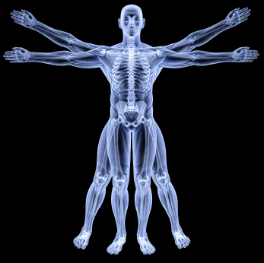
The Anatomy of Temptation
James 1:14-15
¹⁴ But each person is tempted when he is lured and enticed by his own desire.
¹⁵ Then desire when it has conceived gives birth to sin, and sin when it is fully grown brings forth death.

Slide 13
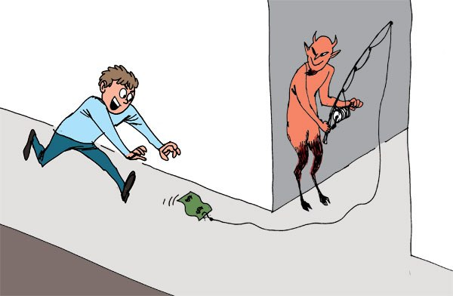
The Anatomy of Temptation

Slide 14
James 1:14-15
¹⁴ But each person is tempted when he is lured and enticed by his own desire.
¹⁵ Then desire when it has conceived gives birth to sin, and sin when it is fully grown brings forth death.

Slide 15
I Peter 2:11-12
Beloved, I urge you as sojourners and exiles to abstain from the passions of the flesh, which wage war against your soul. ¹² Keep your conduct among the Gentiles honorable, so that when they speak against you as evildoers, they may see your good deeds and glorify God on the day of visitation.

Slide 16
Then desire when
it has conceived gives birth to sin, and sin when it is fully grown brings forth death.

Slide 17
Closer to God
Farther from God

Slide 18
What temptation is calling to you in your “trial” right now?

Slide 19
James 1:16-18
Do not be deceived, my beloved brothers. ¹⁷ Every good gift and every perfect gift is from above, coming down from the Father of lights, with whom there is no variation or shadow due to change. ¹⁸ Of his own will he brought us forth by the word of truth, that we should be a kind of firstfruits of his creatures.

Slide 20
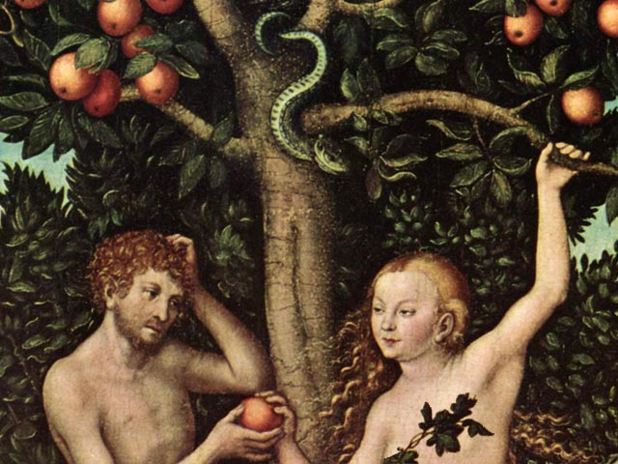
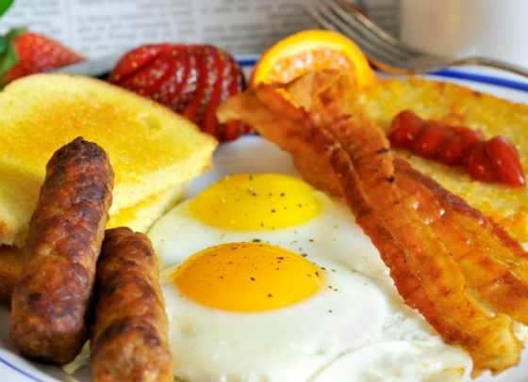

Slide 21
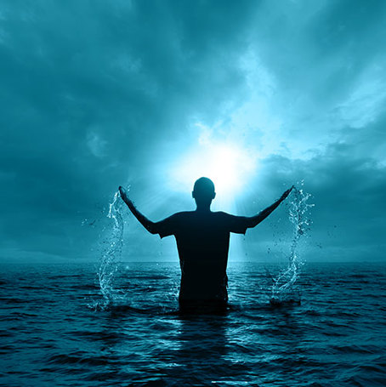
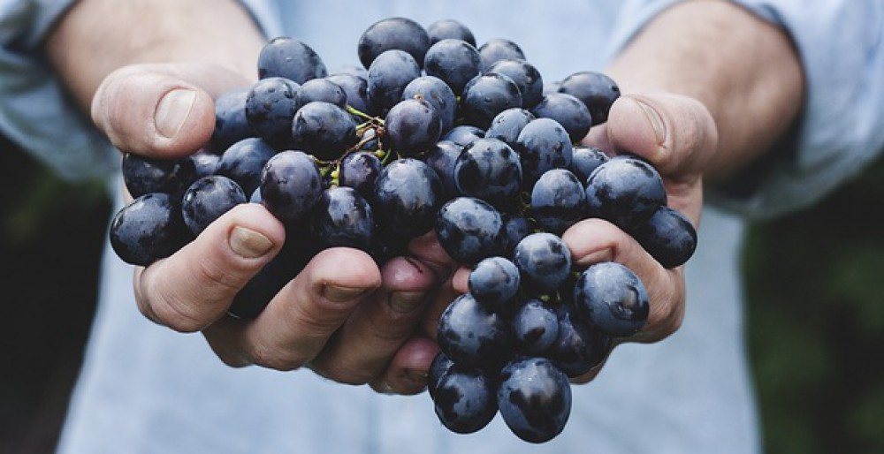
¹⁸ Of his own will he brought us forth by the word of truth that we should be a kind of firstfruits of his creatures.

Slide 22
