Slide 1
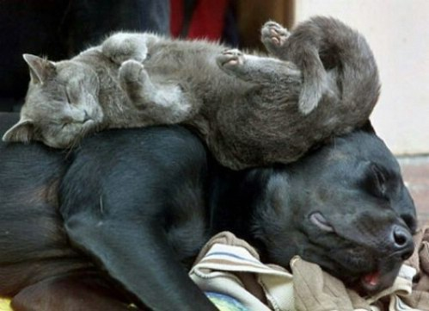
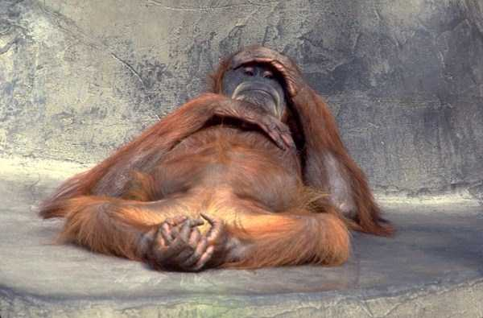
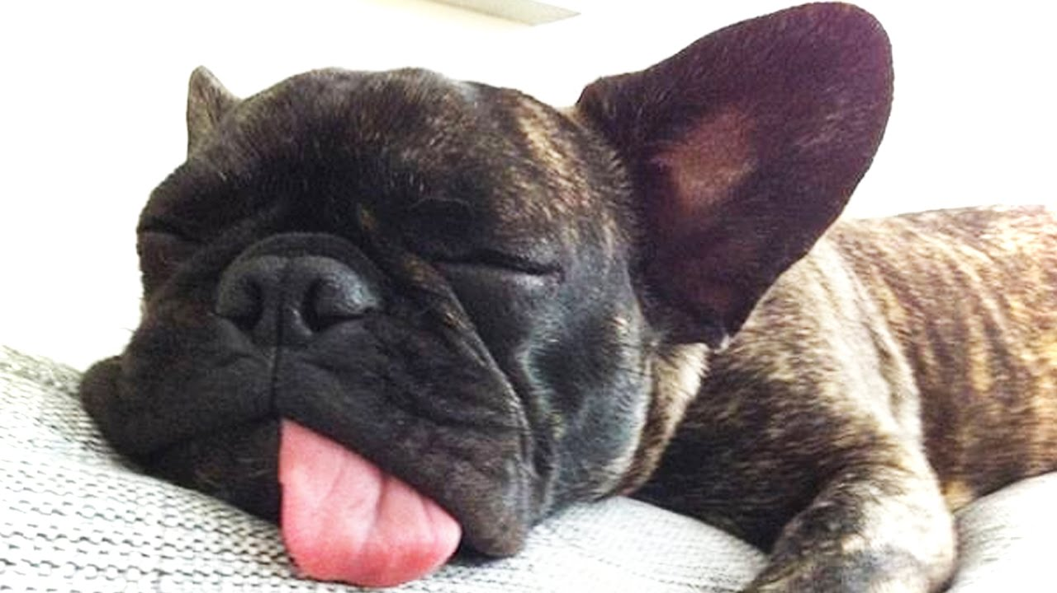
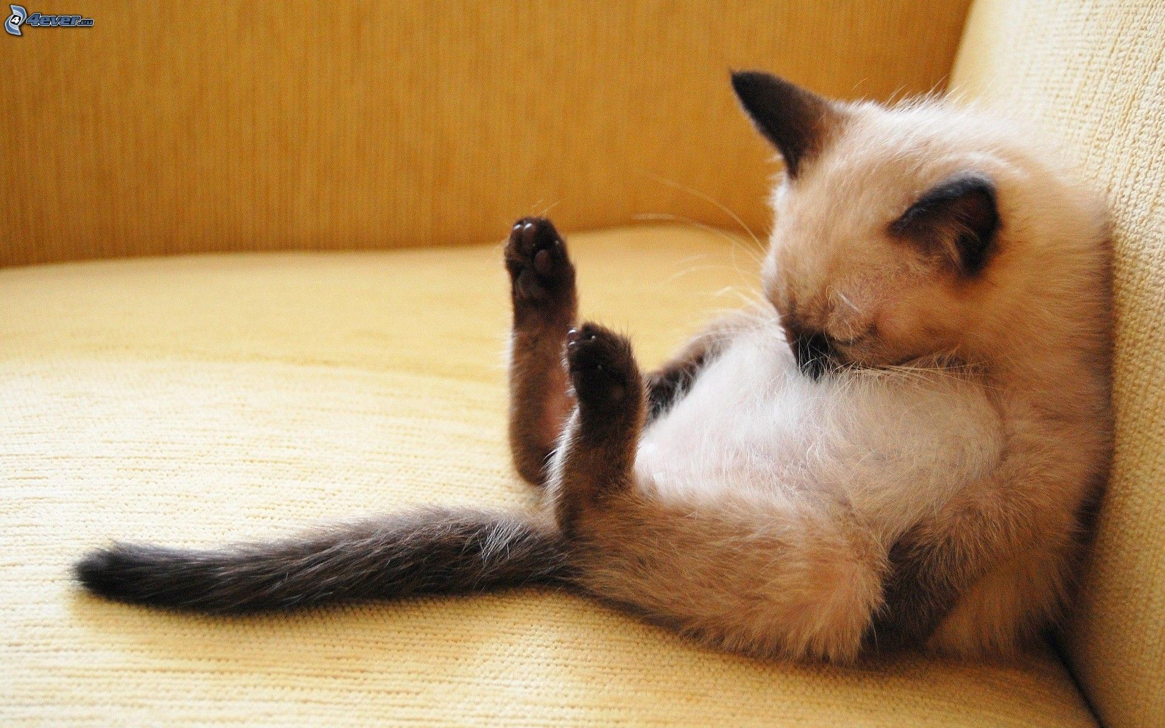
Tired?

Slide 3
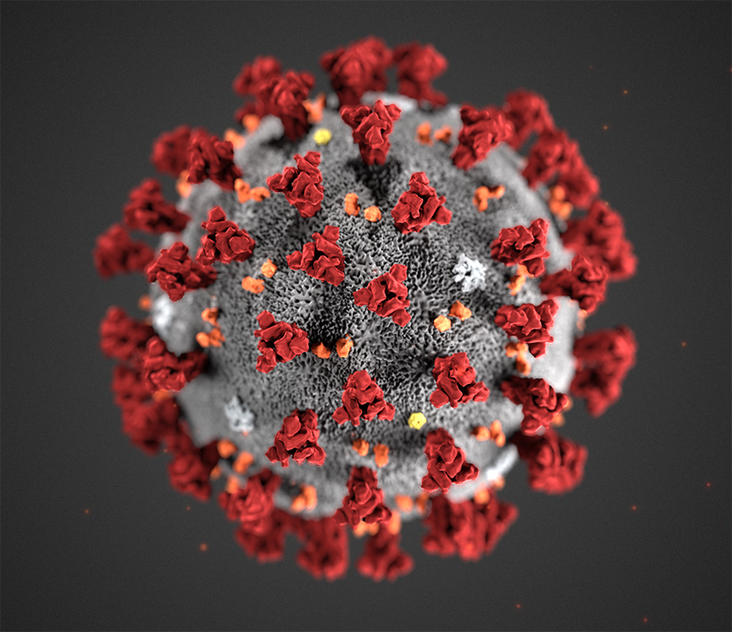

Slide 4
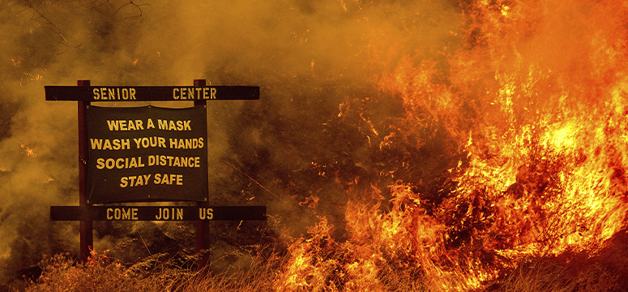

Slide 5
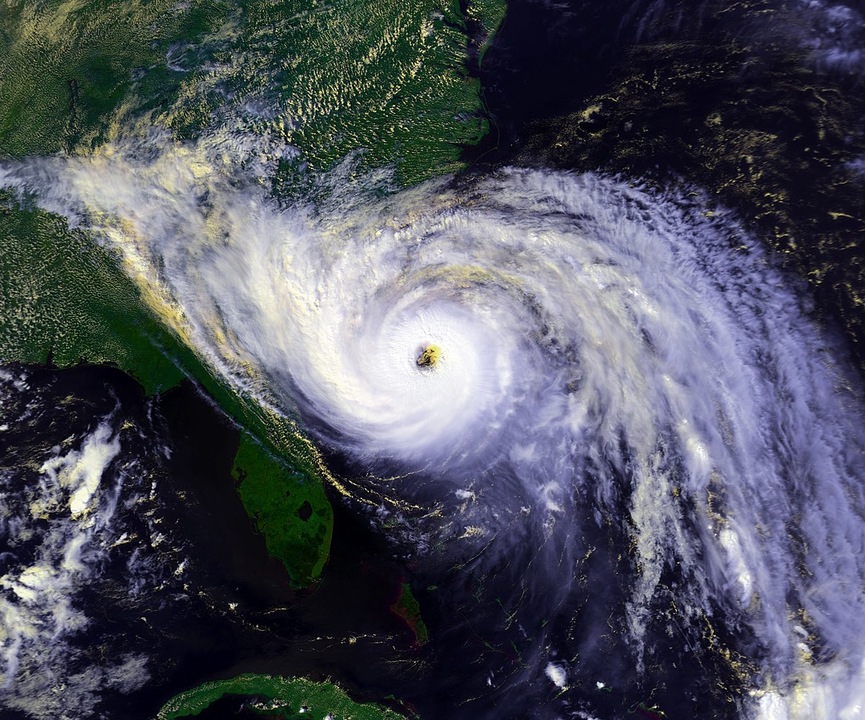

Slide 6
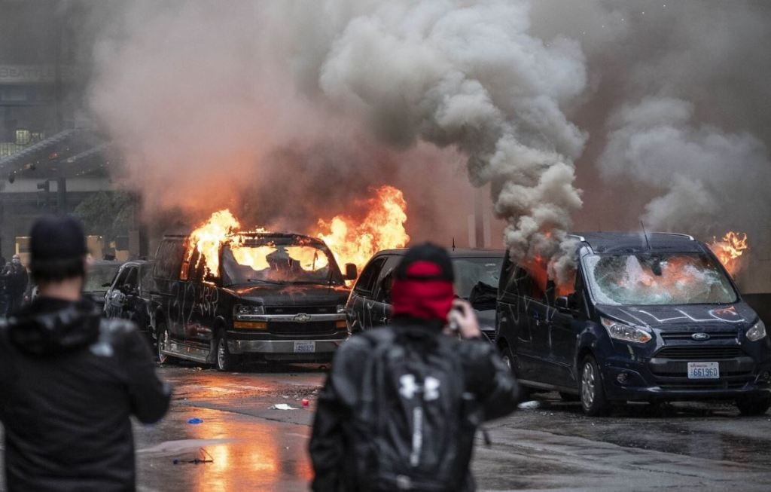

Slide 7
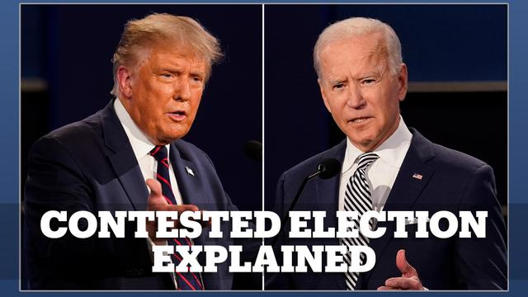

Slide 8
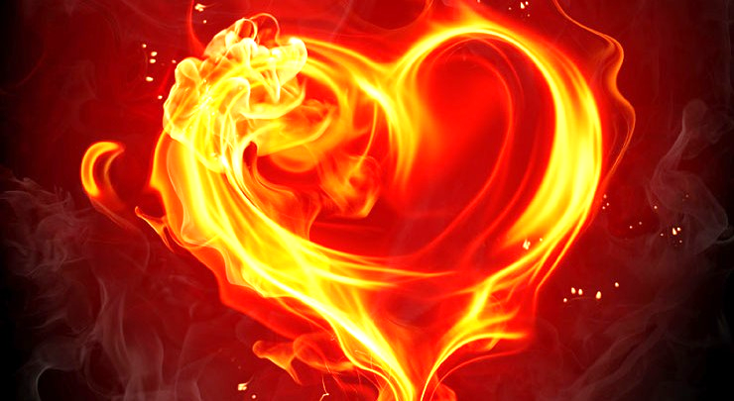
RENEWING YOUR SPIRITUAL PASSION

Slide 9
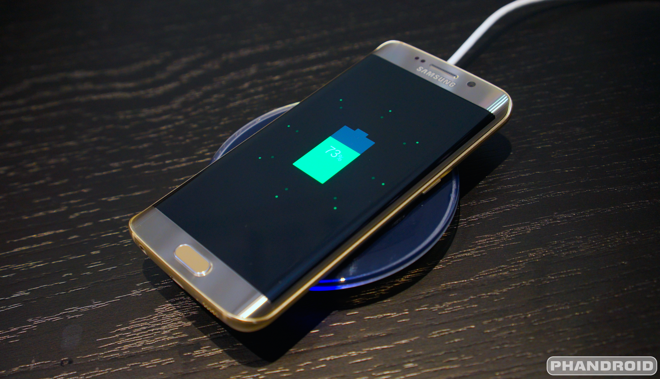

Slide 10
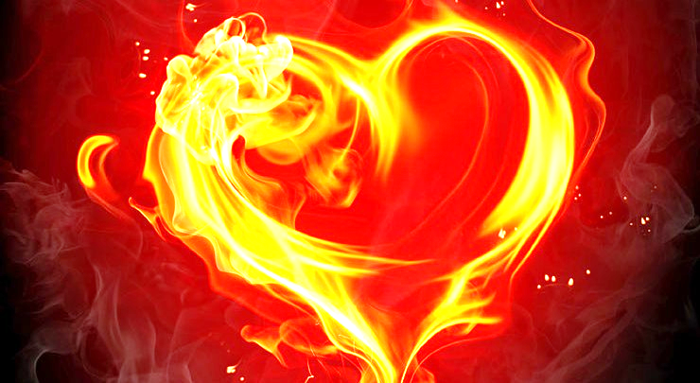
RENEWING YOUR SPIRITUAL PASSION… …THROUGH HEALING CONFESSION

Slide 11
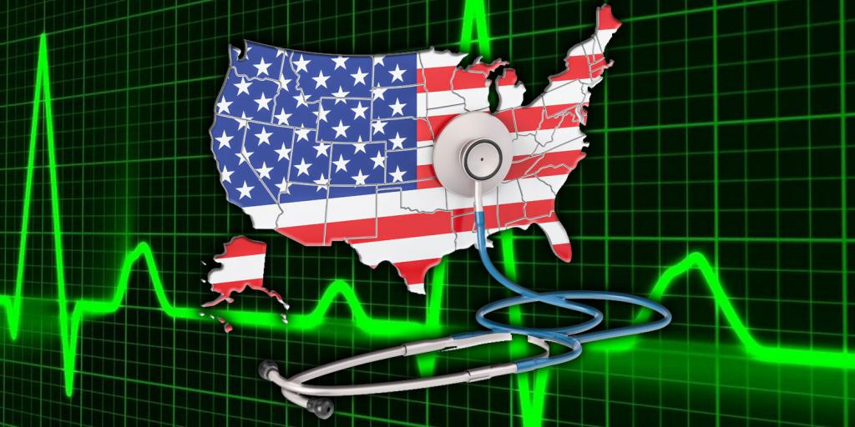

Slide 12
2 Chronicles 7:12-16
(National Illness)
James 5:13-18
(Personal Illness)

Slide 13
2 Chronicles 7:12-16
The Lord appeared to him at night and said: “I have heard your prayer and have chosen this place for myself as a temple for sacrifices. ¹³ “When I shut up the heavens so that there is no rain, or command locusts to devour the land or send a plague among my people,

Slide 14
2 Chronicles 7:12-16
¹⁴ if my people, who are called by my name, will humble themselves and pray and seek my face and turn from their wicked ways, then I will hear from heaven, and I will forgive their sin and will heal their land. ¹⁵ Now my eyes will be open and my ears attentive to the prayers offered in this place.

Slide 15
2 Chronicles 7:12-16
¹⁶ I have chosen and consecrated this temple so that my Name may be there forever. My eyes and my heart will always be there.

Slide 16
2 Chronicles 7:12-16
¹⁴ if my people, who are called by my name, will humble themselves and pray and seek my face and turn from their wicked ways, then I will hear from heaven, and I will forgive their sin and will heal their land. ¹⁵ Now my eyes will be open and my ears attentive to the prayers offered in this place.

Slide 17
2 Chronicles 7:12-16
¹⁴ if my people, who are called by my name, will humble themselves and pray and seek my face and turn from their wicked ways, then I will hear from heaven, and I will forgive their sin and will heal their land. ¹⁵ Now my eyes will be open and my ears attentive to the prayers offered in this place.

Slide 18
2 Chronicles 7:12-16
¹⁴ if my people, who are called by my name, will humble themselves and pray and seek my face and turn from their wicked ways, then I will hear from heaven, and I will forgive their sin and will heal their land. ¹⁵ Now my eyes will be open and my ears attentive to the prayers offered in this place.

Slide 19
WEDNESDAY PRAYER @ 7:00 p.m.
Zoom Call # 849 4579 2528
at
www.zoom.com
(Choose “Join a Meeting” and type in the call number.)

Slide 20
James 5:13-18
¹³ Is anyone among you in trouble? Let them pray. Is anyone happy? Let them sing songs of praise. ¹⁴ Is anyone among you sick? Let them call the elders of the church to pray over them and anoint them with oil in the name of the Lord.

Slide 21
James 5:13-18
¹⁵ And the prayer offered in faith will make the sick person well; the Lord will raise them up. If they have sinned, they will be forgiven. ¹⁶ Therefore confess your sins to each other and pray for each other so that you may be healed. The prayer of a righteous person is powerful and effective.

Slide 22
James 5:13-18
¹³ Is anyone among you in trouble? Let them pray. Is anyone happy? Let them sing songs of praise. ¹⁴ Is anyone among you sick? Let them call the elders of the church to pray over them and anoint them with oil in the name of the Lord.

Slide 23
James 5:13-18
¹³ Is anyone among you in trouble? Let them pray. Is anyone happy? Let them sing songs of praise. ¹⁴ Is anyone among you sick? Let them call the elders of the church to pray over them and anoint them with oil in the name of the Lord.

Slide 24
James 5:13-18
¹³ Is anyone among you in trouble? Let them pray. Is anyone happy? Let them sing songs of praise. ¹⁴ Is anyone among you sick? Let them call the elders of the church to pray over them and anoint them with oil in the name of the Lord.

Slide 25
James 5:13-18
¹⁵ And the prayer offered in faith will make the sick person well; the Lord will raise them up. If they have sinned, they will be forgiven. ¹⁶ Therefore confess your sins to each other and pray for each other so that you may be healed. The prayer of a righteous person is powerful and effective.

Slide 26
Possible Responses
for the next few minutes:
Write a prayer of repentance
Pray with someone here.
Ask to be anointed with oil and receive prayer from one of the prayer station leaders.
Leave your prayer/sins at the cross.

Slide 27
Adultery, Anger, Backbiting (speaking evil of those who are absent), Taking liberty to do things without thinking of the effect on a weaker brother’s conscience, Being angry with one’s brother or sister, Bitterness, Blasphemy, Boasting, Fighting, Suing in court a brother or sister, Burying our talents (not making wise use of what God gave us), Cursing another, Ridiculing another, Complaining, being Contentious or Quarrelsome, Speaking with impure language, Covenant Breakers, Covetousness, acting with Craftiness or Cunning,

Slide 28
Deceiving, Defiling the body, Defrauding someone, Denying Christ, Desiring the praise of people, Dishonesty, Disobedience to parents, Creating divisions, Unbiblical Divorce, Making insincere statements, Drunkenness, Eating the bread or drinking the Lord’s cup unworthily, Envy, Desiring forbidden things, having Selfish Motives, Evil Thoughts, practicing Extortion, Provoking children to wrath, being Fearful of people and things other than God, Filthiness, Receiving personal gain through unrighteousness,

Slide 29
Finding fault with others while having a greater fault ourself, Foolishness, Foolish talking, Fornication, Giving false witness, Giving offense, Greediness, Hardhearted, Hating God, Hatred of people, Enjoying the company of sinners, Hearing the sayings of Christ but not following them, Holding to Heresies (religious opinion different from established Scripture), Highmindedness (arrogance), practicing Hypocrisy, engaging in Idle Words, Idolatry (loving someone or something more than God), Implacable (refusing to be appeased),

Slide 30
Inventors of evil things, Jesting, Judging, Knowing to do good but not doing it, Laying up treasures on earth (pursuing material success at the expense of spiritual things), Living in Pleasure (fond of luxury and sensual pleasure/gratification), Lovers of self, Loving another person more than Jesus, Lusting after a person, Lying, being Malicious, Mocking God or people, Murder, Murmuring (grumbling, secretly complaining), being Presumptuous, Proud, Engaging in Prostitution, Puffed Up (Overestimating of one’s ability or knowledge),

Slide 31
Overindulgence at feasts, Rioting, Slander, Stirring up opposition against authority, Speaking against the Holy Spirit, Sorcery & Practicing Magic, Speaking ill of those to be honored, Stealing, being Stiff-Necked and Uncircumcised in hearts—Obstinate, sowing Strife (Quarreling), being a Striker (Ready to fight), Swearing, Teaching for Doctrine the Commandments of Men (Legalism), Neglecting God’s commandments by manmade interpretation or commandments,

Slide 32
Traitors, Trusting in riches, Unbelief, Uncleanness, Unforgiving heart, Unmerciful, Unrighteousness (moral wrongfulness), Unthankfulness, Whisperers (secretly spreading false or slanderous information), Witchcraft, Wickedness, Without Normal Affection, Without Understanding, Wrathful, Worship of anything but God….

Slide 34
Oh my God, I am sorry for my sins. In choosing to do wrong And failing to do good, I have sinned against You whom I should love above all things and people. I firmly intend, with Your help, to rectify these wrongs where I can,

Slide 35
to sin no more, and to avoid whatever leads me to sin. I come to you in the name of my Savior Jesus Christ
who suffered and died for me. My God, have mercy on me, I pray.
Amen

Slide 36
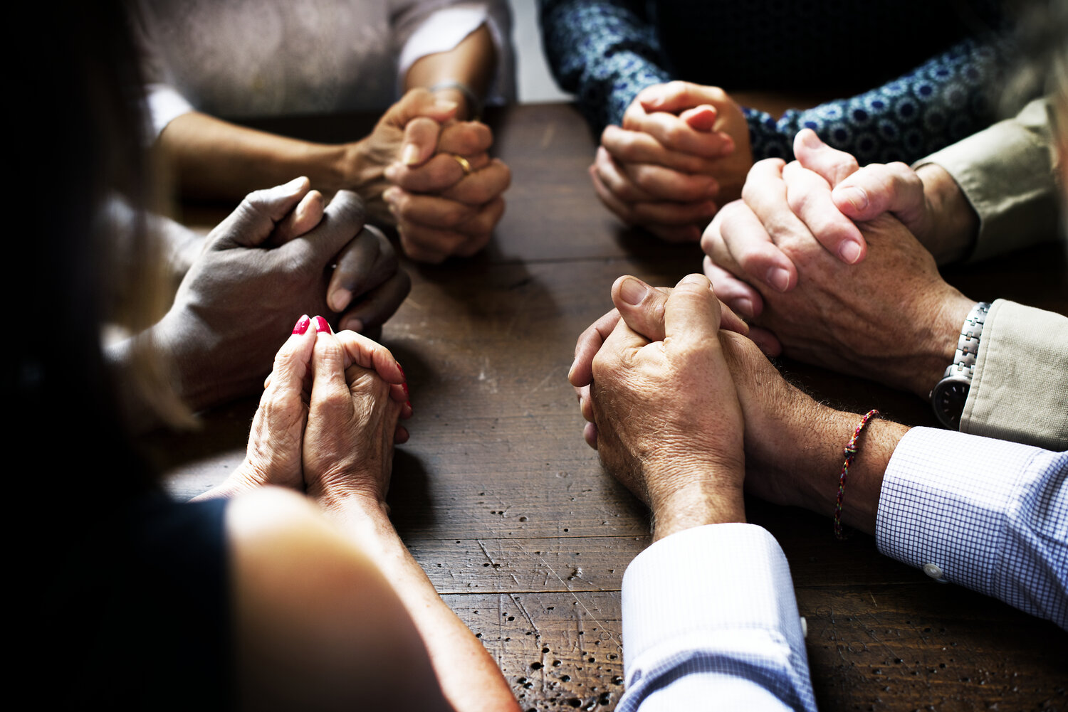
PRAY IN GROUPS OF 3-6

Slide 37
Heavenly Father,
We have come to you today because, bought and redeemed by the blood of Jesus Christ, we still sin. Yet you are holy—rightly jealous that we should not let sin be our master any longer but only respond to the calls and commands of our Jesus Christ.

Slide 38
We have acknowledged today that…
WE are the sinners in need of Your continual saving as we live in this great land we call America.
WE are the ones who need to be rescued from besetting sins that dog us day after day.

Slide 39
WE are the people of your pasture who need to be led by still waters and fed in green pastures.
You have heard our confessions of sin to one another.
You have heard our cries to you this day to forgive us and deliver us from those sins.

Slide 40
You have seen our heart’s longing to ‘seek your face’…and you know how often we fail to long for your presence.
Thank you for taking us just as we are…where we are.
Thank you for being faithful and just to forgive us of our sins.

Slide 41
Thank you for cleansing our hearts from all unrighteousness and everything not in agreement with you.
We thank you for the gift of repentance… and we rejoice in your gift of forgiveness.
In the holy, loving and glorious name of Jesus Christ, or Savior and divine Judge, we pray, AMEN!

